Slide 1
Introduction to (2D) Convolutional Neural Networks
Jordan Montgomery
July 21, 2020
Notes:
1
1
Check distro statement before using:
DISTRIBUTION STATEMENT A. Approved for pubic release: distribution is unlimited.
This material is based upon work supported under Air Force Contract No. FA8721-05-C-0002 and/or FA8702-15-D-0001. Any opinions, findings, conclusions or recommendations expressed in this material are those of the author(s) and do not necessarily reflect the views of the U.S. Air Force.
© 2020 Massachusetts Institute of Technology.
Delivered to the U.S. Government with Unlimited Rights, as defined in DFARS Part 252.227-7013 or 7014 (Feb 2014). Notwithstanding any copyright notice, U.S. Government rights in this work are defined by DFARS 252.227-7013 or DFARS 252.227-7014 as detailed above. Use of this work other than as specifically authorized by the U.S. Government may violate any copyrights that exist in this work.

Slide 2
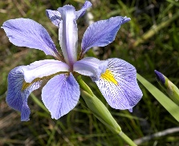
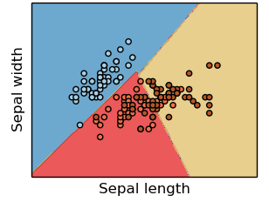
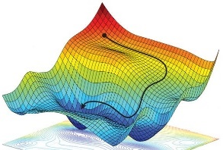
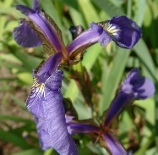
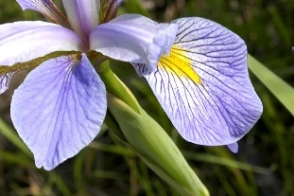
Necessary Components of a Supervised Machine Learning Approach
Training Data
Feature
Selection
Cost Function
Training Algorithm
Model Type
p
s
IrVi
IrSe
Set of labeled example data
Method to select data characteristics critical information
The form of model which will be trained to make decisions
Metric by which a prospective models should be judged
Algorithm to minimize the cost function by tuning model parameters
Description
- Tabular data
- Time-series
- Images
- Videos
- ASCII text
- Intuition
- Expert knowledge
- Statistics
- Learned features
- Regression
- Nearest neighbor
- Decision tree
- SVM
- Neural Network
- Squared error
- Absolute error
- Cross-entropy
- Accuracy
- Gradient descent
- Gradient-free opt.
- Analytic solution
Examples
Supervised machine learning approaches require each of these components
* image sources: scikit-learn (for “model type”) and https://reconsider.news/2018/05/09/ai-researchers-allege-machine-learning-alchemy (for “training algorithm”)

Slide 3
Necessary Components of a Supervised Machine Learning Approach
Training Data
Feature
Selection
Cost Function
Training Algorithm
Model Type
p
s
IrVi
IrSe
Set of labeled example data
Method to select data characteristics critical information
The form of model which will be trained to make decisions
Metric by which a prospective models should be judged
Algorithm to minimize the cost function by tuning model parameters
Description
- Tabular data
- Time-series
- Images
- Videos
- ASCII text
- Intuition
- Expert knowledge
- Statistics
- Learned features
- Regression
- Nearest neighbor
- Decision tree
- SVM
- Neural Network
- Squared error
- Absolute error
- Cross-entropy
- Accuracy
- Gradient descent
- Gradient-free opt.
- Analytic solution
Examples
Focus
Supervised machine learning approaches require each of these components
* image sources: scikit-learn (for “model type”) and https://reconsider.news/2018/05/09/ai-researchers-allege-machine-learning-alchemy (for “training algorithm”)

Slide 4
Outline
Introduction
Understanding 2D Convolution
CNN Architectures
Loss Functions and Optimization
Summary

Slide 5
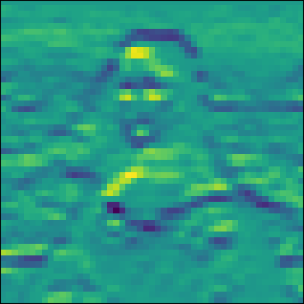
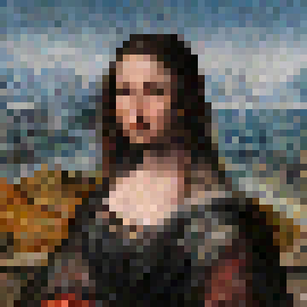
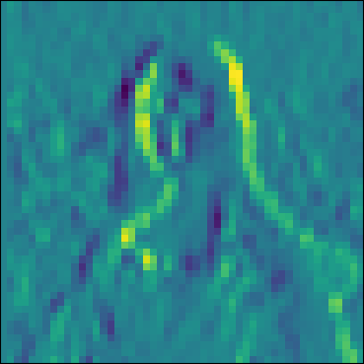


Filters in Two Dimensions
Features
Filters (Kernels)
Image
$$\left[\begin{matrix}+1 & +2 & +1 \\ 0 & 0 & 0 \\ −1 & −2 & −1\end{matrix}\right]$$
Horizontal Edges
$$\left[\begin{matrix}−1 & 0 & +1 \\ −2 & 0 & +2 \\ −1 & 0 & +1\end{matrix}\right]$$
Vertical Edges

Slide 6
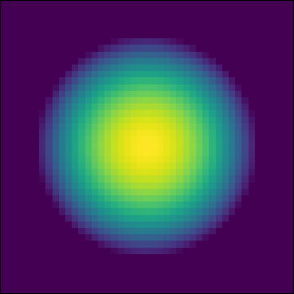
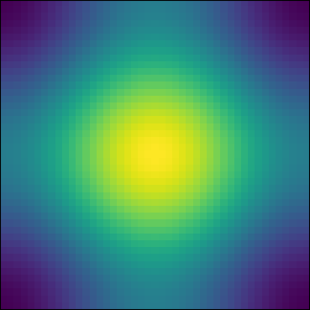
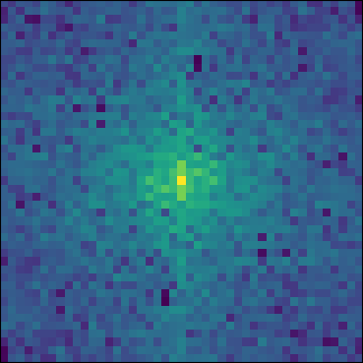
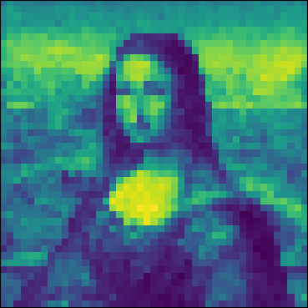

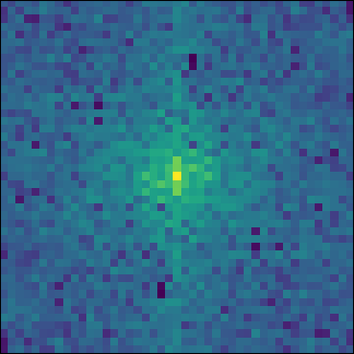
Convolutions Are Still Related to Fourier Transforms
Spatial Representation
Frequency Representation
Image X Kernel (Frequency)
Convolved Image
Kernel
FFT
Mult.
IFFT
Image

Slide 7
Question
What kernels might help detect a human face? (i.e., what features truly characterize a human face?)

Slide 8
Outline
Introduction
Understanding 2D Convolution
CNN Architectures
Loss Functions and Optimization
Summary

Slide 9
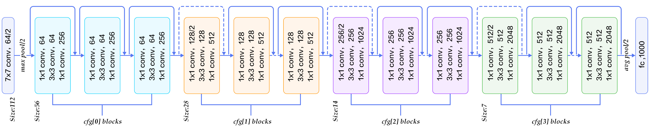
Deep Learning
Depth Provides Abstraction
Initial layers detect basic features
Edges
Spots
Striations
Deeper layers combine features
Curves
Texture
Gradients
Final layer(s) classify image
Most relevant
Combinations
Increasingly Abstract

Slide 10
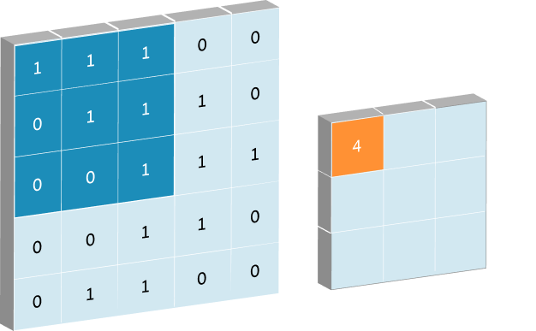
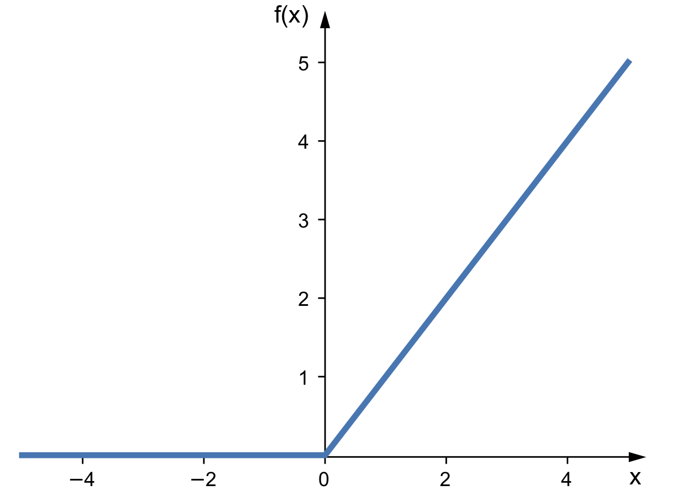
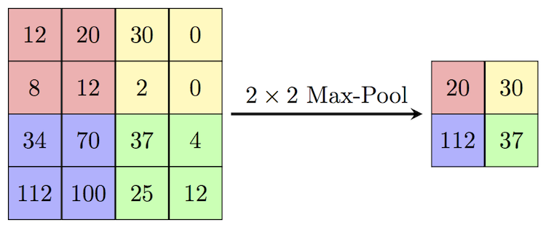
Layers
Convolutional
Applies a learned kernel to the input data
First convolutional layer takes in raw image data
Subsequent convolutional layers take in feature maps
Activation
Acts as a “switch” passing some features and killing others
Enables non-linear relationships to be mapped
Pooling
Aggregates relevant (most activated) features
Allows adding more filters while reducing risk of overfitting

Slide 11
Guiding Architecture Principles
Build for a relatively small input image
perhaps down sample your image data
Much information is retained at lower resolutions
Convolutional kernel size should match scale of features in image
kernel_size >= 5 for full-res images
May be smaller if images are down sampled
More than one convolutional layer before pooling
Activation layer after each convolutional layer
Pool with a 2x2 pool_size and stride 2
Covers all the pixels in a feature map
Double the number of channels after each pooling layer
Repeat several of these blocks until each feature map is “small”

Slide 12
Outline
Introduction
Understanding 2D Convolution
CNN Architectures
Loss Functions and Optimization
Summary

Slide 13
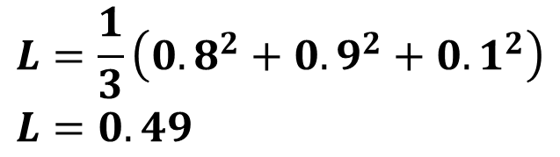


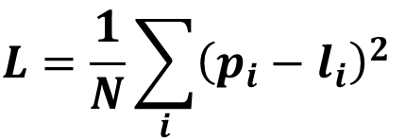

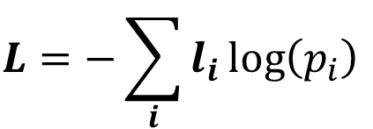

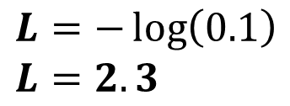
Loss/Cost/Objective Functions
Mean Square Error
Categorical Cross Entropy
$$L=\frac{1}{N}\sum_{i}{{\left(p_{i}−l_{i}\right)}^{2}}$$
$$L=−\sum_{i}{l_{i}\log\left(p_{i}\right)}$$
$$p=\left[\begin{matrix}0.8 & 0.1 & 0.1\end{matrix}\right]$$
$$p=\left[\begin{matrix}0.8 & 0.1 & 0.1\end{matrix}\right]$$
$$l=\left[\begin{matrix}0 & 1 & 0\end{matrix}\right]$$
$$l=\left[\begin{matrix}0 & 1 & 0\end{matrix}\right]$$
Predictions
Labels
$$L=\frac{1}{3}\left({0.8}^{2}+{0.9}^{2}+{0.1}^{2}\right) \\ L=0.49$$
$$L=−\log\left(0.1\right) \\ L=2.3$$
Also called “L2” loss
General purpose
Not designed for classification
Focuses on prediction of actual class
Assumes final softmax activation
Designed for multi-class problems

Slide 14
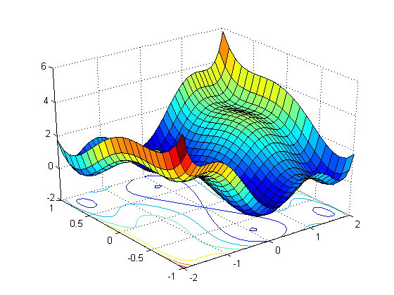
Loss Function Space
Function of parameter values
Changing parameter values
In CNN the filter weights (and biases) are your parameter values
There are far more parameters than can be visualized here
Loss
Param 1
Param 2

Slide 15
Cost Function Optimization
Initial Weight
Training objective is to minimize loss
Compute amount of loss decrease if parameter moved by small amount
Parameter movement size set by “learning rate” and gradient
Move parameters in direction that reduces loss fastest
Possible convergence issues
Can overshoot and fail to converge on minimum
May get caught in local minimum
Stochasticity helps jiggle parameter values out of bad local min
Loss
Learning Rate Too High
Good Learning Rate
Param 1

Slide 16
Question
You are copying your friend’s homework (for shame!). They have produced a CNN which achieves an accuracy of 95% on their hold-out validation set. You are trying to train a CNN with the same architecture. As you train your CNN, however, it never quite gets as good as 95% on the validation set. What might your friend be doing differently?
Different optimizer
Better random seed in train/test split
Reduced learning rate
More “Dense” layers for classification

Slide 17
Question
You are copying your friend’s homework (for shame!). They have produced a CNN which achieves an accuracy of 95% on their hold-out validation set. You are trying to train a CNN with the same architecture. As you train your CNN, however, it never quite gets as good as 95% on the validation set. What might your friend be doing differently?
Different optimizer
Better random seed in train/test split
Reduced learning rate
More “Dense” layers for classification

Slide 18
Summary
Convolutions help extract features from images
Even in 2D, these operate by grabbing frequency-specific information
Multiple layers in a CNN allows features to be generalized/abstracted
Three basic layers to a CNN
Convolution: extract features
Activation: switch connection on-off
Pooling: aggregate spatial relationships
May need to think carefully about cost function for specific applications
Many training/optimization routines
All attempt to minimize loss
Learning rate matters!
Take measures to avoid getting trapped in local minimum

Slide 19

