Slide 1
Digital Noise, Accuracy & Precision
Unums: A Modern Number Format for Computation
Emmanouil Raptakis (supervised by Andreas Wicenec & Chen Wu)

Slide 2
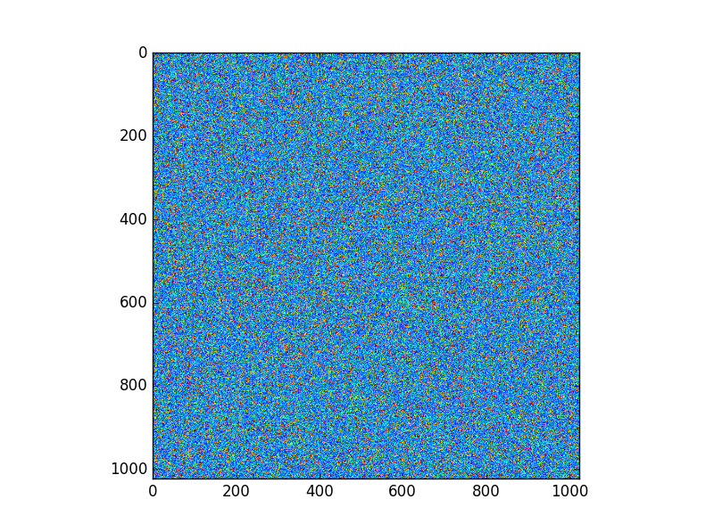
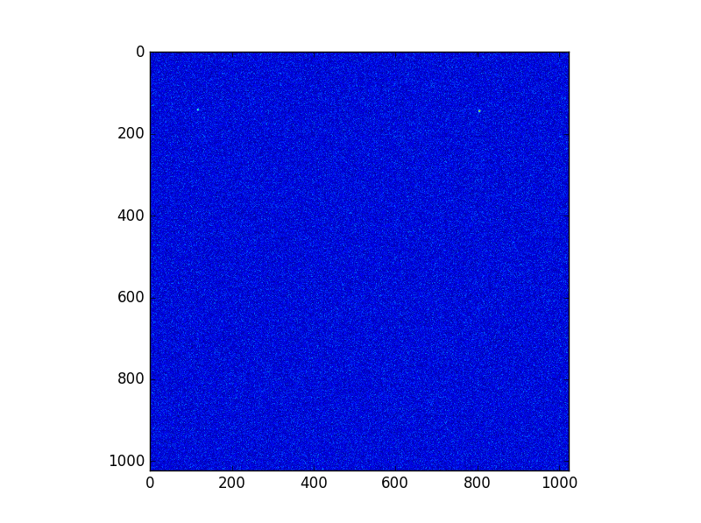
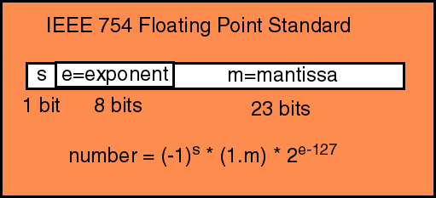

IEEE 754 – The current standard
What are the issues with IEEE754? – REMEMBER TO MAKE NEW IMAGES!
Associativity of Addition and Multiplication:
$$a+\left(b+c\right)=\left(a+b\right)+c$$
Rounding
Fixed size storage of floats (16bit, 32bit, 64bit,128bit)

Slide 3
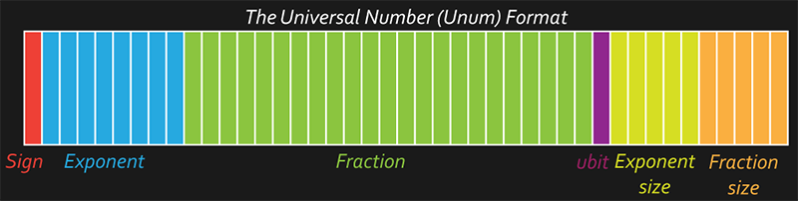
Unums – An Extension of Floats
The Unums form a SUPERSET of the IEEE floats and attempt to resolve many of their issues:
Resolve Rounding Errors using Open Intervals
Resolution of Rounding Errors gives us associativity
Variable Size Storage allow us to reduce power costs and increase speed of computations

Slide 4
Rounding & Associativity
How are these related?

Slide 5
The Impact of Rounding Errors
Heading
Text
Bullet 1
Bullet 2
Bullet 3

Slide 6
The Patriot Missile Issue
Heading
Text
Bullet 1
Bullet 2
Bullet 3

Slide 7
Fixed Size Storage in IEEE
The IEEE standard defines 4 presets for floats
The IEEE standard prescribes our 16, 32, 64 and 128 bit presets with fixed allocations of exponent and fraction bits
There is no “correct” allocation for exponent and fraction bits (chosen by a committee – exponent bits are cheaper so more were added than usually needed)
It isn’t always trivial to know the “correct” float size – too small and you get garbage (possibly without knowing), too large and you waste bits, power and speed

Slide 8
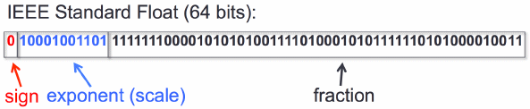
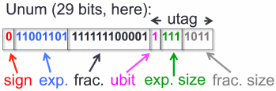
Variable Size Storage
Introducing dynamic bit length allows us to speed up computation and decrease power costs
Bullet 1
Avogadro’s Number represented using a double precision float and the Unum {3,4} environment

Slide 9
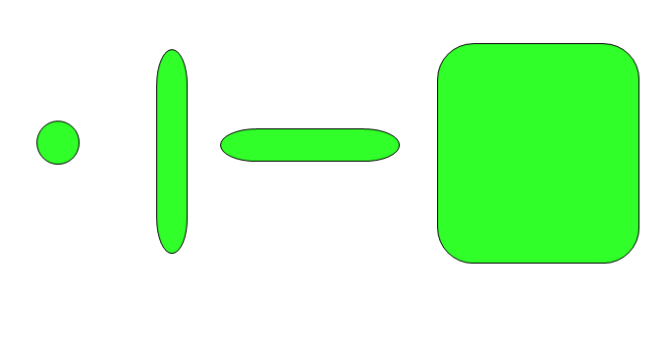
The Ubox follows from the Unum
A Ubox is an extension of Unums to n-dimensions
Unums have the ability to exist as a float or as an open interval between floats
Uboxes generalize unums by being being able to be precise/open in multiple dimensions
Different ‘forms’ of a 2D Ubox
From left to right:
Precise in both dimensions
Precise in x, open in y
Precise in y, open in x
Open in both dimensions

Slide 10
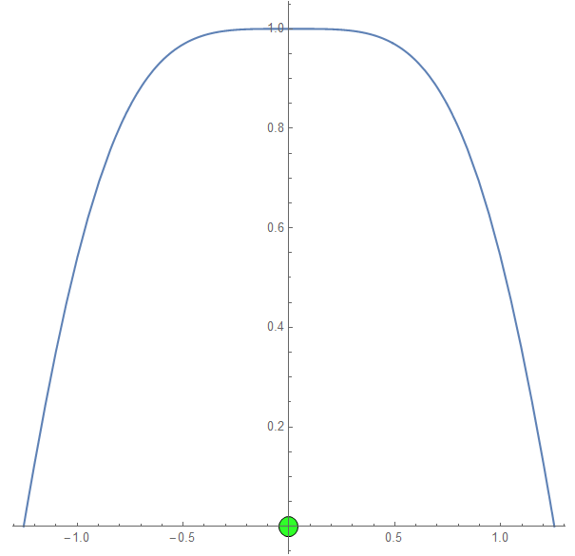
Solving Integrals Using Uboxes
Using Uboxes we can utilize the “Paint Bucket” method for evaluating definite integrals with ease
Works by filling up the domain of integration with Uboxes and finding their “Area”
The Paint Bucket method can be done almost entirely in parallel!

Slide 11

Application : Pendulums
How can the Ubox approach help us to correctly solve a pendulum (Properly!)?
We don’t use Harmonic Oscillator solution: $\sin\left(x\right)=x$
The ‘usual’ numerical approach is to use time steps (no error bounds, no parallelism, sampling errors and rounding errors are likely to occur)
Ubox method solves the problem by requiring that the solution curve obeys Physics (conservation of Energy, continuity, no instantaneous velocity changes)
Ubox method allows for complete parallelism, no sampling or rounding errors, reports error bounds

Slide 12
Current Issues with Unums
Theoretically, the Unums outweigh Floats but in there is more to the discussion:
Currently the only way to use Unums is through software implementations (Python, Julia, Mathematica)
Software implementations are VERY SLOW
Only way to effectively use unums is through a hardware implementation

