Slide 1
Digital Noise, Accuracy & Precision
Unums: A Modern Number Format for Computation
Emmanouil Raptakis (supervised by Andreas Wicenec & Chen Wu)

Slide 2
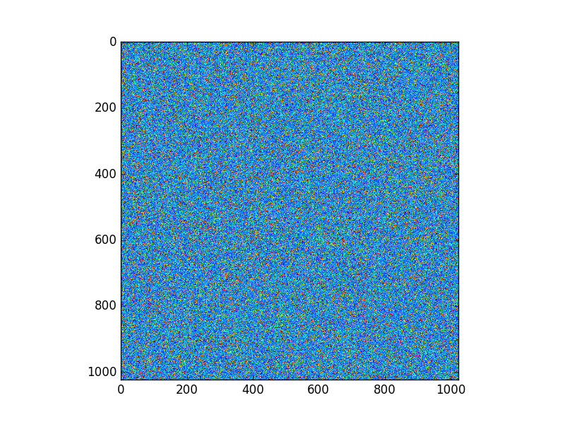
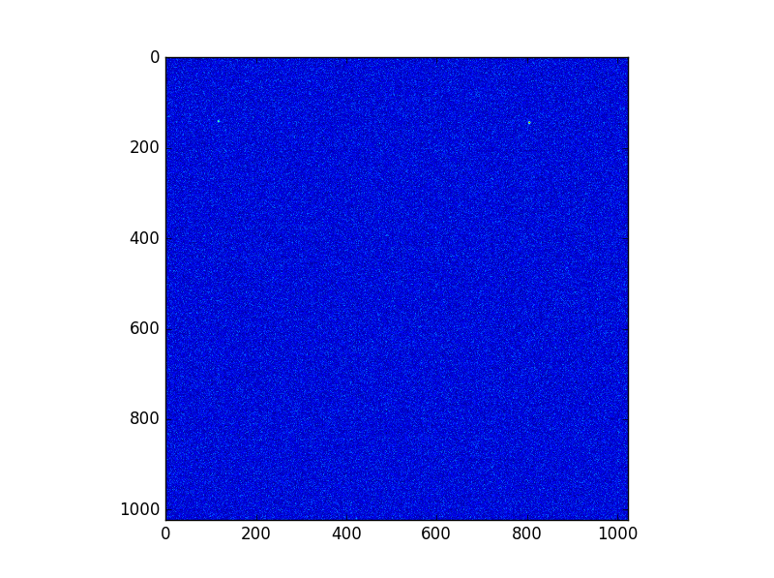

IEEE 754 – The current standard
What are the issues with IEEE754? – REMEMBER TO MAKE NEW IMAGES!
Associativity of Addition and Multiplication:
$$a+\left(b+c\right)=\left(a+b\right)+c$$
Rounding
Fixed size representations of floats (16bit, 32bit, 96bit, 128bit etc.)

Slide 3
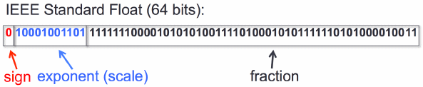
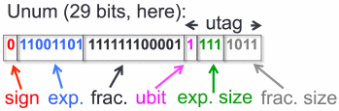
Unums – An Extension of Floats
The Unums form a SUPERSET of the IEEE floats and attempt to resolve many of their issues:
Resolve Rounding Errors using Open Intervals
Resolution of Rounding Errors gives us associativity
Variable Size Representations allow us to reduce power costs and increase speed of computations
Avogadro’s Number represented using a double precision float and the Unum {3,4} environment

Slide 4
Rounding & Associativity
How are these related?
In the IEEE’s if you attempt to store a number that lies between two floats then it must be rounded before being stored
Unums

Slide 5
The Impact of Rounding Errors
Heading
Text
Bullet 1
Bullet 2
Bullet 3

Slide 6
The Patriot Missile Issue
Heading
Text
Bullet 1
Bullet 2
Bullet 3

Slide 7
Fixed Sized Representations
Heading
Text
Bullet 1
Bullet 2
Bullet 3

Slide 8
Variable Sized Representations
Heading
Text
Bullet 1
Bullet 2
Bullet 3

Slide 9
The Ubox follows from Unums
Heading
Text
Bullet 1
Bullet 2
Bullet 3

Slide 10
Solving Integrals Using Uboxes
Heading
Text
Bullet 1
Bullet 2
Bullet 3

Slide 11
Solving Real Problems
Heading
Text
Bullet 1
Bullet 2
Bullet 3

Slide 12
Current Issues with Unums
Theoretically, the Unums outweigh Floats but in there is more to the discussion:
Currently the only way to implement Unums

