Slide 1
Vₛ (mothership advances)
Mothership
mothership side boundary ∈ F
Cradle
disturbance w
(wind, waves, current)
DP point
cradle center
reach avoid set (V(s) ≤ 0)
mothership side
side boundary ∈ F
Phase 1 · Approach / DP
Method : DOB-MPC w RaCBF
cradle walls ∈ F
cradle region (zoom)
target set T (aligned entry, gentle velocity)
Phase 2 · Docking
Method : Robust reach avoid RL

Slide 2
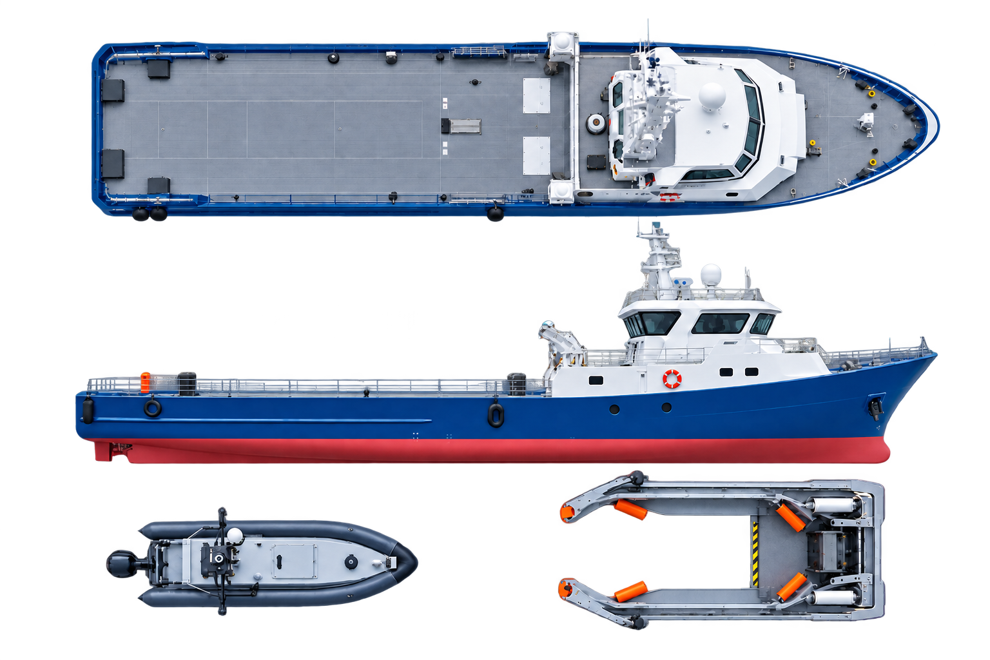
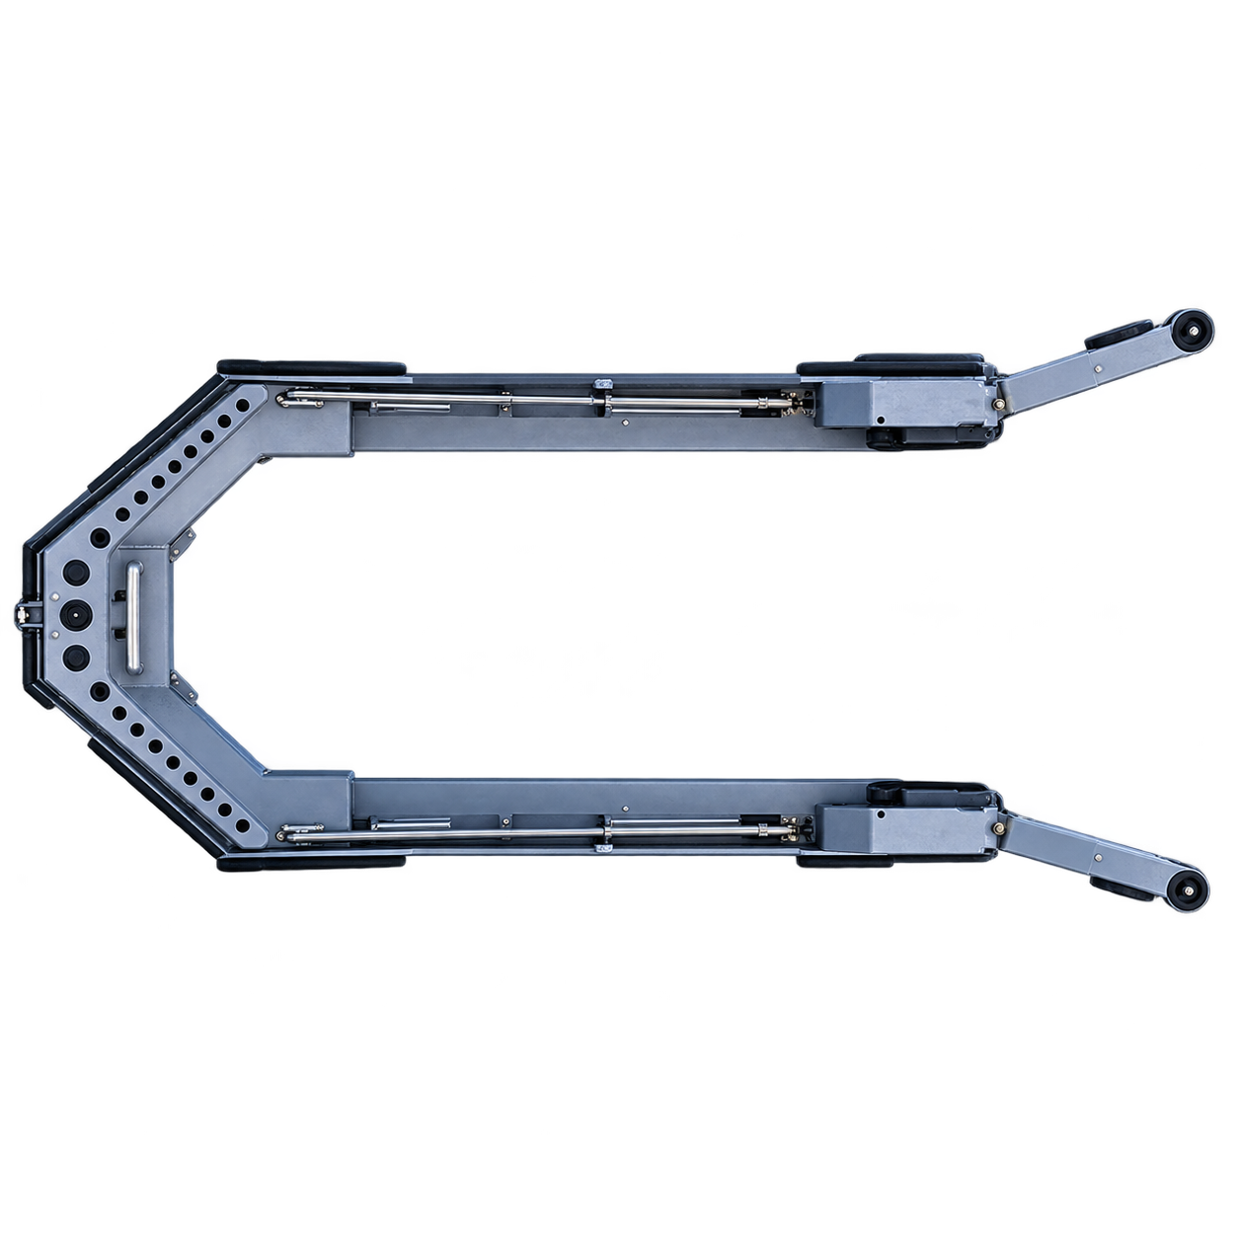
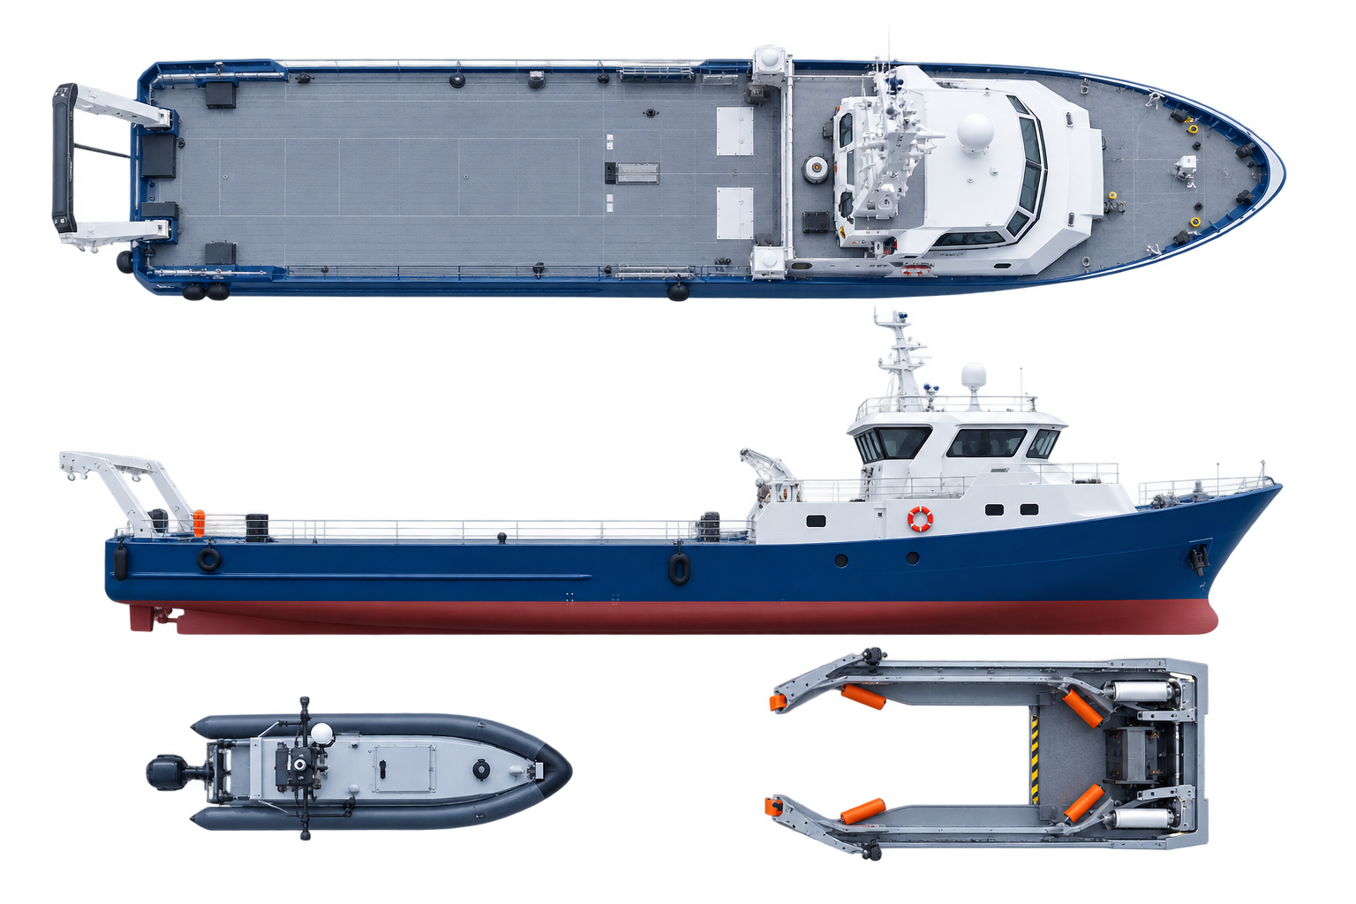



Vₛ (mothership advances)
DP point
Cradle center
Side boundary $∈𝓕$
Target set $𝓣$
reach avoid set (V(s) ≤ 0)
Cradle walls $∈𝓕$
Target and collision sets
Phase 1 · Approach / DP
Method : DOB-MPC w RaCBF
Phase 2 · Docking
Method : Robust reach avoid RL

