Slide 1
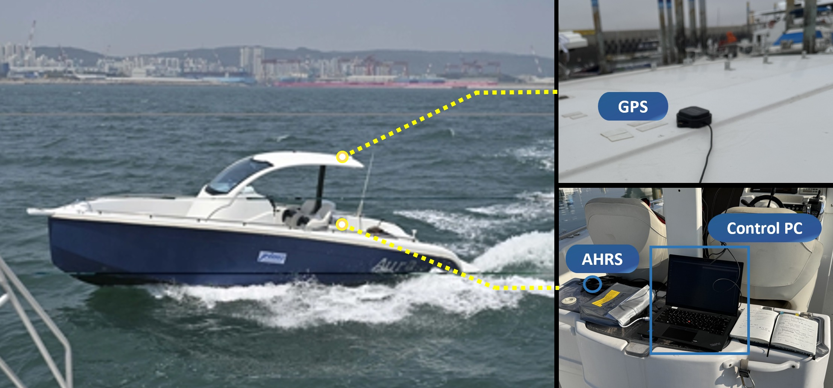
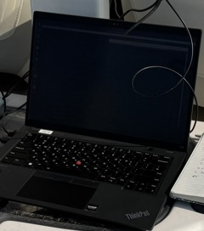
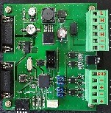
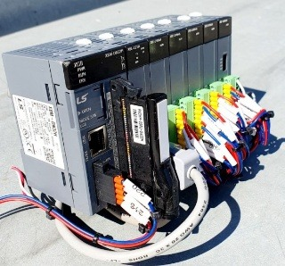
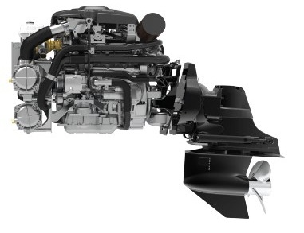
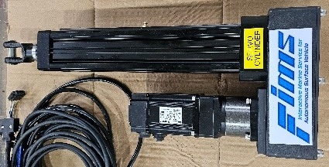
Control PC
ROS 2
Boat control hardware
Ethernet
Engine speed
RS232C
CAN
CAN converter
LS XGB PLC
EtherCAT
Shift and steering
Servo cylinders
(a)
(b)

