Slide 1
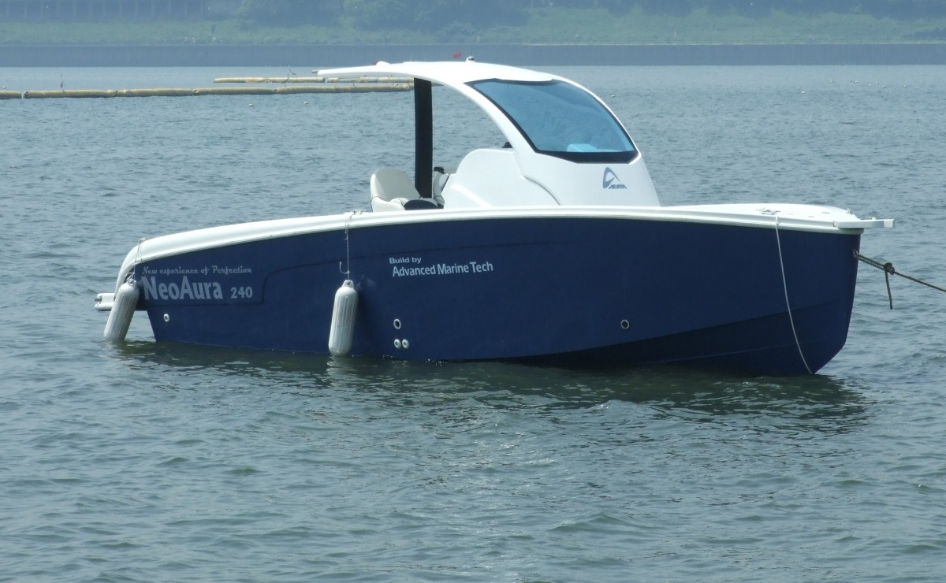
Offline RL training in simulation
Online deployment on the vessel
Simulators ×N
Dwell constrained RIS by adversarial RL with legality masking
legal gear
g* = argmax q
EKF
π_{h}
max
𝒮(g, τ_{g})
w ∈ 𝒲
π_{h}, Q_{h}
5
3
0
GPS, AHRS
g, δ
μ
min
deploy
dwell D_{g} masked
Q_{h,1}, Q_{h,2}
y
w
frozen
unroll over n ≥ D_{g} steps, legal gear chosen at every step
c, w
gear g ∈ {R, N, F}
steering rate
wind and current w
g_{c}
g*
g*
g*
g*
…
V
bootstrap
ξ_{j}, h_{j}
π_{h} and μ act at every step
backward fold
y_{j} = (1 − γ_{h}) h_{j} + γ_{h} min{h_{j}, y_{j+1}}, y = y₀

