Slide 1



District Medical Officers’ NID 2019 & New Initiatives in RI Workshop
DHO Office Meeting Hall
Bidar

Slide 2

Introduction of Tetanus and adult Diphtheria (Td) vaccine in UIP
Dr. Anilkumar S. Talikoti
SMO
WHO - India, Kalaburagi

Slide 3
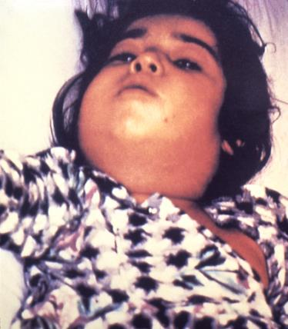
Respiratory Diphtheria
Acute communicable upper respiratory illness caused by toxigenic strains of Corynebacterium diphtheriae (Gm +Ve bacillus)
The illness is characterized
Membranous inflammation of upper respiratory tract, usually pharynx but sometimes posterior nasal passages, larynx, and trachea
Widespread damage to other organs, primarily the myocardium and peripheral nerves.
Potent exotoxin produced by C. diphtheriae causes extensive membrane production and organ damage.
Cutaneous form of diphtheria commonly occurs in warmer climates or tropical countries.
Notes:
Ro is the expected number of secondary cases one case generates (average) over the course of infectious period in an uninfected population or how contagious an infection is.
Measles Ro usually quoted as 12-18

Slide 4
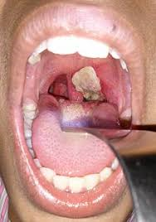
Respiratory Diphtheria
Transmission mainly person to person for C. diphtheriae through respiratory contact.
Onset of respiratory diphtheria occurs after an incubation period of 2–5 days
Mild fever & an exudative pharyngitis which organizes into a pseudo-membrane on pharynx, larynx, tonsil causing obstruction of the airways. Bull neck appearance.
Complications of heart (myocarditis), nervous system (neuritis), blood (thrombocytopenia) may occur
Diphtheria antitoxin (DAT) is highly effective and is the gold standard for treatment.
Case-fatality rates exceeding 10% have been reported, in particular where DAT is unavailable
Notes:
Ro is the expected number of secondary cases one case generates (average) over the course of infectious period in an uninfected population or how contagious an infection is.
Measles Ro usually quoted as 12-18

Slide 5
Suspected Case
Clinical Examination
Meets Case Definition
Yes
No
Yes
Sample
No
Positive
Lab Result
Negative
Epidemiological linkages
Yes
No
Rejected
Laboratory confirmed
Clinically Confirmed
Epidemiologically confirmed
Acknowledgement: Slide taken from Tamil Nadu state presentation

Slide 6
Global Burden of Diphtheria
Overall Global burden is declining,
Large outbreaks have occurred in 2017 and 2018 in a growing number of countries including Bangladesh, Indonesia, Kenya, Philippines, South Africa, Venezuela, and Yemen, among others attracting global attention
SEAR remains major contributor to Diphtheria cases
Under reporting, mostly clinical diagnosis, problem may be bigger
Notes:
2,100 deaths estimated (2015)**
** GBD 2015 Mortality and Causes of Death, Collaborators. (8 October 2016). "Global, regional, and national life expectancy, all-cause mortality, and cause-specific mortality for 249 causes of death, 1980-2015: a systematic analysis for the Global Burden of Disease Study 2015". Lancet. 388 (10053): 1459–1544.
Bangladesh only reported 4 cases

Slide 7
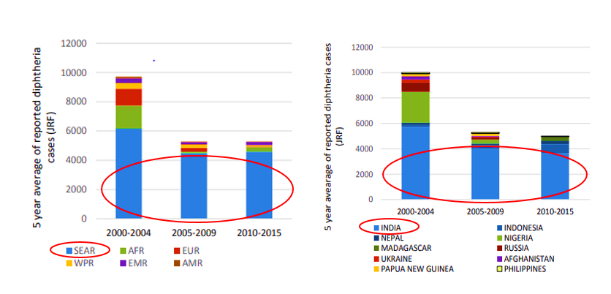
Diphtheria burden- SEAR and India
As per the report on Review of the Epidemiology of Diphtheria- 2000-2016, US- CDC, 5 years average of reported diphtheria cases are more in South East Asia Region of WHO , particularly in India.
From 2011–2015, India had the largest number of reported cases (18,350 cases)- WHO Position paper on Diphtheria- August 2017

Slide 8
Diphtheria burden in India
Reported cases of Diphtheria in India has a fluctuating trend.
Lab supported VPD surveillance in India is expanding - more clear picture expected in coming time
Source: WHO VPD monitoring system. 2018 global summary (data as on 15/07/2018)
Notes:
Turning to pneumonia disease burden data in India:
India accounts for nearly one quarter of the global pneumonia burden. Among Indian children under 5 in 2010, 36 lakhs severe pneumonia episodes occurred and 3.5 lakhs deaths due to pneumonia due to any cause.
When we consider the role of pneumococcal disease specifically in relation to all-cause pneumonia, as shown in the figure, one third of all pneumonia deaths are due to pneumococcal infection. Thus, 1.05 lakhs child deaths were due to pneumococcal pneumonia.
Consider how pneumococcal conjugate vaccine has the potentially to prevent this great number of child deaths due to pneumococcal disease in the country.

Slide 9
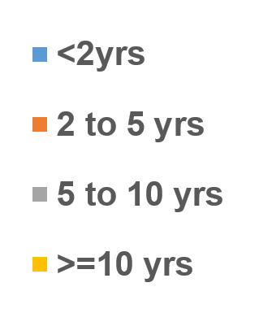
Epidemiology of Diphtheria in India- Age-wise distribution
2017
Bihar, UP, MP, Kerala, HR
2018
Bihar. UP, MP, Kerala, HR, HP, Punjab
N= 1616
N= 464
Most of the cases of Diphtheria are occurring in age group 5 years and above
77% and 69% respectively in 2017 and 2018
*: VPD surveillance data as on 1 September 2018

Slide 10
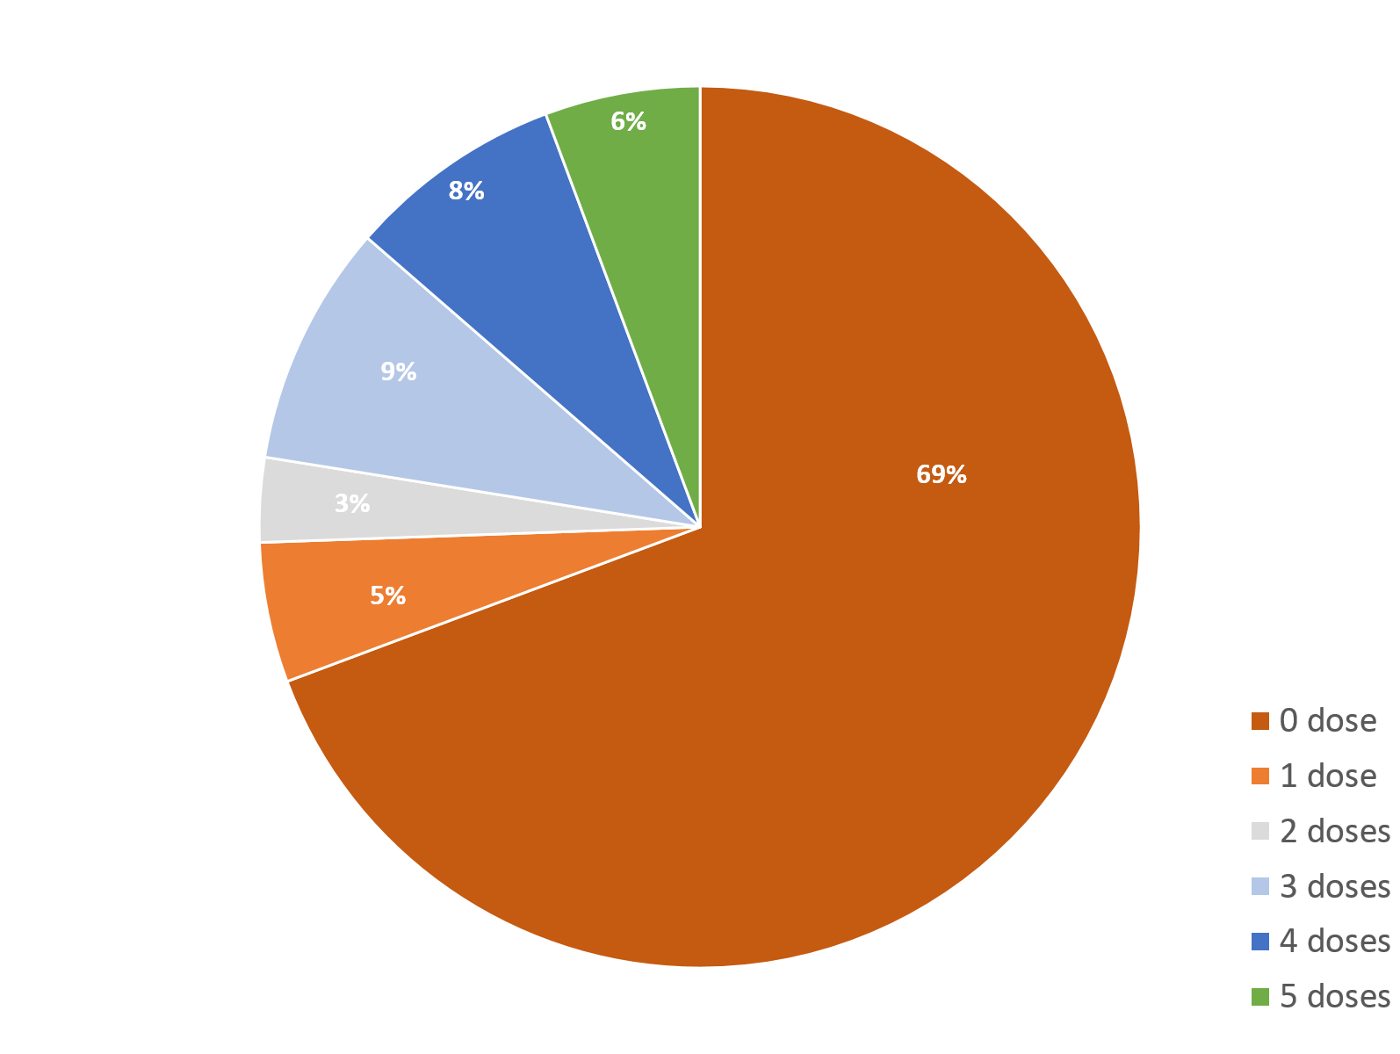
Vaccination status of Diphtheria cases
2017
Bihar, UP, MP, Kerala, HR
2018
Bihar. UP, MP, Kerala, HR, HP, Punjab
N= 1616
N= 464
Most of the cases (~ 2/3rd of Diphtheria are occurring in unvaccinated as expected)
*: VPD surveillance data as on 1 September 2018

Slide 11
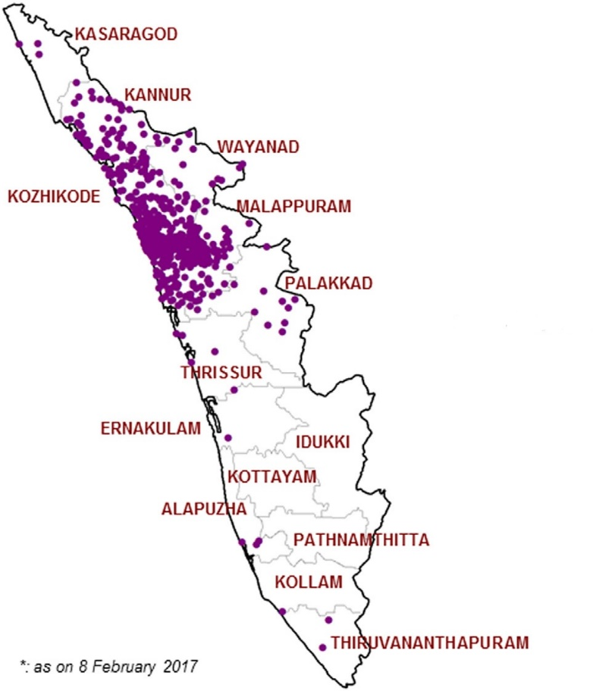
Data from Diphtheria cases- Kerala outbreak 2016
Age wise distribution
Vaccination Status
N= 526

Slide 12
Data from Uttar Pradesh, 2016-18, Line listing of Diphtheria cases
Age-wise distribution
Vaccination Status
N= 1888
For the year 2018, data as on 1 September 2018

Slide 13
Rationale for Td vaccine..
Diphtheria cases occurring in all age groups including older children and adults, majority in unvaccinated
immunity to diphtheria subsides following the primary series of DTP infant immunization
Eastern Europe and South America experienced serious outbreaks in early and mid-90’s. These regions changed to Td vaccine which resulted in sharp decline of diphtheria outbreaks there
Now it is established that booster doses of diphtheria toxoid containing vaccines are needed for continued protection
more than 80% reduction in tetanus mortality since 1999, however diphtheria outbreaks increasing that reflect gaps in diphtheria protection

Slide 14
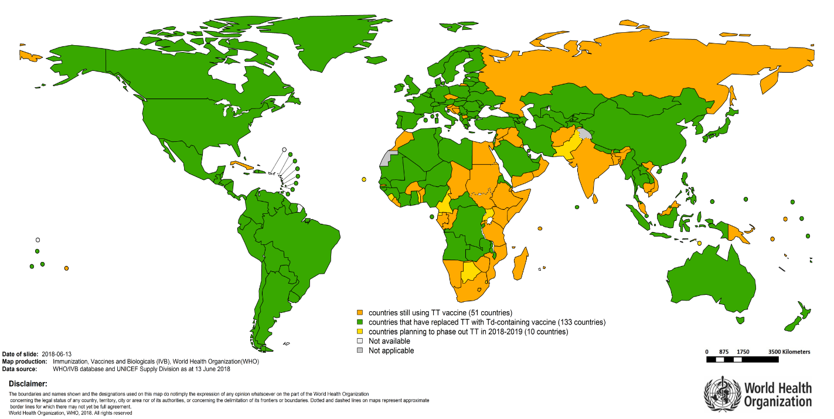
Global Recommendations for Diphtheria vaccination
Since 1998, WHO has recommended that TT should be replaced by Td vaccine. This is reiterated in the WHO tetanus vaccine position paper of 2017
SAGE has recommended (1998, 2002, 2016) to use Td rather than TT
Global uptake for this recommendation so far is slow since diphtheria is underreported and has not emerged as a public health priority in many countries.
133 countries using Td/Tdap at present
Benefit of the Td:
Strengthen immunity against diphtheria while maintaining protection against tetanus as earlier
Diphtheria Position Paper Weekly Epid. Record (2017, 92:417-436)

Slide 15
Why Td vaccine needed for pregnant women when already TT vaccine is administered
The use of Td in place of TT is recommended during pregnancy to protect against maternal and neonatal tetanus & diphtheria during prenatal care.
Vaccination during pregnancy also serves to boost immunity and increase the duration of protection in those pregnant who had not received the full set of recommended booster doses.
boost Increasing diphtheria immunity in addition to assuring tetanus protection, and help to curtail diphtheria outbreaks.

Slide 16
Td introduction in India replacing TT– decision making process
Aug 2017
Review of disease burden, need for vaccine, vaccine efficacy and safety by STSC of NTAGI
- Working group meeting held in April 2015
NTAGI recommendations on introduction of Td
- Recommended switch from TT vaccine to Td vaccine
Empowered Program Committee (EPC) of NHM approval of NTAGI recommendations
Mission Steering Group (MSG) of NHM approved NTAGI and EPC recommendations
Expert Committee Group recommended introduction of Td and further guided on Td introduction in the country.
Dec 2016
As per the NTAGI recommendations, GoI has taken decision to introduce Td vaccine replacing TT vaccine in UIP for all age groups, including pregnant women
NTAGI: National Technical Advisory Group on Immunization
STSC: Standing Technical Sub Committee
NHM: National Health Mission

Slide 17
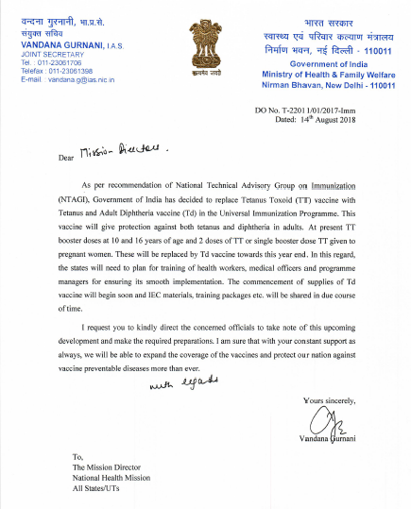
MoHFW letter to States/UTs
MoHFW has issued letter to States/UTs for introduction of Td vaccine replacing TT in UIP
Td will be given to
Children of 10 and 16 years age
Pregnant women
Infants contraindication to pertussis (Penta/DPT)-
Till now children for whom DPT/Pentavalent vaccine was contraindicated could receive only Hep-B and TT.
Now, though not licensed for children <7 years, Td vaccine can also be given in this exceptional situation

Slide 18
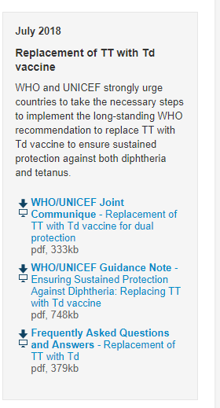
TT to Td- Effective but operationally simple
Cost-effective to replace, nominal additional cost will save substantial resources for diphtheria outbreak response
Enough production capacity of the country to supply Td needed in programme
No major operational challenges, same as TT
Route of administration,
Package size,
Targets,
Schedule,
No change in cold chain capacity,
No change in vaccine delivery logistics
Therefore no separate introduction activities required like for other new vaccines introduction

Slide 19
TT vs Td vaccine..
Characteristic | TT vaccine | Td vaccine
Presentation | 10 dose vial | Same as TT vaccine
Dose and route of administration | 0.5 ml, Intramuscular, Upper arm | Same as TT vaccine
Heat and freeze sensitivity | Heat and Freeze sensitive | Same as TT vaccine
Storage | +2-8 degree Celcius in ILR | Same as TT vaccine
Shelf life | 24 months | 24/36 months depending upon manufacturer
Shake test and Open Vial Policy | Applicable | Same as TT vaccine
Permissible wastage | <10% | Same as TT vaccine
AEFI | Minor local reactions | Same as TT
Tetanus and adult diphtheria (Td) vaccine is a combination of tetanus and diphtheria with lower concentration of diphtheria antigen (d) as recommended for older children and adults

Slide 20
Roll out and timeline for Td introduction
Dr A S. Rudrawadi
RCH Officer, Kalaburagi

Slide 21
Rollout of Td vaccine
Workshops:
State & district level workshops to be organized to disseminate information regarding replacement of TT with Td vaccine
Trainings
Block level ANM trainings to be held to create awareness
Vaccine supply:
Td vaccine will be supplied by Government of India as is done for other vaccines under UIP
Orders placed, supplies likely to commence from November 2018 onwards in phased manner

Slide 22
Stock management of Td vaccine
No requirement for additional cold chain storage capacity to accommodate Td vaccine
If remaining stock of TT vaccine still meets all validity requirements, it should to be used first and then begin using Td vaccine
There is no need to discard or recall stocks of available TT vaccine
Td vaccine can be given as a subsequent dose following TT, and all previous TT doses will remain valid. There is no need to re-start the series

Slide 23
Capacity building and communication for Td vaccine introduction
No separate communication or mobilization activities for Td
awareness will be done during regular RI social communication activities
provide information about the benefits of Td (especially added antigen) to target groups and the stakeholders at the community level during routine immunization IPC meetings
capacity building : Orientation of Health workers and mobilisers on key messages for Td and FAQs
FAQs and 2 pager shared with States/UTs

Slide 24
Recording & Reporting: Revision of formats
Revision of all formats replacing TT with Td is to be done
Mother-child protection (MCP) card
Due list
Tally sheets
Vaccine stock form, indenting forms, distribution registers
Monthly progress report at all levels
Maternal & Child Health (MCH)/Immunization registers
Coverage monitoring charts
Supervisory checklists
Computer databases
Immunization coverage surveys and evaluation formats
AEFI reporting formats
RI microplan

Slide 25
Strategies to achieve maximum coverage of Td
For Children of 10 and 16 years (school going)
Convergence with School Health and Adolescent Health programme will be used as a platform to generate awareness for pregnant women and adolescents.
States may plan annual campaign with Td vaccine to target children at schools : rough idea is that to cover 5th standard (10 years) and 10-11th standard (16 years) children
Health education sessions conducted under Rashtriya Kishor Swasthya Karyakram may be used to create awareness about Td
States may use its experience and advocacy done during MR campaign
For pregnant women
Convergence with Maternal Health programme at various forums
Other RI strengthening activities in general
Involvement of private organizations, professional bodies etc. to be done at all levels

Slide 26
Points to Remember
GoI decision already communicated to all States/UTs for introduction of Td replacing TT.
There will be no change in UIP schedule. Only Td will be used in place of TT.
If both TT and Td are in supply chain at any level, use TT first (TT- First out)
Use Td only when TT is exhausted. TT should not be recalled or discarded.
Td is a safe vaccine. Any minor, severe & serious AEFI event should be reported as being done for other UIP vaccines.
Td will be reported in place of TT till the revision of reporting formats/portals (HMIS, MCTS, RCH register, MCP card etc. ) is done

Slide 27
Training calendar
Thank You

