Slide 1
Explainable Deep Learning for Detection of Diabetic Retinopathy in Retinal Fundus Photographs
HARSH BANDHEY VISHESH AGRAWAL RIDAM PAL
2017234 2018420 PhD19201

Slide 2
Content
Introduction
Method
Data
Dataset
Preprocessing
Model
Baseline Model
Activation Map Model
Explainability
Results
Comparative Analysis
New Features
Limitations

Slide 3
Introduction

Slide 4
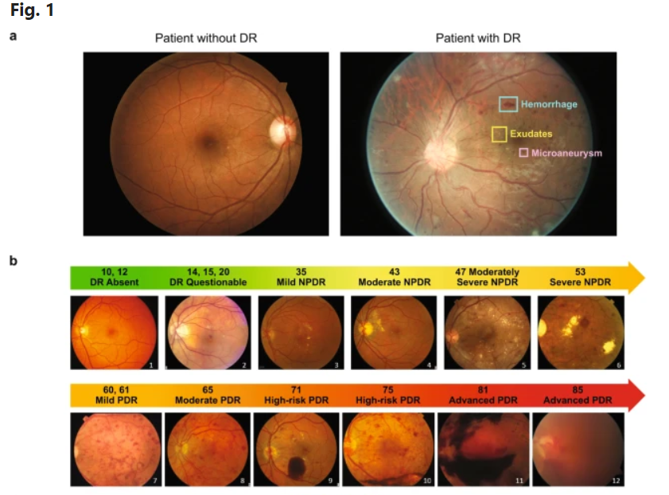
Diabetic Retinopathy
Diabetic retinopathy (DR) is the most common and insidious microvascular complication of diabetes, and can progress asymptomatically until a sudden loss of vision occurs.
Almost all patients with type 1 diabetes mellitus and ~60% of patients with type 2 diabetes mellitus will develop retinopathy during the first 20 years of onset of the disease.
If the detection of this disease is not improved, then by the end of decade
Diabetic Retinopathy would take many many lives!

Slide 5
Method

Slide 6
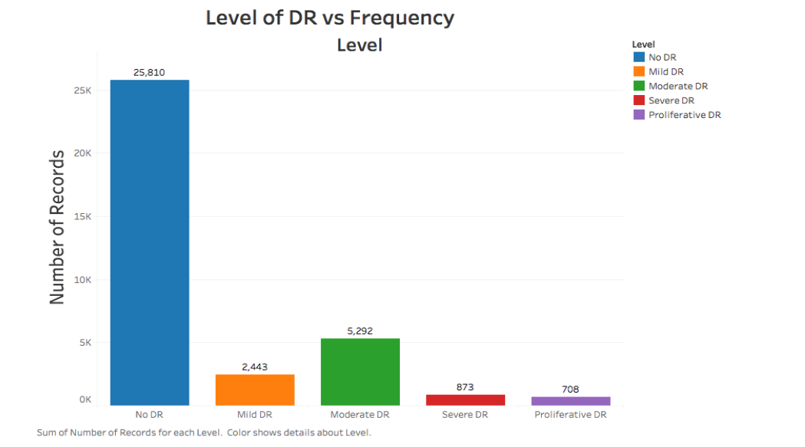
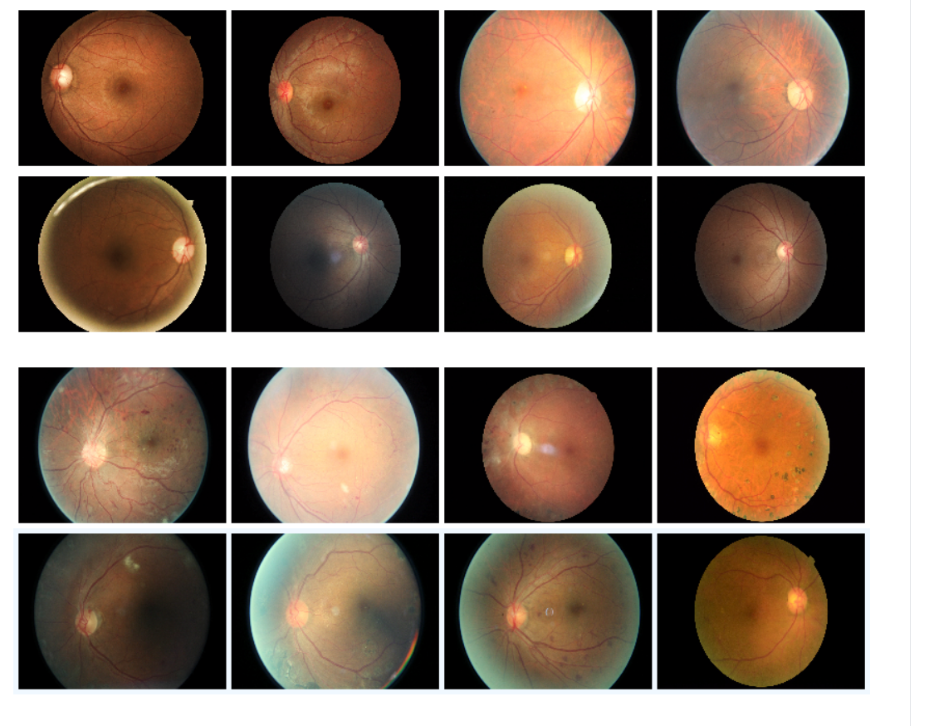
Data[1/2]
Dataset
We chose the EyePACS Fundus retinopathy dataset available through Kaggle
The training dataset consisted of 35,126 images.
25,810 images of no-diabetic retinopathy
9316 of diabetic retinopathy.
Because of class imbalance the data had to be preprocessed.
We encountered a high variance in the images of the eyes for both of the cases.

Slide 7
Data[2/2]
Preprocessing
First we down-sampled the data to remove class imbalance.
We then used Keras Image Generator for generating images. The steps are as follows:
Horizontal Flip
Vertical Flip
Random 360 degree Rotation
Zoom Range +-20%
Shear Range +-10%

Slide 8
Model[1/2]
Baseline Model
Inception-v3 is an Inception family convolutional neural network architecture that allows many modifications, including the use of Label Smoothing, Factorized 7 x 7 convolutions, and the use of an auxiliary classifier to propagate label information down the network (along with the use of batch normalization for layers in the side head). This is the same model used in our base paper, “Development and Validation of a Deep Learning Algorithm for Detection of Diabetic Retinopathy in Retinal Fundus Photographs”.

Slide 9
Model[2/2]
Activation Map Model
The Inception V3 model was not used as a base model for activation maps as the last activation layer gives a 7X7 feature map from the proper estimation of inference can’t be made. The convolutional neural network based on ResNet50 which is significantly used for classification tasks using the image dataset. We perform. Transfer Learning based CNN model was made with the ResNet50 as a base model. Adam optimization was used to train the network weights To speed up the training, batch normalization as well as pre-initialization using ImageNet weights was used. Preinitialization also improved performance. A single network was trained to make categorical predictions of NDR and 4 categories of DR.

Slide 10
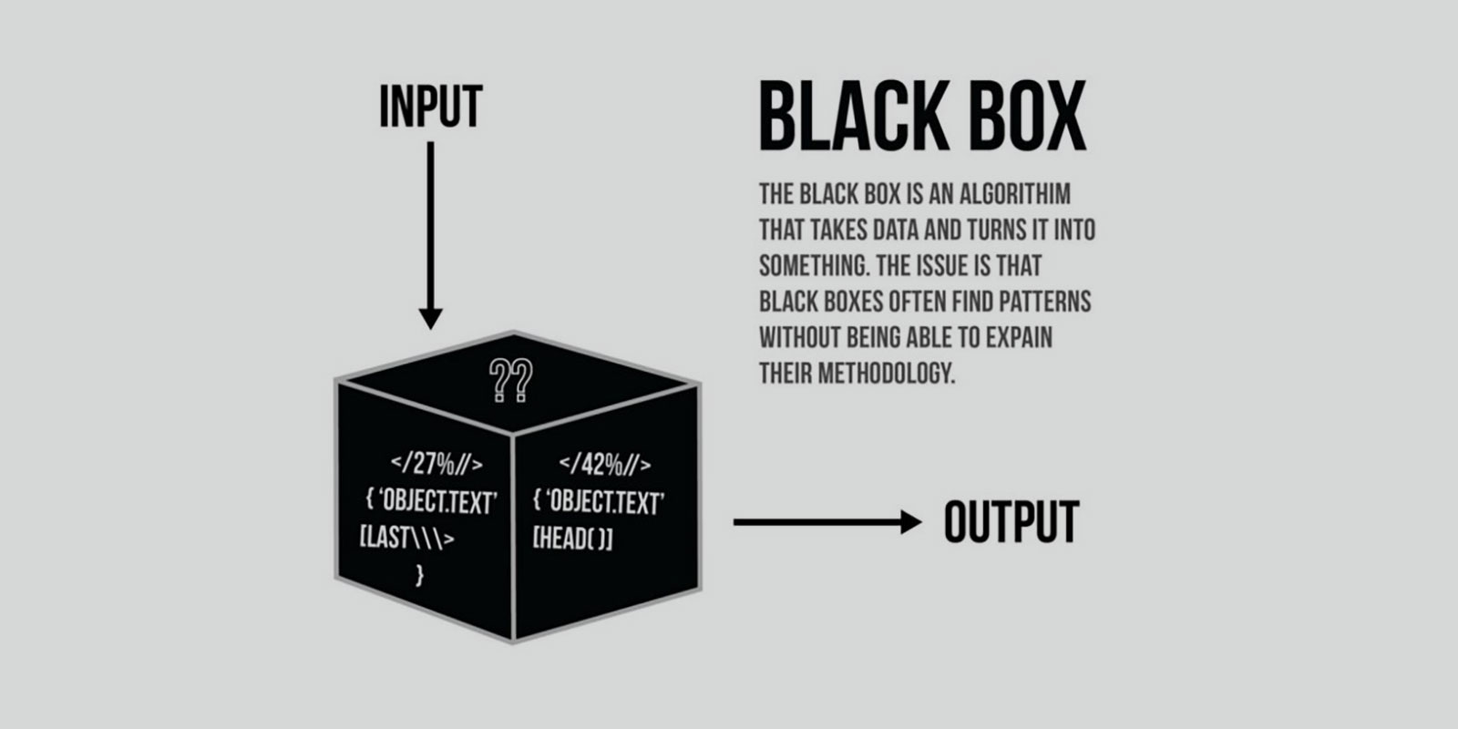
Explainability
The time when deep learning and machine learning were considered as Black Box has gone! Now we can know on what basis and features our model is giving us prediction.

Slide 11
Results

Slide 12
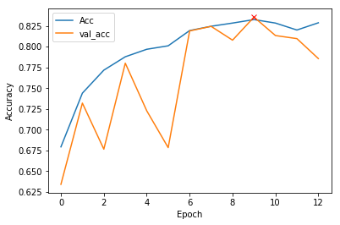
Comparative Analysis
Fig: The learning curve for training and validation set for 12 epocs across a subset of data.

Slide 13
New Features
Even Replicating state of the art models is tough let alone improve it’s accuracy.
We identified that what our state of the art paper (IF: 45) was lacking was not in model but in the explainability in the model. The paper didn’t do anything related to that and though the prediction and other metrics is pretty good, this is something where there is a room for modification.
We used CAM GRAD method in Keras to get our prediction images as explainable.

Slide 14
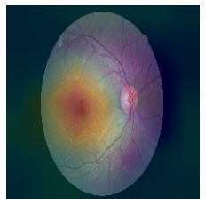
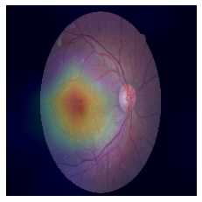
Fig4:An explainable image generated using Saliency depicting the relevant regions in the prediction
Fig5:An explainable image generated using Gradient Classification Activation Map depicting the relevant regions in the prediction

Slide 15
Limitations

Slide 16
Limitations
The inception models requires high GPU resource to train the models. Due to limited bandwidth of time we could not train all the models replicated in the paper.
The dataset was fairly huge for training the models.
GradCam does not always gives correct inference for the CNN models.

