Slide 1
Geolocating Wikipedia Articles Using Label Propagation
Aidan Coyne
Prateek Maheshwari

Slide 2
About Geolocation
Predicting location of documents based on the language used in them
For wikipedia articles, predicting the location of places that the articles are about

Slide 3
Textgrounder
Wing and Baldridge 11, Roller et al. 12
Approaches geolocation as an IR task:
Divides the world into grid cells (“documents”)
Learns a language model for each grid cell
Predicts location for a new article (“query”) by comparing it's language model to that of grid cells

Slide 4
Previous Work (contd.)
Potential Improvements
Only uses geotagged articles for training
Doesn't use information present in link structure
Each article is associated with just one grid cell
I.e., the cell that the article’s coordinates fall in.
What's the correct cell for Texas?
What cell should articles about people be associated with?

Slide 5
Example: Texan Cities
Texas: 31°N 100°W
Austin: 30°15′N 97°45′W
Houston: 29° 45′ 46″ N, 95° 22′ 59″ W
El Paso: 31° 47′ 25″ N, 106° 25′ 24″ W
Texas refers to all these pages!
What about Sam Houston?

Slide 6
Using the Link Structure
Wikipedia articles link to each other
Our Hypothesis:
Articles link to other geographically related articles.
Article text associated with more than single location
Non-geotagged articles can contribute to language models for grid cells.
Goal: Augment/smooth language models for grid cells used in textgrounder with language models of related grid cells.

Slide 7
Methodology

Slide 8
Dataset & Statistics
Wikipedia Dump, March 2012
Grid Cells
Grid size – 1 degree (might be too large)
Grid cells – 64,800
Non Empty Grid Cells – 15,982 (24.66 %)
Cell size – Approx. 100km x 100km
Geo-tagged Graph
Total vertices: 273,606
Total edges: 2,188,860
Average degree: 8.00
Min degree: 1; Max degree: 21,353

Slide 9
Label Propagation
Iterative, graph based semi-supervised algorithm
For distributing class labels around a graph.
Uses the link structure of the graph to “diffuse” labels from a set of seed nodes to unlabeled nodes

Slide 10
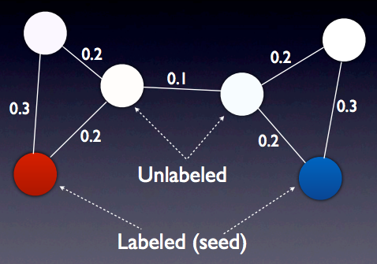
LP Example
Source: New Regularized Algorithms for Transductive Learning. http://talukdar.net/papers/adsorption_ecml09.pdf

Slide 11
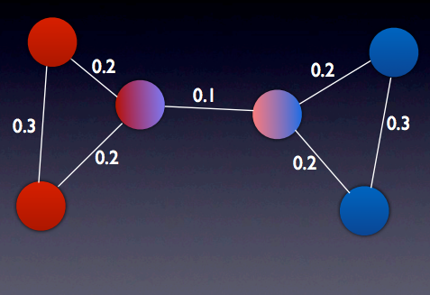
LP Example
Source: New Regularized Algorithms for Transductive Learning. http://talukdar.net/papers/adsorption_ecml09.pdf

Slide 12
Results

Slide 13
Methodology
Use a subset of geotagged articles as seeds.
Run label propagation.
Evaluate predictions from label propagation.
Calculate Mean Error Distance, Precision, Recall @ k

Slide 14
Amount of training data vs. Accuracy
% of Seed Documents | Mean Error (in km) | Precision (%)
12.5 | 1870.89 | 37.79
25 | 1774.53 | 41.88
50 | 1681.29 | 46.69
75 | 1625.87 | 49.75
Mean error = Mean distance between the centroids of the predicted and the actual grid cell.
Precision = % of articles for which the predicted cell is correct.

Slide 15
Recall @ k for % seed data
Recall @ k measures whether the correct grid cell was present in the top k predicted cells.

Slide 16
Comparison with WB ‘11
Strategy | Degree | Median | Mean
Kullback - Liebler | 0.1 | 11.8 | 221
Naïve Bayes | 0.1 | 15.5 | 314
Avg. Cell Probability | 0.1 | 24.1 | 1421
*Label Propagation | 1 | N/A | 1626
Most Frequent Toponym | 0.5 | 136 | 1927
Cell Prior Maximum | 5 | 2333 | 4309
Random | 0.1 | 7259 | 7192
*We use a larger grid size, uniform edge weights, non-optimal algorithm parameters

Slide 17
Conclusions
Link structure contains useful information about article location.
Label propagation can recover this information with reasonable accuracy.
Might help build better language models for grid cells used in Textgrounder.

Slide 18
Future Work
Experiments and Evaluations
Qualitative evaluations
Adaptive grid (k-d trees)
Edge weights based on article similarity
Tuning parameters for LP Algorithm
Running on full wikipedia
Integration with TG
Using LP results for smoothing TG language models

