Slide 1
RECOMMENDER SYSTEMS
Submitted by
SAPIREDDY SWAMI SHANKAR
ADMN NO. 14JE000436
7TH Semester B.Tech. CSE

Slide 2
What is a recommender system?
A part of information filtering system that seeks to predict rating or preference that a user can give to an item.
Recommender systems identify recommendations autonomously for individual users based on past purchases and searches, and on other users' behaviour.

Slide 3
What is a recommender system?
A recommender system normally focuses on a specific type of item (e.g., Cds,or news) and accordingly its design, its graphical user interface, and the core recommendation technique used to generate the recommendations are all customized to provide useful and effective suggestions for that specific type of item.

Slide 4
ADVANTAGES of recommender systems
To help the users cope with information explosion, companies have deployed recommendation systems to guide their users.
Users can buy/view similar products they are searching for and fulfil their needs.
Many companies gain a lot of profit using the recommender systems.

Slide 5
Categories of recommender systems
The Recommender systems can be classified into two categories:
Content-based Filtering Approach
Collaborative Filtering Approach

Slide 6
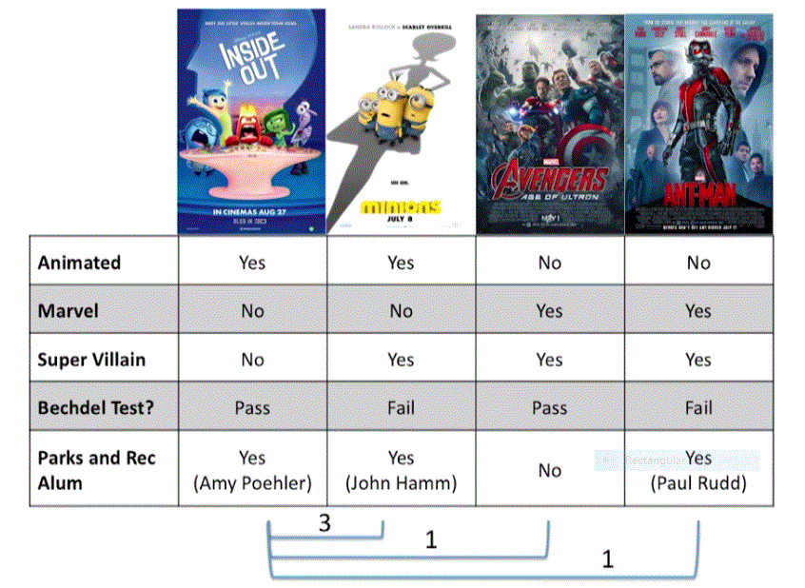
CONTENT based filtering
Content-based filtering is based on the profile of the user’s preference and the item’s description.
In CBF ,to describe items we use keywords apart from user’s profile to indicate user’s preferred liked or dislikes. In other words CBF algorithms recommend those items or similar to those items that were liked in the past.
It examines previously rated items and recommends best matching item.

Slide 7
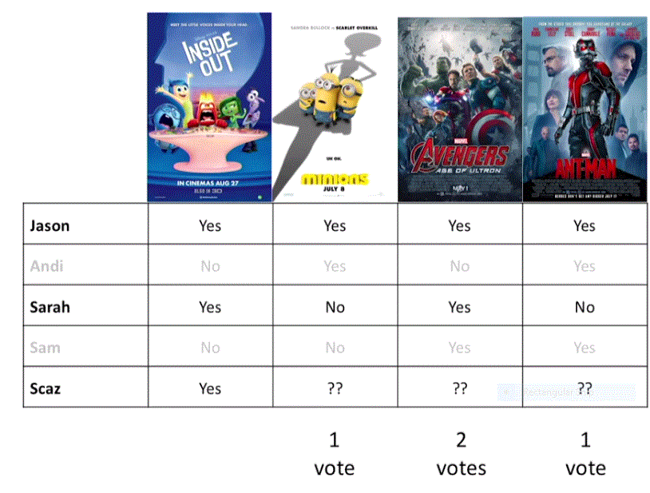
Collaborative filtering
Collaborative filtering methods are based on collecting and analysing a large amount of information on users’ behaviours, activities or preferences and predicting what users will like based on their similarity to other users.
Collaborative filtering system recommends items based on similarity measures between users and/or items. The system recommends those items that are preferred by similar kind of users.

Slide 8
Advantages of collaborative FILTERING
It is content-independent i.e., it relies on connections only.
Since in Collaborative Filtering people makes explicit ratings so real quality assessment of items are done.
It does not rely on machine analysable content and therefore it is capable of accurately recommending complex items such as movies without requiring an understanding of the item itself.

Slide 9
Limitations of collaborative filtering
Cold start problem:
These systems often require a large amount of existing data on a user in order to make accurate recommendations.
Scalability:
In many of the environments in which these systems make recommendations, there are millions of users and products. Thus, a large amount of computation power is often necessary to calculate recommendations.

Slide 10
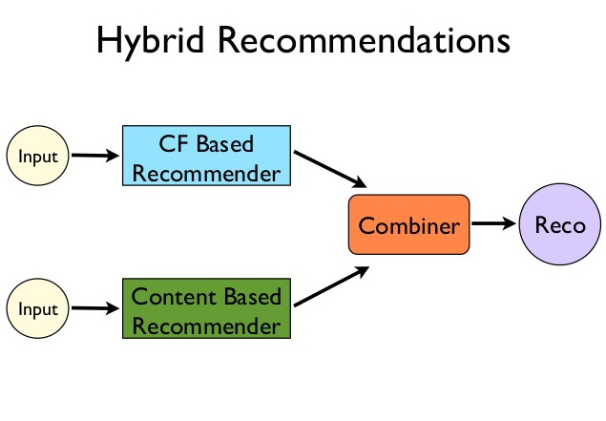
Hybrid recommender system
Recent research has demonstrated that a hybrid approach , combining collaborative filtering and content-based filtering could be more effective in some cases.
Hybrid approaches can be implemented in several ways:
1. By making content-based and collaborative-based predictions separately and then combining them.
2. By adding content-based capabilities to a collaborative-based approach (and vice versa)

Slide 11
Movie recommender system
Step 1:
Find the attributes which are sparse and fill the sparse places with the median of all the similar kind of attributes. Though there are many efficient ways to fill them I opted median for simplicity.
Step 2:
Find distinct number of actors, directors, genres to make their feature vectors for all the films.

Slide 12
MOVIE RECOMMENDER SYSTEM
Step 3:
Feature vector: it is a vector where 1 is stored in every place corresponding to the attributes which are related to them i.e., For "DARK KNIGHT" movies the column corresponding to Christopher Nolan is '1' in director feature vectors.
Step 4:
Combine all the feature vectors into single array and add IMDB rating, run length etc. All the factors needed to the feature vector.

Slide 13
MOVIE RECOMMENDER SYSTEM
Step 5:
Now we have a dictionary with movie titles as keys and feature vectors as values.
Step 6:
Mean normalization.....i.e., subtract mean of all the feature vectors from every feature vector and divide it by standard deviation of the same.
Step 7:
Use cosine similarity to get the top 10 similar movies as shown in the code.

Slide 14
END

