Slide 1

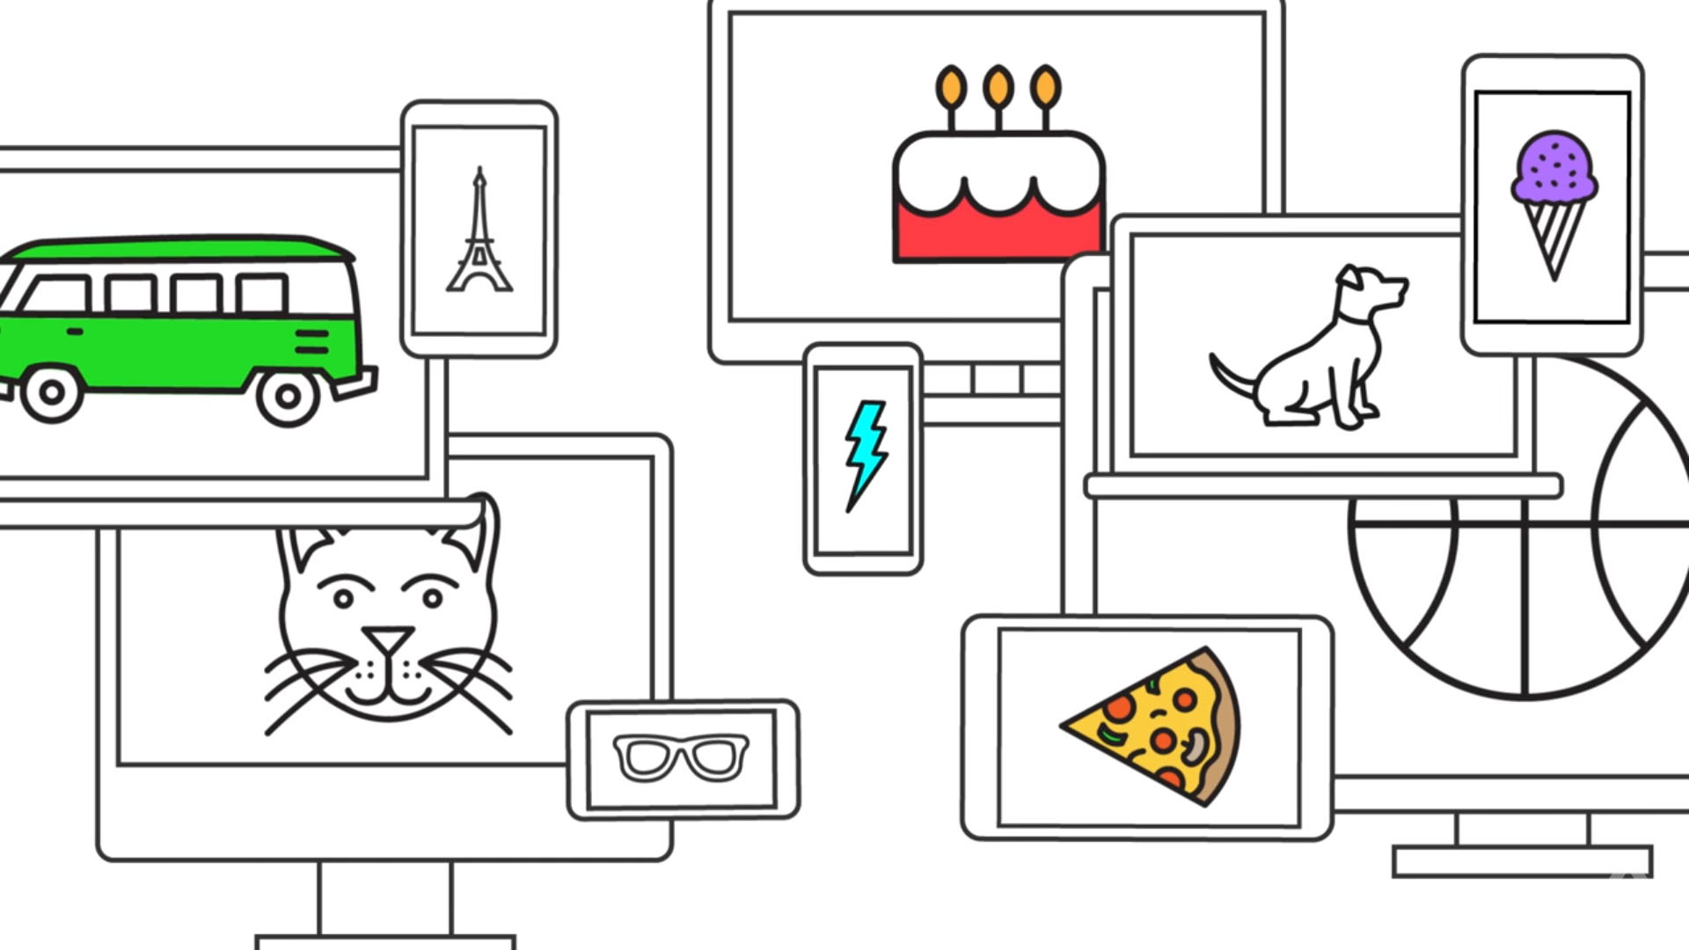
AUTODRAW
GOOGLE’S AI DOODLE BOT

Slide 2

AUTODRAW
YOU DOODLE
THE APP GUESSES AND SUGGESTS IMAGES
YOU PICK A DOODLE, COLOR, ETC.
FAST DRAWING FOR EVERYONE
Click me!

Slide 3
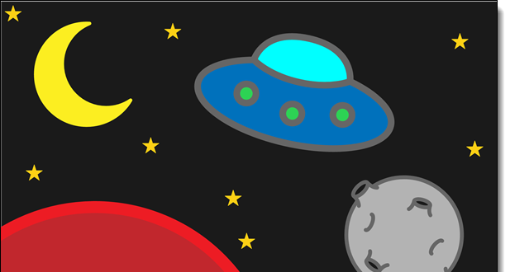
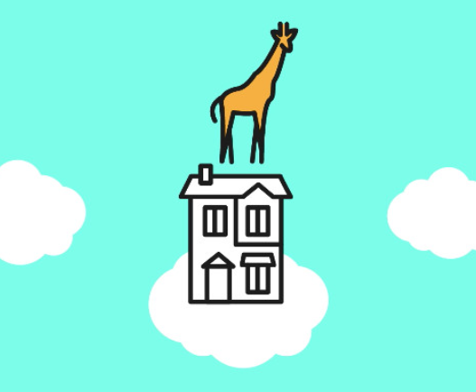
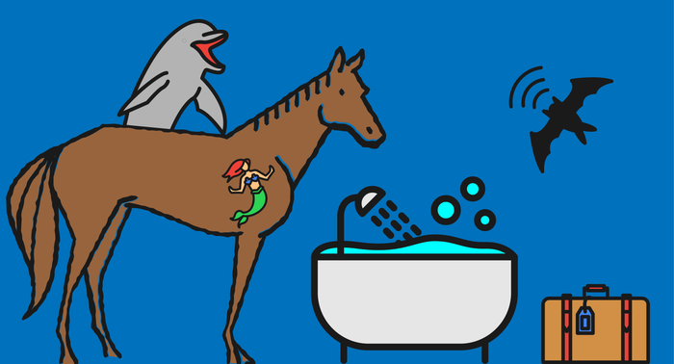
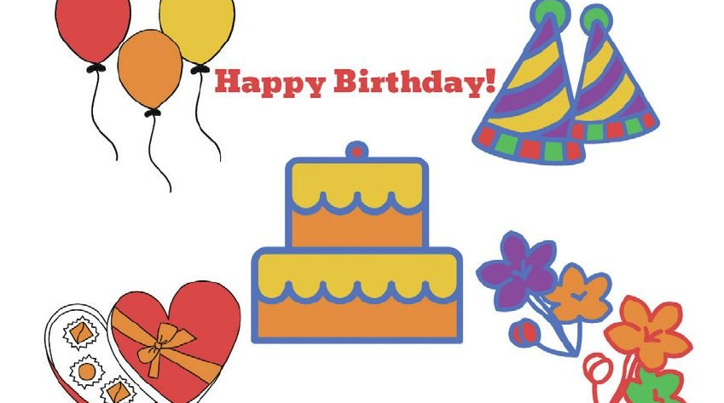

Slide 4
MACHINE LEARNING AND DRAWINGS FROM TALENTED ARTISTS
IDENTIFY AN OBJECT
PAIR WITH A DATABASE OF NEAT AND SIMPLISTIC HAND-DRAWN IMAGES
TECH FROM GOOGLE’S EXPERIMENTAL IMAGE RECOGNITION SOFTWARES
A neural network is a series of algorithms that endeavors to recognize underlying relationships in a set of data through a process that mimics the way the human brain operates.

Slide 5
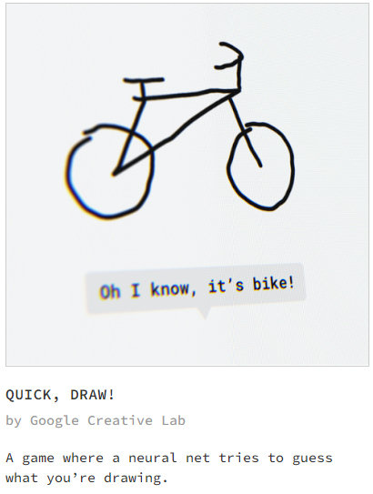
Over 15 million players have contributed millions of drawings playing Quick, Draw! These doodles are a unique data set that can help developers train new neural networks, help researchers see patterns in how people around the world draw, and help artists create things we haven’t begun to think of. That’s why we’re open-sourcing them, for anyone to play with.
Será que uma rede neural consegue aprender a reconhecer seus desenhos?Ajude a ensinar a rede adicionando seus desenhos ao maior conjunto de dados sobre desenhos do mundo (em inglês). Esses dados são compartilhados com o público para ajudar nas pesquisas sobre aprendizado de máquina.

Slide 6
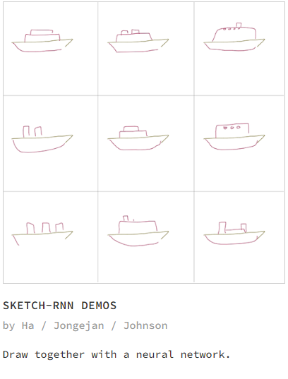
We present sketch-rnn, a recurrent neural network (RNN) able to construct stroke-based drawings of common objects. The model is trained on thousands of crude human-drawn images representing hundreds of classes. We outline a framework for conditional and unconditional sketch generation, and describe new robust training methods for generating coherent sketch drawings in a vector format.
We made an interactive web experiment that lets you draw together with a recurrent neural network model called sketch-rnn. We taught this neural net to draw by training it on millions of doodles collected from the Quick, Draw! game. Once you start drawing an object, sketch-rnn will come up with many possible ways to continue drawing this object based on where you left off
model is trained on a dataset of how other people doodle, we also found it interesting to deliberately draw in a way that is different compared to the model’s predictions to help with our own mental search process for novelty, and not conform to the masses. Try the Multi Predict demo. In addition to predicting the rest of an incomplete drawing, sketch-rnn is also able to morph from one drawing to another drawing.

Slide 7
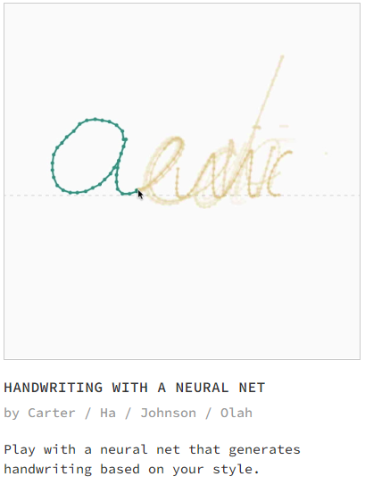
The model is quite simple (so as to run well in the browser) so the generated output mostly produces gibberish letters and words (albeit, gibberish that look like real handwriting), but it is still useful for our purposes of exploring visualization techniques. This is because the type of architecture used for this model (LSTM) has a mechanism for remembering previous strokes. It is therefore able to remember things like how loopy or jerky the handwriting is, or which letter preceeded the current one.
It is obvious from these experiments that this model has learned quite a lot about human handwriting. Which sort of raises the question, can we extract that knowledge in any meaningful way, rather than just blindly using it to mimic handwriting? reading postal addresses, bank check amounts, and forms. Furthermore, OCR plays an important role for digital libraries, allowing the entry of image textual information into computers by digitization, image restoration, and recognition methods.

