Slide 1

CSS Flexbox
Modern Web Layout
Week 1 – Full-Stack DPP Course

Slide 2
Welcome
Manuel Cubuca
Technical Trainer
manuelc@justit.co.uk

Slide 3
Outline
Web Layout History and Evolution
What’s Flexbox
Flexbox Basics
Flexbox Container
Flex Flow Direction
Flex Line Wrapping
Display Order
Flexibility
Alignment

Slide 4
Learning Objectives
Learners would have a good understanding of:
Layout Evolution From Tables, CSS1/2, Float Based Layout to Responsive Web Design
Flexible Box Model (as an Extension of the Display Property)
Core Concepts and Key Terminologies of Flexbox
Flexible Layouts
Distribute Extra Space
Align Content
Main Axis vs. Cross Axis

Slide 5
Learning Objectives cont.
Learners would have a good understanding of:
Flow Content Horizontally o Vertically
Align Items on the Container or Individually
Stretch, Shrink and Grow
Change Display Order
Real World Examples

Slide 6
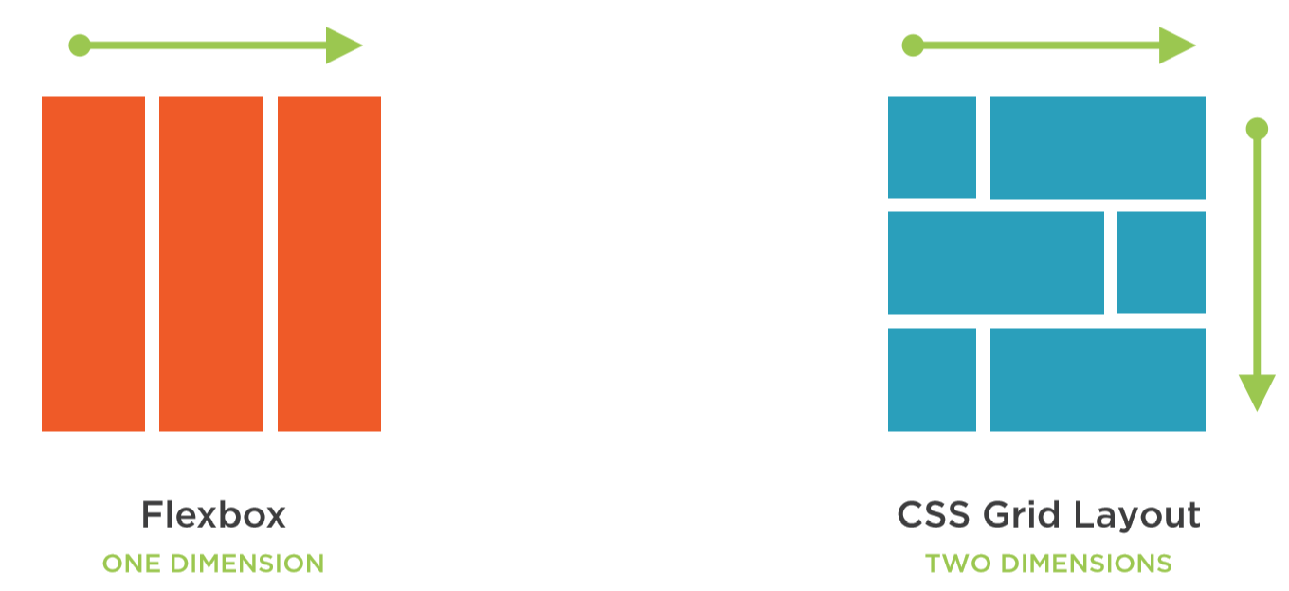
Flexbox vs. CSS Grid Layout
They are similar but Flexbox controls how items flow in one dimension, whereas, grid controls how items flow in two dimensions.

Slide 7
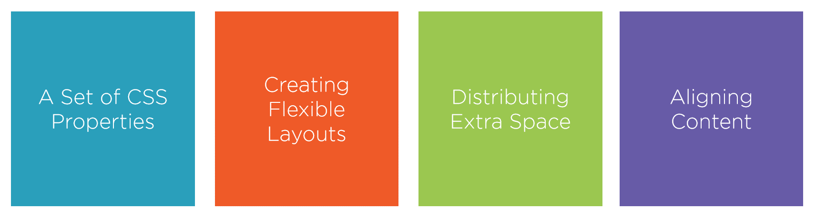
What is Flexbox
Short for Flexible Box Model
Is an extension of the Display Property

Slide 8
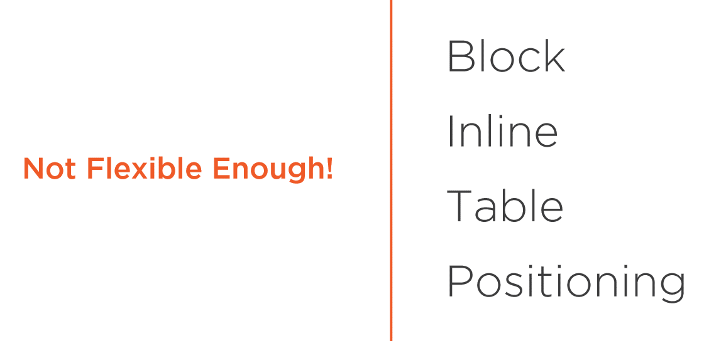
Layout Mode From CSS2.1
Did not provide enough Flexible and Control for the web as we known it today, which is why Flexbox was created.

Slide 9

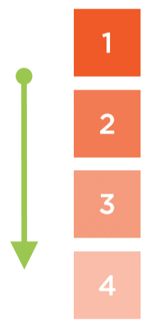
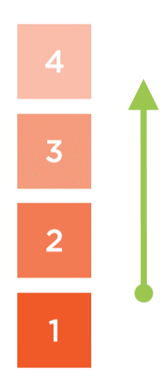
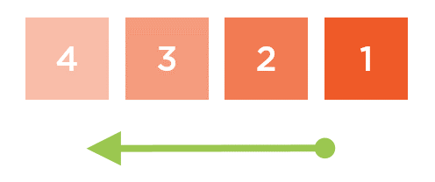
Flexbox
Provides the ability to arrange items in any directions, left to right, right to left, top to bottom or bottom to top.

Slide 10
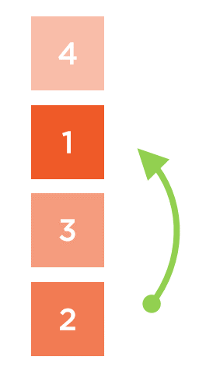
Flexbox
Provides the ability to easily reverse or rearrange the visual display order of a set of items.

Slide 11
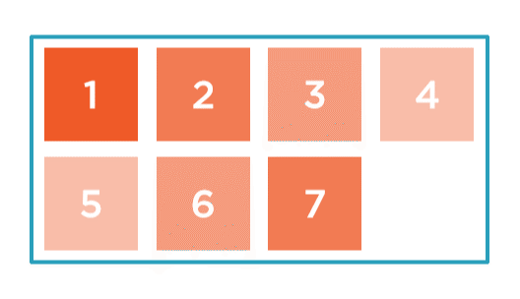
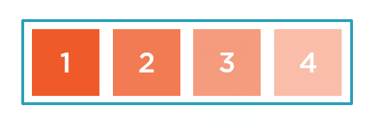
Flexbox
Provides the ability to lay items out linearly without wrapping or forcing them to wrap, when there is not enough room.
NO WRAP
WRAP

Slide 12
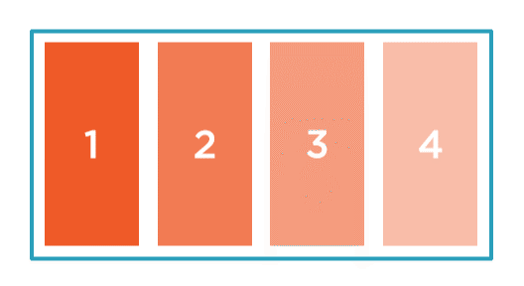
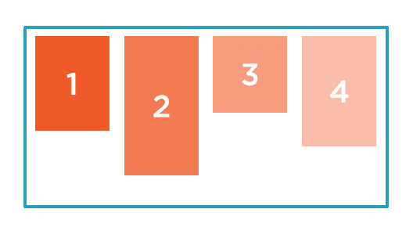
Flexbox
Ability to stretch and align items in relation to their parent container.

Slide 13
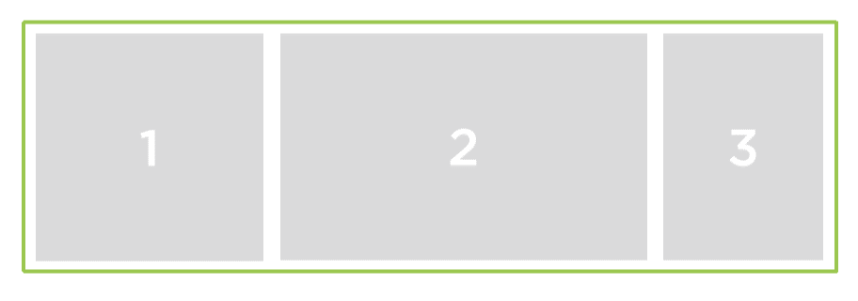
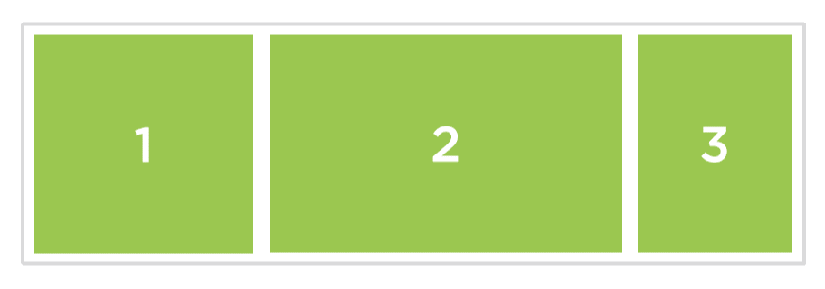
Flexbox the Basics
Flexbox is all about the relationship between a PARENT CONTAINER and its direct descendant's CHILD ITEMS.
The parent container is known as FLEX CONTAINER
The direct descendants of this container are FLEX ITEMS

Slide 14
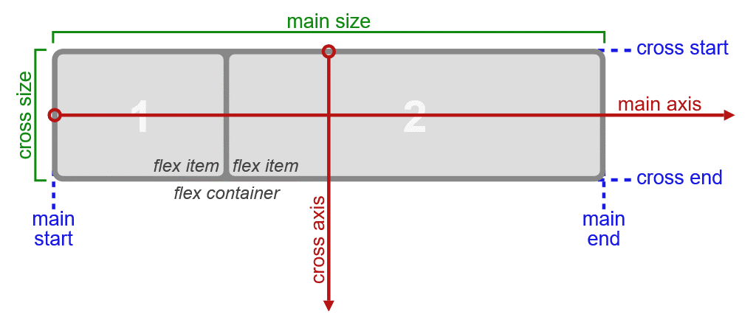
Main Axis vs Cross Axis

Slide 15
The Flex Container
Forms the containing block for its Flex Items and it acts very similar to other block level items.
To define or establish an element as Flex Container, we use the DISPLAY PROPERTY.
display: flex;
display: inline-flex;

Slide 16
Flexbox 1st Demo
Let’s practice

Slide 17
Flex Flow Container
By default flex items will flow horizontally from left to right within their container.
To make it act differently, we can change this with a new flexbox property.
flex-direction: row;
This is the default behaviour

Slide 18
Flex Flow Container
Flow from right to left:
flex-direction: row-reverse;
Flow from top to bottom:
flex-direction: column;
Flow from bottom to top:
flex-direction: column-reverse;

Slide 19
Flexbox 2nd Demo
Let’s practice

Slide 20
Flex Line Wrapping
How flex items respond when there’s not enough room and the ways we can change their behaviours to suite our needs.
If you used text-wrap property before, it works in a very similar manner with Flex Line Wrapping.
flex-wrap: nowrap;
This is the default behaviour

Slide 21
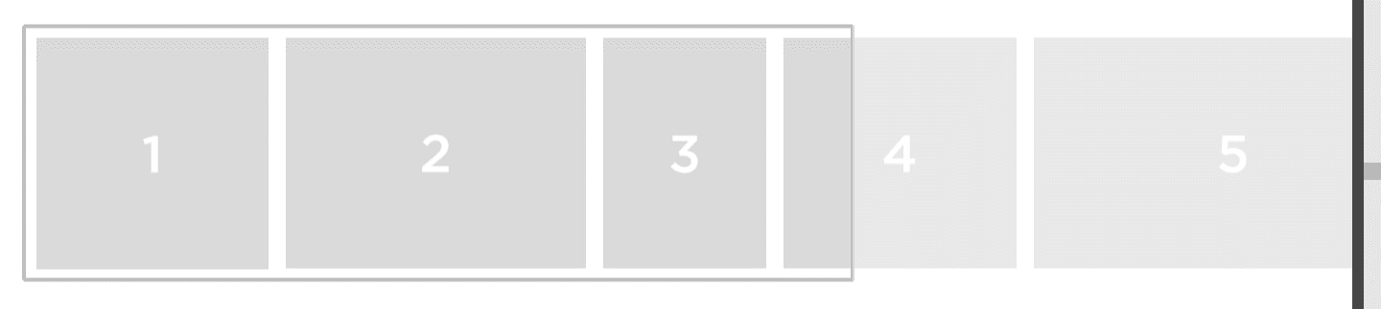
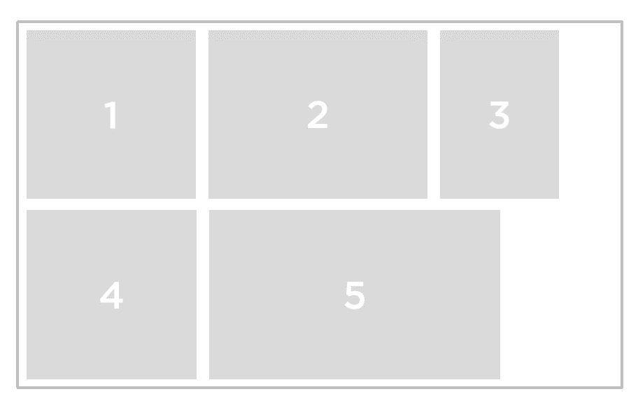
Single Line Formatting vs Multi-line Formatting
flex-wrap: nowrap;
flex-wrap: wrap;

Slide 22
Flex Line Wrapping cont.
Make items wrap above the first row when there’s not enough room, items will flow from bottom to top.
flex-wrap: wrap-reverse;
We can also use shorthand to combine both flex direction property and flex wrap property with flex-flow.
flex-flow: column wrap;
We can use other combinations such as:
flex-flow: row-reverse wrap-reverse;

Slide 23
Flexbox 3rd Demo
Let’s practice

Slide 24
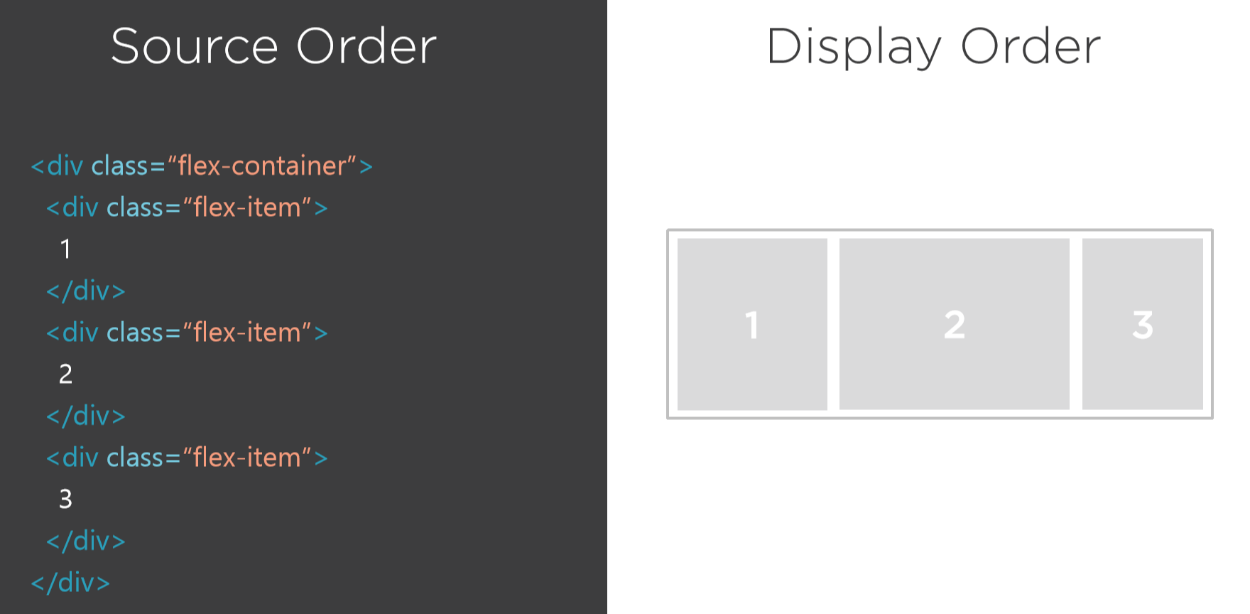
Flex Display Order
How easy its to control the display order of flex items. You can easily change the order flex items are display within their container.

Slide 25
Flex Display Order cont.
By default all flex items within a container are placed into one ordinal group, which has a value of ZERO.
We can use a new flex property called order to change the display order.
order: 0; // This is the default
To move the item to the very end (right side)
order: 1;
To move the item to the very beginning (left side)
order: -1;

Slide 26
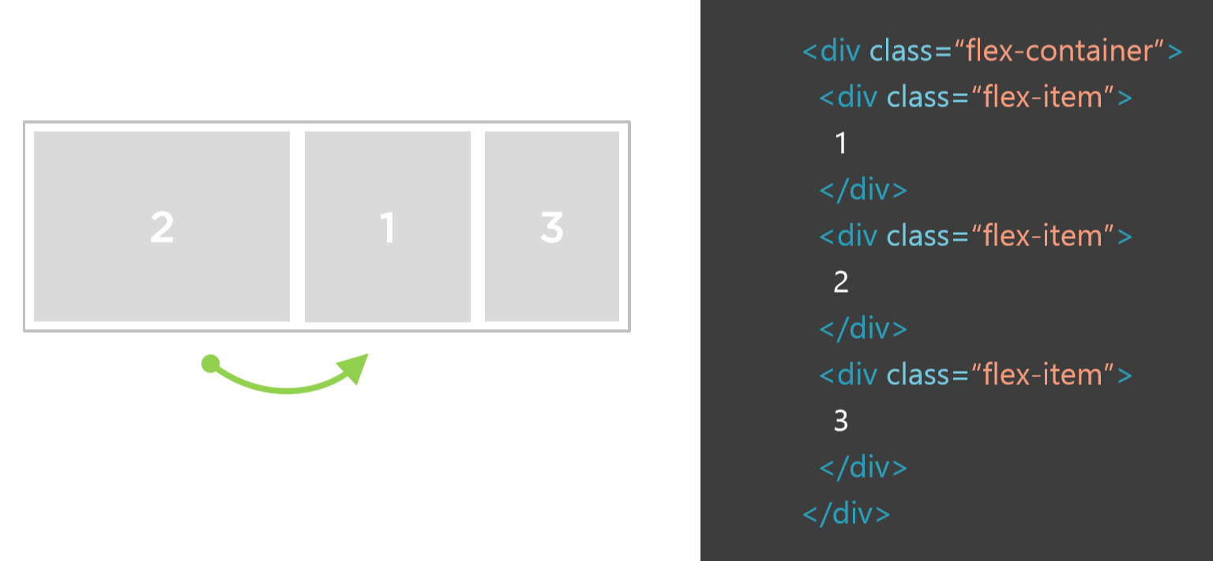
Accessibility
The order property only changes the visual order of the content and not the source order. The key is to user order property only to alter the items for visual purposes only.

Slide 27
Flexbox 4th Demo
Let’s practice

Slide 28
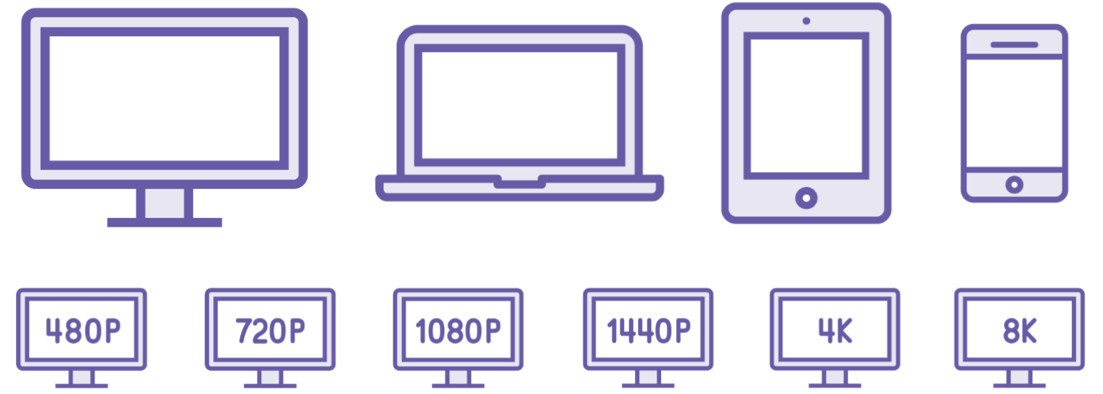
Flexibility
The most notable component of Flexbox is the ability to make flex items flex, to shrink and grow to feel available space within a flex container.
Flexible Box Model was created to allow us to more easily create flexible layouts that can change and adapt to their viewing environment.

Slide 29
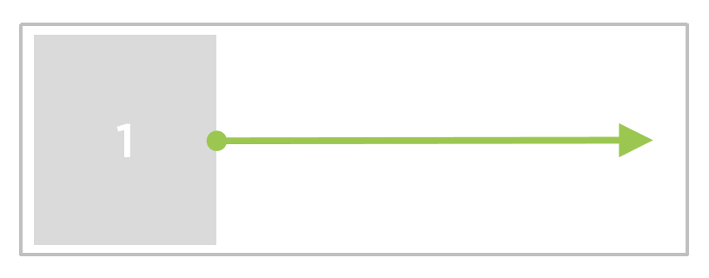
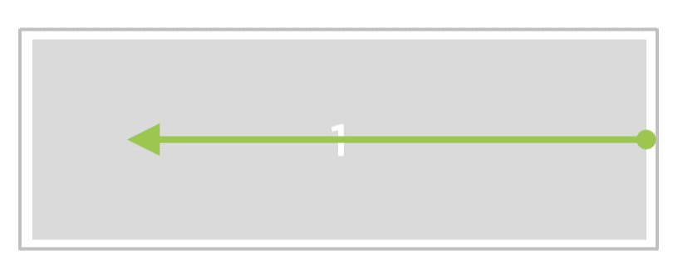
Flex Grow Factor and Flex Shrink Factor
flex-grow: 1;
flex-shrink: 2;

Slide 30
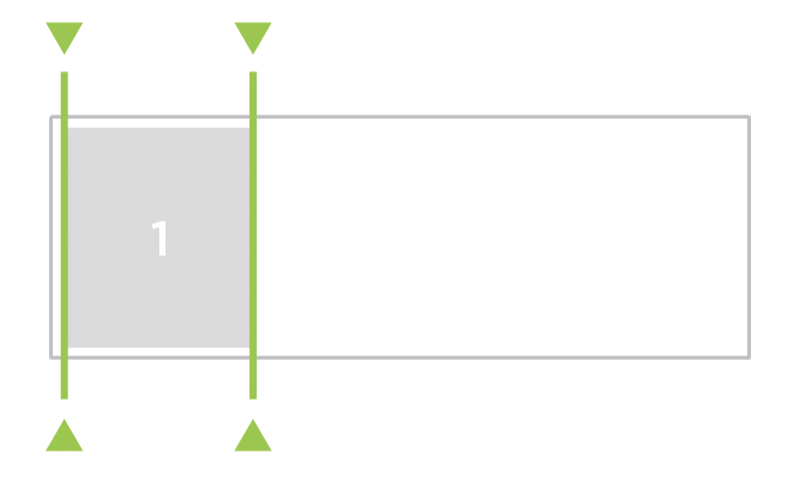
Flex Basis Property and Shorthand
flex-basis: 10em;
The shorthand:
flex: flex-grow flex-shrink flex-basis;

Slide 31
Flexbox 5th Demo
Let’s practice

Slide 32
Alignment
In CSS 2.1 we often find it very difficult to align items. To vertically align an item in a given container it requires very hacky CSS.
Flexbox leverages the CSS box alignment module, which allows us to use simple keywords to align items.
Flexbox alignment can be handled in two different ways:
Can be applied to all the flex items in a given container via the justify-content, align-items, or align-content properties.
Also, it can be applied to the individual flex items themselves via the align-self property.

Slide 33
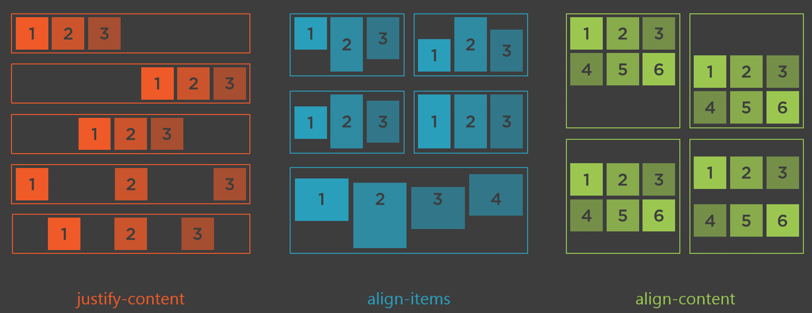
Alignment cont.

Slide 34
Alignment justify-content
Allows us to align the flex container’s items along the main axis.
Notice the flex-start is the default:
justify-content: flex-start;
justify-content: flex-end;
Can be combine with flex-direction:
justify-content: flex-end;
flex-direction: column;

Slide 35
Alignment justify-content cont.
Can be combine with flex-direction to centre items:
justify-content: center;
flex-direction: column;
Can also add space between the items:
justify-content: space-between;
justify-content: space-around;

Slide 36
Align Items
align-items: flex-start;
align-items: flex-end;
align-items: flex-center;
align-items: baseline; // aligns the txt at same level
align-items: stretch; // is the default value

Slide 37
Align Self
To align individual items uniquely, can be achieved with the align-self property.
align-self: flex-start;
align-self: flex-end;
align-self: stretch;

Slide 38
Align Content
Will do nothing to single line flex containers.
align-content: flex-start;
align-content: flex-end;
align-content: center;
align-content: space-between;
align-content: space-around;
align-content: stretch; // is the default

Slide 39
Flexbox 6th Demo
Let’s practice

Slide 40
Resources
Pluralsight video tutorials
Modern Web Layout with Flexbox and CSS Grid
CSS Flexbox Fundamentals

Slide 41
Resources cont.
Relevant websites for sample codes, examples and general information.
Browser Support
CSS Layout News
W3C
A Complete Guide to Flexbox
A visual Guide to Flexbox Properties
Solved by Flexbox

