Slide 1
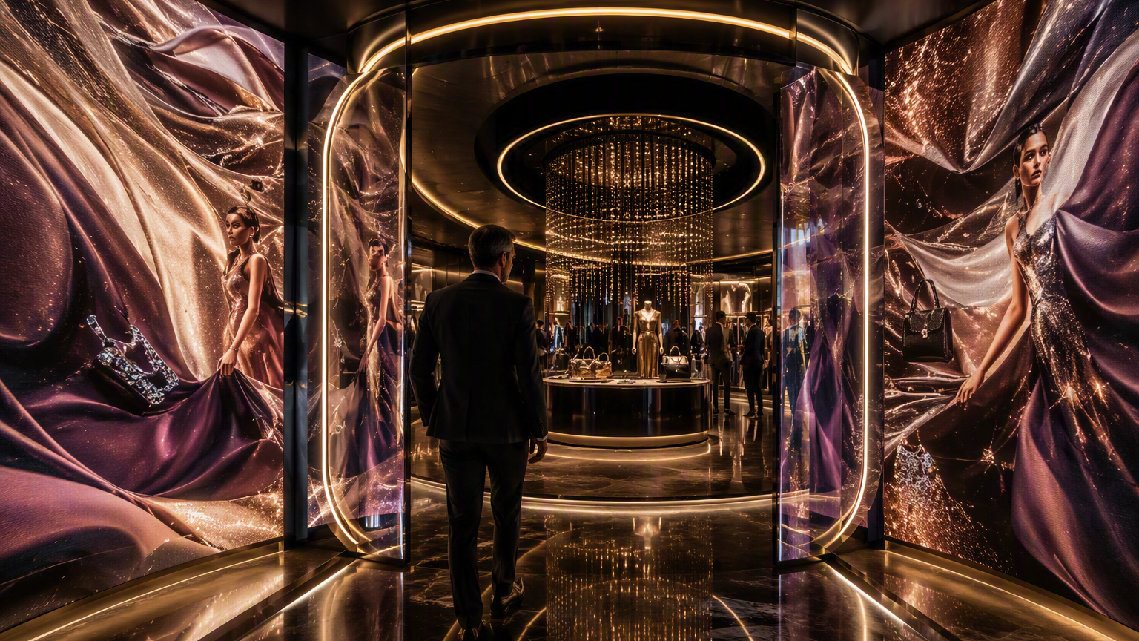
House of Me
Build a Wardrobe,
Not a Shopping Cart
Powered by Capsule Intelligence
Buy less. Wear more. Make every piece earn its place.
Notes:
[Sources]
- Internal reference: moodmixer-platform-vision-v2.pptx, provided by the user, used as a visual-format reference only.
- Internal reference: House_of_Me_Luxury_Fashion_Experience.pptx, provided by the user.
- Visual on this slide was generated with Microsoft Copilot.
[/Sources]

Slide 2
A full closet can still feel like nothing to wear
The problem is not lack of fashion. It is lack of wardrobe coherence.
CLOSET FULLNESS
DISCONNECTED PURCHASES
Many items, but few dependable combinations.
Pieces are bought individually without considering the existing wardrobe.
OCCASION PRESSURE
LOW WARDROBE UTILITY
Travel, promotions and events lead to rushed purchases.
A small number of pieces are repeatedly worn while others remain unused.
Notes:
[Sources]
- Internal reference: moodmixer-platform-vision-v2.pptx, provided by the user, used as a visual-format reference only.
- Internal reference: House_of_Me_Luxury_Fashion_Experience.pptx, provided by the user.
[/Sources]

Slide 3
Every piece must earn its place
House of Me evaluates a purchase by the wardrobe value it creates, not only by style affinity.
NEW OUTFITS CREATED
EXISTING PIECES COMPLEMENTED
OCCASIONS COVERED
How many combinations become possible?
Which owned items become more wearable?
What real-life needs are solved?
REDUNDANCY AVOIDED
WARDROBE GAP SOLVED
CONFIDENCE CREATED
Does the customer already own a similar piece?
Does the item connect or complete the wardrobe?
Does the capsule make dressing easier?
Hero moment: “This blazer works with 8 pieces you own and creates 12 new outfits.”
Notes:
[Sources]
- Internal reference: moodmixer-platform-vision-v2.pptx, provided by the user, used as a visual-format reference only.
- Internal reference: House_of_Me_Luxury_Fashion_Experience.pptx, provided by the user.
[/Sources]

Slide 4
Choose a capsule mission
The experience begins with a specific life need, not a generic style quiz.
THE NEW LEADER CAPSULE
THE CARRY-ON CAPSULE
Office, client meetings, leadership events and work-to-dinner.
Five days, one carry-on and multiple occasions.
THE EVENT-SEASON CAPSULE
THE STYLE-RESET CAPSULE
Several events, minimal new purchases and distinct looks.
A new role, lifestyle or wardrobe transition.
Recommended MVP hero: The New Leader Capsule
Notes:
[Sources]
- Internal reference: moodmixer-platform-vision-v2.pptx, provided by the user, used as a visual-format reference only.
- Internal reference: House_of_Me_Luxury_Fashion_Experience.pptx, provided by the user.
[/Sources]

Slide 5
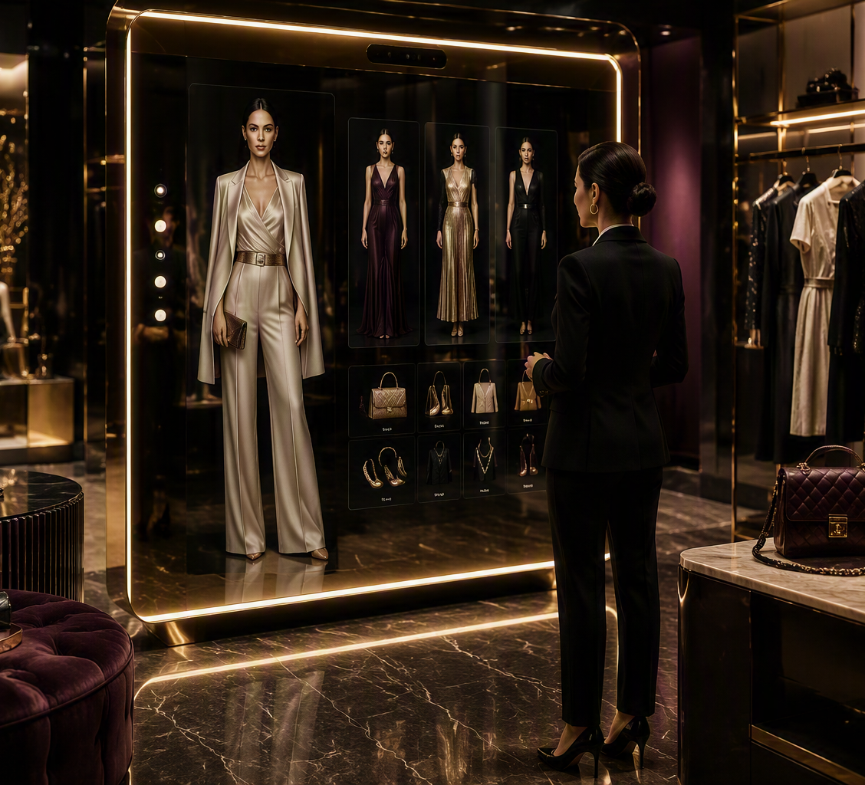
The capsule builder
Use what the customer already owns, then add the smallest number of pieces that unlocks the most value.
ALREADY OWN
ADD
7 usable pieces selected from the customer’s wardrobe.
3 strategically selected gap-filling pieces.
UNLOCK
CONTINUE
18 outfit combinations across real occasions.
Save capsule, request fitting or add only the missing pieces.
THE BUSINESS IDEA
Adding fewer, better-chosen items creates more wardrobe utility than adding many disconnected pieces.
Notes:
[Sources]
- Internal reference: moodmixer-platform-vision-v2.pptx, provided by the user, used as a visual-format reference only.
- Internal reference: House_of_Me_Luxury_Fashion_Experience.pptx, provided by the user.
- Visual on this slide was generated with Microsoft Copilot.
[/Sources]

Slide 6
Wardrobe gap analysis
House of Me should be willing to say “do not buy another dress.”
MISSING THIRD LAYER
TOO MANY STATEMENT PIECES
A neutral blazer connects existing tops, trousers and dresses.
The wardrobe lacks foundations that multiply combinations.
LIMITED WORK-TO-EVENING RANGE
PALETTE DOES NOT CONNECT
One versatile shoe or layer unlocks multiple transitions.
A bridge color can make separate wardrobe groups work together.
TRAVEL GAP
CATEGORY OVERLOAD
The customer lacks a repeatable, packable shoe or outer layer.
The customer already owns enough items in the proposed category.
Notes:
[Sources]
- Internal reference: moodmixer-platform-vision-v2.pptx, provided by the user, used as a visual-format reference only.
- Internal reference: House_of_Me_Luxury_Fashion_Experience.pptx, provided by the user.
[/Sources]

Slide 7
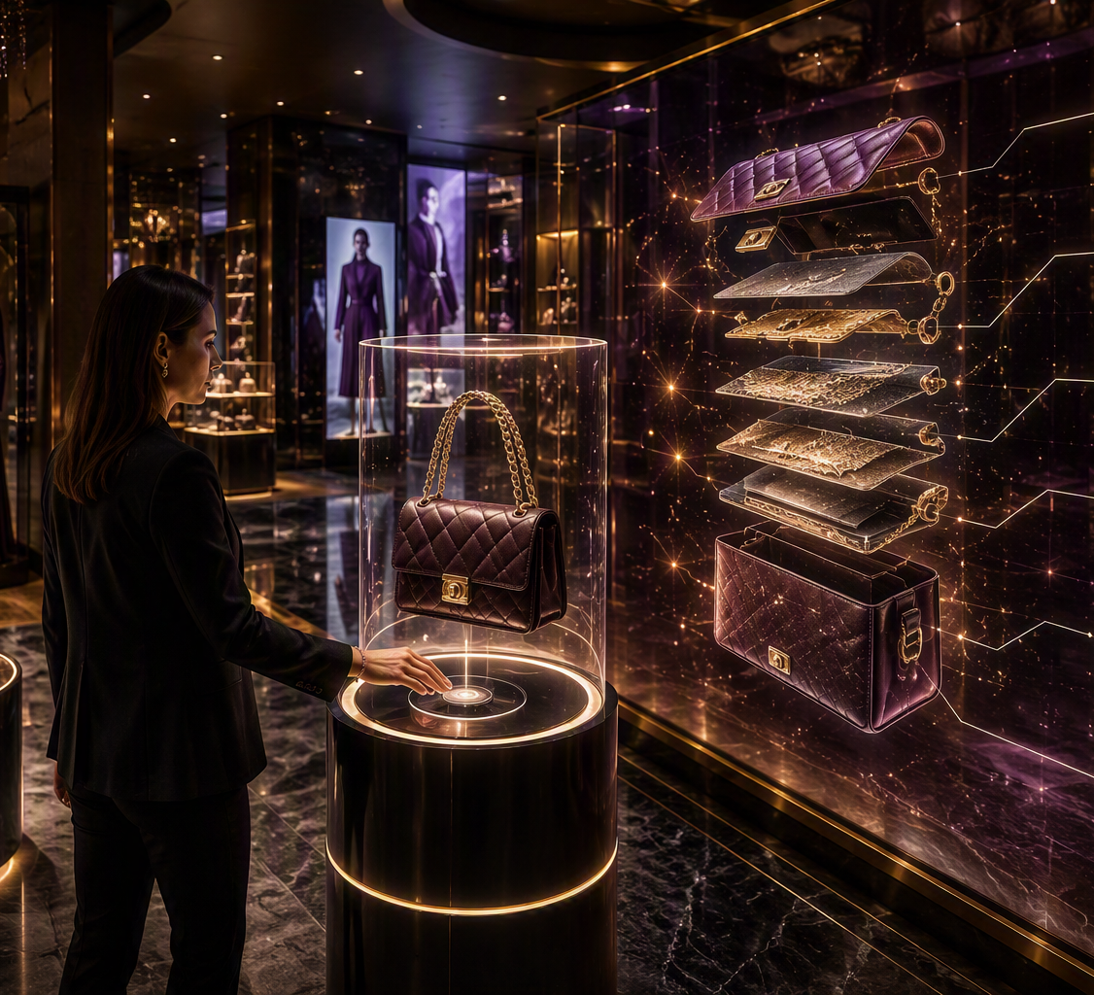
Why this piece?
Replace opaque style scores with clear wardrobe-utility explanations.
RECOMMENDED
Structured Neutral Blazer
✓
Works with 8 existing pieces
✓
Creates 12 new outfits
✓
Covers office, client meeting, travel and dinner
✓
Fills an identified layering gap
✓
Complements the existing wardrobe palette
Explanation beats “92% style match.”
Notes:
[Sources]
- Internal reference: moodmixer-platform-vision-v2.pptx, provided by the user, used as a visual-format reference only.
- Internal reference: House_of_Me_Luxury_Fashion_Experience.pptx, provided by the user.
- Visual on this slide was generated with Microsoft Copilot.
[/Sources]

Slide 8
Components
IDENTITY + INPUT
Member profile
Style preferences
Wardrobe selection
Capsule mission
PROFILE + WARDROBE
style_profile.json
wardrobe.json
purchase_history.json
occasion_context.json
CAPSULE + DECISION
catalog.json
outfit compatibility
gap analysis
capsule optimization
EXPERIENCE
OUTPUT
Kiosk
Mobile lookbook
Smart mirror ⊕
Capsule edit
Outfit matrix
Wishlist / appointment
⊕ optional enhancement
Notes:
[Sources]
- Internal reference: moodmixer-platform-vision-v2.pptx, provided by the user, used as a visual-format reference only.
- Internal reference: House_of_Me_Luxury_Fashion_Experience.pptx, provided by the user.
[/Sources]

Slide 9
MVP scope
Prove the capsule decision loop before investing in immersive hardware.
MUST HAVE
NOT NEEDED YET
• One hero persona
• One capsule mission
• Sample wardrobe
• Small product catalog
• Compatibility rules
• Capsule builder
• Outfit matrix
• Gap analysis
• Recommendation explanations
• Mobile lookbook
• Full wardrobe recognition
• Live inventory integration
• Real checkout
• Advanced body visualization
• Smart mirror
• RFID garment rail
• Digital concierge
• Hologram
• Living runway
• Production loyalty
Notes:
[Sources]
- Internal reference: moodmixer-platform-vision-v2.pptx, provided by the user, used as a visual-format reference only.
- Internal reference: House_of_Me_Luxury_Fashion_Experience.pptx, provided by the user.
[/Sources]

Slide 10
MVP success question
Can one intentional purchase create more wardrobe value than several disconnected purchases?
NEW OUTFITS
OCCASION COVERAGE
EXISTING PIECES REUSED
How many combinations were created?
How many real-life needs are addressed?
How much of the wardrobe becomes useful again?
REDUNDANT PURCHASE AVOIDED
CAPSULE SAVED
NEXT ACTION
Did the platform stop an unnecessary purchase?
Did the customer want to keep the edit?
Was a gap-filling item wishlisted or requested?
Profile → Wardrobe → Capsule → Closet
Notes:
[Sources]
- Internal reference: moodmixer-platform-vision-v2.pptx, provided by the user, used as a visual-format reference only.
- Internal reference: House_of_Me_Luxury_Fashion_Experience.pptx, provided by the user.
[/Sources]

