Slide 1
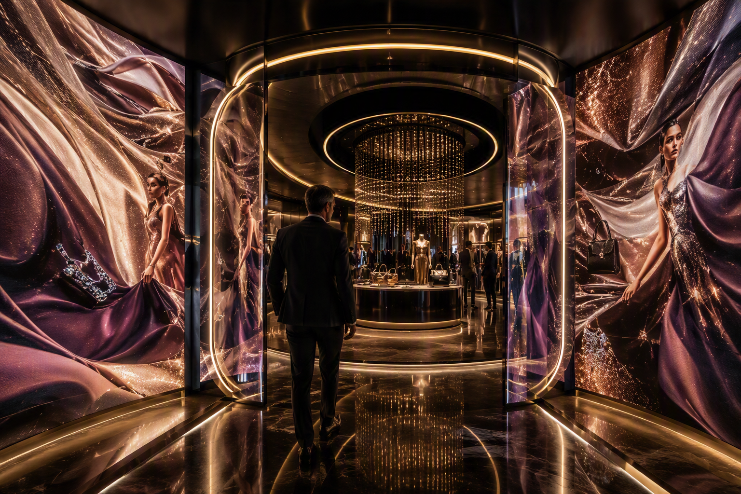
CLIENT EXPERIENCE
HOUSE OF ME
Luxury Fashion Experience
Where style meets identity, storytelling and personalized commerce.
The store adapts to the customer, rather than the customer adapting to the store.
Notes:
[Sources]
- Visual on this slide was generated with Microsoft Copilot.
[/Sources]

Slide 2
The client floor walk
I do not browse a store. I become the protagonist of a personalized luxury story.
1
2
3
4
5
6
ARRIVE
STYLE
DISCOVER
TRY
CONNECT
CREATE
Select my identity
Meet my digital concierge
Explore craftsmanship
Enter the infinite dressing room
Move campaign to closet
Build my capsule collection
Client promise: I experience how brand storytelling, clienteling, product discovery, virtual styling, commerce and loyalty become one elevated journey.

Slide 3
1 | The boutique changes to reflect who I want to be
The opening moment sets the mood, collection, styling lens and journey for the visit.
What I do
Select a style identity or occasion such as executive, creative, traveler, minimalist or collection explorer.
What changes
Lighting, sound, visual merchandising, digital content and suggested collections adapt to the selected story.
Equipment
Panoramic LED wall • touch kiosk • projection mapping • programmable lighting • spatial audio • show controller
Notes:
[Sources]
- Visual on this slide was generated with Microsoft Copilot.
[/Sources]

Slide 4
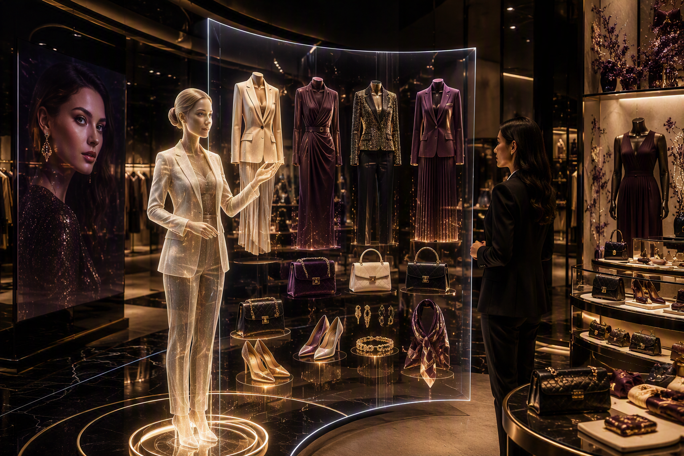
2 | I meet my digital luxury concierge
The concierge translates identity, occasion and preferences into a curated edit.
My interaction
Describe the occasion, silhouette, palette or desired expression and ask for coordinated looks.
Marketing + clienteling
The experience connects collection storytelling, customer context, loyalty and appointment-based service.
Equipment
Transparent OLED or holographic display • microphone array • directional speakers • camera • clienteling tablet
Notes:
[Sources]
- Visual on this slide was generated with Microsoft Copilot.
[/Sources]

Slide 5
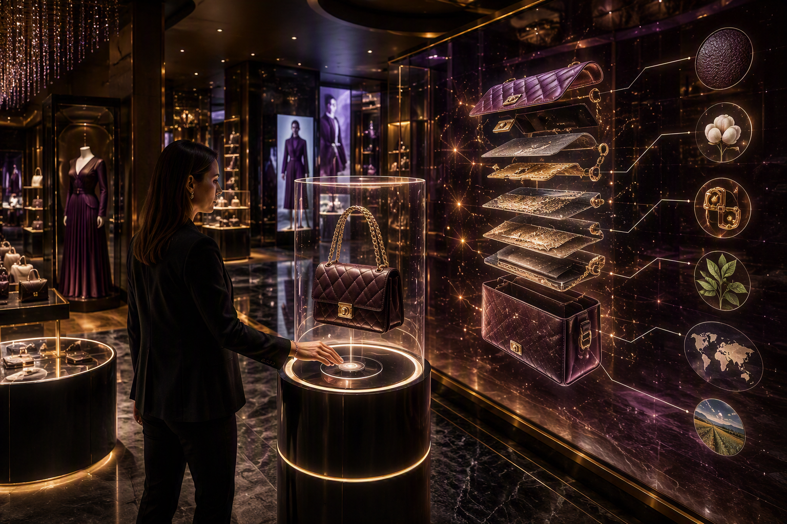
3 | The product becomes a story, not a shelf item
A signature piece is presented like art, then opened into craftsmanship, materials and provenance.
What I do
HOLOGRAM MOMENT
Place or scan a piece on the pedestal and explore its construction, inspiration and complementary items.
Commerce connection
Save the piece, compare editions, build a look, request an associate or continue the journey on mobile.
Equipment
RFID pedestal • tagged products • transparent display or hologram • motion sensors • product-recognition camera • touch control
Notes:
[Sources]
- Visual on this slide was generated with Microsoft Copilot.
[/Sources]

Slide 6
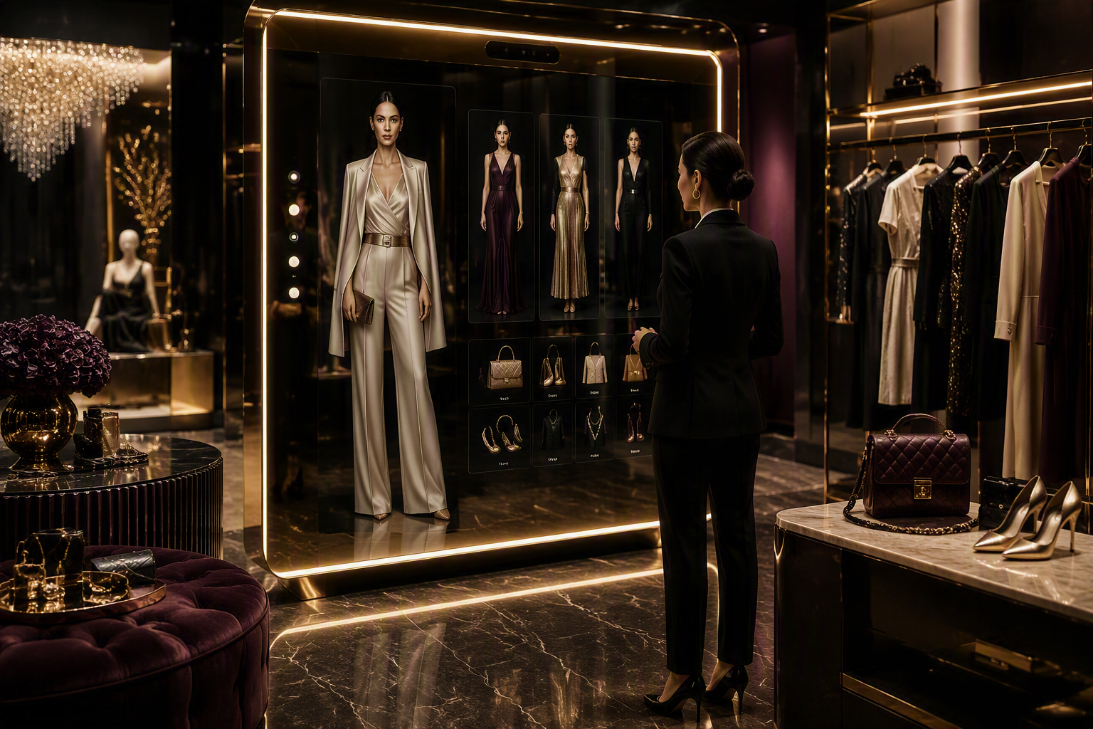
4 | I enter the infinite dressing room
The smart mirror lets me explore complete looks, colors, accessories and occasions before physical try-on.
My interaction
Change look, color, accessory and destination. Save favorites or request pieces in the fitting room.
Commerce moment
Add a complete look to the client profile or cart, check availability and choose delivery or appointment follow-up.
Equipment
Large smart mirror • camera array • interactive glass • garment rail with RFID • associate tablet • mobile checkout
Notes:
[Sources]
- Visual on this slide was generated with Microsoft Copilot.
[/Sources]

Slide 7
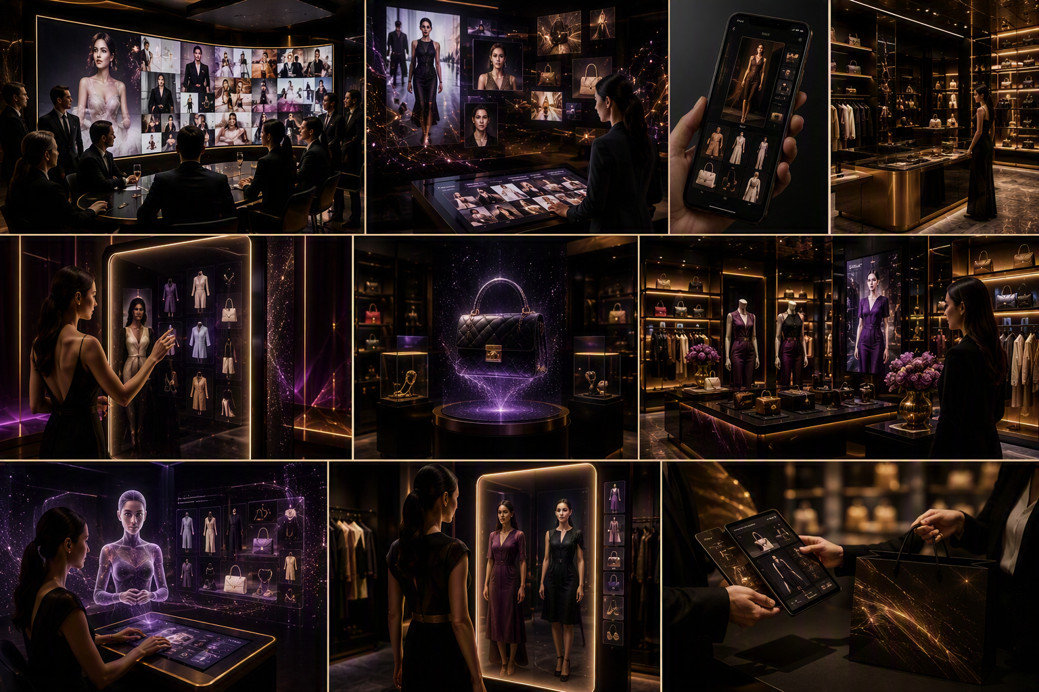
5 | I experience campaign-to-closet
A collection story moves from inspiration and content into commerce, boutique service and loyalty.
Marketing experience
Choose an audience or cultural moment. AI agents develop the collection narrative, campaign variants and channel concepts.
Commerce experience
The same story continues into mobile discovery, boutique appointment, smart mirror, product selection and purchase.
Equipment
Content wall • creative workstations • interactive commerce display • mobile devices • clienteling station • omnichannel dashboard
Notes:
[Sources]
- Visual on this slide was generated with Microsoft Copilot.
[/Sources]

Slide 8
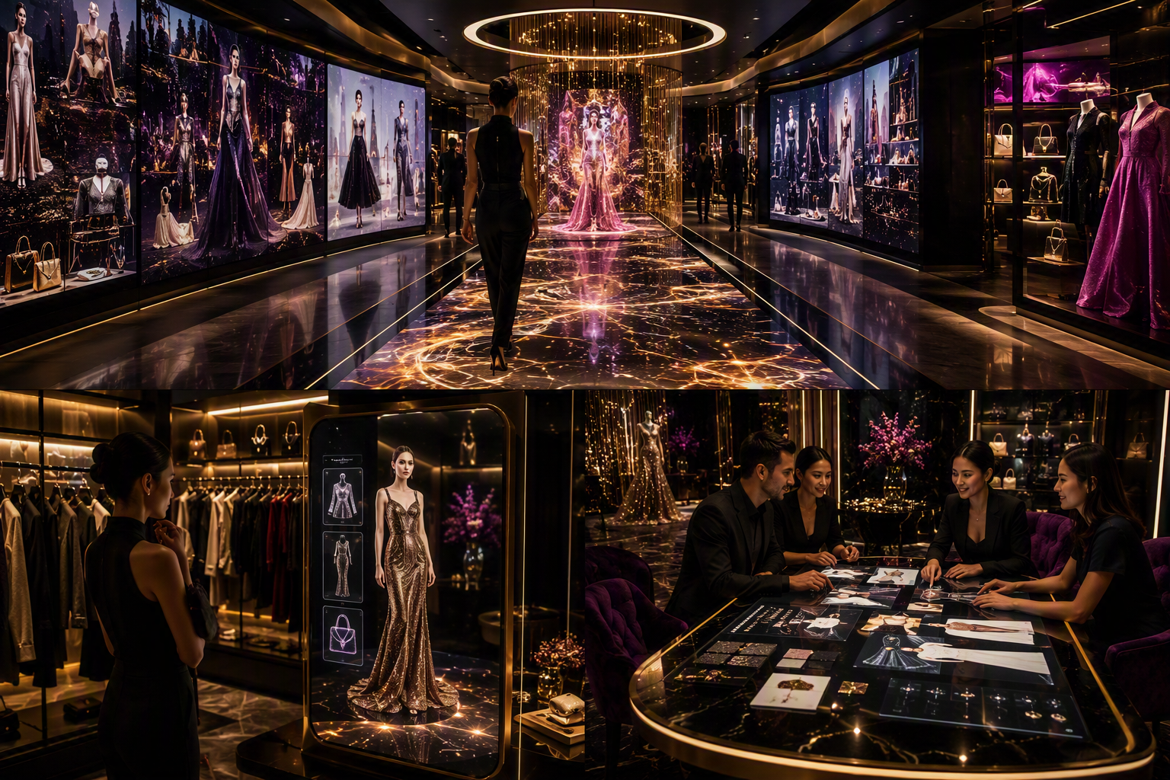
6 | I walk the living runway, then create my own edit
The closing combines a memorable immersive moment with a practical co-creation output.
Living runway
Interactive floor and surrounding displays transform the walk into a personalized collection moment.
VIP salon
Co-create a capsule collection, appointment journey or collection-launch experience for the client’s own brand.
Equipment
Interactive LED floor • panoramic displays • spatial audio • multi-touch salon table • digital whiteboard • secure handoff
Notes:
[Sources]
- Visual on this slide was generated with Microsoft Copilot.
[/Sources]

Slide 9
What needs to be procured
Prioritize a reusable premium AV platform, then add the distinctive luxury interaction devices.
IMMERSIVE SPACE
CONCIERGE + VOICE
PRODUCT STORY
FITTING + COMMERCE
CONTENT + SALON
• Panoramic LED walls
• Projection mapping
• Interactive LED floor
• Programmable lighting
• Spatial audio
• Transparent OLED / hologram
• Digital concierge screen
• Microphone array
• Directional speakers
• Camera / presence sensors
• RFID pedestal
• Tagged hero products
• Product-recognition camera
• Transparent product display
• Motion sensors
• Smart mirror
• Camera array
• RFID garment rail
• Associate tablets
• Mobile checkout
• Creative workstations
• Campaign content wall
• Multi-touch salon table
• Digital whiteboard
• Storage + reset kit
Luxury principle: fewer, more cinematic interactions with impeccable content quality will feel more premium than too many devices.

Slide 10
The client should leave saying…
“I did not visit a store.
I became the center of a luxury brand experience.”
PERSONAL
STORY-LED
CONNECTED
MEMORABLE
The boutique adapts to identity, occasion and preference.
Every hero product reveals craftsmanship and meaning.
Campaign, fitting, clienteling and purchase operate as one journey.
The holographic gallery and living runway create signature moments.
HOUSE OF ME | Where style meets identity.

