Slide 1
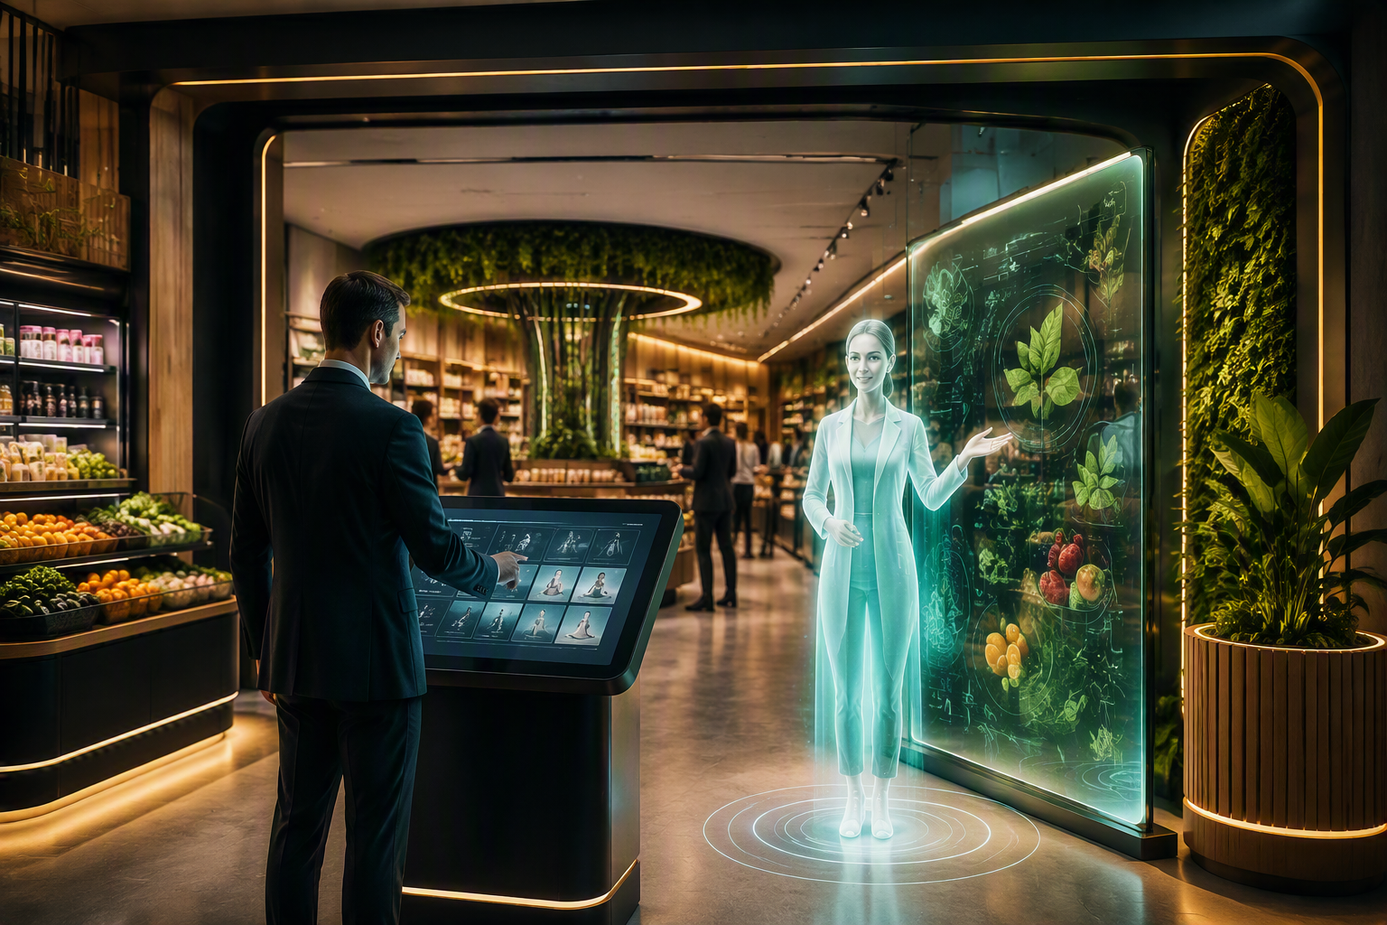
CLIENT EXPERIENCE
NutriVerse
Grocery Experience
Where nutrition meets personalized commerce and marketing.
A future grocery journey that understands my goals, guides my basket and continues beyond checkout.
Notes:
[Sources]
- Visual on this slide was generated with Microsoft Copilot.
[/Sources]

Slide 2
The client floor walk
I become the shopper, make choices and see how nutrition, marketing and commerce work together.
1
2
3
4
5
6
CHOOSE
UNDERSTAND
DISCOVER
PLAN
ACTIVATE
CONTINUE
Set my wellness goal
Explore my basket
Meet products in the smart aisle
Build meals and budget
Turn insight into campaign + cart
Connect kitchen, loyalty and reorder
Client promise: I do not receive a generic “healthy product” message. I experience how the store can responsibly connect my stated preferences to discovery, choice and ongoing engagement.

Slide 3
1 | I choose the experience I want
The visit begins with preferences declared by the client, not inferred medical information.
What I do
Choose a planning scenario such as active lifestyle, family nutrition, balanced meals, value or convenience.
What appears
A digital guide explains the visit and configures the grocery environment around the selected scenario.
Equipment
Transparent OLED or holographic display • touch kiosk • microphone array • directional speakers • programmable lighting
Notes:
[Sources]
- Visual on this slide was generated with Microsoft Copilot.
[/Sources]

Slide 4
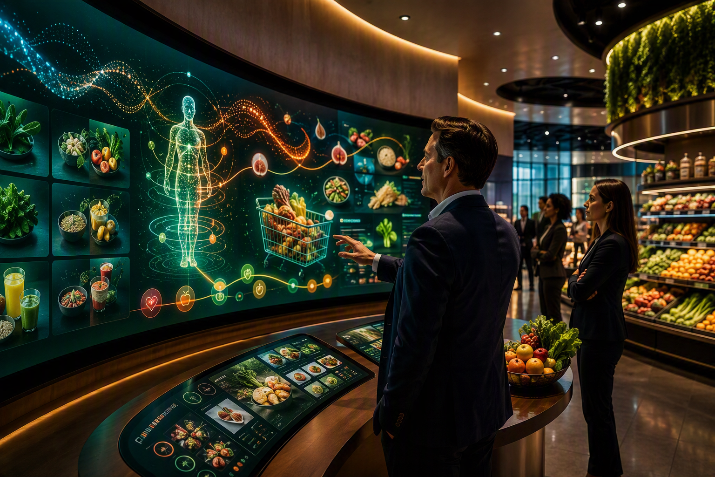
2 | I understand the basket, not just individual products
The client sees how food choices, budget, convenience and preferences can be viewed together.
My interaction
Build or scan a sample basket, then compare categories, alternatives and meal possibilities.
Marketing connection
Consumer segments and occasions can shape educational content, recipes and campaign themes.
Equipment
Curved LED wall • multi-touch table • basket scanner or RFID reader • sample products • facilitator tablet
Notes:
[Sources]
- Visual on this slide was generated with Microsoft Copilot.
[/Sources]

Slide 5
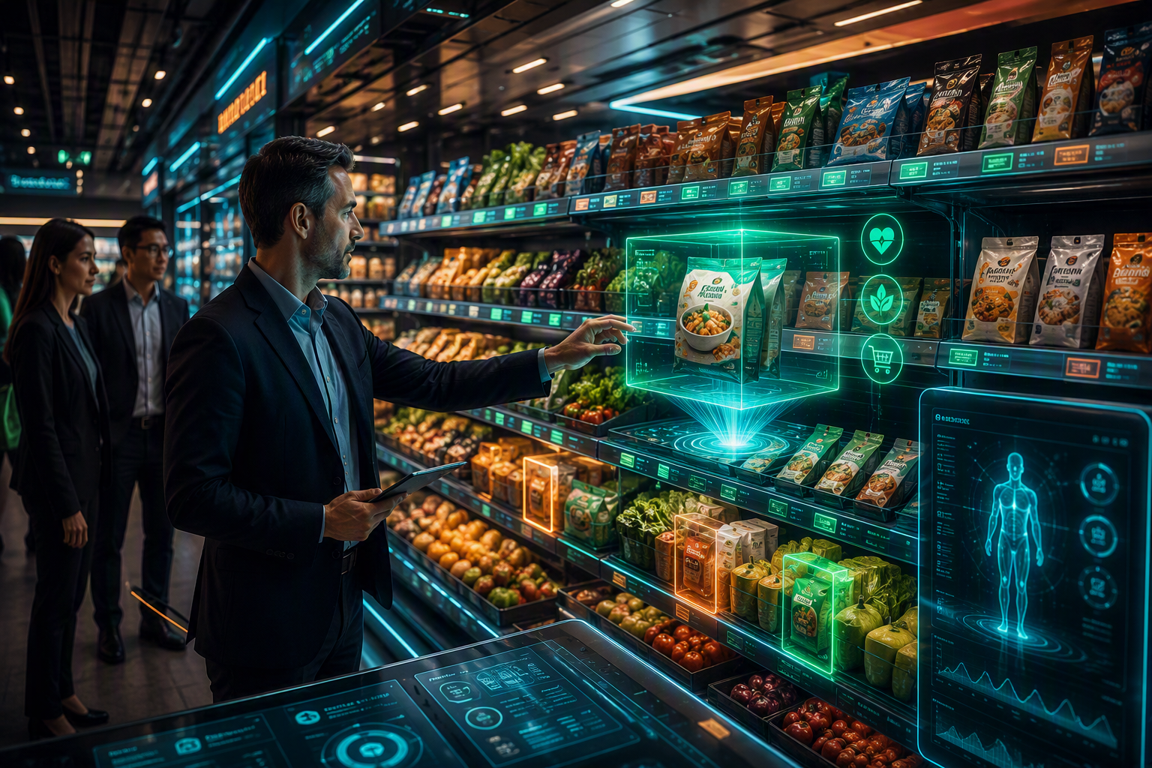
3 | I walk into a smart grocery aisle
Products become interactive. The biggest wow moment is the product appearing as a holographic story.
What I do
HOLOGRAM MOMENT
Pick up, scan or point to a product and ask what it is, how it can be used and what alternatives exist.
What the shelf does
Highlights relevant options, displays product origin, ingredients, meal ideas, availability, bundles and promotions.
Equipment
RFID shelf • tagged products • digital shelf labels • smart lighting • product scanner • holographic display or transparent OLED
Notes:
[Sources]
- Visual on this slide was generated with Microsoft Copilot.
[/Sources]

Slide 6
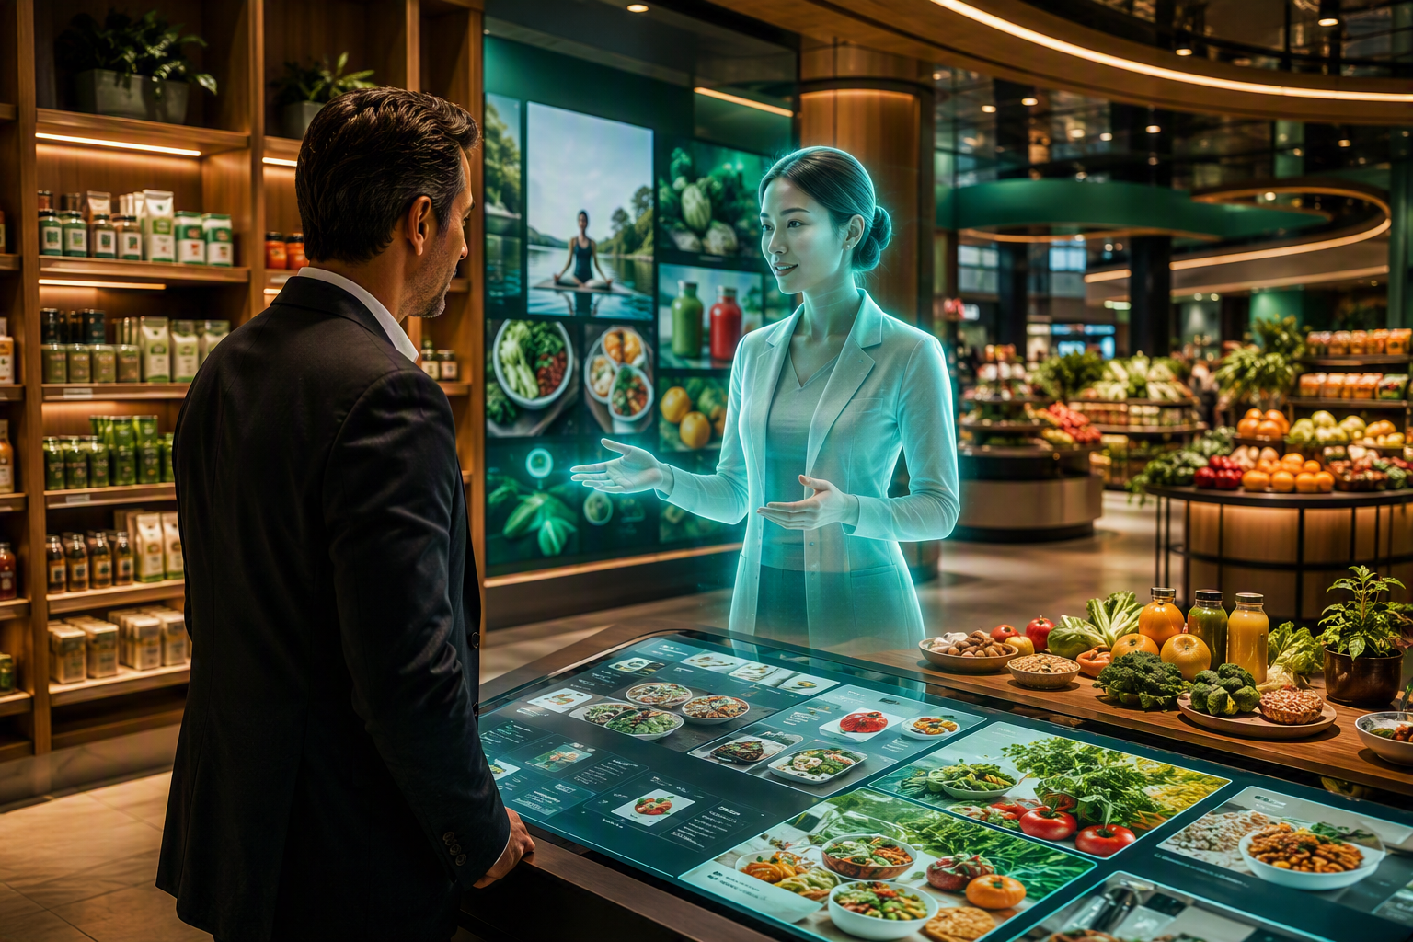
4 | I co-create a meal plan and grocery basket
The digital guide connects meal inspiration to a shoppable basket, budget and store availability.
My interaction
Choose household size, meal occasion, preferences, budget and available preparation time.
Commerce moment
Create a shoppable list, compare basket options, swap items and select fulfillment or checkout.
Equipment
Life-size digital guide • multi-touch meal table • voice interface • mobile cart station • checkout simulator
Notes:
[Sources]
- Visual on this slide was generated with Microsoft Copilot.
[/Sources]

Slide 7
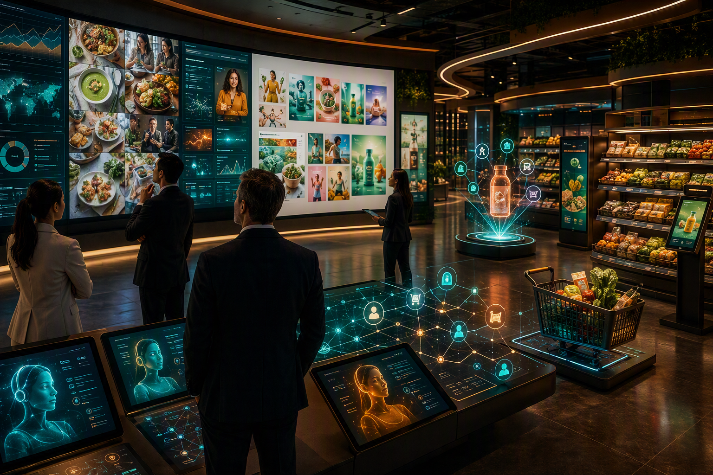
5 | I watch a nutrition insight become marketing and commerce
The showcase connects consumer occasion, campaign content, storefront, shelf and basket in one story.
Marketing experience
Select a consumer occasion. AI agents create educational content, campaign variants and channel concepts.
Commerce experience
The same proposition continues into the mobile storefront, product shelf, bundle and cart.
Equipment
Content wall • creative workstations • mobile demo devices • interactive storefront • smart shelf • agent orchestration display
Notes:
[Sources]
- Visual on this slide was generated with Microsoft Copilot.
[/Sources]

Slide 8
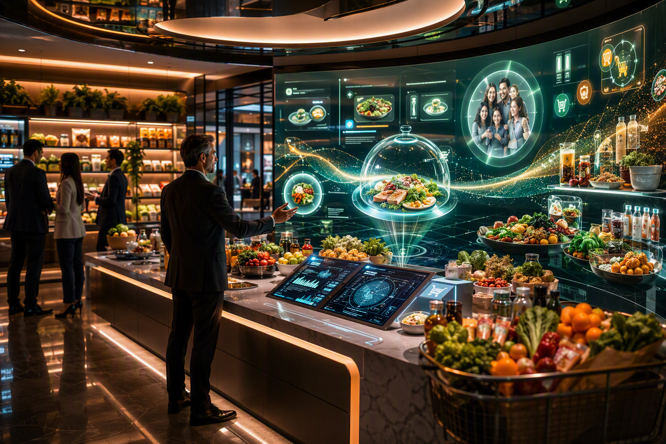
6 | The relationship continues after checkout
The future grocery experience helps the shopper use the basket, replenish it and build an ongoing relationship.
Smart kitchen moment
Use purchased items to surface meal inspiration, preparation guidance and ways to reduce waste.
Loyalty moment
Choose replenishment, subscription, community, recognition or personalized offers as the next interaction.
Equipment
Interactive kitchen island • panoramic display • voice interface • connected product props • loyalty touch table • mobile station
Notes:
[Sources]
- Visual on this slide was generated with Microsoft Copilot.
[/Sources]

Slide 9
What needs to be procured
Build a reliable shared platform, then add the smart-grocery and holographic components.
CORE EXPERIENCE
HOLOGRAM + VOICE
SMART GROCERY
COMMERCE + MARKETING
KITCHEN + WORKSHOP
• Panoramic LED / video wall
• Multi-touch wall + table
• Central AV control
• Secure showcase network
• Programmable lighting + audio
• Transparent OLED or holographic display
• Life-size digital guide screen
• Microphone arrays
• Directional speakers
• Camera / presence sensor
• RFID smart shelf
• Tagged demo products
• Digital shelf labels
• Product scanner
• Smart shelf lighting
• Content workstations
• Interactive storefront
• Mobile demo devices
• POS / checkout simulator
• Campaign and agent wall
• Interactive kitchen island
• Connected food props
• Loyalty touch table
• Interactive whiteboard
• Storage, charging and reset kit
Suggestion: use the hologram as one memorable product-story moment, not as the entire experience.

Slide 10
The client should leave saying…
“I did not just see a smart grocery store.
I experienced how nutrition, marketing and commerce can become one connected customer journey.”
PERSONAL
PHYGITAL
MEMORABLE
ACTIONABLE
The experience begins from my declared preferences and shopping context.
Campaign, mobile journey, smart shelf and basket work as one experience.
A holographic product story and digital guide create the signature moment.
I leave with a client-specific grocery and wellness experiment.
NutriVerse Grocery Experience | Where nutrition meets personalized commerce.

