Slide 1
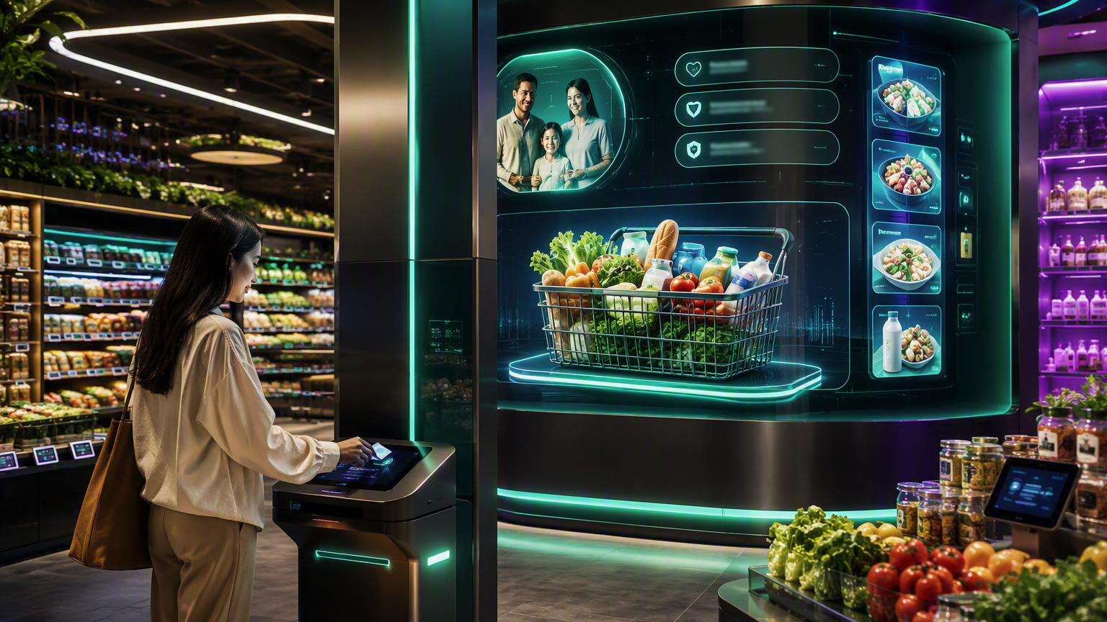
NutriVerse
Computer Vision +
Dynamic Pricing User Story
A grocery experience where the store sees shelf conditions, understands household context, and proposes the right action with human approval.
HOUSEHOLD INTELLIGENCE × STORE INTELLIGENCE
Notes:
[Sources]
- Concept and user-story details were developed from the user-provided NutriVerse requirements.
- Visual on this slide was generated with Microsoft Copilot.
[/Sources]

Slide 2
Hero user story
The scenario combines a known household, shelf computer vision, product interaction, inventory, and an approved price action.
As a returning grocery member,
I want the store to recognize products I may need and show relevant, available options when I interact with the shelf,
so that I can make a faster, informed purchase without searching the entire aisle.
MEMBER CONTEXT
STORE CONTEXT
OUTCOME
The member profile indicates a recurring shampoo purchase pattern. A replenishment reminder was shown before the visit.
Computer vision observes shelf stock and detects that the member lifted a shampoo product. Inventory and electronic shelf-label data are available.
NutriVerse explains relevance, shows an available comparable option, and presents an approved promotional price. The member chooses what to buy.
AI observes and proposes. Pricing rules and accountable humans control the final price action.
Notes:
[Sources]
- Concept and user-story details were developed from the user-provided NutriVerse requirements.
[/Sources]

Slide 3
User journey
The strongest demo is one continuous story, not separate computer-vision and pricing stations.
1
2
3
4
5
6
IDENTIFY
›
ANTICIPATE
›
OBSERVE
›
DECIDE
›
EXPERIENCE
›
CONTINUE
Member taps card or app QR
Replenishment Agent flags shampoo
Computer vision detects shelf and lift event
Pricing Agent evaluates approved conditions
Shelf display shows relevance and options
Member adds item; journey updates
Member-facing promise: “You may be due for shampoo. Your usual item and a comparable promoted option are available today.”
Notes:
[Sources]
- Concept and user-story details were developed from the user-provided NutriVerse requirements.
[/Sources]

Slide 4
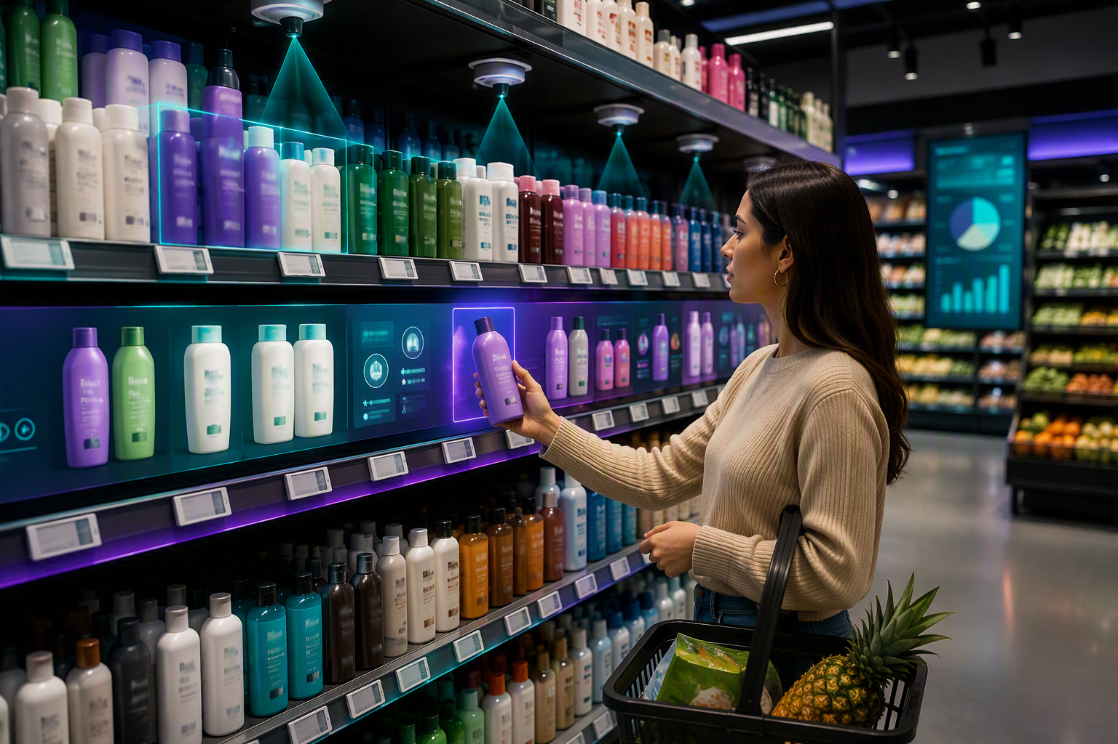
Computer vision story
Computer vision makes the physical shelf observable and responsive. It does not need to identify the member’s face.
WHAT THE CAMERA OBSERVES
Product presence, low-stock conditions, incorrect placement, and a lift-or-return product interaction.
WHAT THE EVENT CREATES
A product interaction event containing product, shelf, store, timestamp, and event type. Member identity comes from the membership session, not the camera.
WHAT HAPPENS NEXT
The Journey Orchestrator combines the event with inventory, member context, approved content, and pricing rules to produce the shelf response.
Notes:
[Sources]
- Concept and user-story details were developed from the user-provided NutriVerse requirements.
- Visual on this slide was generated with Microsoft Copilot.
[/Sources]

Slide 5

Dynamic pricing story
The MVP should demonstrate controlled price proposals and electronic label updates, not autonomous individualized pricing.
INPUT SIGNALS
Inventory level • shelf stock • expiry or waste risk • approved promotion • demand signal • margin floor • store policy
PRICING AGENT
Evaluates whether an approved pricing rule applies and produces a proposed price, reason, effective window, and affected store or product.
APPROVAL AND EXECUTION
An authorized person or policy gate approves the action. The pricing service updates the electronic shelf label and NutriVerse records the audit trail.
Notes:
[Sources]
- Concept and user-story details were developed from the user-provided NutriVerse requirements.
- Visual on this slide was generated with Microsoft Copilot.
[/Sources]

Slide 6
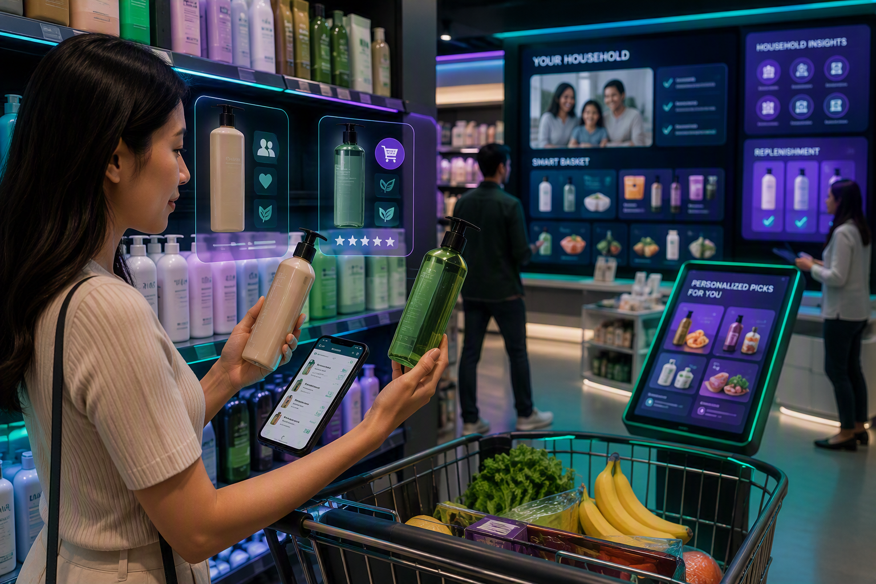
The shelf response
Lift & Learn becomes more powerful when household relevance and store conditions appear together.
WHY THIS PRODUCT APPEARS
Possible replenishment based on the member’s usual purchase interval.
WHAT THE STORE KNOWS
The usual product and a comparable alternative are currently available.
WHAT CHANGED
An approved promotion applies to the comparable option for a defined period.
MEMBER CONTROL
Add usual item • choose alternative • remind later • update frequency
Notes:
[Sources]
- Concept and user-story details were developed from the user-provided NutriVerse requirements.
- Visual on this slide was generated with Microsoft Copilot.
[/Sources]

Slide 7
AI agent and system flow
Bounded agents collaborate through the Journey Orchestrator; deterministic services execute the final actions.
COMPONENT
ROLE
OUTPUT
Household Insight Agent
Loads consented household and purchase context
Household summary
Replenishment Agent
Estimates whether shampoo may be due
Replenishment candidate + reason
Computer Vision Service
Detects shelf state and lift / return event
Product interaction event
Inventory Service
Returns store and shelf availability
Availability state
Pricing Agent
Evaluates approved pricing rules
Price proposal + explanation
Journey Orchestrator
Combines member, shelf, inventory and offer context
Experience instruction
Shelf Experience Service
Renders content and choices
Digital rail / display response
Basket Intelligence Agent
Updates basket after member action
Basket and continuation
Experience Intelligence Agent
Analyzes acceptance, swaps and corrections
Improvement insight
Notes:
[Sources]
- Concept and user-story details were developed from the user-provided NutriVerse requirements.
[/Sources]

Slide 8
MVP acceptance criteria
The demo is successful when the customer story, store action, and safety controls all work together.
MEMBER CONTEXT
REPLENISHMENT
Given a known demo member, the experience loads an approved household profile and sample purchase history.
When the expected interval is reached, the system presents shampoo as a possible need and shows the evidence used.
COMPUTER VISION
STORE CONTEXT
When the product is lifted, a product interaction event is generated without using facial identification.
The experience retrieves current demo availability and the active electronic-label price.
PRICING CONTROL
PERSONALIZED RESPONSE
A price change occurs only when an approved rule or authorized approval is present.
The shelf display shows the usual item, a comparable option, rationale, price, and member choices.
MEMBER CONTROL
AUDITABILITY
The member can add, decline, defer, or correct the replenishment frequency.
The system records the shelf event, pricing reason, approval, member action, and basket update.
Notes:
[Sources]
- Concept and user-story details were developed from the user-provided NutriVerse requirements.
[/Sources]

Slide 9
Guardrails for the demo
Dynamic pricing and computer vision should improve operations and relevance without becoming invasive or unfair.
NO FACIAL IDENTIFICATION
NO SENSITIVE INFERENCE
Use membership tap, login, or QR for identity. The camera observes product and shelf events.
Do not infer health conditions or protected characteristics from video or purchasing patterns.
NO SECRET PERSONAL PRICE
HUMAN / POLICY APPROVAL
The MVP price action applies to a defined product, store, promotion, or period, not an opaque price unique to a person.
Respect margin floors, promotion rules, and approval gates before updating the electronic label.
EXPLAINABILITY
MEMBER CONTROL
Show why replenishment and pricing messages appeared.
Allow the member to decline, defer, correct, and edit preferences.
AUDIT TRAIL
SAFE FALLBACK
Record model or rule inputs, proposals, approvals, shelf-label update, and member action.
If video, inventory, pricing, or profile data is unavailable, show standard product information and current verified price.
Notes:
[Sources]
- Concept and user-story details were developed from the user-provided NutriVerse requirements.
[/Sources]

Slide 10
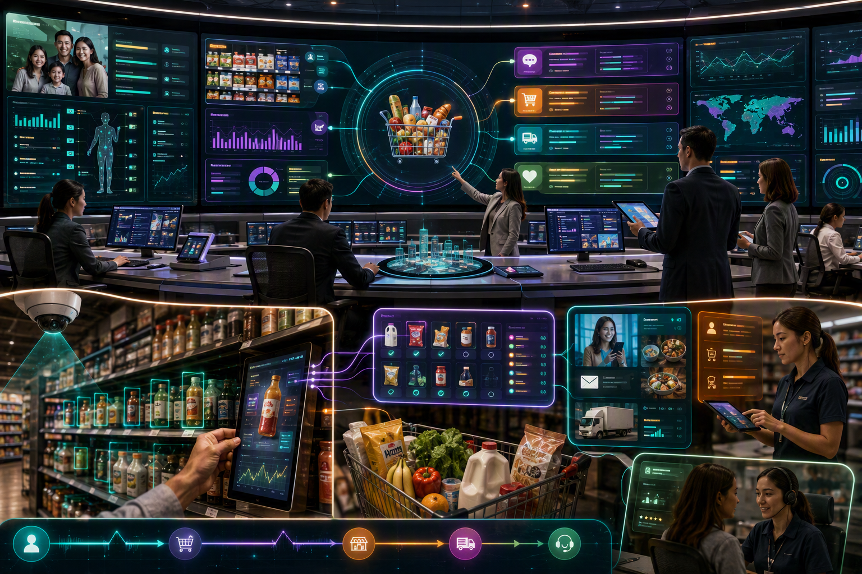
NutriVerse user story at a glance
The innovation is the connection between household intelligence and real-time store intelligence.
HOUSEHOLD INTELLIGENCE
Who the member shops for, what is regularly purchased, and what may be relevant now.
STORE INTELLIGENCE
Shelf state, product interaction, inventory, promotions, and current verified price.
EXPERIENCE INTELLIGENCE
The next relevant, explainable action across shelf, basket, marketing, sales, and service.
SEE → UNDERSTAND → PROPOSE → APPROVE → EXPERIENCE → LEARN
Notes:
[Sources]
- Concept and user-story details were developed from the user-provided NutriVerse requirements.
- Visual on this slide was generated with Microsoft Copilot.
[/Sources]

