Slide 1

Team Hot Wheels
Sharara Hossain
Sangeetha Mydam
Devnath Reddy Motati

Slide 2
Reinforcement Learning for Autonomous Vehicles
With AWS DeepRacer

Slide 3
Objectives
Build a reinforcement learning model for self-driving cars
Deploy the model on AWS DeepRacer virtual simulator
Train and fine-tune the model for optimal performance
Compete in a virtual circuit race

Slide 4
Approach
Model training: AWS DeepRacer, AWS SageMaker
Hyperparameter tuning: AWS SageMaker
Deployment: AWS SageMaker, DeepRacer virtual simulator, DeepRacer league
Model Storage: AWS S3
Monitoring: AWS CloudWatch

Slide 5
Evaluation Methodology
Reward Graph displaying model performance over time
AWS DeepRacer virtual simulator test
League leaderboard

Slide 6
Deliverables
Reinforcement Learning model
SageMaker notebook
Video demo
Project presentation

Slide 7
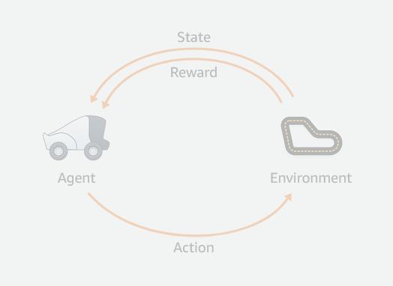
Reinforcement learning
Reinforcement learning (RL) is a type of machine learning, in which an agent explores an environment to learn how to perform desired tasks by taking actions with good outcomes and avoiding actions with bad outcomes.
A reinforcement learning model will learn from its experience and over time will be able to identify which actions lead to the best rewards.
From the AWS DeepRacer Guide

Slide 8
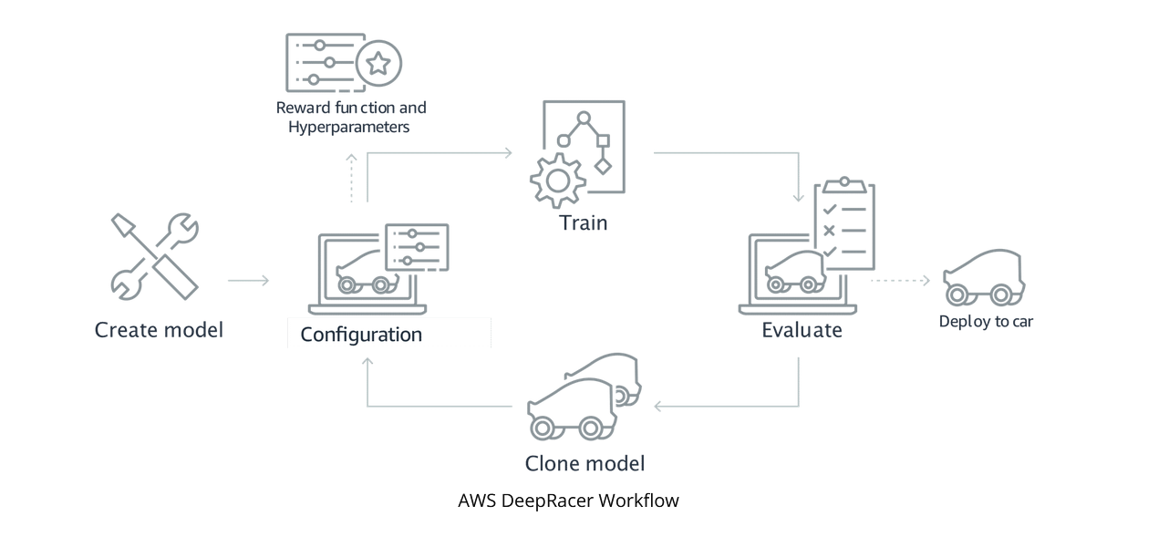

Slide 9
Hyperparameters
Exploitation makes use of given information, while exploitation can find undiscovered high reward paths. The hyperparameter associated with exploration is entropy. Higher entropy → higher exploration.
Learning Rate determines how fast and how well the model learns from each episode. There is a tradeoff between faster learning and accuracy, a higher learning rate means faster training but a low value can take a long time for better convergence.

Slide 10
Model 1: Iteration 1
Race type: time trial
RL algorithm: PPO (Proximal Policy Optimization)
Gradient Descent Batch Size: 64
Number of Epochs: 10
Learning Rate: 0.0003
Entropy: 0.005
Loss type: Huber
Number of experience episodes between each policy-updating iteration: 20
Discount factor: 0.999

Slide 11
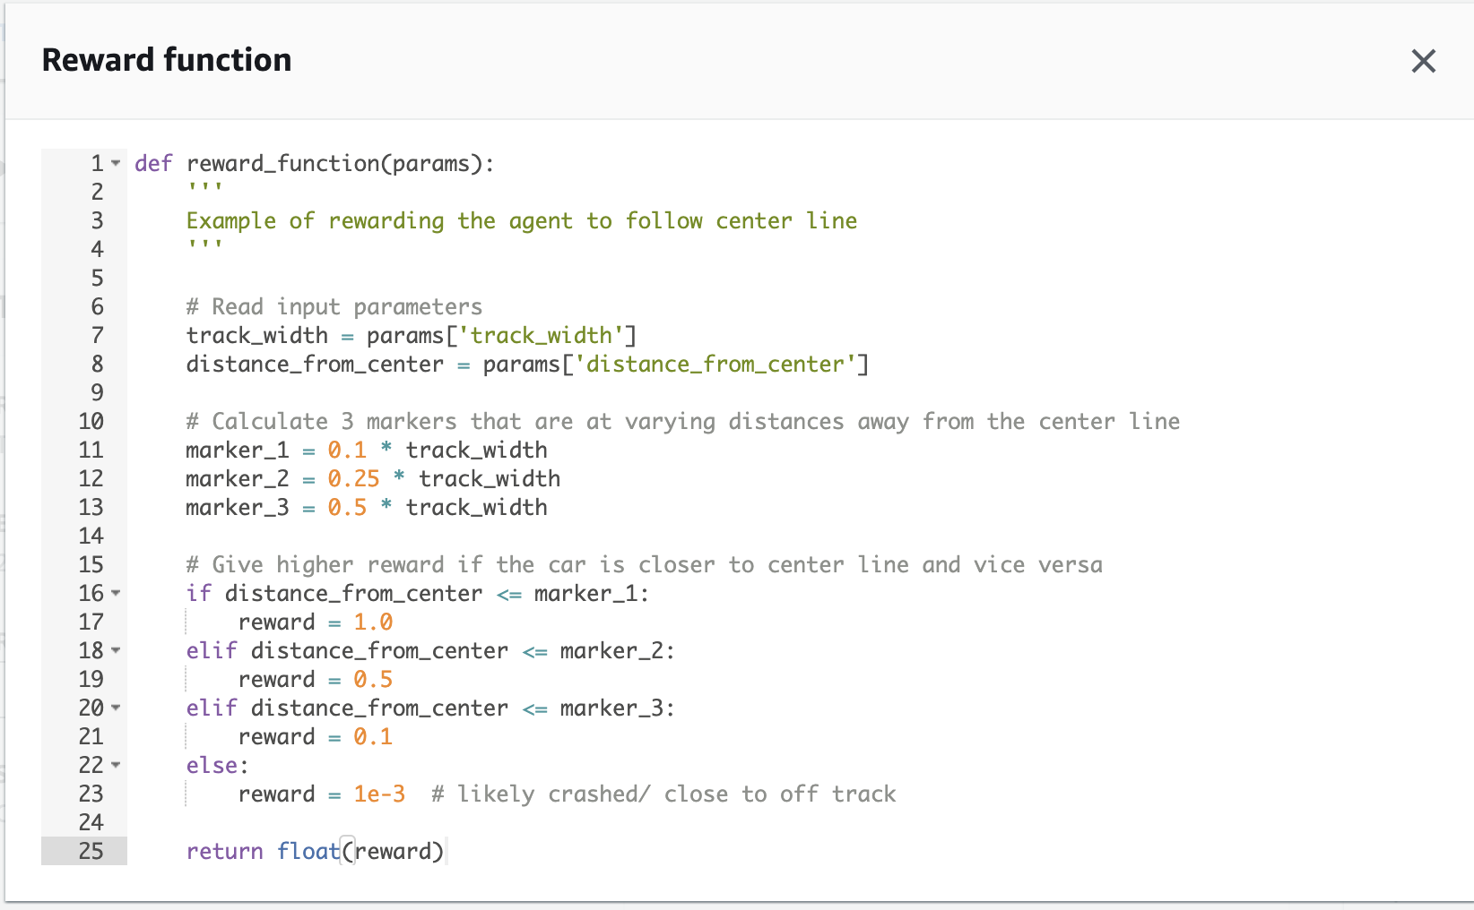

Slide 12
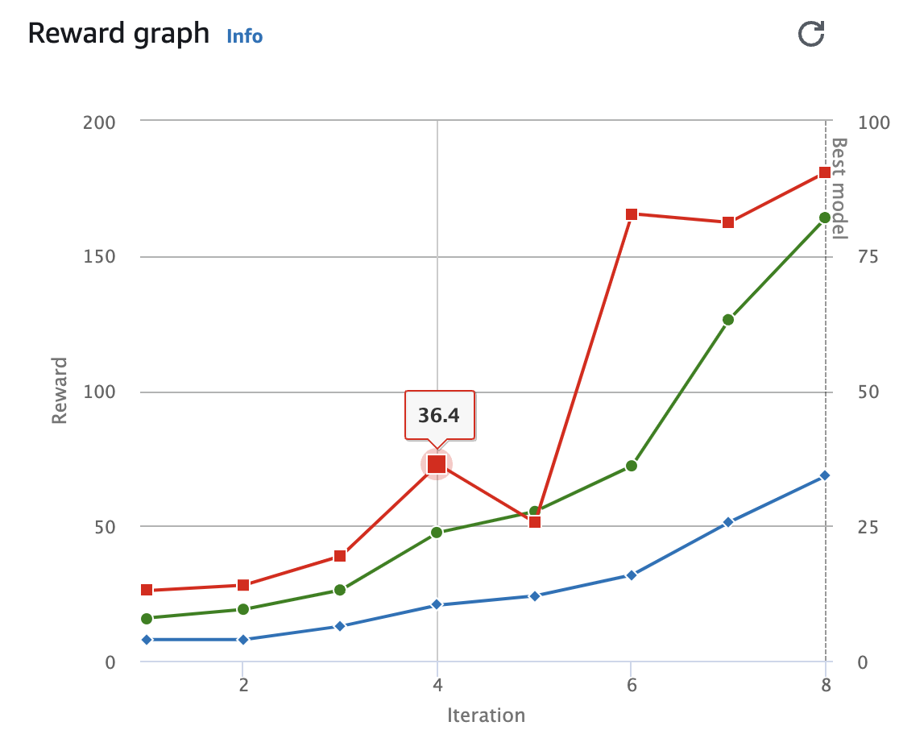
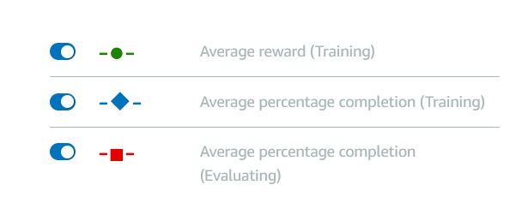

Slide 13
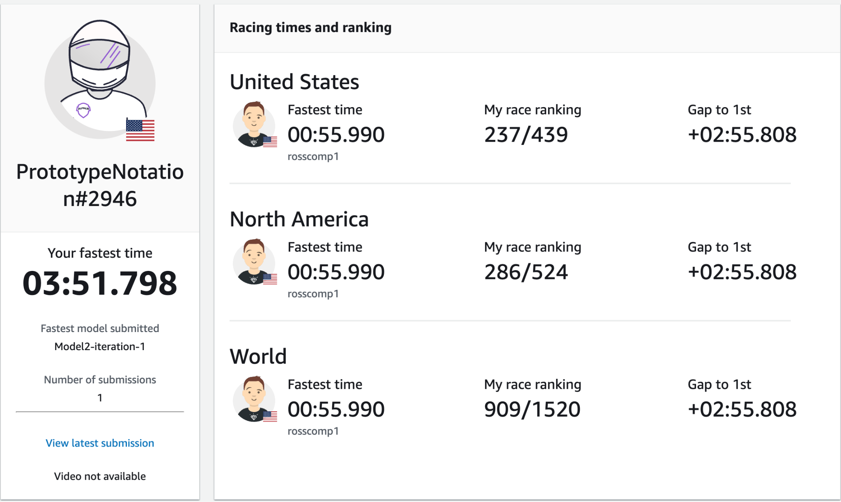

Slide 14
Model 2: Iteration 1
Race type: time trial
RL algorithm: PPO (Proximal Policy Optimization)
Gradient Descent Batch Size: 32
Number of Epochs: 10
Learning Rate: 0.0003
Entropy: 0.01
Loss type: Huber
Number of experience episodes between each policy-updating iteration: 20
Discount factor: 0.999

Slide 15
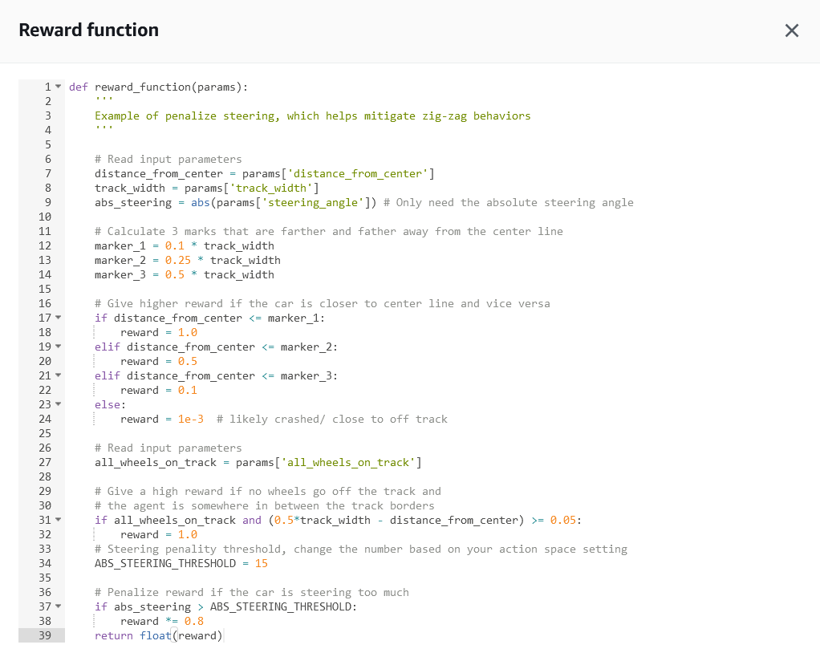

Slide 16
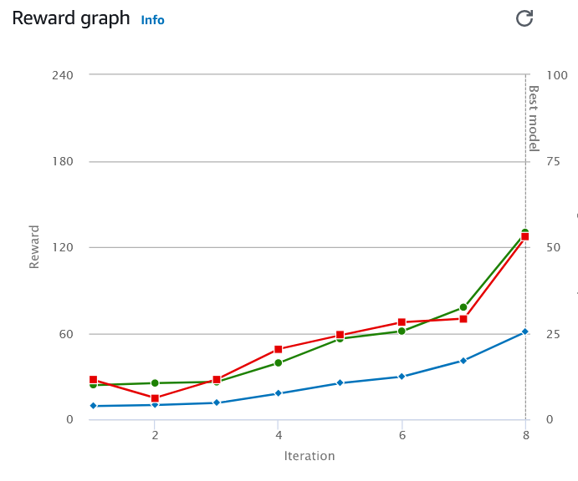

Slide 17
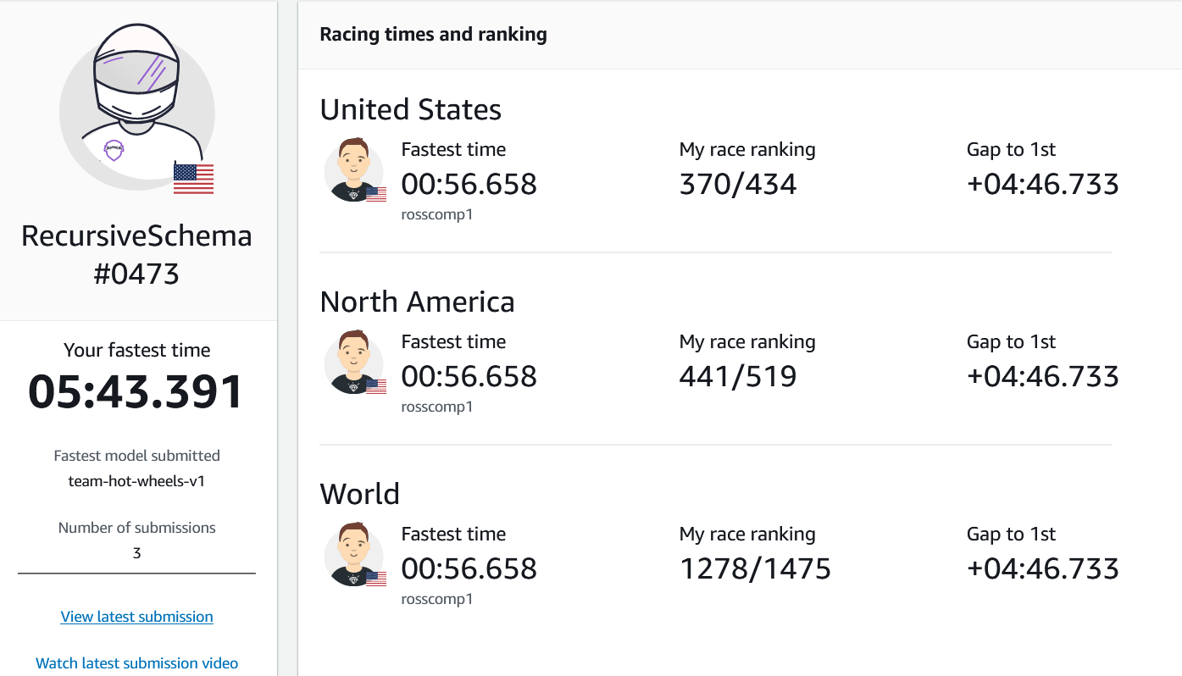

Slide 18
Model 2: Iteration 2
Race type: time trial
RL algorithm: PPO (Proximal Policy Optimization)
Gradient Descent Batch Size: 32
Number of Epochs: 10
Learning Rate: 0.0005
Entropy: 0.045
Loss type: Huber
Number of experience episodes between each policy-updating iteration: 17
Discount factor: 0.999

Slide 19
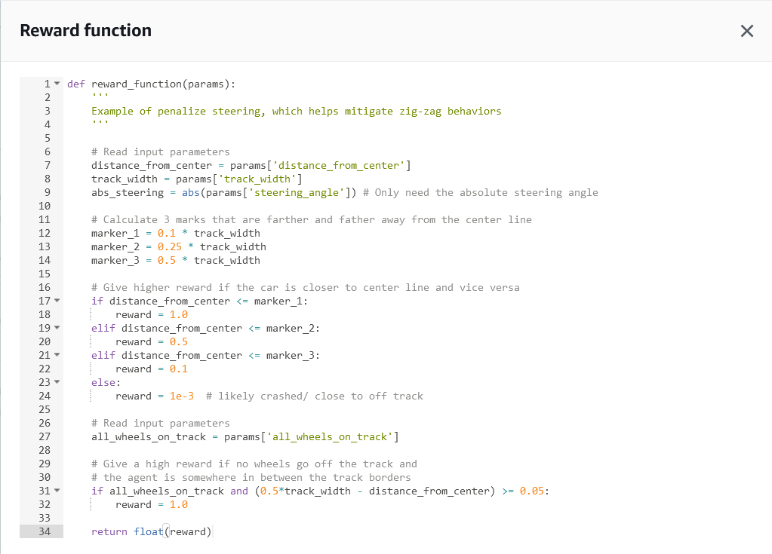

Slide 20
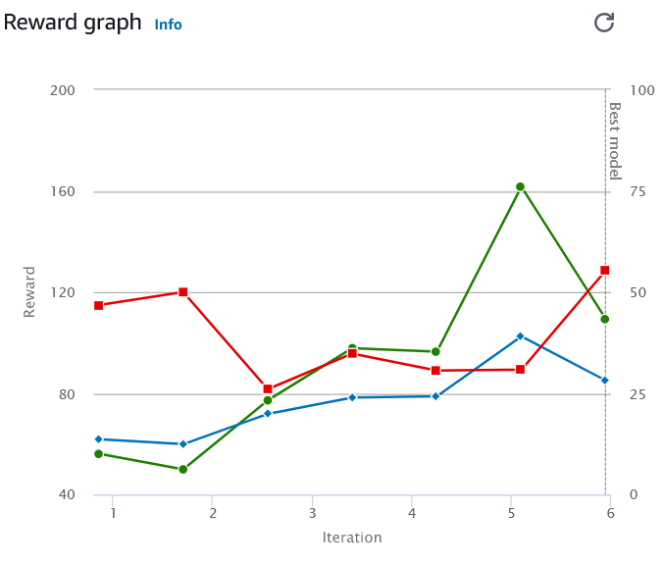

Slide 21
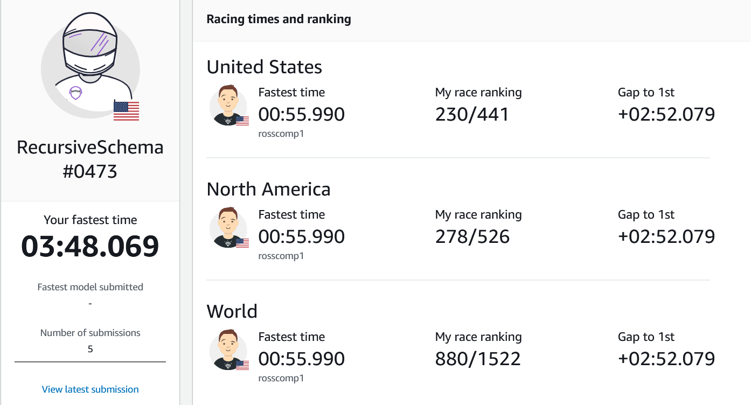

Slide 22
Model 2: Iteration 3
Race type: time trial
RL algorithm: PPO (Proximal Policy Optimization)
Gradient Descent Batch Size: 32
Number of Epochs: 10
Learning Rate: 0.00025
Entropy: 0.035
Loss type: Huber
Number of experience episodes between each policy-updating iteration: 15
Discount factor: 0.999

Slide 23
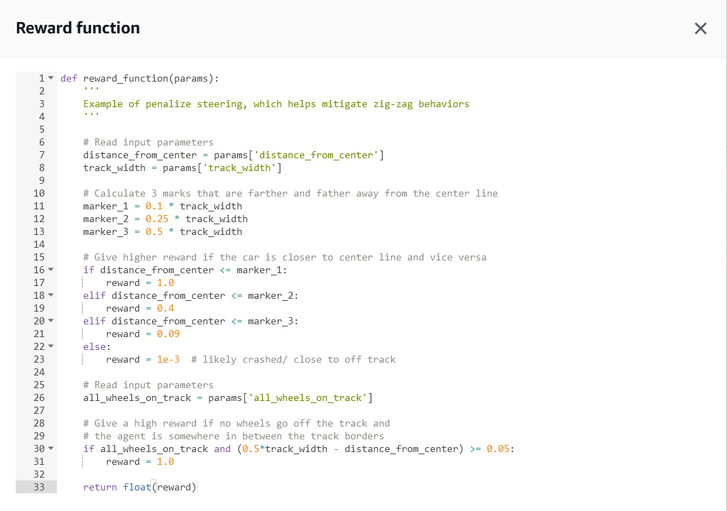

Slide 24
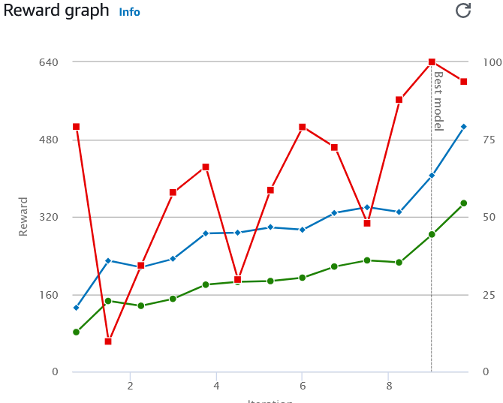

Slide 25
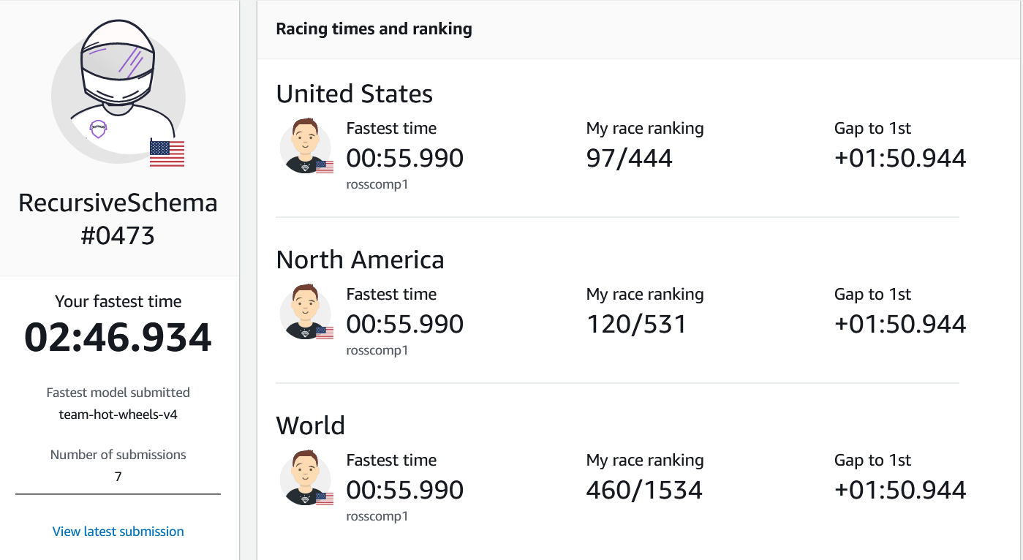

Slide 26
Thank you!

