Slide 1
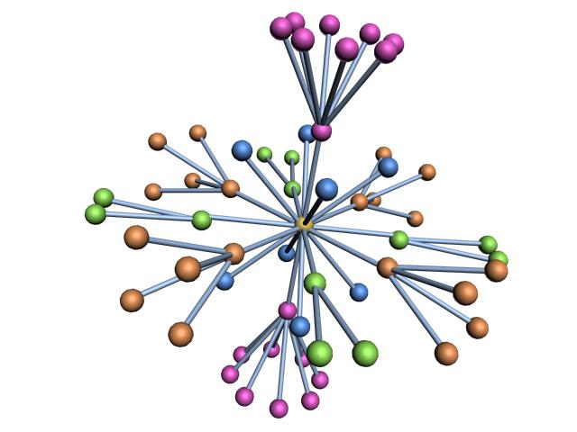
Algorithms for drawing large graphs
Yehuda Koren
The Weizmann Institute of Science

Slide 2
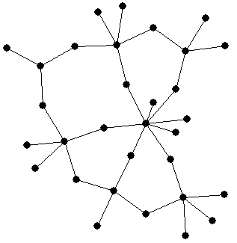
Graphs
A graph consists
nodes and edges
The nodes model entities
The edge set models a binary relationship on the nodes
Edges may be weighted, reflecting similarities/distances between respected nodes

Slide 3
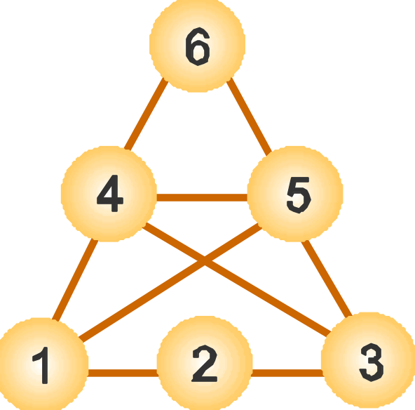
Graph Drawing
Find an aesthetic layout of the graph that clearly conveys its structure
Technically: Assign a location for each node and a route for each edge, so that the resulting drawing is “nice”
V = {1,2,3,4,5,6}
E = {(1,2),(2,3),(1,4),
(1,5),(3,4),(3,5),
(4,5),(4,6),(5,6)}
Graph drawing

Slide 4
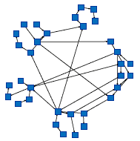
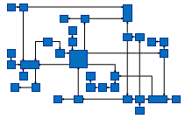

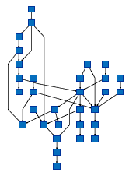
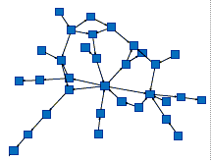
Drawing conventions
Edge oriented
Clustering oriented
Orthogonal
Circular
Hierarchy oriented
Node oriented
Force-Directed
Hierarchical
Pictures from: www.tomsawyer.com
We concentrate on Force-Directed graph drawing
(most general)

Slide 5
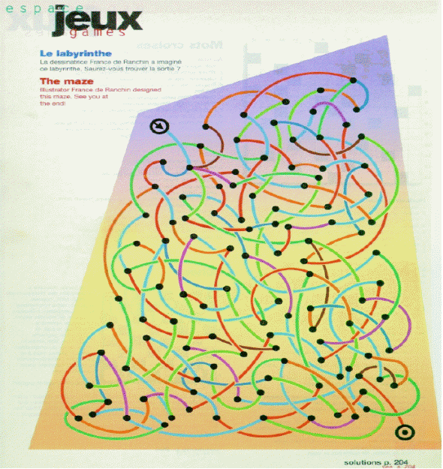
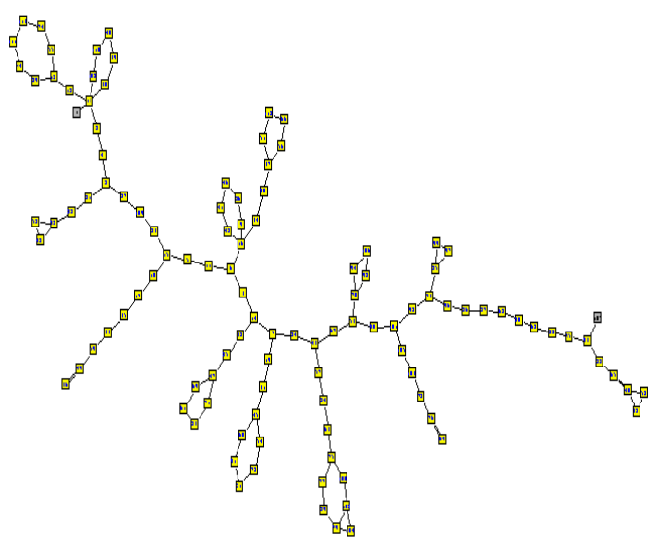
Force-directed graph drawing
The graph drawing problem is ill-defined!
Which layout is nicer?
I have a clear structure!
I am a colorful
maze!
Layout by Tom Sawyer
Energy: 1.77x10³²¹
Energy: 2.23x10⁶
An energy model is associated with the graph layouts
Low energy states correspond to nice layouts
…now we have a well-defined problem

Slide 6
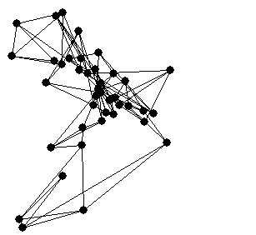
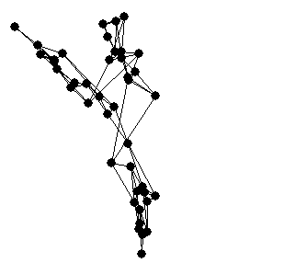
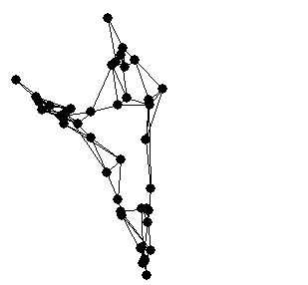
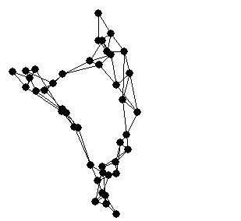
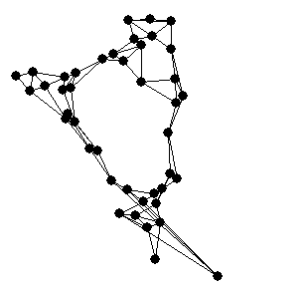
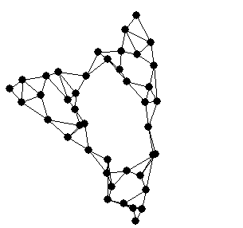
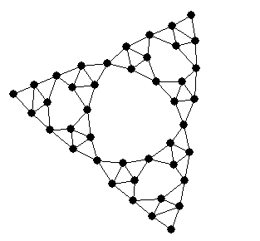
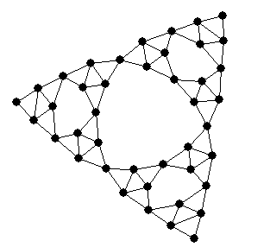
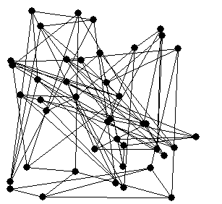
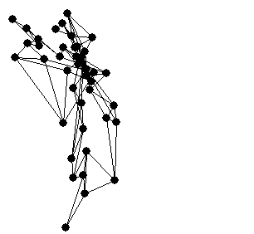
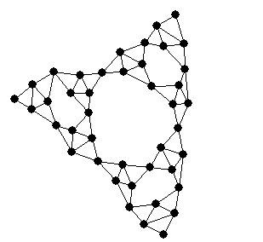
Force-directed graph drawing
Graph drawing = Energy minimization
Hence, the drawing algorithm is an iterative optimization process
Convergence to global minimum is not guaranteed!
Initial (random) layout
Final (nice) layout
Iteration 1:
Iteration 2:
Iteration 3:
Iteration 4:
Iteration 5:
Iteration 6:
Iteration 7:
Iteration 8:
Iteration 9:
Aesthetical properties
Proximity preservation: similar nodes are drawn closely
Symmetry preservation: isomorphic sub-graphs are drawn identically
No external influences: “Let the graph speak for itself”
Energy
Layout

Slide 7
Example of F.D. method: Spring Embedder
[Eades84, Fruchterman-Reingold91]
Replace edges with springs (zero rest length) ---
attractive forces
Replace vertices with electrically charged particles, repelling each other --- repulsive forces
Start with a random placement of the vertices, then just let the system go…

Slide 8
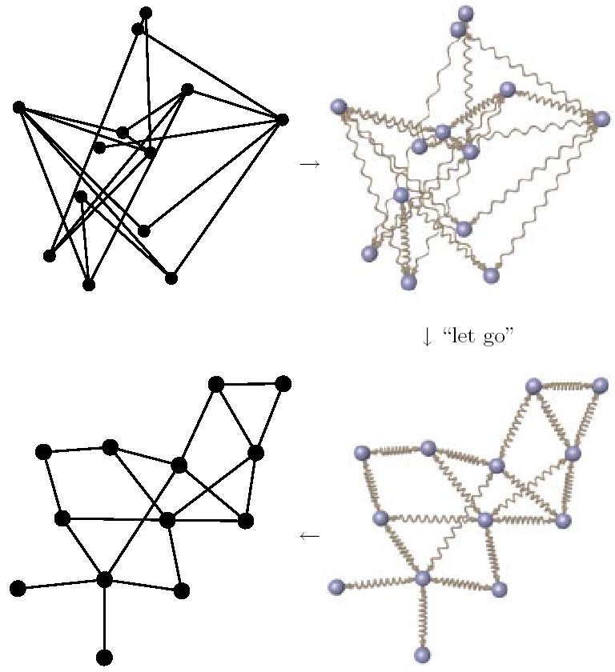
[Kaufmann and Wagner, 2001]
“let go”

Slide 9
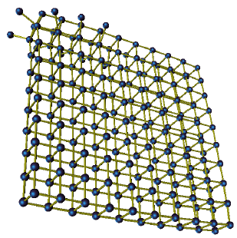
Force directed methods in 3-D
Drawing by Aaron Quigley

Slide 10
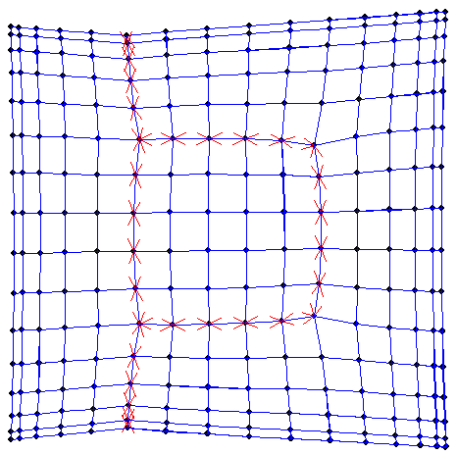
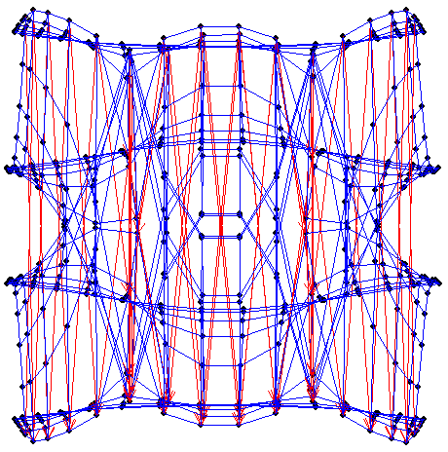
Should I show hierarchy?
ACE
[Carmel,Harel,Koren’02]

Slide 11
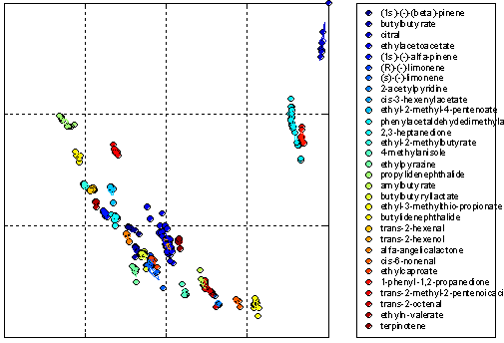
Sometimes drawing edges is not important…
Visualization of odorous chemicals (300 measurements)
(by ACE)
Preservation of the clustering decomposition
Outlier detection

Slide 12
Outline of this talk
Force directed methods and large graphs
Multi-scale acceleration of force directed methods
Hall’s graph drawing method
(a particular force-directed method)
ACE: a multi-scale acceleration of Hall’s method
High dimensional embedding: a new approach to graph drawing
Examples and comparison
Hall
High Embedding
Force directed
Multi-scale
ACE
10⁰
10¹
10²
10³
10⁴
10⁵
10⁶
No. of nodes drawn in a minute

Slide 13
Scaling with large graphs
Traditional force-directed methods are limited to a few hundred nodes
Problems when drawing large graphs:
  Visualization issue: not enough drawing area
    Cures: dynamic navigation, clustering, fish-eye view, hyperbolic space,…
  Algorithmic issue: convergence to a nice layout is too slow
We concentrate on the algorithmic issue, i.e., the computational complexity (mainly time).

Slide 14
Force-directed methods: complexity
Complexity per single iteration is O(n²)
  Energy contains at least one term for each node pair (repulsive forces)
Estimated number of iterations to convergence is O(n)
Overall time complexity is ~ O(n³)
Force directed methods do not scale up well to large graphs!
A particularly interesting approach:
Multi-scale graph drawing
  [Hadany-Harel 99, Harel-Koren 00]
  also: [Walshaw 00, Gajer-Goodrich-Kobourov 00]

Slide 15
Multi-Scale Graph Aesthetics
A graph should be “nice” on all scales
Large scale aesthetics refer to phenomena related to large areas of the picture, disregarding its micro structure
Local aesthetics are limited to small areas of the drawing

Slide 16
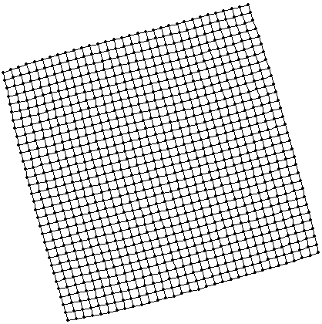
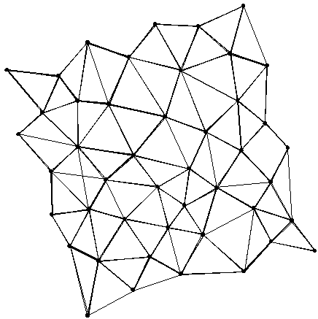
Globally nice layout
Globally nice layout: vertices are allowed to deviate from their location in a nice layout only by a limited amount – express large scale aesthetics
A globally nice layout can be generated from a nice layout by putting closely drawn vertices at the same location, thus coarsening the graph
A globally nice layout,
or, maybe,
a nice layout of coarse graph
??
Both!!!
A nice layout

Slide 17
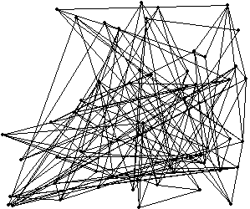
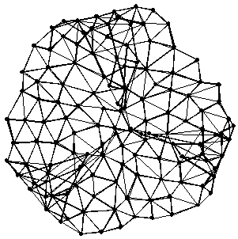
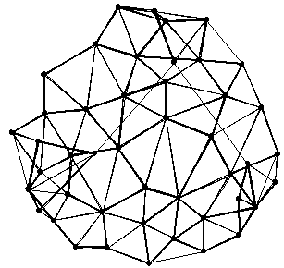
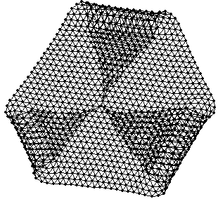
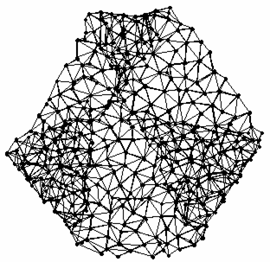
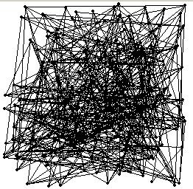

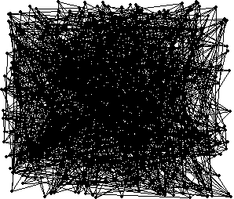
Multi scale graph drawing
Multi-scale representation of the graph: a series of coarse graphs that approximate the original graph
Layout of a coarser graph is used as an initial layout for the finer graph
Gain no. 1: Convergence within few iterations (<<O(n))
Global characteristics of the drawing were already determined in coarser graphs
Only local refinement is needed
We neglect long distance forces
➔ Gain no. 2: fast execution of a single iteration (<<O(n²))
coarsen
coarsen
coarsen
1275 nodes
425 nodes
145 nodes
50 nodes
extend
extend
extend

Slide 18
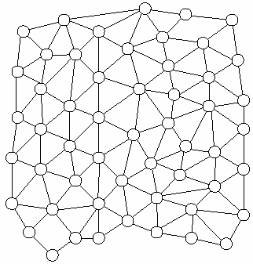
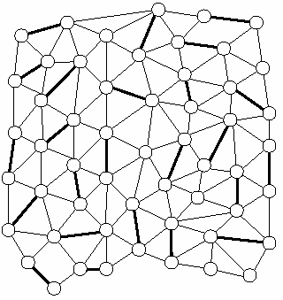
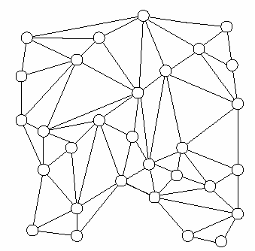
Coarsening
Goal: reduce size of the graph while keeping its crucial structure
Several possibilities in practice…
A candidate is:
Edge contraction
Choose edges to contract
Fine graph
Contract edges
Coarse graph

Slide 19
Properties of multi-scale F.D. graph drawing
Running times are significantly improved:
  10⁴-node graphs are drawn in a around 1 minute
Ability to converge to true global minimum is improved
Convergence to global minimum is still not guaranteed

Slide 20
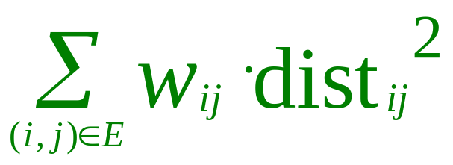
Hall’s model [K.M. Hall, 1970]
The optimal layout minimizes:
Euclidean distance between i and j
(Weighted sum of squared edge lengths)
Weight of edge (i,j)
➔Heavier edges are shorter
Subject to the constraints:
  Variance of the drawing is fixed – a global repulsive force
  All axes have equal variance
  Axes of the drawing are uncorrelated
Balanced aspect ratio
Complexity of Hall’s energy is linear (O(|E|)), compared with quadratic complexity (O(n²)) of traditional models

Slide 21
Advantages of Hall’s model
Linear time for a single iteration of optimization process
The global optimizer can be efficiently computed!
Hall’s model facilitates a rigorous multi-scale process
We need to define the Laplacian…

Slide 22

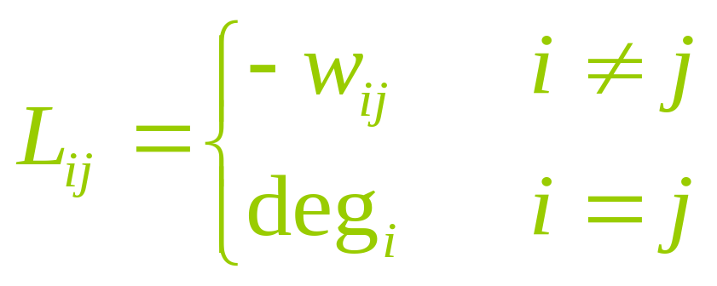
Laplacian
Given a weighted graph with n nodes, with the w_{ij} being the weights
The Laplacian of the graph is the matrix L, where:

Slide 23
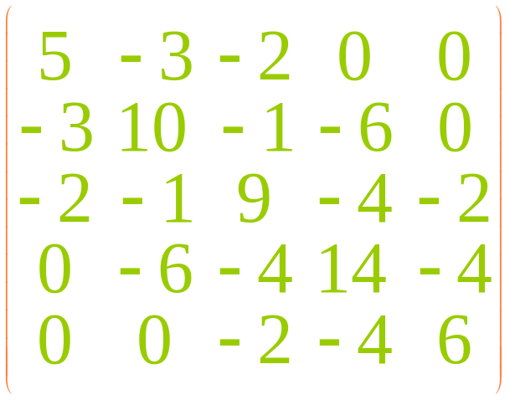
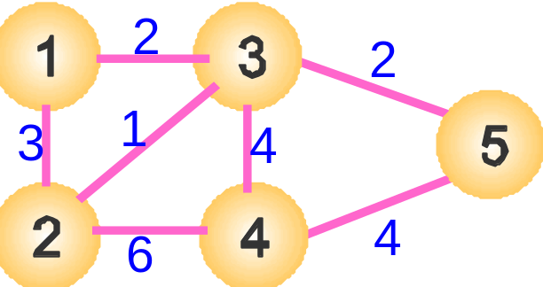
Laplacian
Properties of the Laplacian:
A symmetric matrix
Sum of each row is 0
All eigenvalues are non-negative
Zero eigenvalue with associated eigenvector (1,1,…,1)

Slide 24
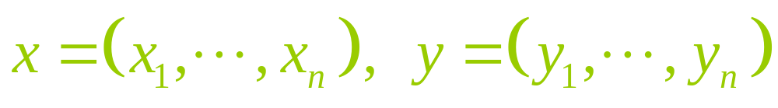


Optimizer of Hall’s model
For simplicity we assume a 2-D drawing
The coordinates of node i, (x_{i} ,y_{i} ), are determined by two vectors:
Claim
The optimal layout of Hall’s model satisfies:
  is the eigenvector of the Laplacian with the smallest positive eigenvalue
  is the eigenvector of the Laplacian with the second smallest positive eigenvalue
To draw the graph, we have to compute low eigenvectors of the Laplacian

Slide 25
The ACE Algorithm
(joint work with L. Carmel and D. Harel)
Regular eigen-solvers encounter real difficulties with 10⁵-node graphs
We propose a multi scale algorithm for computing low eigenvectors of the Laplacian:
ACE – Algebraic Multigrid Computation of Eigenvectors
Two orders of magnitude improvement over past multi-scale / force-directed methods

Slide 26
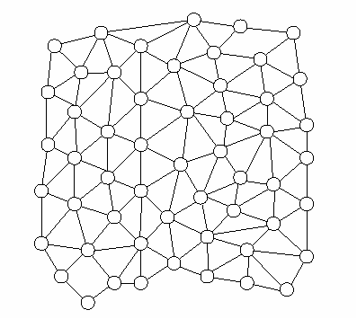
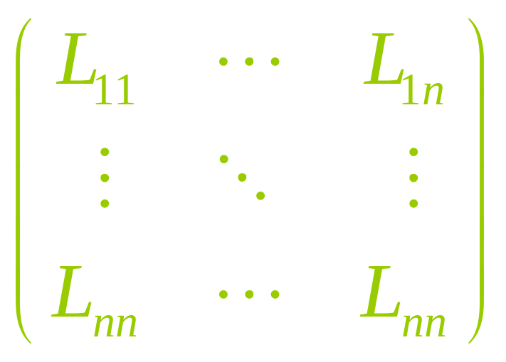
ACE algorithm
Input: A graph with n nodes
The graph is represented by its Laplacian, L
If n is small enough:
compute the low eigenvectors of L directly
Otherwise…

Slide 27
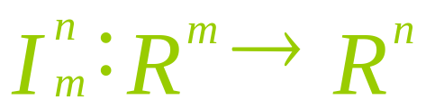

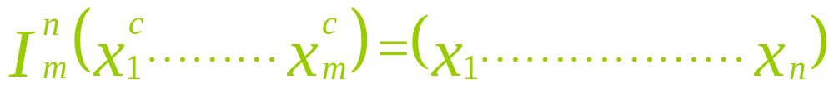
ACE algorithm
Input: A graph with n nodes
Construct an interpolation operator:
What is this ??
The interpolation operator is a way to derive a drawing of n nodes from a drawing of m nodes (m<n)
Coarse drawing
Fine drawing

Slide 28
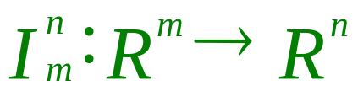
ACE algorithm
Input: A graph with n nodes
Construct an interpolation operator:
Create coarse graph of m nodes
  Typically, m = n / 2
  More details later…

Slide 29
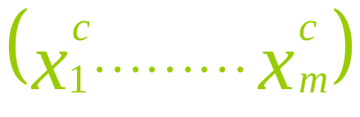
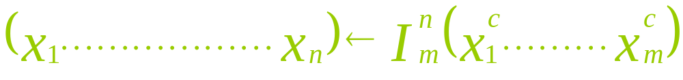
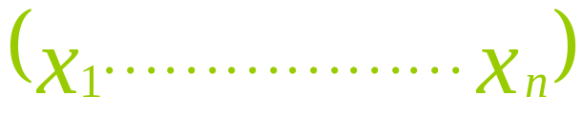
ACE algorithm
Input: A graph with n nodes
Construct an interpolation operator:
Create coarse graph of m nodes
Recursively, build layout of the coarse graph:
Interpolate, yielding a layout of the fine graph:
Final drawing is: Refine
Smart initialization
Refine using iterative solvers (Power-Iteration, RQI) that benefit from the smart initialization

Slide 30



How to coarsen
The key component is the interpolation operator
High quality
interpolation operator
Criteria for choosing interpolation operator:
Interpolated drawings of high quality
Fast interpolation
In practice, interpolation operator is an matrix

Slide 31
How to coarsen
same costs
optimal interpolated solution
optimal coarse solution
Important requirement:
cost of coarse drawing = cost of its interpolated fine drawing
Solution of coarse problem is the optimal drawing in a subspace of fine problem
Achieved using a careful construction of coarse graph
In practice, coarse graph is constructed using the interpolation operator, matrix multiplication and a “mass matrix”

Slide 32
Aesthetical properties of results
Quality of results depends on the appropriateness of Hall's model
Hall's model is distinguished by its simple form and also by its convergence to a global minimum
  For many graphs, traditional force directed methods will provide better drawings (e.g., trees)
  Preservation of global structure
  Excellent expression of symmetries

Slide 33


Results (4elt, |V | = 15606, |E| = 45878)
Each node is placed around the weighted center of its neighbors
Dense areas
ACE
Multi-scale f.d.

Slide 34


Results (Dwa512, |V | = 512, |E| = 1004)
Shows the clustering structure of the drawing
Symmetry preservation
ACE
Multi-scale f.d.

Slide 35
Guidelines for multi-scale graph drawing
Define formally what is a nice graph
  Spring embedder, MDS, Hall,…
Choose an optimization method
  Gradient descent, Gauss-Seidel, Simulated annealing
Construct a method for coarsening and interpolation
Optimize layout on multi scales

Slide 36
A new approach:
Graph Drawing by
High-Dimensional Embedding
(Joint work with D. Harel)

Slide 37
A New Approach to Graph-Drawing
First stage: Embed the graph in a very high dimension (e.g., 50-D).
Utilize the flexibility of the high dimension to simplify the layout creation
Second stage: Project the graph onto the 2-D plane using PCA, a well known mathematical process

Slide 38
Advantages
Running time is linear in the graph size.
In practice, comparable to ACE.
No iterative optimization process; insensitive to “initial placement”
Simple implementation
Side effect: provides excellent means for interactive exploration of large graphs
10⁵-node graphs are drawn in 2-3 sec
10⁶-node graphs are drawn in < 1 min

Slide 39
First Stage:
Embedding the Graph in a High Dimension

Slide 40


Choose m pivot nodes, uniformly distributed on the graph:
Here, m=50, (this is a typical number, independent of |V|)
33x33 grid (1089 nodes)

Slide 41
How to Choose m Pivots “Uniformly” ?
Choose first pivot, p₁ , at random
The i –th pivot, p_{i} , is the node furthest a way from the already chosen pivots:
{p₁, p₂, … , p_{i-1}}
This is a known 2-approximation to the k- Center problem

Slide 42
The m Dimensional Drawing
Draw the graph in m dimensions by associating each axis with a pivot node
Axis i shows the graph from the “viewpoint” of p_{i} , the i –th pivot node
The i-th axis:
0
1
2
3
d
node p_{i}
p_{i}’s neighbors
nodes whose graph-theoretic distance from p_{i} is d
Thus, the i –th coordinate of node v is the graph-theoretic distance between v and p_{i}

Slide 43
Projecting Onto a Low Dimension
Second Stage:

Slide 44
Principal Components Analysis (PCA)
A fast and straightforward procedure taken from multivariate analysis
Data is projected in a way that maximizes its variance ➔ minimize information loss
Very useful for finding the “best viewpoint” for projecting the drawing

Slide 45


Demonstration of PCA
First Principal Component

Slide 46



Results (Crack, |V | = 10240, |E| = 30380)
High Dim. Embedding
Multi-scale f.d.
ACE

Slide 47


Zooming-in on Regions of Interest
Change viewpoint for exploring local regions, by performing PCA on selected portion of the graph
Reveal new properties that are hidden in the full drawing!!

Slide 48
 | Multi-scale force-directed | ACE | High Dimensional Embedding
Running time in practice | 10⁴ nodes/minute | 10⁶ nodes/minute | 10⁶ nodes/minute
Time complexity | Convergence depends on graph’s structure |  | O(|V|+|E|)
Drawing quality | High
Drawing robustness | May converge to poor local min | Optimal | Optimal up to randomization
High dimensionality |  |  | Essentially same running time
Zoom-in |  |  | Available
Symmetry | Good | Excellent | Good
Aspect ratio | No guarantee | Essentially balanced | Good
Trees | Difficult | Impossible | Impossible
Moderate
Increases running time
Not available
No winner!!

Slide 49
The End

