Slide 1

NutriCoach
Building an AI nutrition coach
Plans, food logging, summaries, and resilient AI

Slide 2

OVERVIEW
Executive summary
The complete story in three ideas.
PURPOSE
BUILD
RESULT
Personal meal plans
with practical food logging.
Flask + SQLite
Gemini + local-first data.
Useful summaries
even when AI is unavailable.

Slide 3


PRODUCT
What the app does
A simple loop for everyday nutrition
INPUT
OUTPUT
Profile
Goals and restrictions
Recent progress
Actual food eaten
Four-meal daily plan
Nutrition estimates
Daily, weekly, monthly summaries

Slide 4
BUILD
Technology stack
Small components with clear responsibilities
APP
DATA
AI
Python
Flask
Jinja templates
SQLite
Local profile
Meal and weight history
Gemini REST
JSON Schema
Google Search grounding

Slide 5

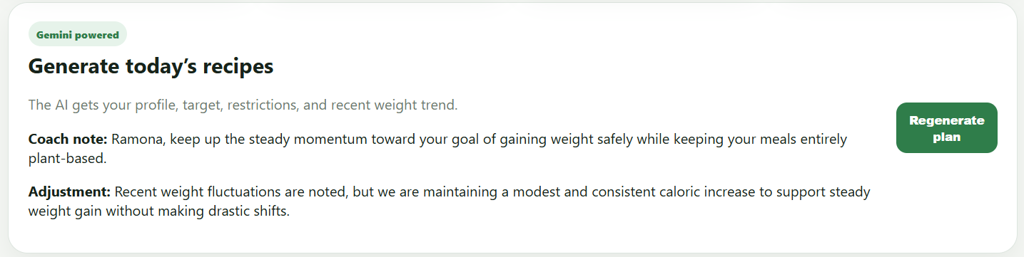
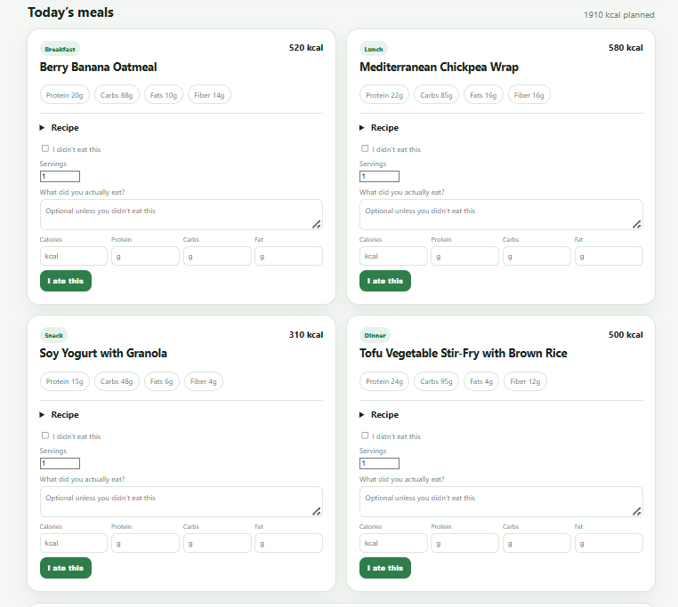

AI DESIGN
How Gemini is used
DAILY PLAN
FREE-TEXT FOOD
DAILY PLAN
Profile + targets + restrictions
→ four meals
→ coach note

Slide 6
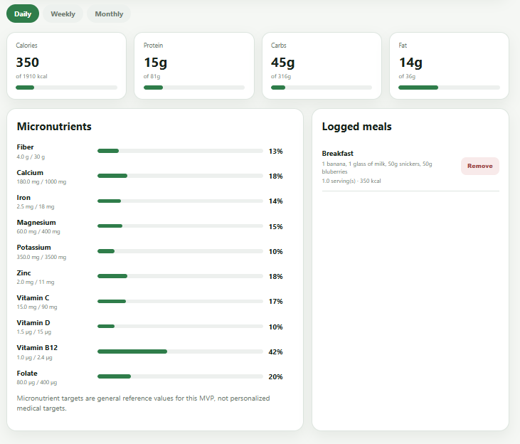

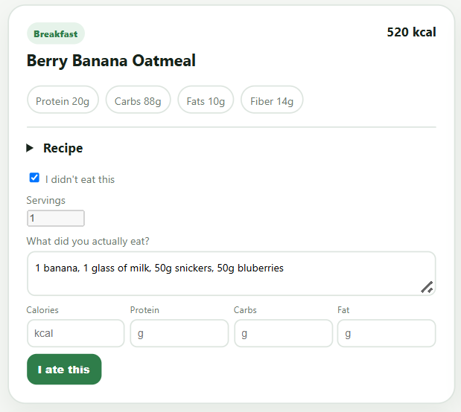
AI DESIGN
How Gemini is used
FREE-TEXT FOOD
User description
→ product lookup
→ nutrition estimate

Slide 7

ITERATION
Main issues
The problems that shaped the solution
AI INTEGRATION
APP BEHAVIOR
OpenAI to Ollama to Gemini migration
Missing environment variables
Model unavailable to new users
Unsupported JSON Schema fields
Old coach note after profile update
Remove button used the wrong ID
Summary needed multiple time ranges
Gemini Search returned HTTP 429

Slide 8
RESILIENCE
How we fixed them
Errors became product improvements
CONFIGURATION
DATA AND STATE
FAIL-SAFE AI
Gemini REST
Configurable model
Automatic .env loading
Clear old plans
Use log_id
Local SQLite history
Structured JSON
Search grounding
Fallback values on failure

Slide 9
TRUST
Privacy
What stays local and what is sent to Gemini
LOCAL
API REQUEST
Profile and preferences
Logged meals
Plans and weight history
Local database
Only generation inputs are sent
The key stays in .env
Database and secrets stay out of Git

Slide 10



ROADMAP
Next steps
From MVP to a more accurate product
ACCURACY
EXPERIENCE
PRODUCTION
Trusted nutrition database
Verified product labels
Source tracking
Charts
Exports
Tests
Authentication
Encrypted sync

