Slide 1
Web Fundamentals

Slide 2
How it work
How it Works
The Internet works because open standards allow every network to connect to every other network.
This is what makes it possible for anyone to create content, offer services, and sell products without requiring permission from a central authority.
It levels the playing field for everyone and it’s the reason why we have a rich diversity of applications and services that many of us enjoy today.

Slide 3
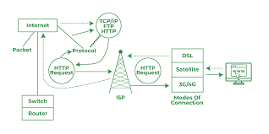
The internet works

Slide 4
Who’s in charge of the Internet?
No one is, but everyone is.
Unlike the telephone network, which for years in most countries, was run by a single company, the global Internet consists of tens of thousands of interconnected networks run by service providers, individual companies, universities, governments, and others.

Slide 5
What’s the infrastructure of the Internet like?
The Internet is that it’s a network of networks that needs to operate around the world as if it were one.
Like policy, the technical coordination of the Internet has common characteristics:
Open,
Independent,
Run by non-profit membership organizations that work together to meet the needs everyone.
This self-regulation has been the key to the successful growth of the Internet and is flexible enough to adapt to changing future needs.
Read about the technical aspects of the Internet.

