Slide 1
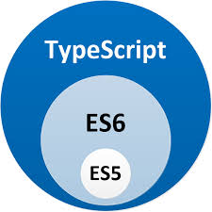
Application Delivery Fundamentals
Parameswari Ettiappan

Slide 2
Typescript
Goals
Types
Values
Namespaces
Simple Combinations: One name, multiple meanings
Built-in Combinations
User Combinations
Advanced Combinations

Slide 3
Typescript
strictBindCallApply
Generic object rest variables and parameters
tsconfig.json inheritance via Node.js packages
The new --showConfig flag
Properties declarations on functions
Version selection with typesVersions
Tuples in rest parameters and spread expressions
Rest parameters with tuple types

Slide 4
Typescript
Spread expressions with tuple types
Generic rest parameters
Optional elements in tuple types
New unknown top type

Slide 5
Context
Writing large applications in JavaScript is difficult, not originally designed for large complex applications (mostly a scripting language, with functional programming constructs)
Lacks structuring mechanisms like Class, Module, Interface
TypeScript is a language for application scale JavaScript development.
TypeScript is a typed superset of JavaScript that compiles to plan JavaScript.
TypeScript adds Static Typing and structuring (class, module) to JavaScript.

Slide 6
Fix/Improve JavaScript – different approaches
Through Library and Frameworks
jQuery, AngularJS, Knockout, Ext JS, Bootstrap …. (new libraries are being created and getting popular everyday)
New language that extend/improve language features of JavaScript. Superset of JavaScript. Compiles to JavaScript
Entirely new language with many new features that compile to JavaScript
GWT (Google Web Toolkit), Dart

Slide 7
What is TypeScript
Helps in large scale JavaScript application development.
Adds additional features like Static Type (optional), Class, Module etc (that are not present in JavaScript) to JavaScript
Starts with JavaScript, ends with JavaScript. TypeScipt is JavaScript. Any valid .js file can be renamed .ts and compiled with other TypeScript files.
Runs on Any browser, Any host, Any OS.
Open Source
The compiler is an open source project and released under the Apache 2.0 license.
TypeScript purposefully borrows ideas from EcmaScript 6 (European Computer Manufacturers Association Script) spec – class, module

Slide 8
Bit of History
Version number | Release date | Significant changes
0.8 | October 1, 2012
0.9 | June 18, 2013
1.1 | October 6, 2014 | performance improvements
1.3 | November 12, 2014 | protected modifier, tuple types
1.4 | January 20, 2015 | union types, let and const declarations, template strings, type guards, type aliases
1.5 | July 20, 2015 | ES6 modules, namespace keyword, for..of support, decorators
1.6 | September 16, 2015 | JSX support, intersection types, local type declarations, abstract classes and methods, user-defined type guard functions

Slide 9
Bit of History
1.7 | November 30, 2015 | async and await support,
1.8 | February 22, 2016 | constraints generics, control flow analysis errors, string literal types, allowJs
2.0 | September 22, 2016 | null- and undefined-aware types, control flow based type analysis, discriminated union types, never type, readonly keyword, type of this for functions
2.1 | November 8, 2016 | keyof and lookup types, mapped types, object spread and rest,
2.2 | February 22, 2017 | mix-in classes, object type,
2.3 | April 27, 2017 | async iteration, generic parameter defaults, strict option
2.4 | June 27, 2017 | dynamic import expressions, string enums, improved inference for generics, strict contravariance for callback parameters
2.5 | August 31, 2017 | optional catch clause variables

Slide 10
Bit of History
2.6 | October 31, 2017 | strict function types
2.7 | January 31, 2018 | constant-named properties, fixed length tuples
2.8 | March 27, 2018 | conditional types, improved keyof with intersection types
2.9 | May 14, 2018 | support for symbols and numeric literals in keyof and mapped object types
3.0 | July 30, 2018 | project references, extracting and spreading parameter lists with tuples
3.1 | September 27, 2018 | mappable tuple and array types
3.2 | November 30, 2018 | stricter checking for bind, call, and apply

Slide 11
Features
Optional Static Type Annotation / Static Typing
Additional Features for Functions
Types for function parameters and return type, optional and default parameter, rest parameter, overloading
Class
Field, Property, Method, Constructor, Event, Static methods, Inheritance
Interface
Module
Generics
Declaration Merging
Few other features (Enum) …

Slide 12
TypeScript in 5 minutes
Installing TypeScript
There are two main ways to get the TypeScript tools:
Via npm (the Node.js package manager)
By installing TypeScript’s Visual Studio plugins
> npm install -g typescript

Slide 13

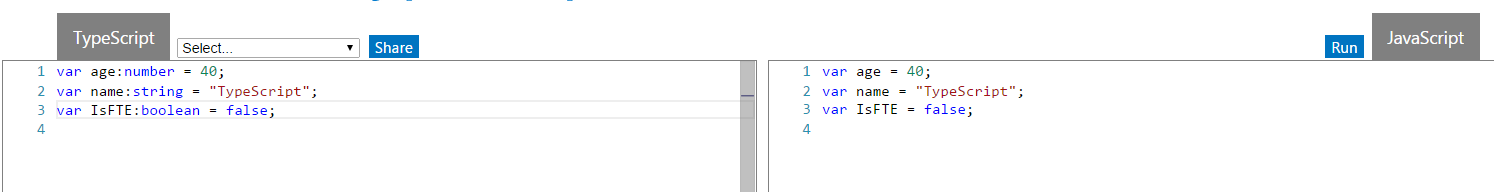

Optional Type Annotation
TypeScript allows annotating variables with types
Purely a design time feature. No additional code is emitted in the final JavaScript that TypeScript compiler produces.
If there’s a type mismatch TypeScript shows a warning.

Slide 14
Types / Optional Type Annotation
Optional Static Types
Any
Primitive
Number
Boolean
String
Void
Null
Undefined -> same as JavaScript “undefined” type
Array
Enum
Object

Slide 15
Datatypes
Does not have separate integer and float/double type
All numbers in TypeScript are floating point values. These floating point numbers get the type 'number'.
var x:number = 55
var y:number = 123.4567
boolean – true/false value
var hasPassport:boolean = true // or false
string - Both single quote or double quote could be used
var msg1 = 'hello from TypeScript'
var msg2 = "hello from TypeScript"
No separate char type
var character = 'a'

Slide 16
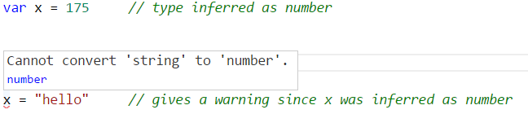

Optional Type Annotation
TypeScript tries to infer type

Slide 17
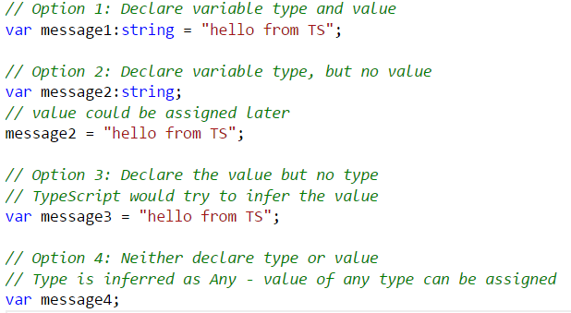
Type Inference
Four ways of variable declaration -
Declare its type and value (as a literal) in one statement.
Declare its type but no value. The value will be set to undefined.
Declare its value but no type. The variable will be of type Any (that is, an old-school dynamic JavaScript variable), but its type may be inferred based on its value.
Declare neither value nor type. The variable will be of type Any, and its value will be undefined.

Slide 18
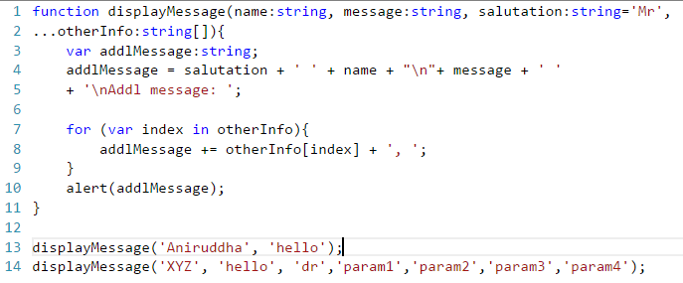
Array
var cities:string[] = ["Berlin","Bangalore","New York"]
var primes:number[] = [1,3,5,7,11,13]
var bools:boolean[] = [true,false,false,true]

Slide 19
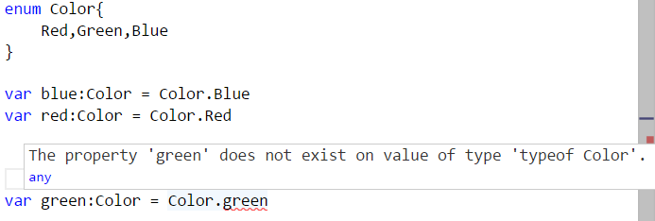
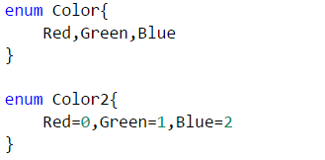
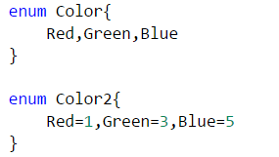
Enum
Addition to JavaScript datatypes. Similar to C# enum
Like languages like C#, an enum is a way of giving more friendly names to sets of numeric values.
By default, enums begin numbering their members starting at 0. You can change this by manually setting the value of one its members.

Slide 20
Any
Useful to describe the type of variables that we may not know when we are writing the application.
May come from dynamic content, eg from the user or 3rd party library.
Allows to opt-out of type-checking and let the values pass through compile-time checks.
Same as not declaring any datatype – uses JavaScript’s dynamic nature
var notSure: any
var list:any[] = [1, true, "free"]
list[1] = 100

Slide 21
Void
Perhaps the opposite in some ways to 'any' is 'void',
the absence of having any type at all.
Commonly used as the return type of functions that do not return a value
function warnUser(): void {
alert("This is my warning message");
}

Slide 22
Function

Slide 23
Function Overview
Functions are the fundamental building block of any applications in JavaScript.
JavaScript is a functional programming language, and so supports first class functions.
Allows build up layers of abstraction, mimicking classes, information hiding, and modules (JavaScript does not support class, module, private members).
In TypeScript, while there are classes and modules, function still play the key role in describing how to 'do' things.
TypeScript adds some new capabilities to the standard JavaScript functions to make them easier to work with.
Type Annotation for parameter and return type
Optional and Default Parameter
Rest Parameter
Function Overloads

Slide 24
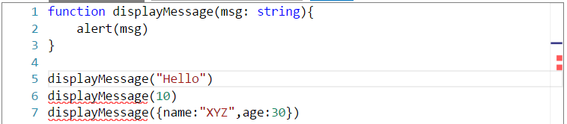
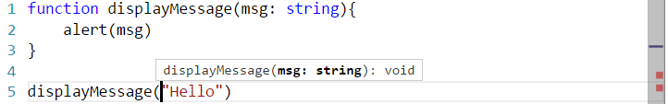
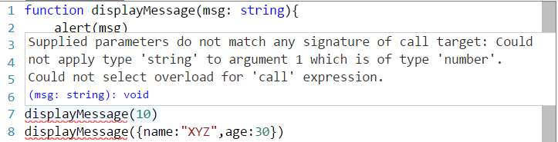
Function
Allows parameter and return type annotation

Slide 25
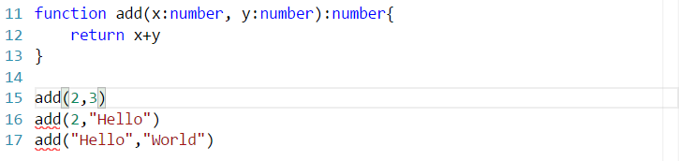
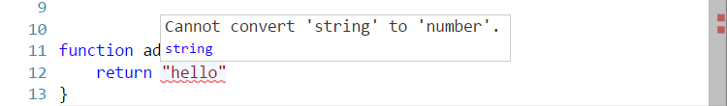

Function (2)
Shows warning for type mismatch

Slide 26
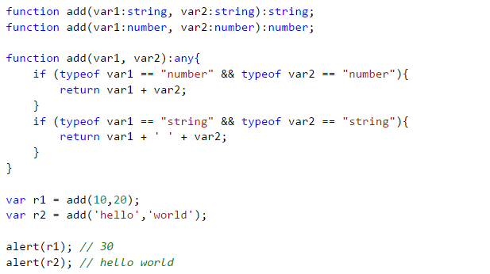
Function Overloads
Allows function overloads

Slide 27
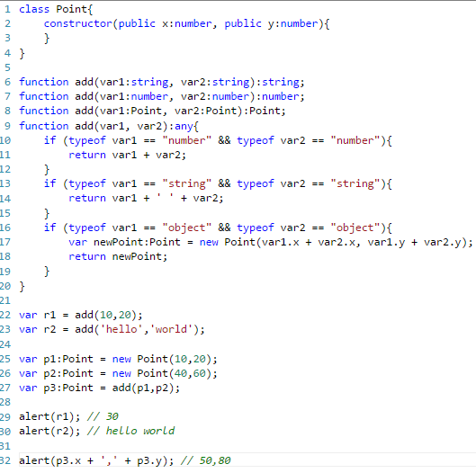
Function Overloads (2)

Slide 28
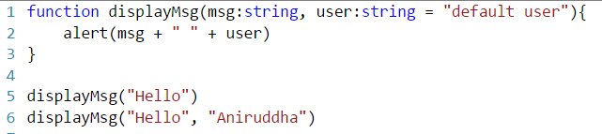
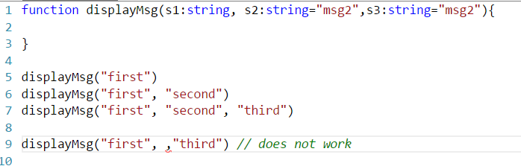
Optional & Default Parameter
Optional Parameters should have default value that would be used if the value is not specified while invoking the function
Should be the last arguments in a function

Slide 29

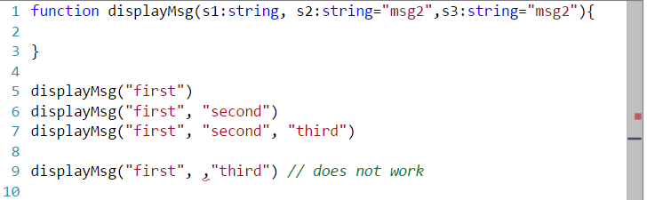

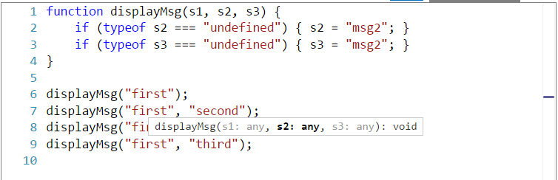
Optional Parameter Implementation
Optional Parameters should have the default value that would be used if the value is not specified while calling the function

Slide 30
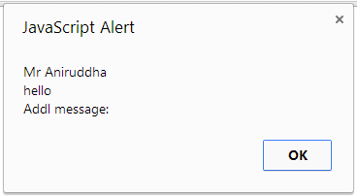
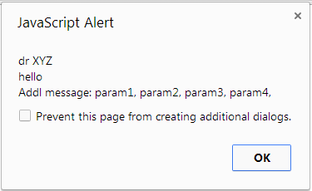
Rest Parameter
Declared as … paramName:[paramType]

Slide 31
Class

Slide 32
Class
Properties and fields to store data
Methods to define behavior
Events to provide interactions between different objects and classes

Slide 33
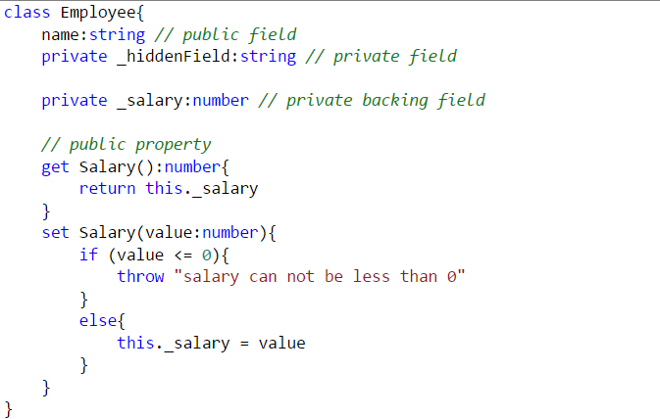
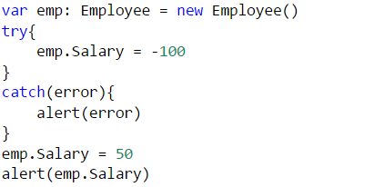
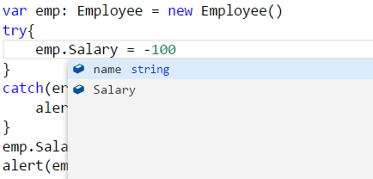
Field and Property

Slide 34
Method and Constructor

Slide 35
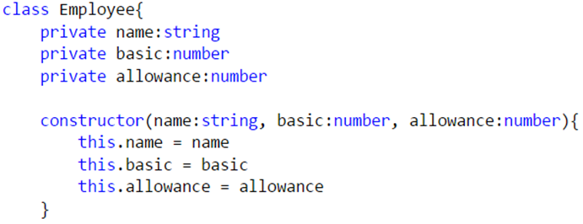
Constructor
Uses constructor keyword
public by default, can not be private

Slide 36
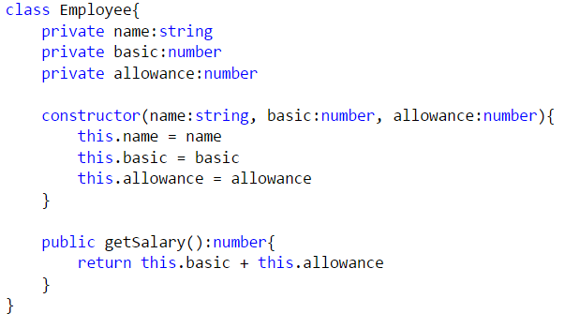
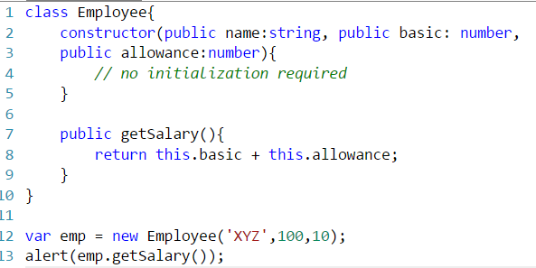
Constructor shortcut

Slide 37
Events

Slide 38
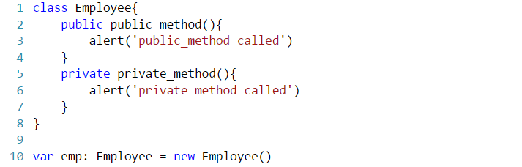
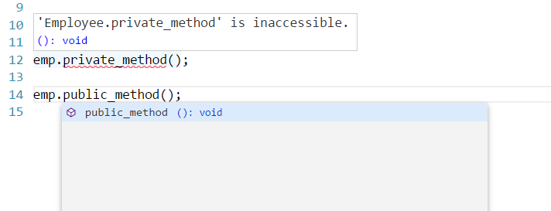
Access Modifiers
public (default) - member is available to all code in another module.
private - member is available only to other code in the same assembly.

Slide 39
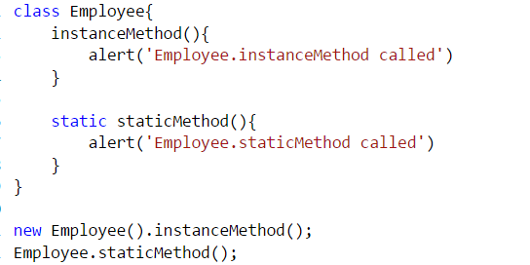
Static Methods
TypeScript supports static members (methods)
static methods are visible on the class itself rather than on the instances

Slide 40
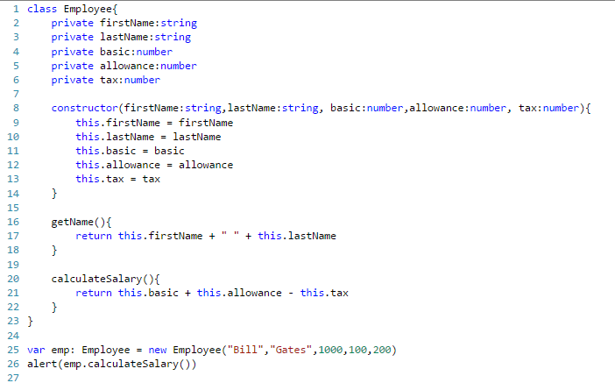
Class

Slide 41
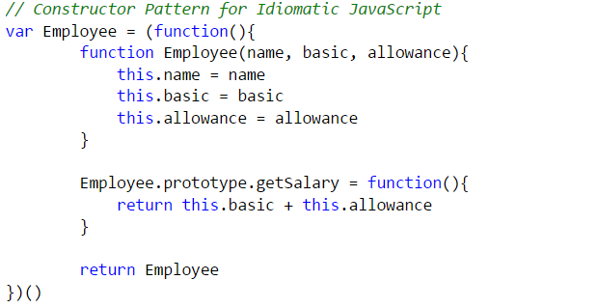

JavaScript Constructor Pattern

Slide 42
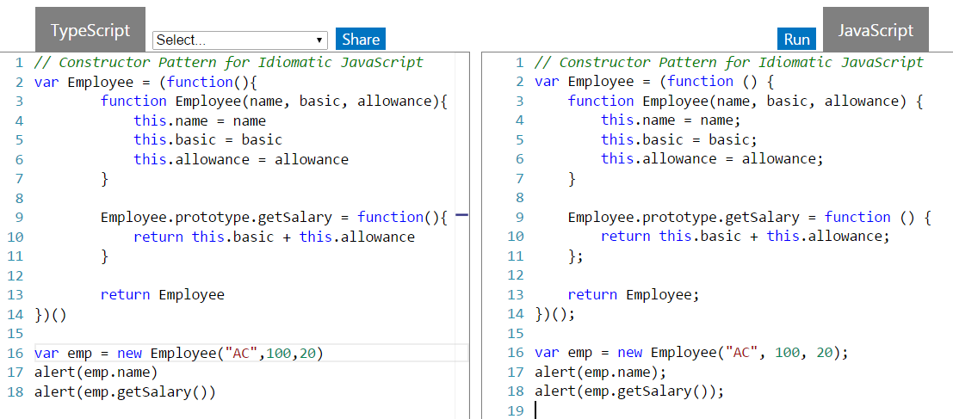
JavaScript Constructor Pattern (2)

Slide 43
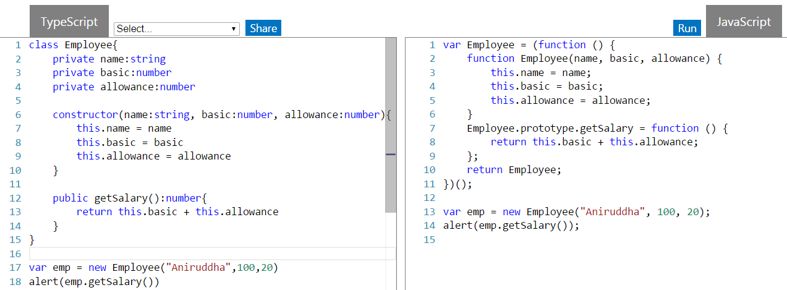
Class – TypeScript uses same Constructor Pattern

Slide 44
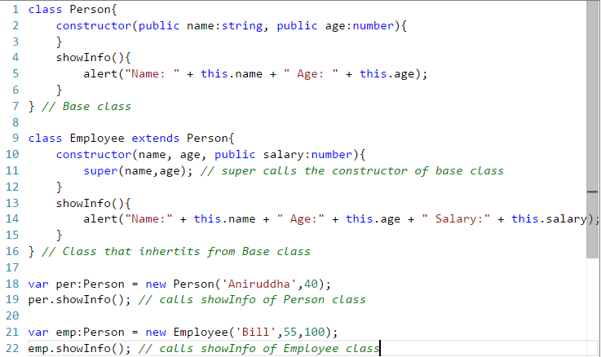
Inheritance
TypeScript supports inheritance of class through extends keyword

Slide 45
Module

Slide 46
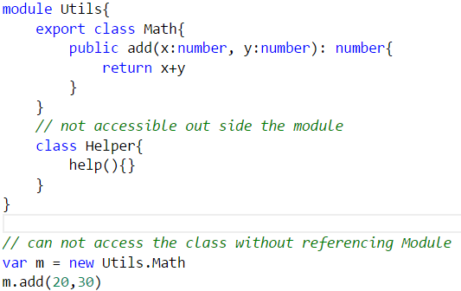
Module
Modules can be defines using module keyword
A module can contain sub module, class, interface or enum. Can not directly contain functions (similar to C#, Java)
Modules can be nested (sub module)
Class, Interfaces can be exposed using export keyword

Slide 47
Interface

Slide 48
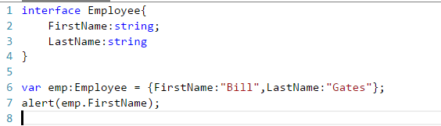
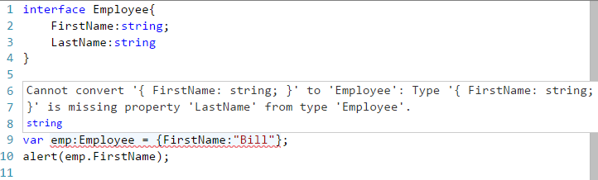
Interface
Declared using interface keyword
Like many other TypeScript feature it’s purely a Design time feature. No additional code is emitted for this!
TS compiler shows error when Interface signature and implementation does not match

Slide 49
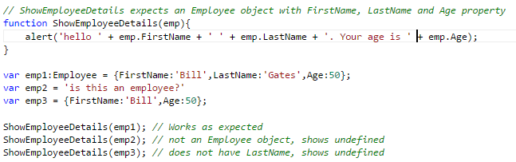
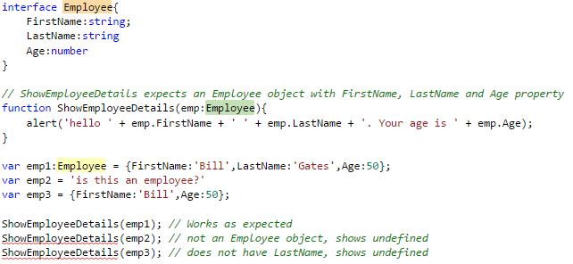
Interface (Cont’d)

Slide 50
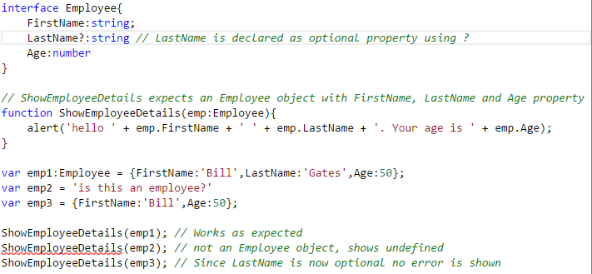
Optional Property
Optional properties can be declared for an interface (using ?)
Optional properties need not be implemented

Slide 51
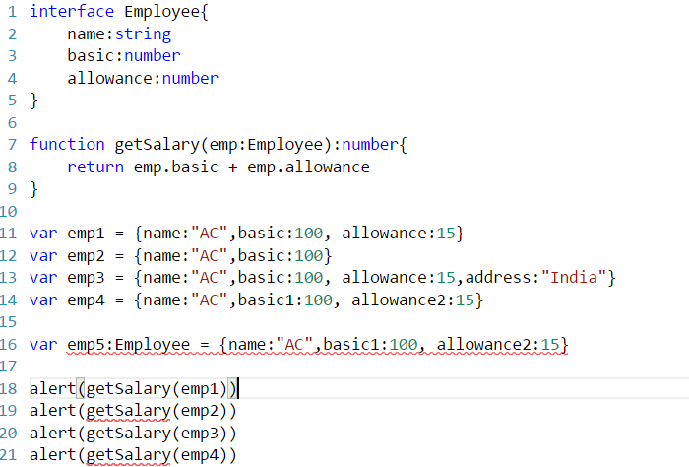
Interface

Slide 52
Mixin

Slide 53
Mixin
In object-oriented programming languages, a mixin is a class which contains a combination of methods from other classes.
Along with traditional OO hierarchies, another popular way of building up classes from reusable components is to build them by combining simpler partial classes – called Mixin
Several languages support Mixin (e.g. Trait in PHP and Scala).
This pattern in popular in JavaScript community, so TypeScript provides language support.

Slide 54
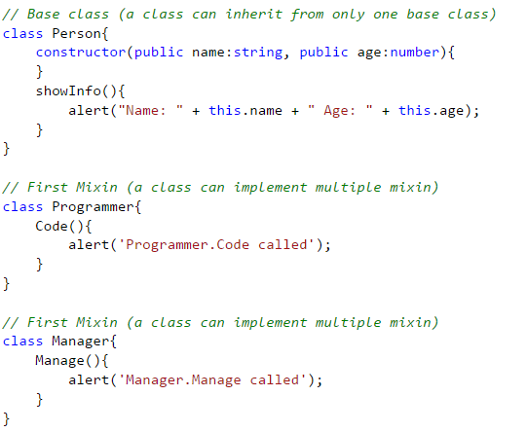
Mixins
Programmer
Manager
Person
Employee

Slide 55
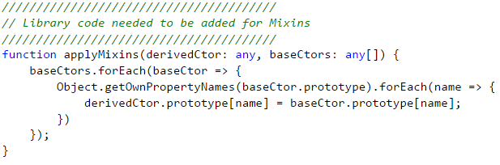
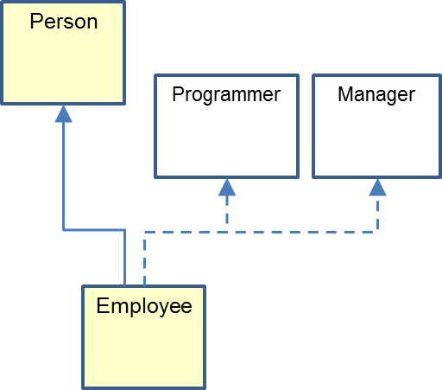
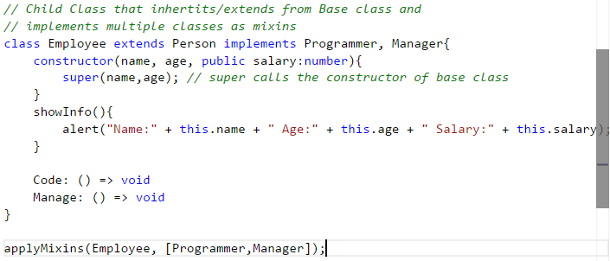
Mixins (Cont’d)

Slide 56
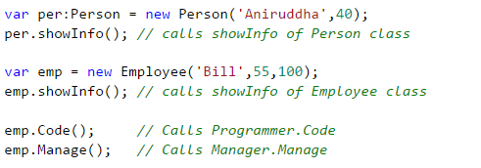
Mixins (Cont’d)

Slide 57
JavaScript gochas (not fixed in TS)
TypeScript does not introduce block scope (JavaScript only supports function scope)
; is still optional in TypeScript also (; is not mandatory in JavaScript and it tries to infer ; and sometime does it differently than expected)
== vs === (and != vs !==)
== checks for value equality only
=== checks for both type and value equality
global variables (variables declared outside of function), implied global (variables declared within function without var keyword)
issues with floating point (.1 + .2 != .3, it’s something like .3000…00004)

Slide 58
Questions

