Slide 1
E-voting App Based on Blockchain
A comprehensive solution for secure electronic voting leveraging blockchain technology. Developed by Nedelcu Mihail Rares, IT&C Security Master program.

Slide 2

Introduction
Secure Platform
Built on Spring Boot microservices architecture with multiple security layers to ensure vote integrity.
Identity Verification
Advanced facial recognition technology to verify voter identity and prevent impersonation.
Blockchain Trust
Immutable record of votes stored on Ethereum blockchain for complete transparency and auditability.

Slide 3





Objective and Problem Description
Identity Verification
Authenticate users with multi-factor systems to prevent impersonation attacks.
Data Security
Protect sensitive voter information and ballot data through encryption and secure storage.
Vote Integrity
Prevent manipulation of cast votes through immutable recording mechanisms.
User Trust
Build public confidence in digital voting through transparency and auditability.

Slide 4
Methods and Technologies Used
Backend Framework
Spring Boot
JWT authentication RESTful APIs
Data Management
PostgreSQL database Redis caching Docker containers
Identity Verification
OpenCV facial recognition
Tesseract OCR
Blockchain Integration
Ethereum network Web3j library
Maven dependency management

Slide 5
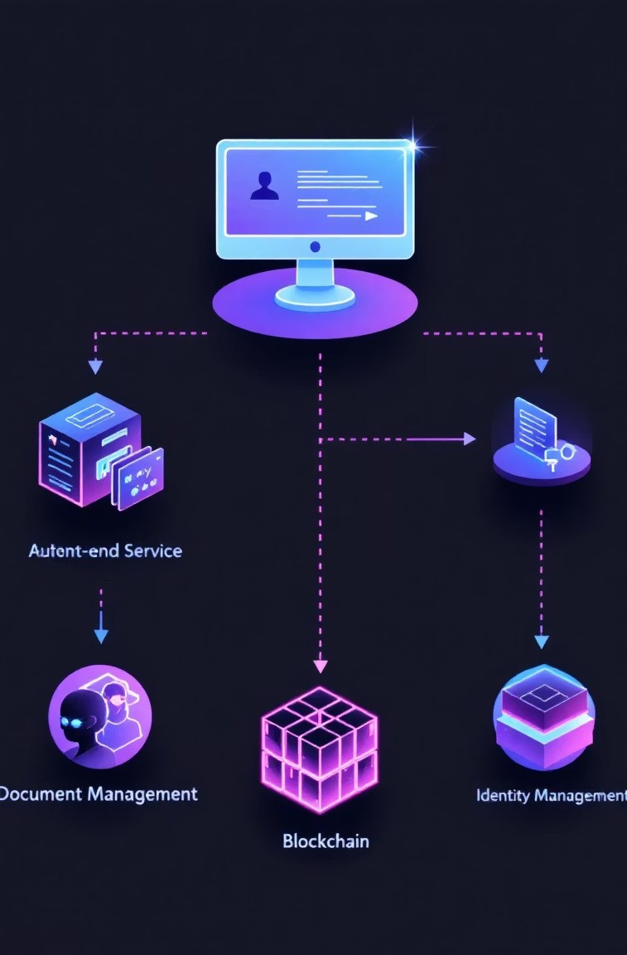






Solution Architecture
Frontend Application
User interface for registration, authentication, and voting operations.
Backend Microservices
Four specialized services handling distinct aspects of the voting system.
Secure Communication
RESTful APIs with JWT authentication between all system components.
Data Storage
Distributed databases and blockchain for different data types.
4

Slide 6








Auth Microservice
Registration
Secure account creation with email
verification step.
Authentication
JWT-based login with Time-based One-Time Password (TOTP) for 2FA.
Audit Logging
Comprehensive activity tracking for
security analysis.
Authorization
Role-based access control for different system functions.

Slide 7
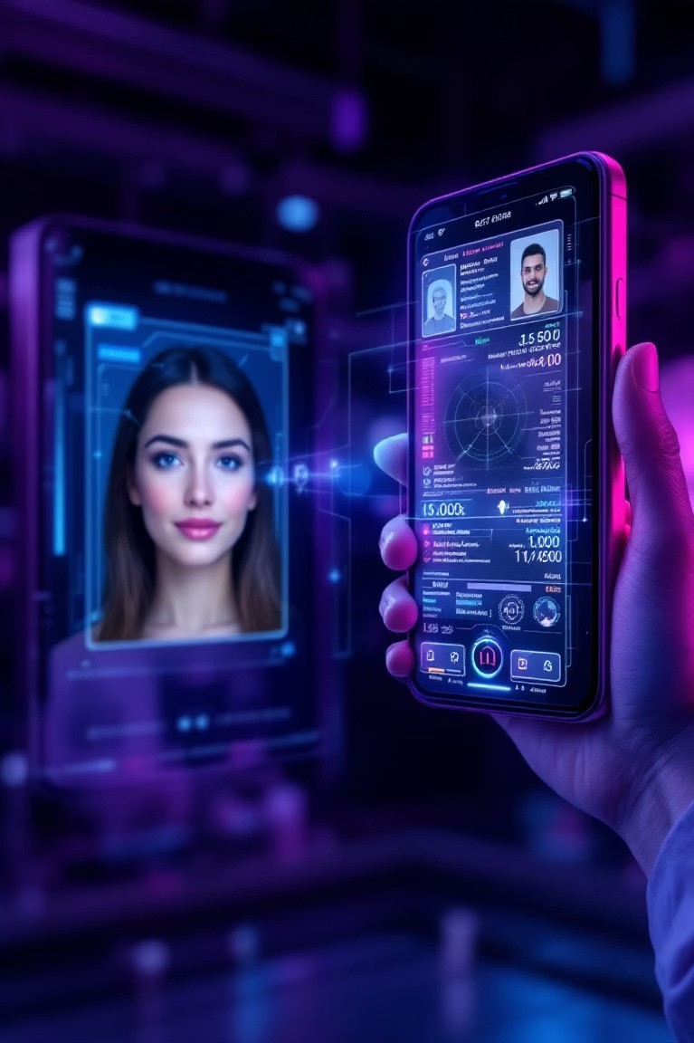
Identity & Document Services
Document Upload
Users submit government ID documents through secure encrypted channels.
Data Extraction
Tesseract OCR extracts document information and photos for verification.
Face Matching
OpenCV compares document photos with live selfies using advanced algorithms.
Secure Caching
Redis stores verification data temporarily for performance optimization.

Slide 8




Blockchain Voting Service
Identity Validation
Confirm user has completed all verification steps.
Vote Casting
Secure ballot submission through encrypted channels.
Blockchain Recording
Vote data stored in Ethereum smart contracts.
Verification
Public audit capability without compromising voter privacy.

Slide 9






Conclusions
Future Expansion
Cloud deployment and user scaling capabilities.
Security Validation
Robust architecture withstanding common attack vectors.
Core Achievements
Real-time face verification and immutable blockchain voting.
The system successfully combines multiple security layers to create a trustworthy e-voting platform. Face verification and blockchain technology provide a robust foundation for digital democracy.

