Slide 1

TypeScript
JavaScript that scales

Slide 2





Hello!
I am Rareş
user for ~3 years
Egghead.io instructor
mentor
@volkeron

Slide 3
Agenda
Part 1
Making the transition to TS
Part 2
Diving deeper

Slide 4
“DEMO TIME”
- Famous last words of unknown developer

Slide 5
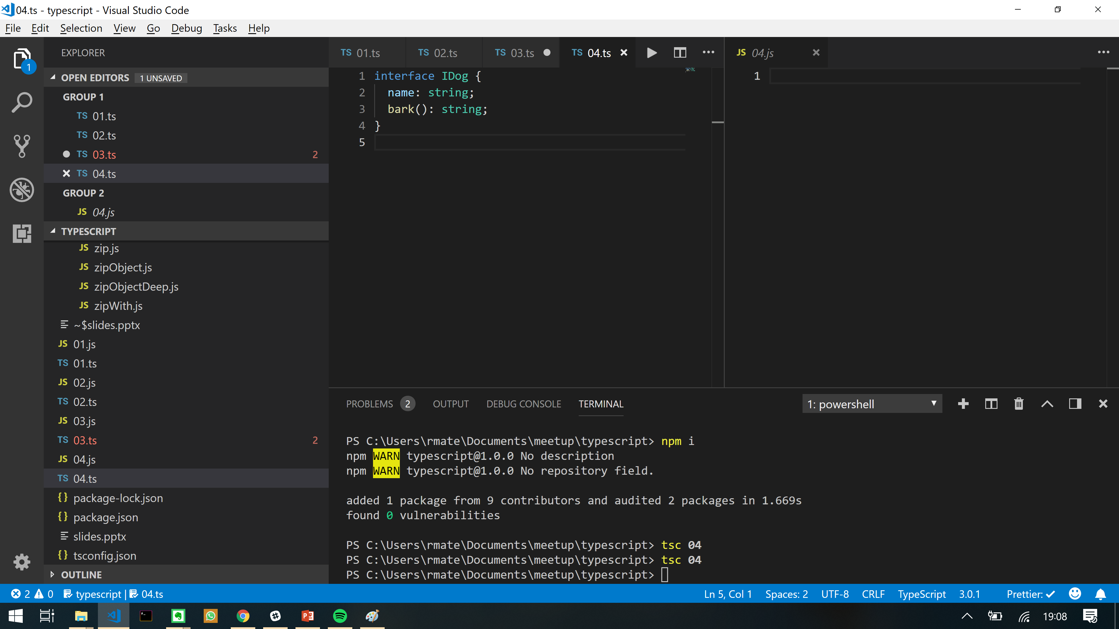
“DEMO TIME”
- Famous last words

Slide 6


89,526,124$
That’s a lot of money

Slide 7

89,526,124$
That’s a lot of money
Most loved

Slide 8
89,526,124$
That’s a lot of money
Most loved
3rd place

Slide 9
89,526,124$
That’s a lot of money
Most loved
3rd place
4th place

Slide 10

89,526,124$
That’s a lot of money
Most loved
Most wanted
3rd place
4th place

Slide 11
89,526,124$
That’s a lot of money
Most loved
Most wanted
3rd place
6th place
4th place

Slide 12
89,526,124$
That’s a lot of money
Most loved
Most wanted
3rd place
6th place
4th place
5th place

Slide 13

89,526,124$
That’s a lot of money
Most loved
Most wanted
3rd place
Most dreaded
6th place
4th place
5th place

Slide 14


TypeScript
Top programming languages
2017
#17 #14

Slide 15
“MORE DEMO TIME”
- More famous last words

Slide 16


Slide 17


Slide 18
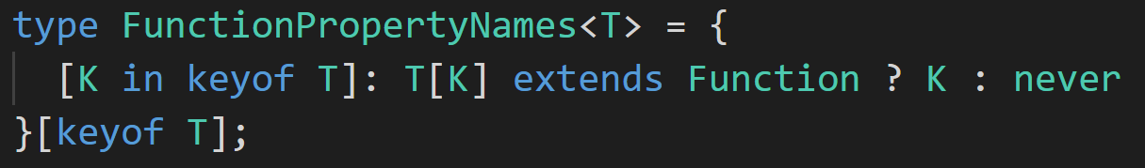

Slide 19

Thanks!
Questions please!
@volkeron
“Advanced practical TypeScript”
on

