Slide 1
DUPUY
Hopper replacement guide
Removal and refitting procedure
BREATHE CLEAN

Slide 2
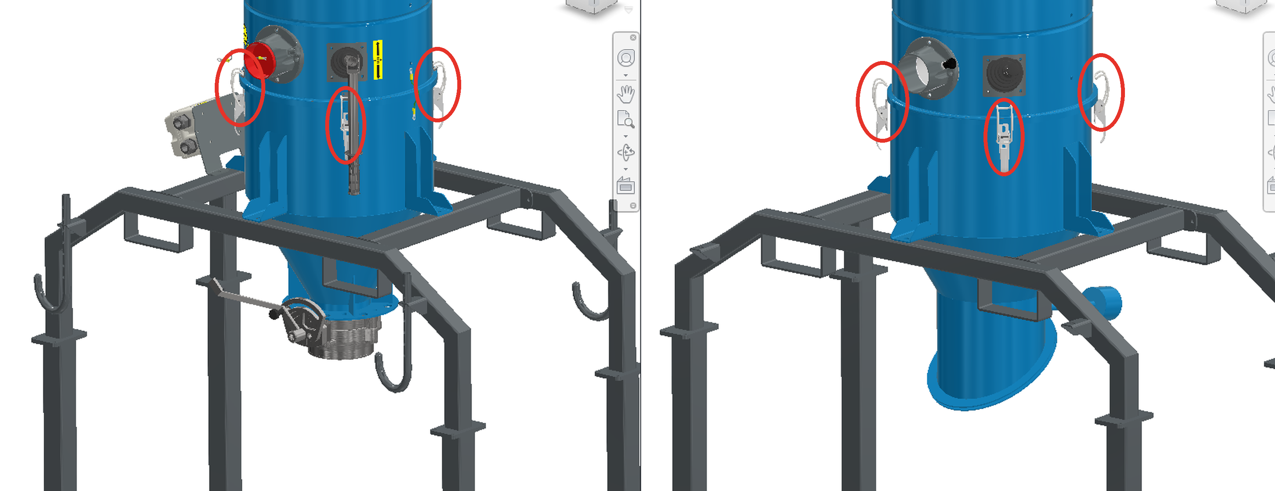
REMOVAL · STEP 1
DUPUY
Release the latches
Unhook all toggle latches (circled in red)
1. Locate the 3 toggle latches around the body (circled in red).
2. Pull each lever away from the body to release the tension.
3. Unhook every latch from its catch.
4. Make sure all 3 latches are fully open before moving on.
SAFETY: switch off and lock out the machine, depressurise the unit and make sure the hopper is empty before starting.
HOPPER REPLACEMENT GUIDE
2

Slide 3
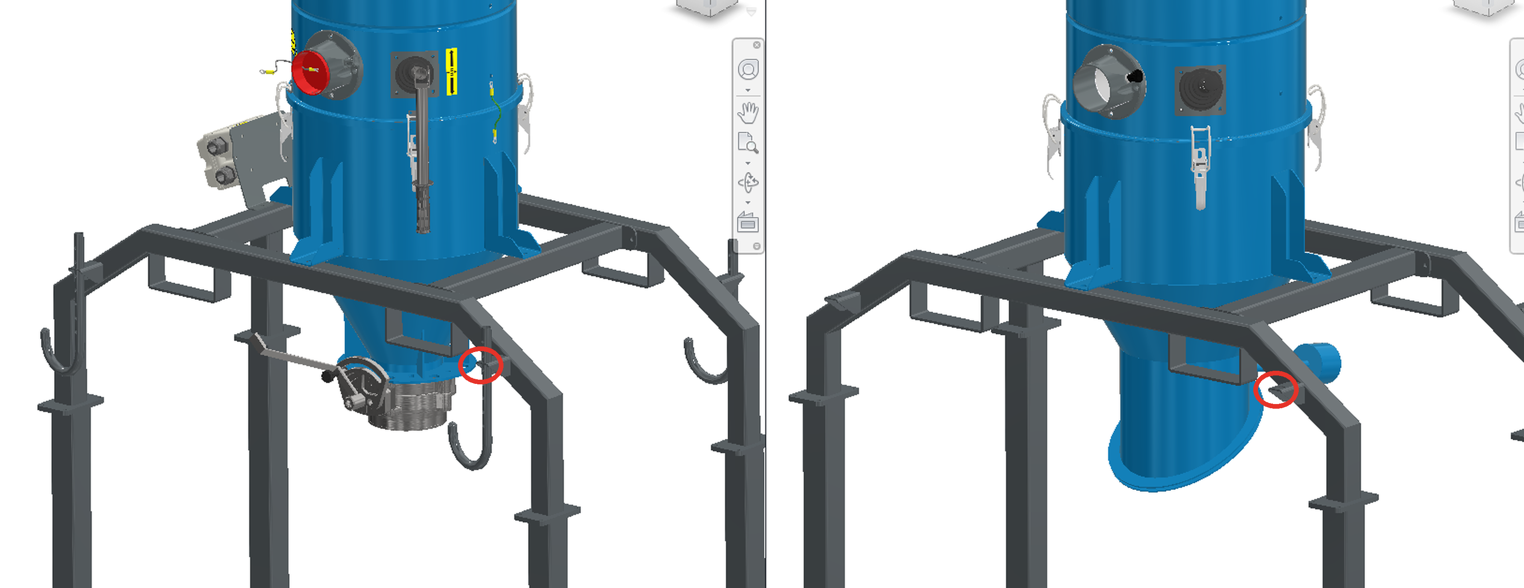
REMOVAL · STEP 2
DUPUY
Unscrew the hopper fixing screws
Remove the screws holding the hopper (circled in red)
1. Support the hopper from below.
2. Unscrew all fixing screws at the points circled in red.
3. Keep screws and washers together for refitting.
4. Lower the hopper carefully and remove it.
WARNING: the hopper is heavy – support it before removing the last screw.
HOPPER REPLACEMENT GUIDE
3

Slide 4
REFITTING · STEP 3
DUPUY
Refit the hopper and tighten the screws
Reverse of removal – fixing points circled in red
1. Position the new hopper under the body.
2. Align it with the fixing points circled in red.
3. Insert all screws and washers by hand first.
4. Tighten the screws evenly, in a cross pattern.
Check that the hopper is seated flat and the seal is correctly positioned.
HOPPER REPLACEMENT GUIDE
4

Slide 5
REFITTING · STEP 4
DUPUY
Close the latches
Hook and lock all toggle latches (circled in red)
1. Hook each latch onto its catch.
2. Press the lever towards the body until it locks.
3. Check that all 3 latches are closed and secure.
4. Restore power and run a final check.
Done: the hopper is replaced and the unit is ready for operation.
HOPPER REPLACEMENT GUIDE
5

Slide 6
DUPUY
Thank you for your attention!
Via Enrico de Nicola 27 - 10036 Settimo Torinese (TO)
Tel. +39 011 8975444
Email: info@dupuy.it

