Slide 1

DISTRIBUTION NETWORK · GERMANY
Distribution channel development
Best practices, commercial results and a method for mapping distributors

Slide 2
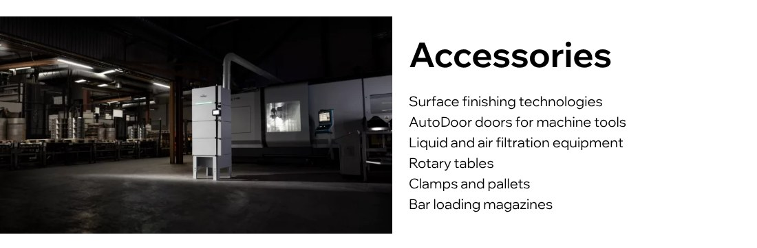
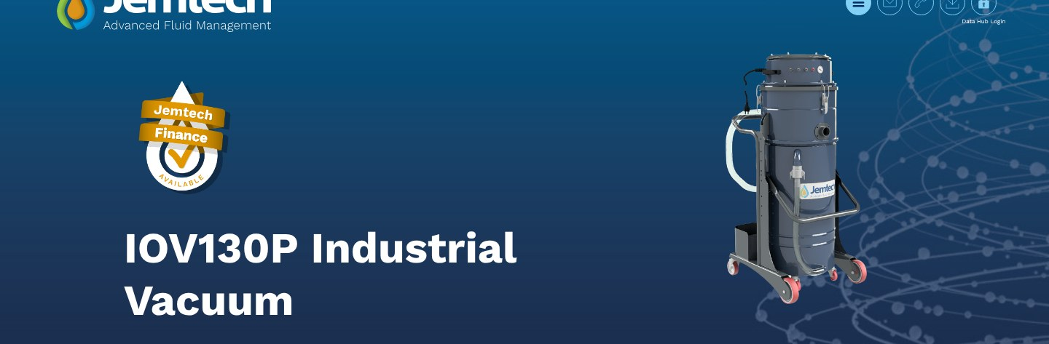
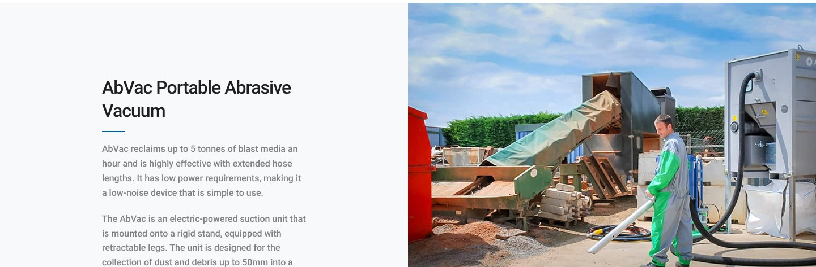
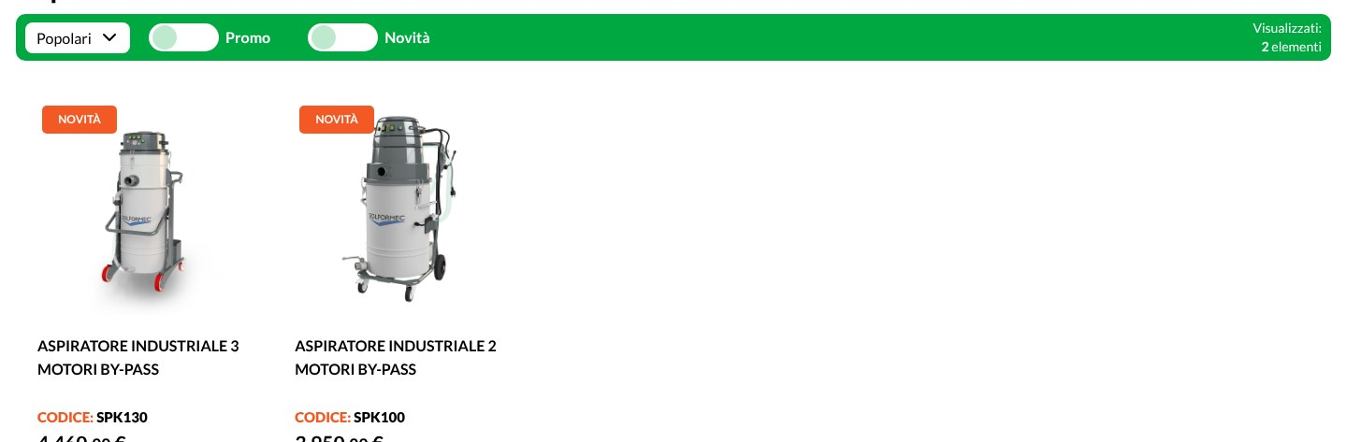
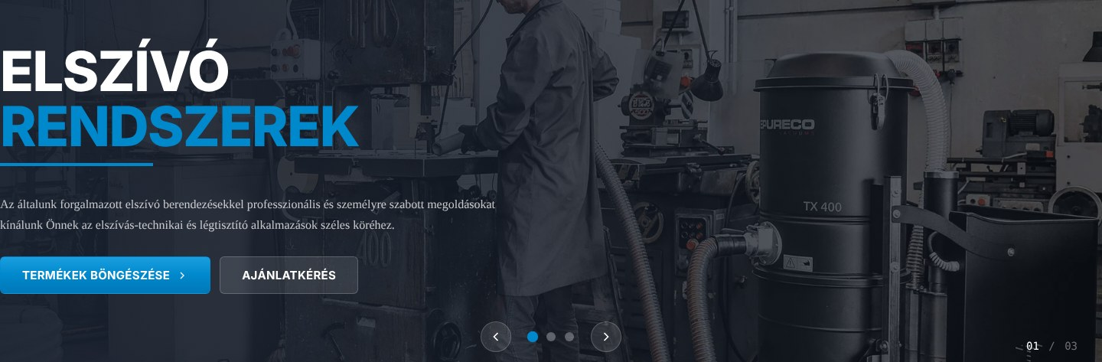
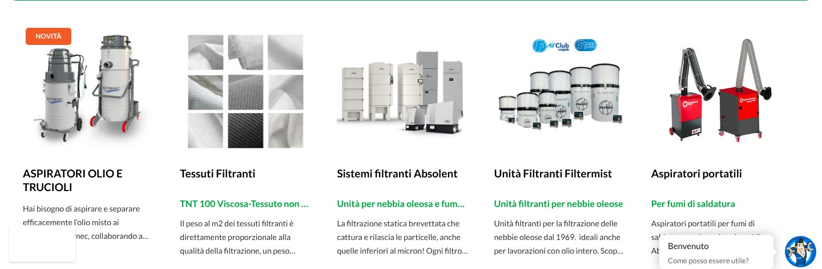
Six channels, one method
OVERVIEW
1
CNC machine dealers
2
Cutting oil & coolant dealers
3
Blasting equipment
MTC Flextek · FI
Jemtech · UK
Blasquem · PT / AIRBLAST · UK
4
Tool shops & buying groups
5
Installers & system integrators
6
Competitor-brand dealers
Rubix · CDU · Cagelli · IT
Hardtest · HU
Mapping in Germany
1
WHO
the ideal distributor, with real examples
2
HOW MUCH
revenue it can generate
3
WHERE
to find them: targeted mapping

Slide 3
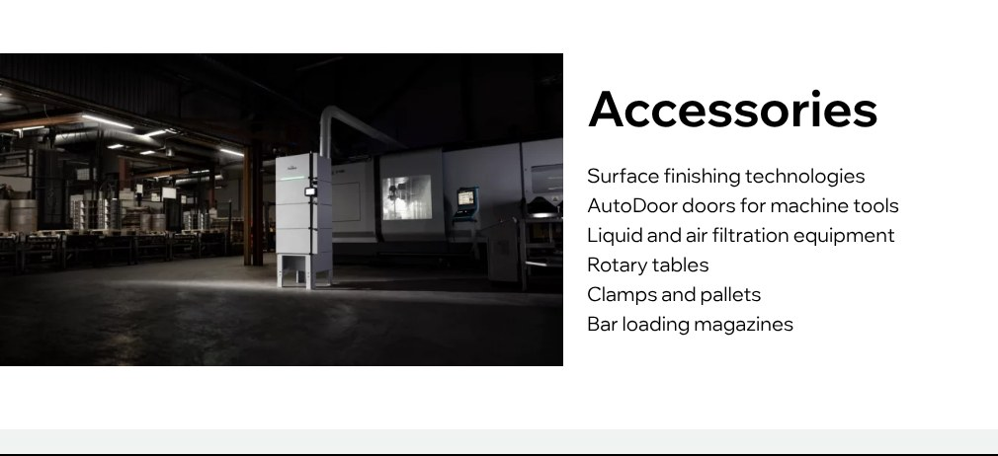




CNC machine dealers
CHANNEL 1
BEST PRACTICE
MTC Flextek
Finland · mtcflextek.fi
RESULTS
20–25
OILVAC 130 PUMP units / year
Starts with OILVAC 130 PUMP
Then all other DUPUY ranges
BRANDS REPRESENTED
WHERE TO FIND THEM IN GERMANY
DMG MORI · Mazak · TRUMPF · EMCO · Hermle · CHIRON · GROB · INDEX · GF Machining Solutions · Mikron · Fehlmann (manufacturer list: EMO Hannover exhibitor catalogue)
Dealer database of CNC manufacturers

Slide 4
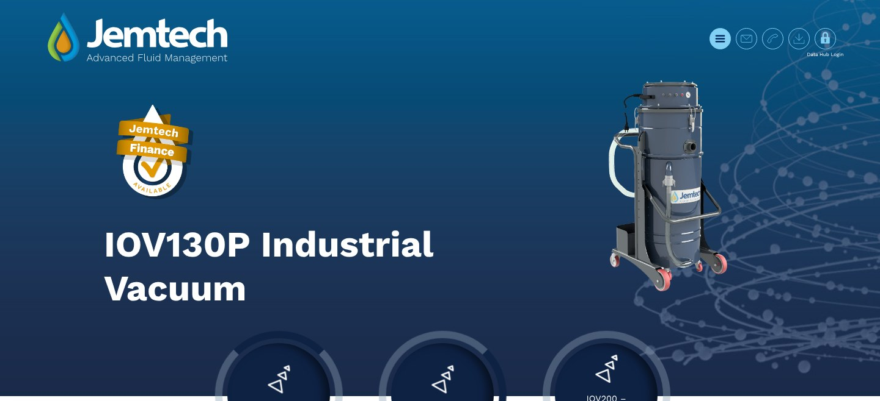

Cutting oil & coolant dealers
CHANNEL 2
BEST PRACTICE
Jemtech
United Kingdom · jemtech.co.uk
RESULTS
PRIVATE LABEL
DUPUY machines under the Jemtech brand, in blue
First machine for the service team
Recurring sales
Whoever sells oil can sell the vacuum too
Partners: Blaser Swisslube · HFiltration
Other DUPUY ranges
WHERE TO FIND THEM IN GERMANY
Blaser Swisslube · Castrol · Motul · TotalEnergies · FUCHS · Quaker Houghton · Oemeta · Rhenus Lub · Zeller+Gmelin · Klüber
Distributors of coolant manufacturers

Slide 5
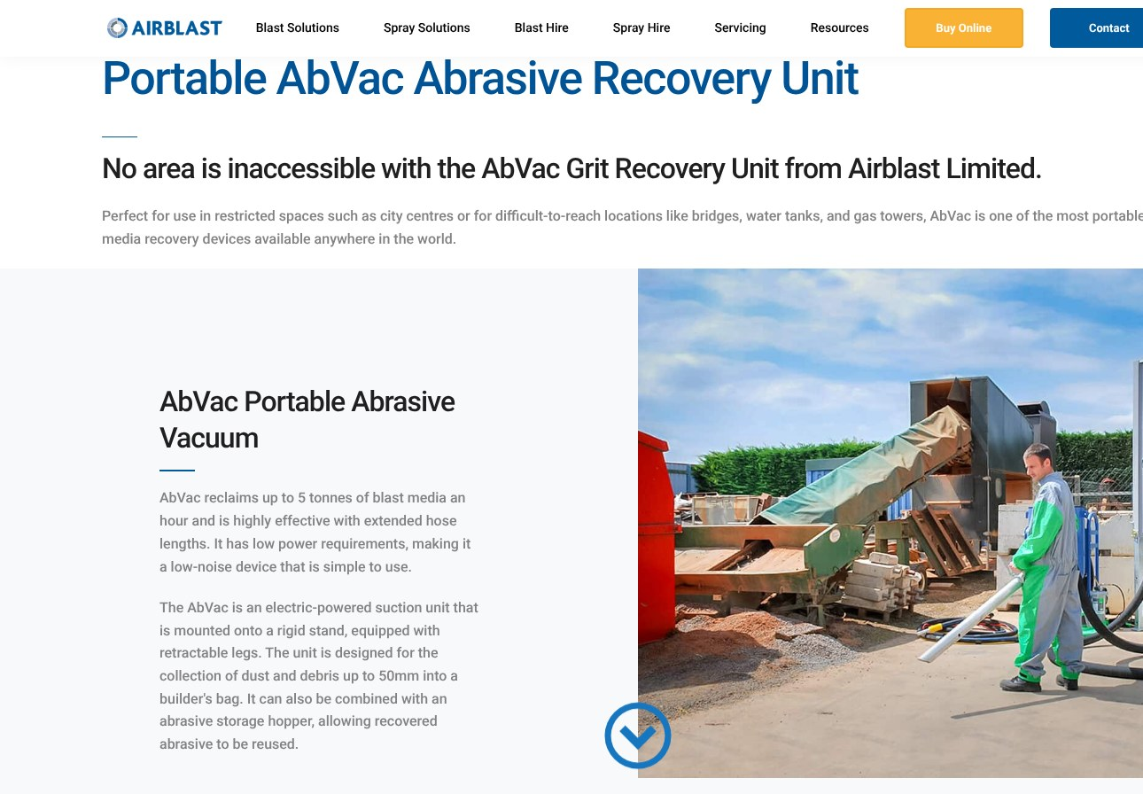
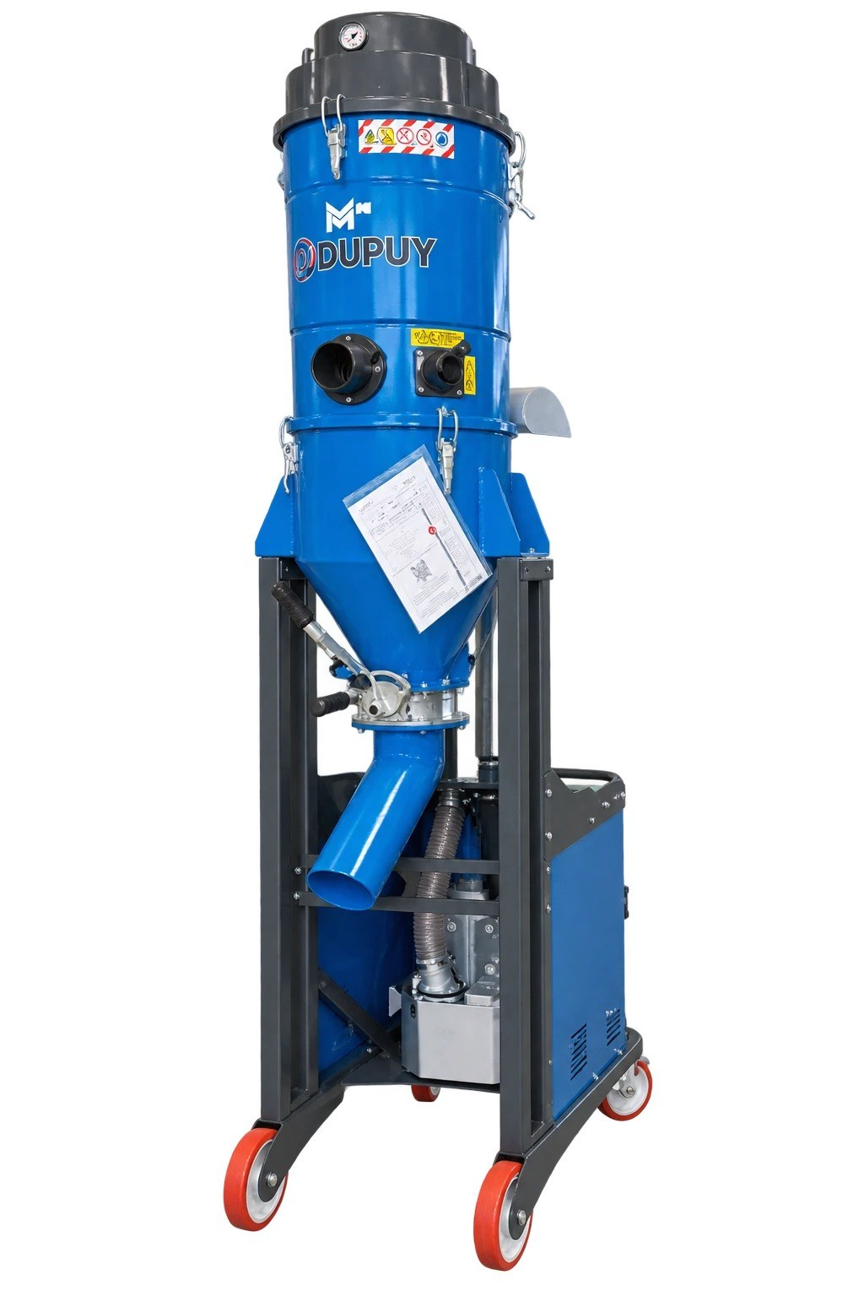

Blasting equipment: OEMs and dealers
CHANNEL 3
BEST PRACTICE
Blasquem · AIRBLAST
Portugal · United Kingdom
RESULTS
6
OEMs already served: OMSG, COGEIM, Turbotecnica, Norblast, STEM, Protech
+1
M50 Cogeim
German OEM already active (2-motor heads)
M50 Cogeim · MHD AIR 30 · SILOFILTER: solutions not in the DELFIN range
airblast.co.uk
portable machines, abrasive recovery, hire
WHERE TO FIND THEM IN GERMANY
Sapi · Clemco · AGTOS · ROSLER · SLF … then grit and equipment distributors, to approach directly
German OEMs + distributors of machines and consumables

Slide 6
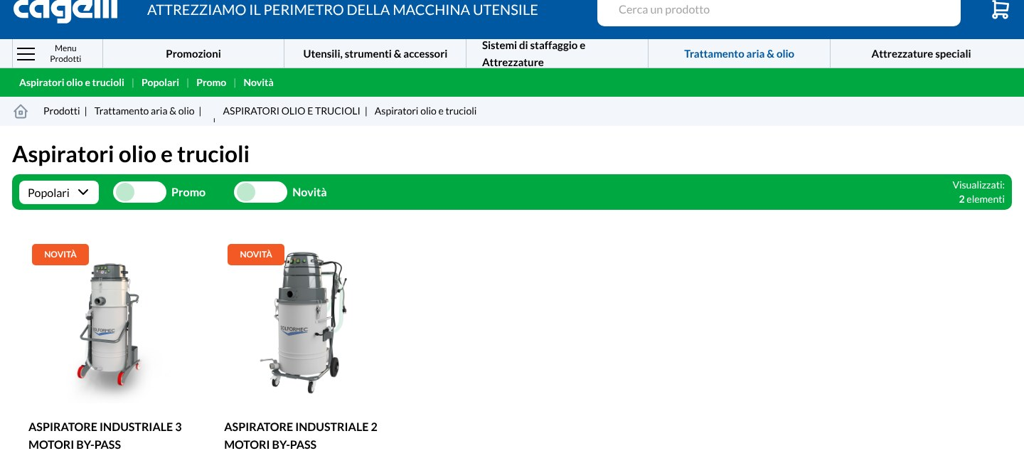



Tool shops & buying groups
CHANNEL 4
BEST PRACTICE
Italian market
Dense regional coverage
RESULTS
~100
tool shops served today
€10,000
average revenue / year per customer
≈ €1M
/ year from the channel (estimate: 100 × €10,000)
~€20,000 average per customer
OILVAC 130 in private label
rubix.com/it · IT · FR · ES
WHERE TO FIND THEM IN GERMANY
Progressive regional coverage: buying groups aggregate many shops and multiply growth. CDU = Consorzio Distribuzione Utensili
Buying groups, tool-shop chains and local distributors

Slide 7
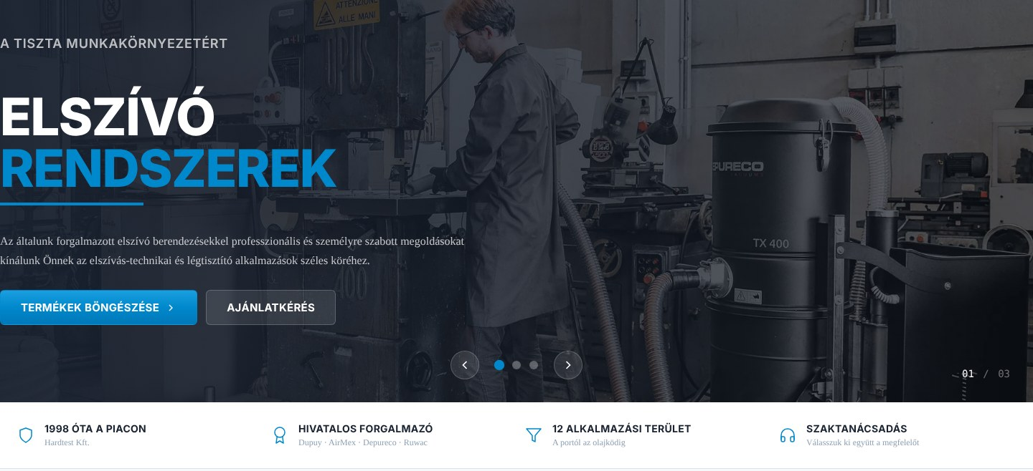

Dust-extraction installers and integrators
CHANNEL 5
BEST PRACTICE
Hardtest
Hungary · hardtest.hu
RESULTS
30–40
dust collectors purchased / year
€100,000
revenue year 1 (figure to be rechecked)
€150,000+
BUYS THE DUST COLLECTOR FROM US, PIPING LOCALLY, INSTALLS
revenue year 2 (figure to be rechecked)
Visit hardtest.hu
WHERE TO FIND THEM IN GERMANY
Donaldson · Nederman · Fumex · TEKA · BOFA · ULT · ESTA · Coral · TAMA Air Nova → not only official dealers: small installers are often more interesting
Installers and small independent system builders, city by city

Slide 8
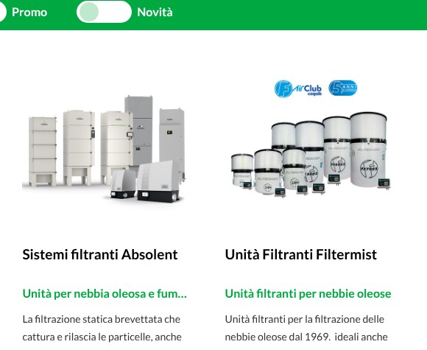
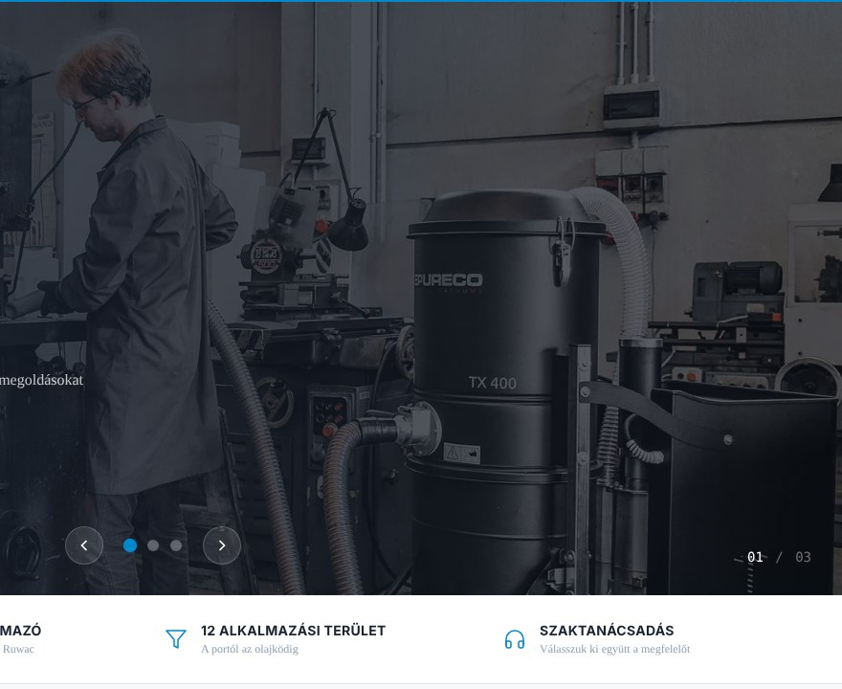
Competitor-brand dealers
CHANNEL 6
HOW IT WORKS
Dealer mapping
We will support you on this
RESULTS
27
competitor brands to map
Our dealers already sell competitors too: Cagelli → Filtermist, Absolent · Hardtest → Ruwac, Depureco
Cagelli → Filtermist · Absolent
Hardtest → Depureco
OIL MIST
Filtermist · 3nine · Absolent · Losma · LTA Lufttechnik · AR Filtrazioni · Keller
DUST EXTRACTION
Donaldson · Nederman · ESTA · TEKA · ULT · BOFA · Fumex · Coral · ULMATEC · Kemper · TBH · Plymovent · Camfil
INDUSTRIAL VACUUMS
Ruwac · Nilfisk · Kärcher Industrial · Depureco · RGS · Sibilia · Wieland
WHERE TO FIND THEM IN GERMANY
Where are the German dealers of Filtermist, 3nine, Absolent, Donaldson, Nederman, Ruwac, Nilfisk…? Identify the most interesting and offer the DUPUY range
Database of German dealers of competitors

Slide 9

We are not inventing new channels.
We replicate in Germany what already works.
1
Who is the ideal distributor
2
How much revenue it can generate
3
How to find them in Germany
The ideal partner profile, with real examples already active
Results measured on partners already active in other markets
Through targeted mapping of potential partners, channel by channel
EXAMPLES
€10,000 – 150,000+
6 channels
Next step: a partner database for each channel, built together.
DUPUY · Via Enrico de Nicola 27 · 10036 Settimo Torinese (TO) · Tel. +39 011 8975444 · info@dupuy.it

