Slide 1
Foco: Analytics

Slide 2
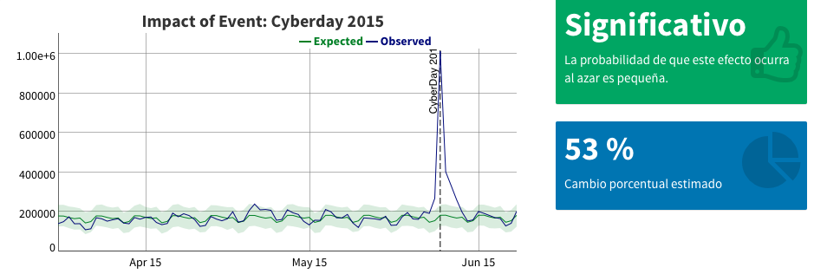
Foco: Analytics

Slide 3
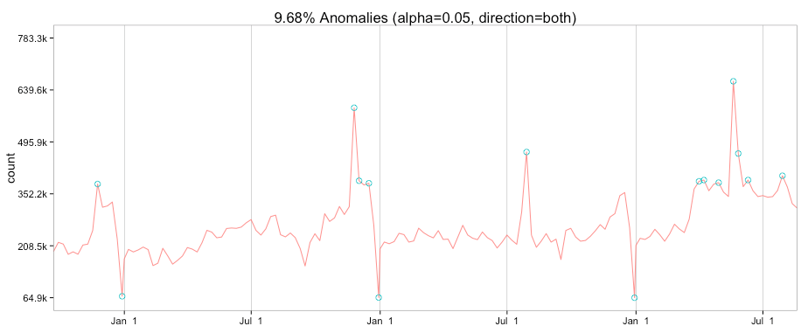
Foco: Analytics

