Slide 1

Metaprogramming in Ruby

Slide 2
Definition
Metaprogramming is writing code that manipulates language constructs at runtime.
Ruby is one of the most flexible languages for metaprogramming
Notes:
In other words, almost every structure (classes, instance methods and variables, constants) can be accessed at runtime.

Slide 3
Characteristics
Code that writes code
Reduce lines of code
Dynamic programming
Notes:
Example: Active Record
active record como maneja metaprogramación, en la clase no hay un set y un get por cada campo del modelo, sino que cuando se invoca al setter o getter se crea el attribute correspondiente
5.times do
class MYClass
puts 'Testing'
end
end
binding.pry
class D
def x
'x'
end
end
class D
def y
'y'
end
end
# obj = D.new
# obj.x
# obj.y

Slide 4
Open Classes
IF multiple classes were declared multiple times, what happen?
Ruby reopens classes
The class keyword in Ruby is more like
a scope operator than a class
declaration

Slide 5
Grep
Use here to lookup methods
Grep to avoid monkey patching
Notes:
Grep ayuda a buscar metodos por expresión regular, ideal para no sobreescribir inadvertidamente métodos
Mencionar el riesgo de las classes abiertas

Slide 6
Instance variables
There is no connection between instance variables and object class.
obj.instance_variables
Instances variables reside in objects
Notes:
class MyClass
def my_method
@v = 1
end
End
1# obj = MyClass.new
# obj.instance_variables
# obj.my_method
# obj.methods.grep(/my/)
# var_name = 'v'
# obj.instance_variables.include?("@#{var_name}".to_sym)

Slide 7
Instance methods
Methods that are only accessible by creating an instance of the corresponding class.
String.instance_methods == "abc".methods
String.methods == "abc".methods
Notes:
Correr comandos para ver resultados
Instance_methods(inherited)

Slide 8
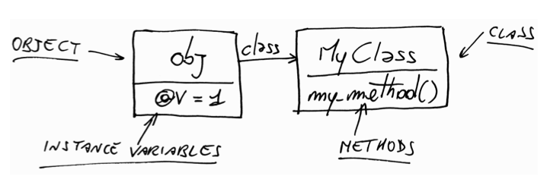
Classes themselves are nothing but
OBJECTS
Notes:
‘Hello Juampi’.class => String
String.class => Class
Mencionar superclass

Slide 9
Constants
Arranged as a file system tree
Name starts with a Capital
Module.nesting
Module.constants

Slide 10
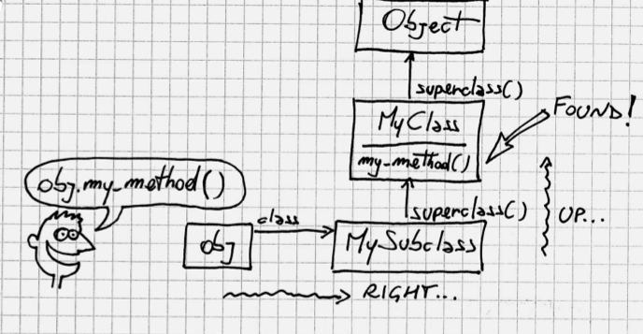
Method Lookup
Ancestors
Notes:
Ancestors

Slide 11
summary
When you call a method, Ruby goes right into the class of the receiver and then up the ancestors chain, until it either finds the method or reaches the end of the chain.
Every time a class includes a module, the module is inserted in the ancestors chain right above the class itself.
When you call a method, the receiver takes the role of self.
When you’re defining a module (or a class), the module takes the
role of self.
Instance variables are always assumed to be instance variables of
self.
Any method called without an explicit receiver is assumed to be a
method of self.

Slide 12
METHODS
Notes:
Differences between Java and Ruby

Slide 13
Dynamic Dispatch: SEND
To call methods dynamically
Name of method is an argument
Notes:
SendTest.rb
For testing, send llama a publicos y privados

Slide 14

Dynamic Dispatch: DEFINE_METHOD
To define methods dynamically
Name of method and params are arguments

Slide 15
METHOD_MISSING
To catch calls to missing methods
Optional: Receive method name, args and block as parameters.

Slide 16
RESPOND_TO?
Default: check whether or not method is defined.
BUT
It can be overwritten for our convenience

Slide 17
DRG metaprogramming
https://github.com/dresources/biogenidecformulary/blob/master/lib/site_config.rb
https://github.com/dresources/novartisformulary/blob/staging/app/models/publisher_formulary.rb#L486

