Slide 1
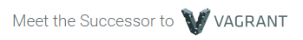


Raman Preet Singh (rpsingh2)
Rohit Arora (rarora4)
Kumar Utsav (kutsav)
Xavier Primus (xjprimus)

Slide 2
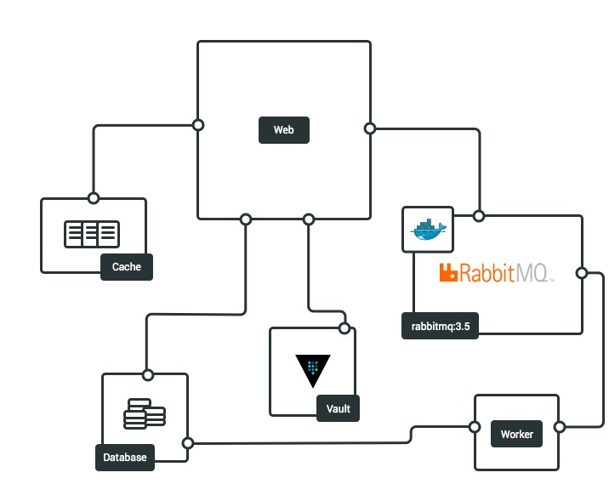
Introduction
Single solution to develop and deploy any application on any cloud platform
Everything is controlled within a single consistent workflow to maximize the productivity.
Builds a development environment tailored specifically for your application, with zero or minimal configuration.

Slide 3
Key Features
Automatic development environments:
Detects your application type and builds a development environment tailored specifically for that application, with zero or minimal configuration.
Automatically configures any other services that your application may need.
Built for Microservices:
An application only needs to tell Otto its immediate dependencies; dependencies of dependencies are automatically detected and configured.

Slide 4
Deployment:
Otto can deploy your application to any environment.
Docker:
Use Docker to download and start dependencies for development to simplify microservices
Production-hardened tooling:
Otto uses production-hardened tooling to build development environments (Vagrant), launch servers (Terraform), configure services (Consul)

Slide 5
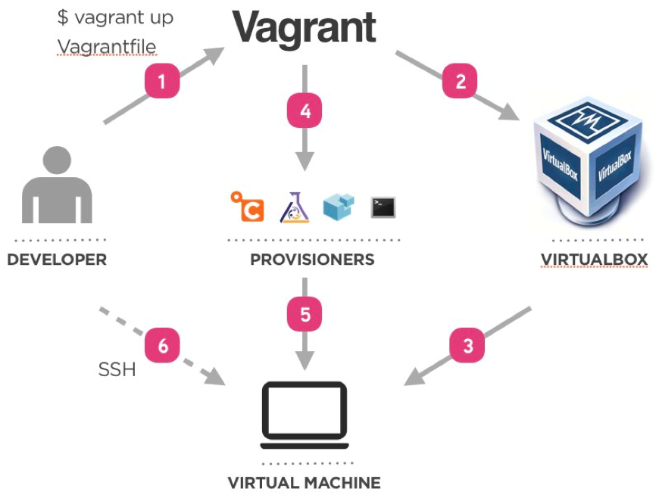
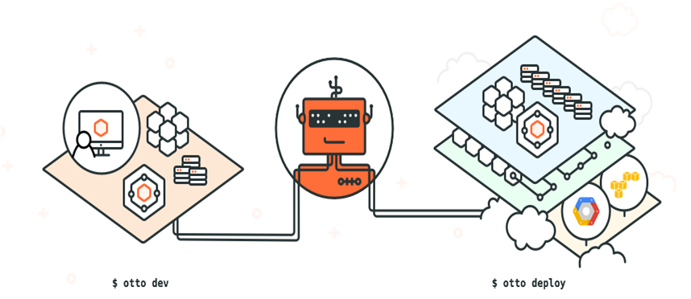
Otto vs Vagrant

Slide 6
Otto vs Chef
The user writes "recipes" that describe how Chef manages server applications and utilities (such as Apache HTTP Server, MySQL, or Hadoop) and how they are to be configured.
Otto automatically builds development environments without any configuration; it can detect your project type and has built-in knowledge of industry-standard tools to setup a development environment that is ready to go.

Slide 7
Limitations
In a future step we'll see how to configure things such as the version of Ruby installed.
For our example, otto compile detected our application is Ruby and used opinionated defaults for the rest. In a future step, we'll write an Appfile to more precisely configure Otto.
Supports only AWS but plans on supporting DigitalOcean in the future.

Slide 8
Vagrant is now obsolete (This class deprecated)
Succesor of Vagrant
Too many headaches and different variable env’s based on Vagrant dependency management
Process too involved
Scripts installing pip3 for production and distributed dev env not updated
Post provisioning failed in windows not mac

