Slide 1
eCafe
Laura Aquino, Keith Cruz, Tuan Dinh, Ryan Roseman, and Michael Schappel

Slide 2
The Model
Menu
Inventory
Tables
Orders
Accounting
Notes:
In the Model, we’ll need to store information about the entire restaurant.
We’ll have a menu, so we’ll need to store what’s on it along with any specials the restaurant is running. This will include prices and availability.
Along with the menu, we’ll need to keep an inventory of what ingredients are available; this will affect which items on the menu are available.
We’ll need to track the restaurant seating, so we’ll store information about tables; which are open, how many they can seat, what orders have been placed from where, and payment status.
The restaurant will revolve around orders; what menu items are included, from which table they came, and whether they’ve been fulfilled.
The restaurant will certainly be interested in cash in versus cash out, so we’ll store information on inventory bought versus meals sold.

Slide 3
The Model
Menu
Menu Item
Special
Inventory
Ingredient
Floor
Table
Order
Account
Notes:
The Menu class will track all Menu Items and Specials, each of which will have a description and price. Menu items will have a prep time and cost in ingredients.
The Inventory class will track quantities of Ingredients, each of which will have a description and a cost per unit in dollars.
The Floor class will track the Tables in the restaurant, each of which will store number of seats, availability, orders placed, and payment status.
The Order class will store source Table, Menu Items included, and fulfillment status.
The Account class will keep track of the cash in versus cash out.

Slide 4
The View
MenuView
MenuItemDisplay
OrderDisplay
BillDisplay
KitchenView
QueueDisplay
CurrentOrderDisplay
KitchenItemDisplay
Notes:
The MenuView class will display the restaurant menu. It will display Menu Items using an Instance of the MenuItemDisplay class and allow orders to be reviewed and placed using an instance of the OrderDisplay class. After placing an order, the bill will be available for review and payment using an instance of the BillDisplay class.
The KitchenView class will display a queue of orders placed, each of which displayed by an Instance of the QueueDisplay class, which will allow for orders to be accepted and processed. Upon accepting an order from the order queue, an instance of the CurrentOrderDisplay will display Menu Items included and estimated preparation time. Each Menu Item will be displayed using the KitchenItemDisplay class, which will show ingredients required and individual item preparation time.

Slide 5
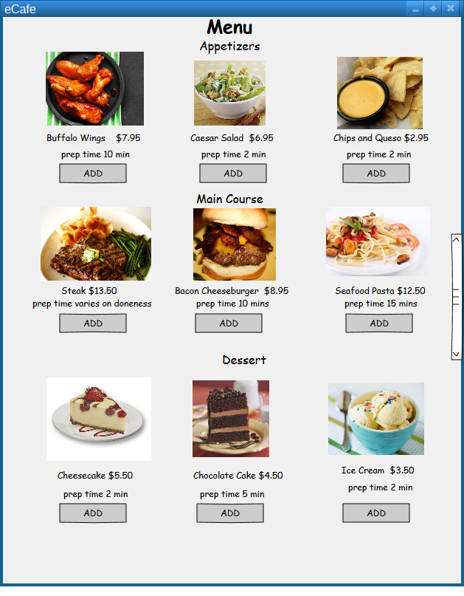
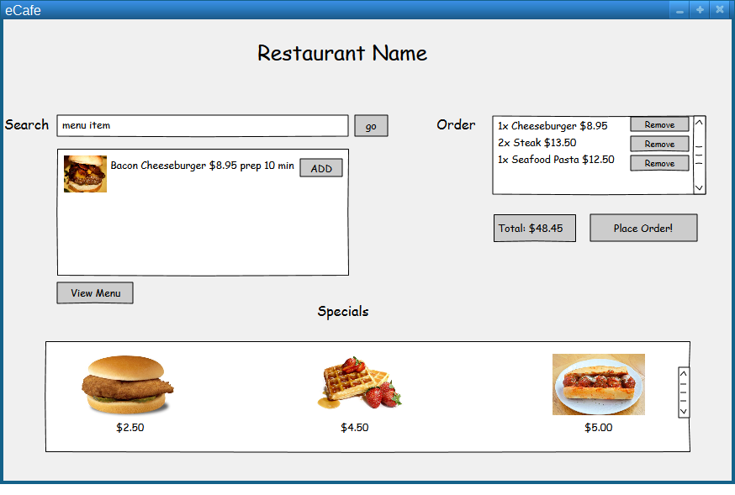
The View

Slide 6
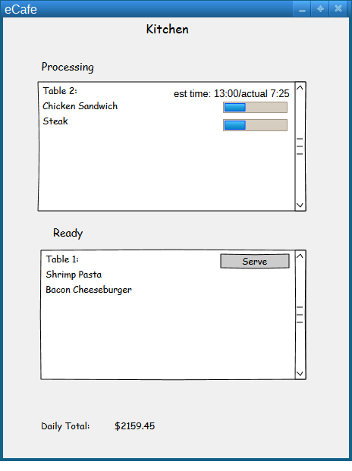
The View

Slide 7
The Controller
OrderHandler
MenuHandler
AccountHandler
Notes:
The OrderHandler class will create orders, populate the kitchen order queue, and mark orders as fulfilled.
The MenuHandler class will populate the MenuView with available Menu Items and adjust after orders accordingly.
The AccountHandler class will process bill payments and edit restaurant accounting information.

Slide 8
Milestone
To have all of our model classes completed.

Slide 9
Milestone
To implement our controller classes using network communication.

Slide 10
Questions?

