Slide 1
Hello!
We are team Bubbles
And we are here to provide a smart solution for Uncovering Modern Policing Talent.
Team: 2288

Slide 2
Smartpol
Smart Police System

Slide 3
History
Traditional Police Systems
There is several manual work for each process.
There are always chances of losing potential evidences due to lack in technology.
Police departments are sometime incapable of keeping up with innovation in crimes.
There is always chance of human errors.
Police Recruitment
There is no metrics or benchmark to evaluate right candidates.
The evaluation criteria to assess candidates are outdated.
There is still lack of diverse skill sets required to solve criminal cases.

Slide 4
Explanation
Its is a smart police recruitment system that leverages the use of Artificial intelligence and machine learning to analyse and automate existing system.

Slide 5
Recruiting with Machine learning

Slide 6
Resume Screening
Resume will be matched on the given skillset is required for the particular job description.
It also matches the relevant courses, minimum eligibility requirements will be cleared by the resume screening.
Based on the Natural Language Processing (NLP)’s.

Slide 7
Psychological Evaluations
Pymetric Test
This test allows us to analyse the analytical and problem solving skills to determine the perfect candidate for the role .
Sourced: 3rd Party Vendor
Facial and Speech Analysis
Analyzing the micro facial expressions and speech analysis to generate the score for this analysis.
Tech: Computer Vision and NLP
Behavioural Analysis
Check the applicants digital footprint on the various social-media platform to give an insight about his/her personality.
Tech: NLP and Data Scraping

Slide 8
Data Flow Diagram

Slide 9
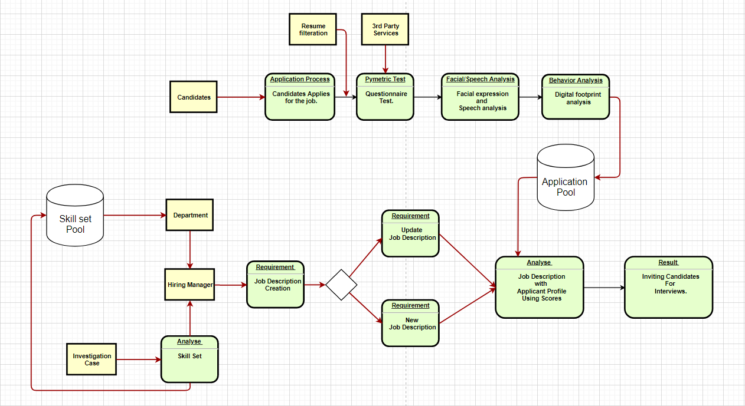

Slide 10
Samples

Slide 11
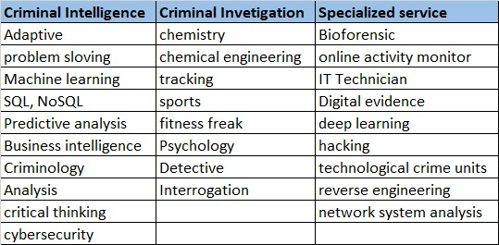
Sample skill Sets

Slide 12
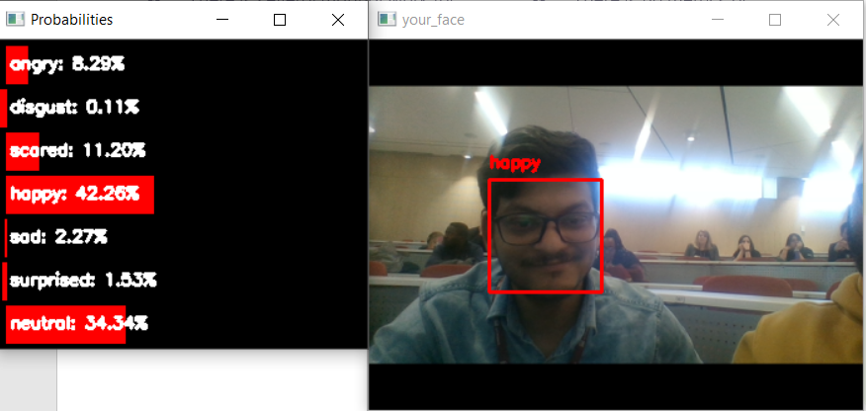
Facial Expression Assessment
Detection of the various facial expression in form of emotions.
Probabilities will be calculated.
It will help us to evaluate the applicant’s Emotional Quotient.

Slide 13
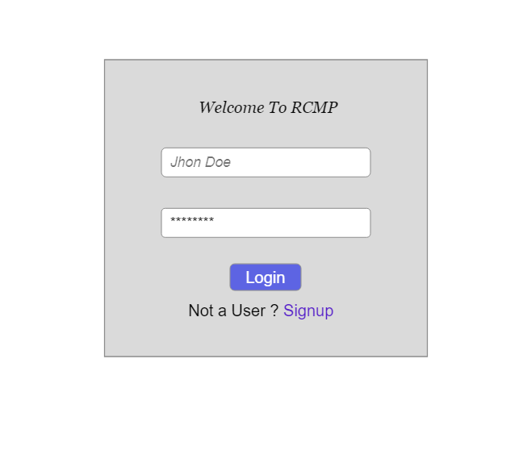
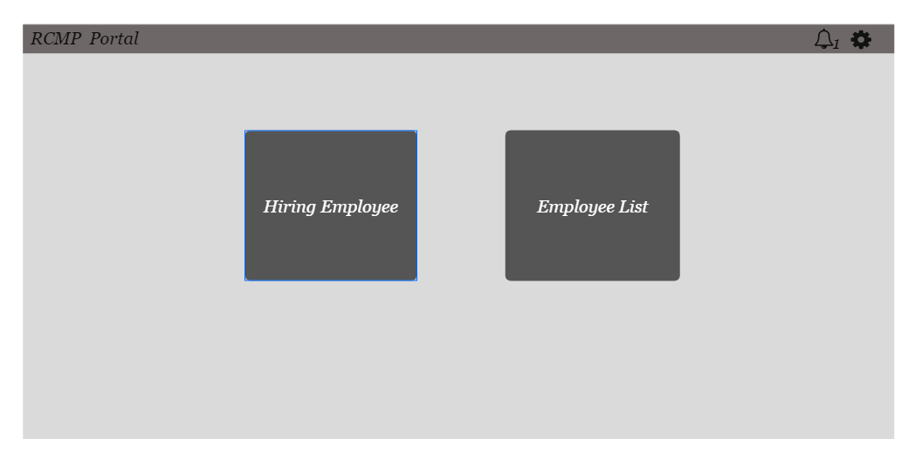
USER INTERFACE FOR THE USERS

Slide 14
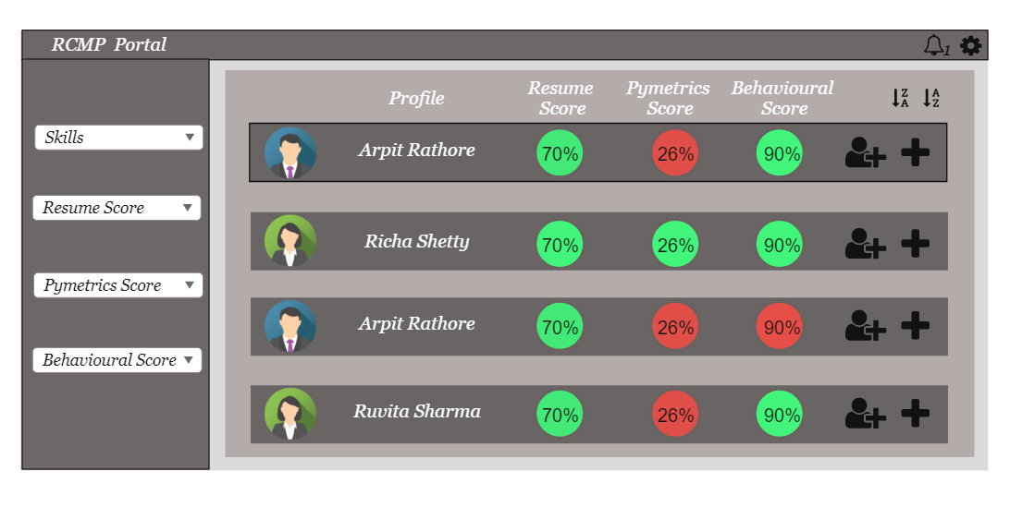

Slide 15
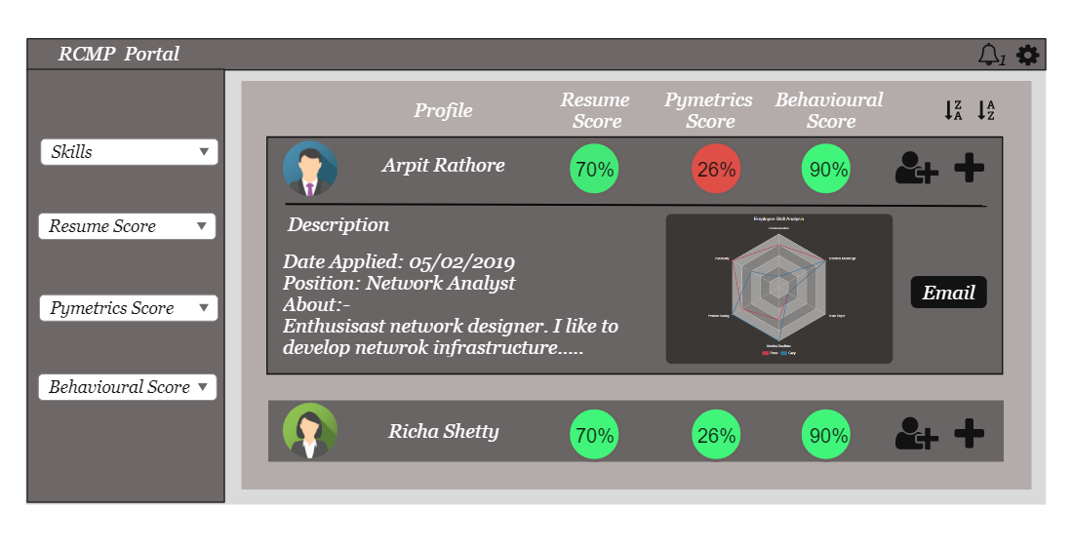

Slide 16
Thank You !

