Slide 1
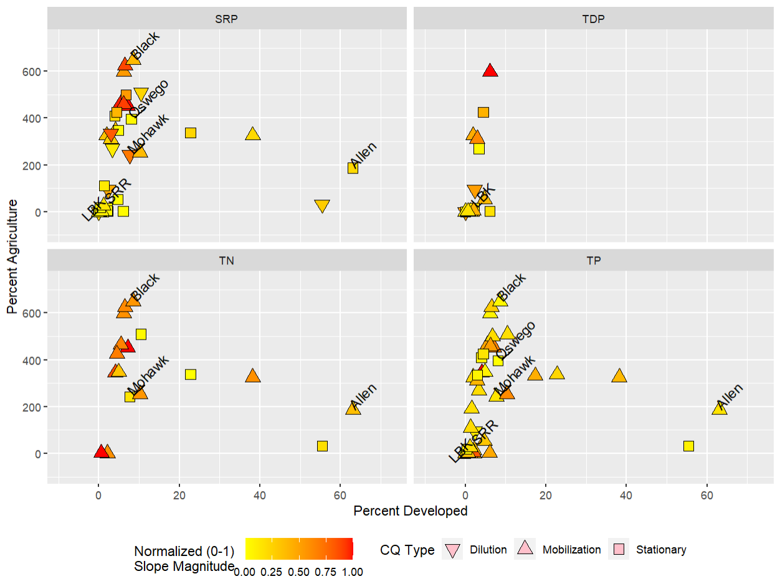
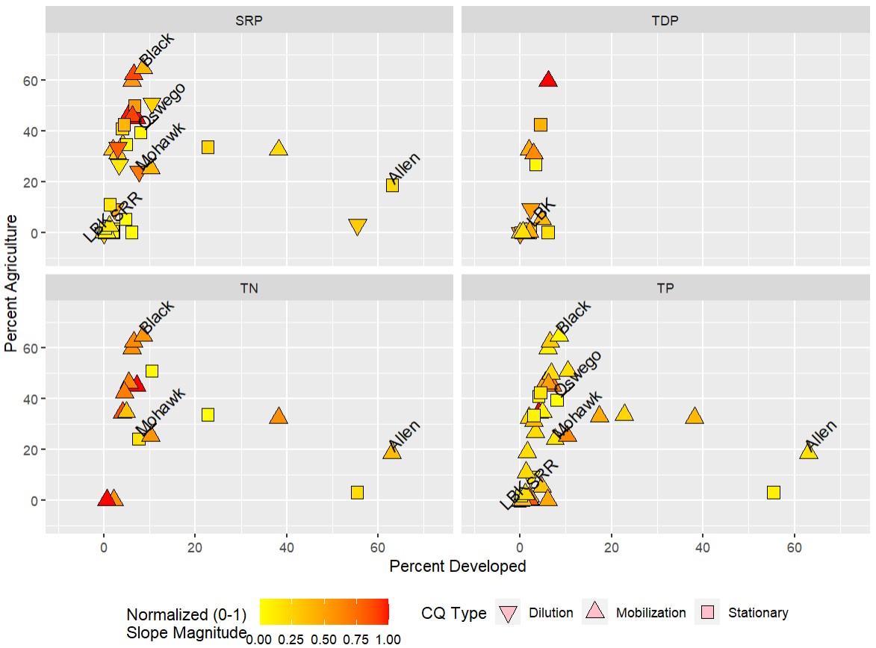
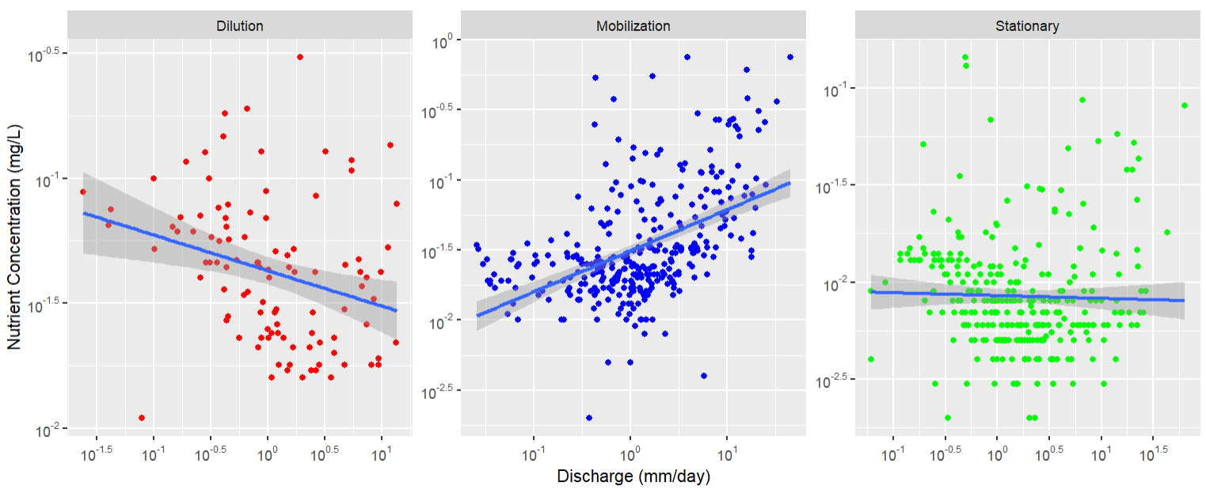
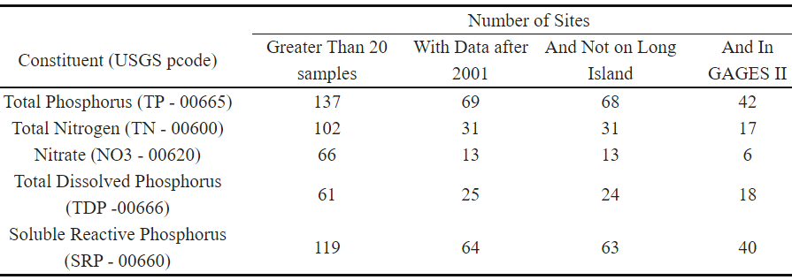
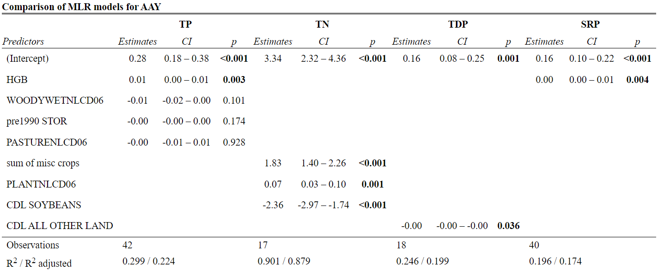
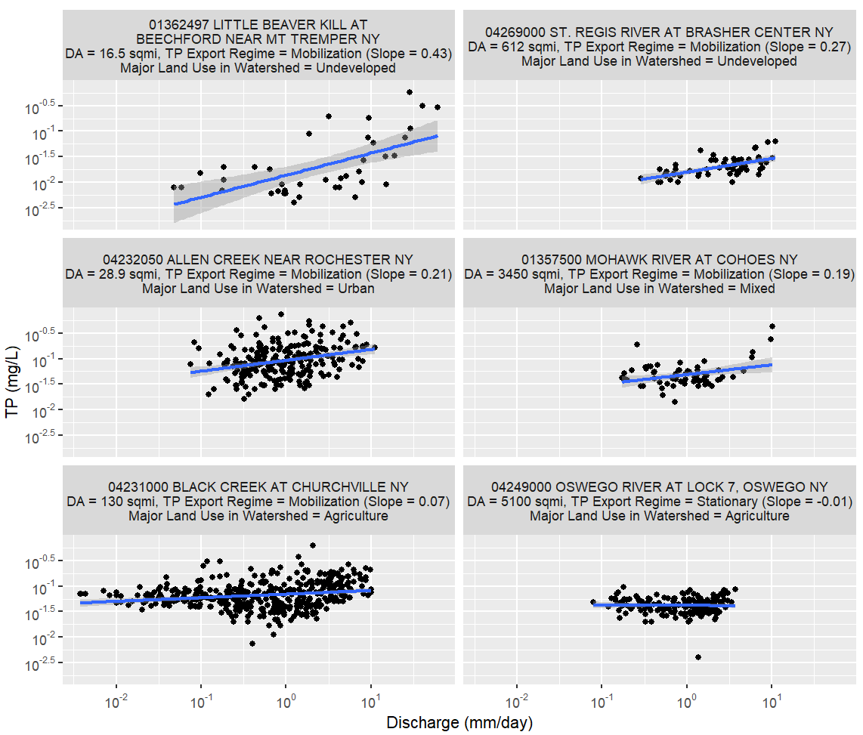
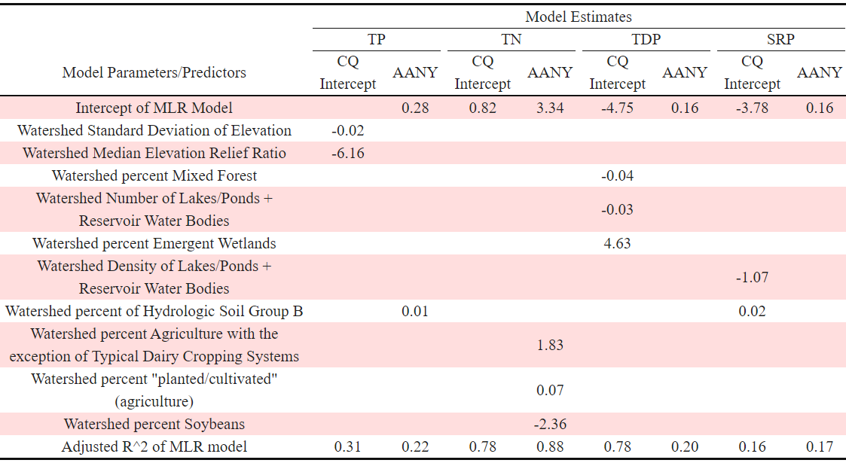
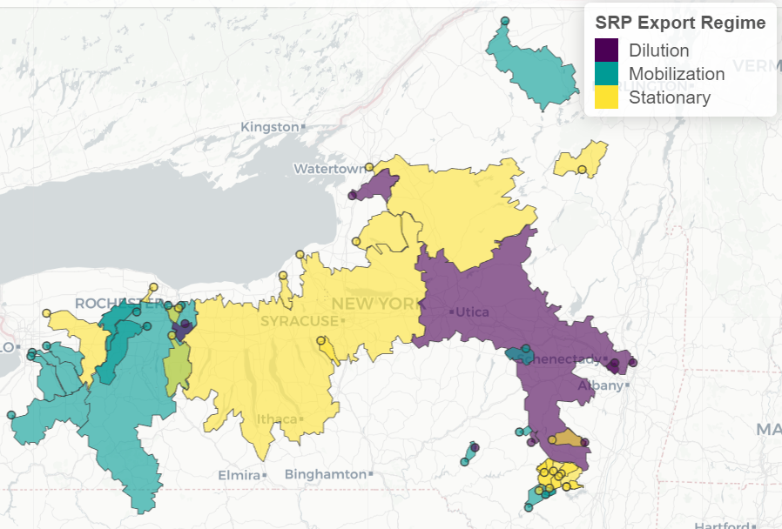
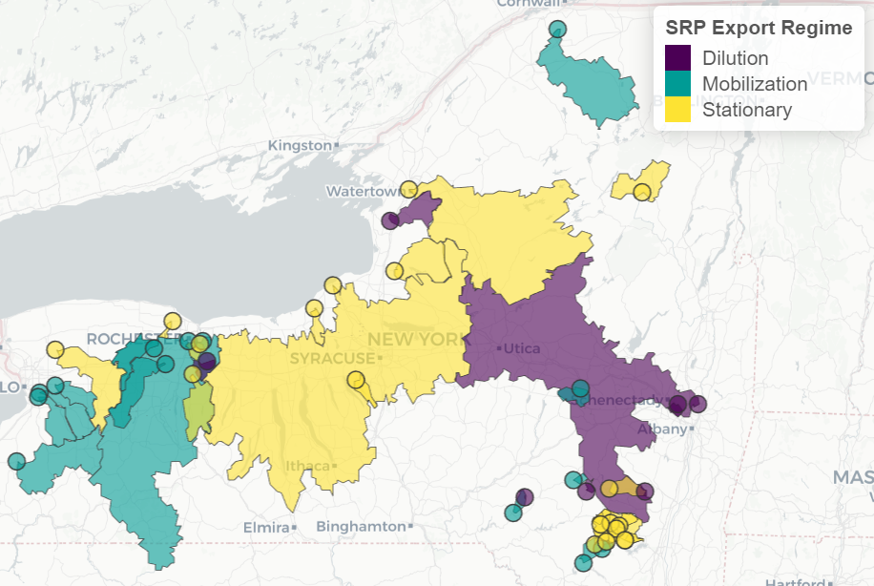
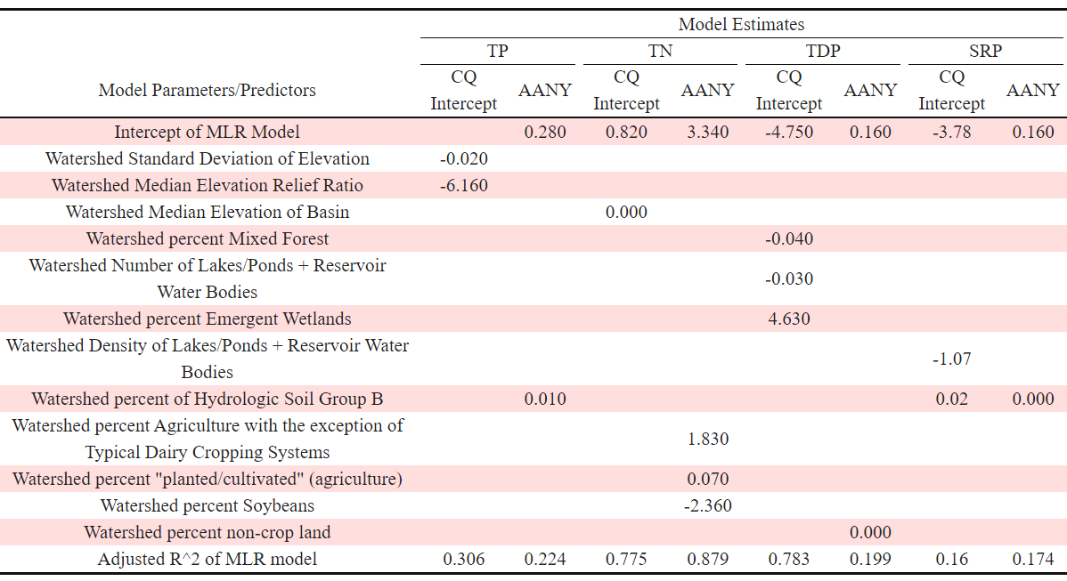
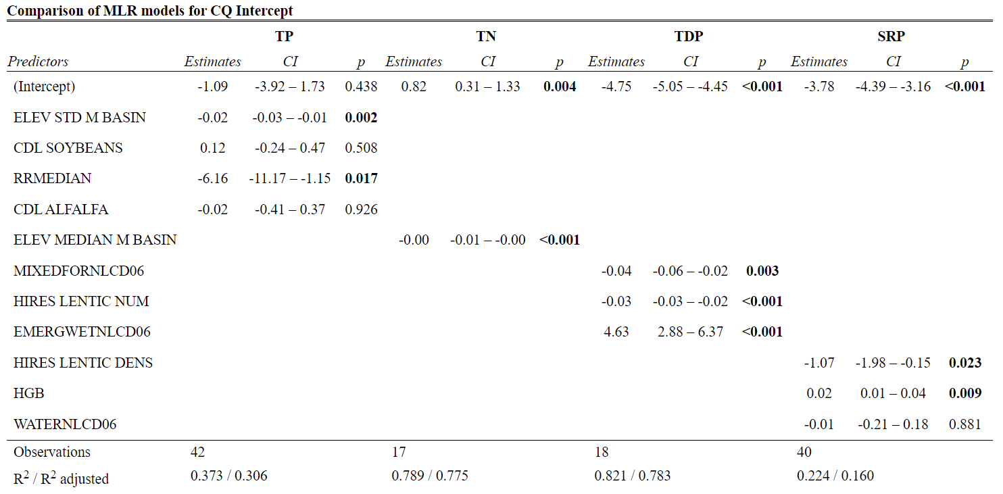
Implications of Watershed Characteristics on Nutrient Concentration-Discharge Relationships in NYS Rivers
Ryan Ruggiero^{1*}, Chuck Kroll¹, Steve Shaw¹, Charley Driscoll²
¹SUNY ESF Department of Environmental Resources Engineering ²Syracuse University Department of Civil and Environmental Engineering *Corresponding Author: raruggie@syr.edu
1) Background
Phosphorus (P) and Nitrogen (N) are key nutrients that play a pivotal role in governing primary productivity in freshwater systems. As anthropogenic activities continue to alter global P and N cycles, it becomes imperative to explore the relationship between nutrient concentrations in rivers and discharge.
This dependency of nutrient concentrations on discharge – often referred to as a C-Q relationship or CQ curve - provides insight into watersheds-scale controls on nutrient export. The shape of the CQ relationship is often considered to be influenced by watershed characteristics such as land use, soils, and topography. The relationship between C and Q is often conceptualized by empirical models, where the intercept and slope represent essential descriptors of the relationship.
3) Methods
4) Results (cont.)
The sequence of analysis for this study consists of three main steps:
USGS NWIS Database Query for Sample Locations (Sites) in NYS
Filter List of Sites for Data Requirements
Analysis to test H1 and H2
Table 1 - Number of sampling locations in NYS with paired observations of USGS gauged discharge and nutrient samples as a function of restrictions. The USGS National Water Information System (NWIS) was queried for 5 constituents, 3 phosphorus species and 2 nitrogen species. These 5 were chosen because they are common analytes in water quality sampling protocols. Nitrate was excluded from subsequent analyses due to the small number of sites. The USGS Geospatial Attributes of Gages for Evaluating Streamflow (GAGES II) database was used as the source of watershed characteristics for the sites used in this study.
Table 3 – Comparison of MLR models for Average Annual Yield.
Figure 1 – Conceptual diagrams of CQ relationships showing the three nutrient export regimes; dilution – downward trend (red symbols), mobilization – upward trend (blue symbols), stationary – flat trend (green symbols). A linear regression trend line (blue line) is fit after transforming the data using logarithm base 10. This linear model is used to predict concentration on any given day when discharge is known and can be used to estimate average annual nutrient yields. The intercept of the line indicates the concentration in the river when the discharge is low (baseflow conditions).
Figure 4 – Analysis of CQ export regime as dependent on disturbance in the watershed. Disturbance appears to have little influence on the strength and grouping of CQ export regimes (H2). The color of the symbols indicates the magnitude of the CQ slope (normalized to between 0 and 1) and the sites shown in Figure 3 are labeled.
4) Results
2) Hypotheses
While extensive analyses of controls on nutrient export have been conducted in places such as the Chesapeake Bay watershed or intensive agricultural regions of the Great Lakes, there has been little synthesis of nutrient data collected in NYS. Our goal was to test the following hypotheses:
Land use associated with anthropogenic disturbance will contribute to higher nutrient export
Nutrient export regime (diluting, mobilizing, stationary) is not fully controlled by land use
Table 2 – Estimates of the parameters and coefficients of the multiple linear regression models fit to CQ intercept and average annual nutrient yields (AANY) for each constituent. TN AANY was the only model with positive coefficient estimates for land uses associated with anthropogenic disturbance. However, TP intercept was found to be inversely related to elevation; initial analysis suggests elevation is related to land use (e.g. sites with higher elevation are usually more forested and therefore have less disturbance) (H1). The predictors are from the GAGES II database.
H1.
H2.
Undeveloped
Mixed
3) Methods
3.1) Data
The USGS NWIS database was queried for sites in NYS with >20 paired CQ observations for 5 constituents: total phosphorus (TP), total nitrogen (TN), nitrate (NO3), total dissolved phosphorus (TDP), and soluble reactive phosphorus (SRP). This list of sites was further reduced to those having observations after 2001, sites that are not on Long Island, and sites that are in the USGS Geospatial Attributes of Gages for Evaluating Streamflow database (GAGES II) (Figure 1). Due to a limited number of sites with NO3 data we just focused on TP, TN, TDP, and SRP.
3.2) Analysis
Ordinary least squares (OLS) regression was used to fit the CQ relationship (Figure 2). OLS estimates the coefficients of the linear relationship between the depended (concentration) and independent (discharge) variable. For a specific nutrient at a site, the export regime was determined to be mobilizing or dilutionary if the slope was significantly different from zero and positive or negative, respectively. The export regime was determined to be stationary if the slope was not significantly different from zero.
Average Annual nutrient yield (AAY) was calculated using the OLS regression and an average annual hydrograph (AAH). The AAH was determined by taking the average flow for every day of the year.
Spearman correlation coefficients and multiple linear regression (MLR) using forward selection were used to explore the GAGES II watershed attributes (predictors) that could explain the variations in intercept, slope, and AAY. MLR models were restricted to 5 or less predictors
4) Results
3.1) Water Quality Sites and CQ Trends
There were 42 sites with TP data, 17 with TN, 18 for TDP, and 40 with SRP.
There were 7 dilutionary sites for SRP. Of these 7, only 1 was also dilutionary for TP, while the other 6 were an even split of stationary and mobilizing. None of the TN sites were dilutionary
The distribution of the CQ slope magnitude varied across constituents across sites with varying levels of disturbance (Figure 3). The trend for TP was unclear. The trend for SRP shows that sites with low disturbance have lower slope magnitude, while 4 of the 7 dilutionary sites have considerable % agriculture in the watershed. The trend of TN shows that for both high and low disturbance sites mobilization can be strong
4.2) Correlations and MLR
For CQ intercept and AAY across constituents, with exception of SRP, land use predictors associated with high nutrient loading were generally in the top positive correlates, while land use predictors associated with lower nutrient loading were in the top negative correlates. Top correlates for CQ slope did not follow this trend
MLR models for CQ intercept had good adjusted R2 for TN and TDP, however the model fit for TP and SRP were poor. TN was the only constituent with good model performance for AAY (Tables 1 and 2).
The predictors that were selected for the intercept and AAY models did not overlap between the constituents except for % HSG B for TP and SRP AAY.
Agriculture
5) Conclusions, Future Directions, and Acknowledgments
There were differing outcomes depending on the analyte. H1: land use associated with anthropogenic disturbance contributed to higher nutrient export for N and P species (Table 2). H2: the relationship between export regime and disturbance was complex (Figure 4).
The goal of this work is to develop an empirical model to predict processed based model output for identifying critical source areas of N and P. We aim to extend the workflow to non-GAGES II sites by replicating the GAGES II predictors using open-source data layers. Also, we aim to include predictors not in GAGES II, e.g. hydrograph limb, wastewater treatment plants, and antecedent moisture conditions, to better account for the within-site variability and highlight the between site variability
This project is funded by the New York State Department of Environmental Conservation (DEC). We would like to thank Anthony Prestigiacomo of the DEC for his input throughout the course of this project.
Figure 3 – 6 CQ relationships for TP – three pairs of differing major land use (rows) for one small (left column) and one large (right column) site. For these sites, land use does not fully define the CQ relationship (H1). When trying to explain the variability in the CQ relationship parameters, site characteristics other than land use (e.g. watershed size, hydrologic impoundments, and wastewater treatment plants) need to be examined as well. For instance, the smaller watersheds (column 1) have stronger mobilization (indicated by higher slope values) relative to larger watersheds with similar land use (column 2), and their point clouds are higher along the y-axis (indicating higher concentrations on average). The smaller sites have similar discharge as the larger sites because we normalized discharge by the drainage area size.
Figure 2 – Map of watersheds and sampling locations for this study. The symbols show the location where stream discharge measurement and nutrient concentration sampling occurred for each study site and the polygons depict the associated watershed boundary. The symbols and polygons are colored to indicate the phosphorus export regime of the study site. Refer to Figure 1 for explanation of the different export regimes and Table 1 for the definition and justification of analyzing SRP.
Table 2 – Comparison of MLR models for CQ intercept.

