Slide 1
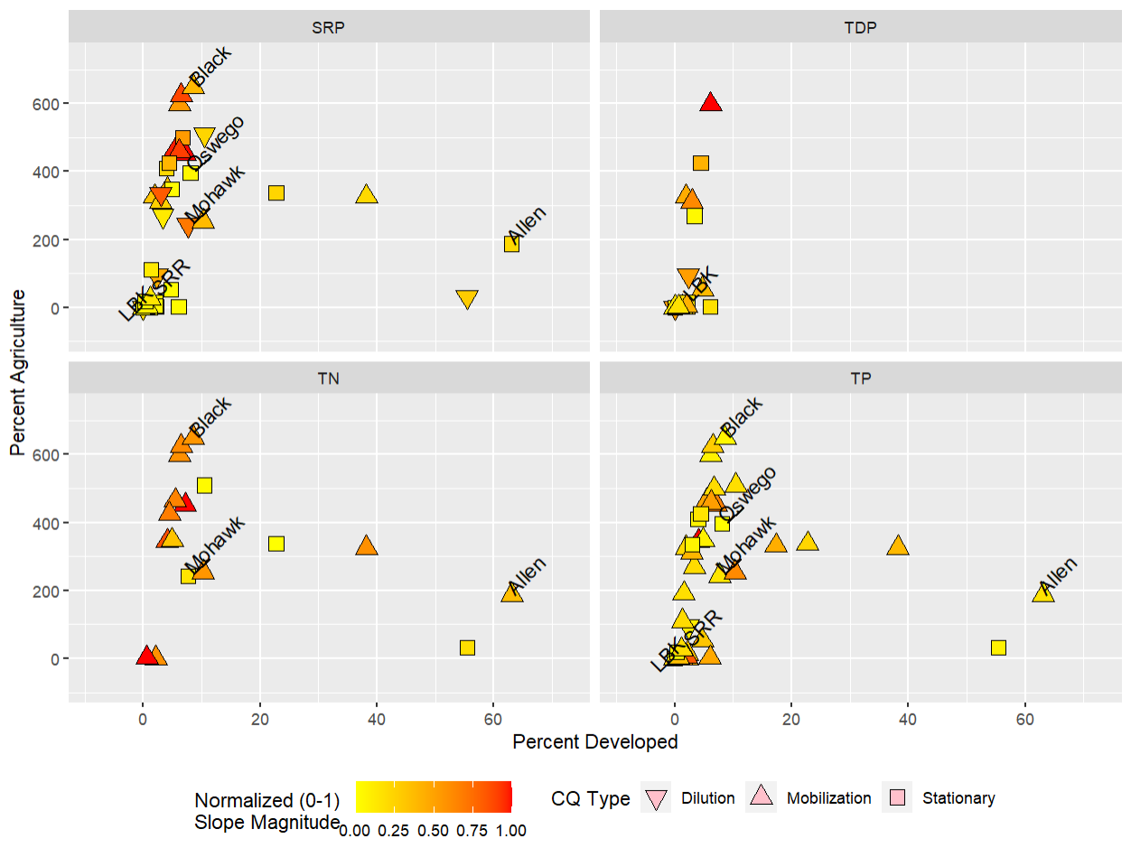
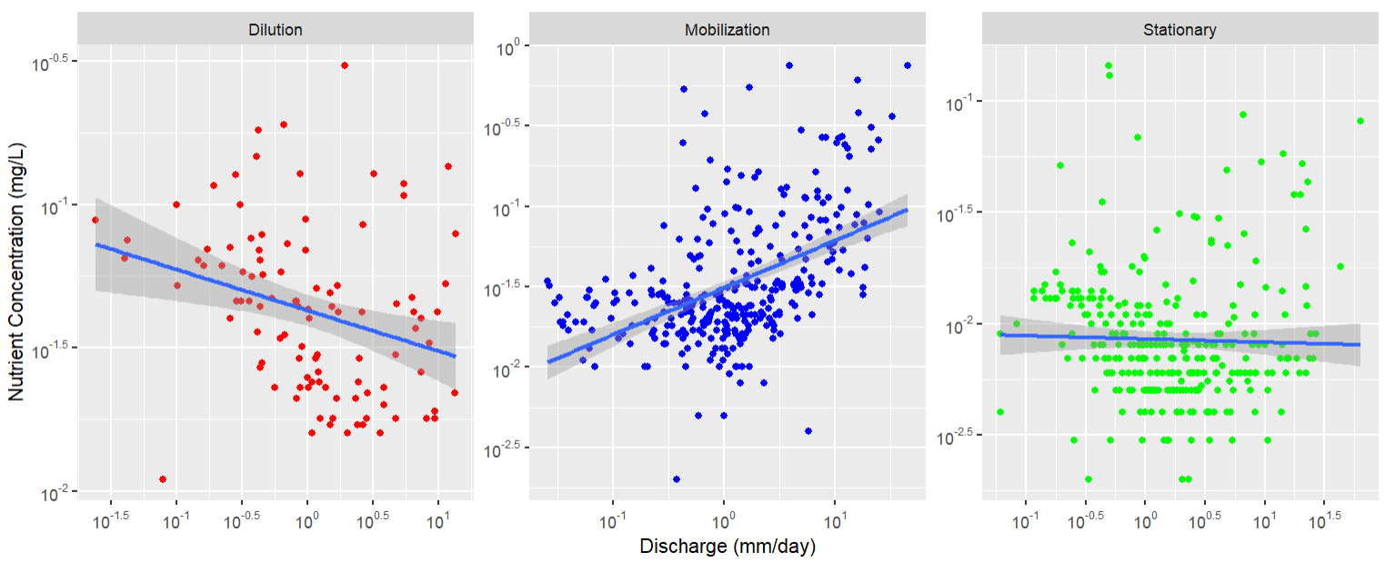
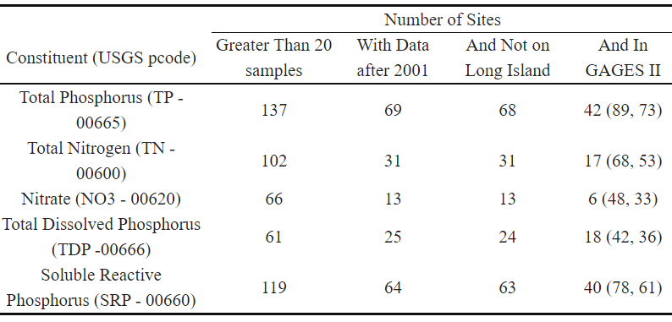
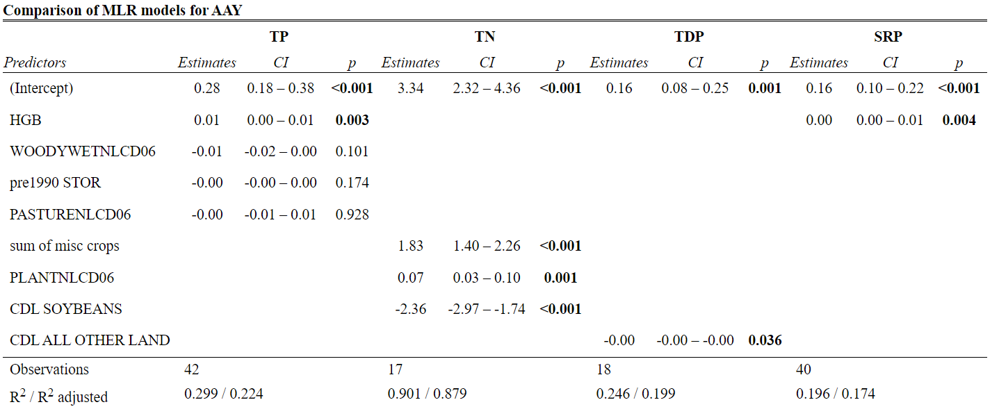
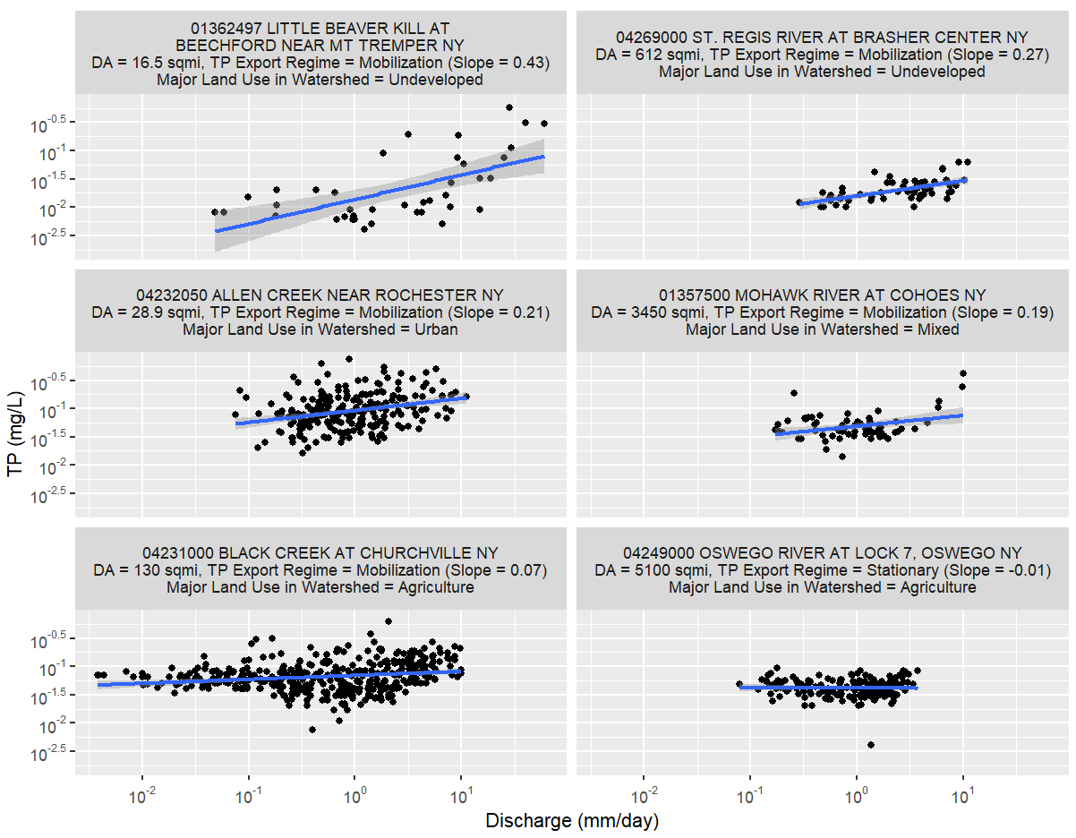
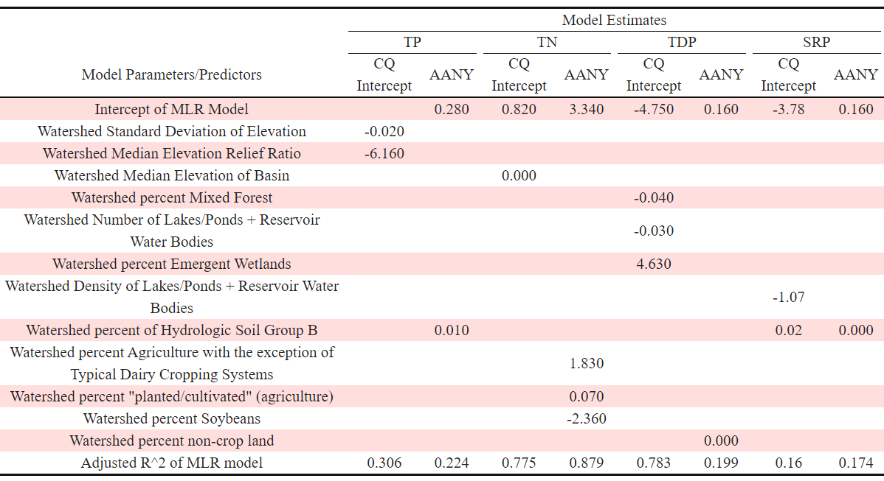
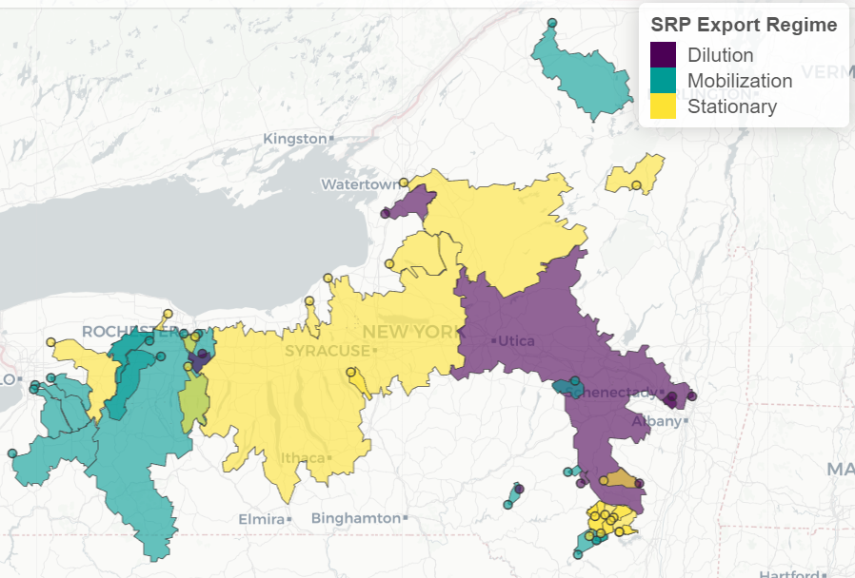
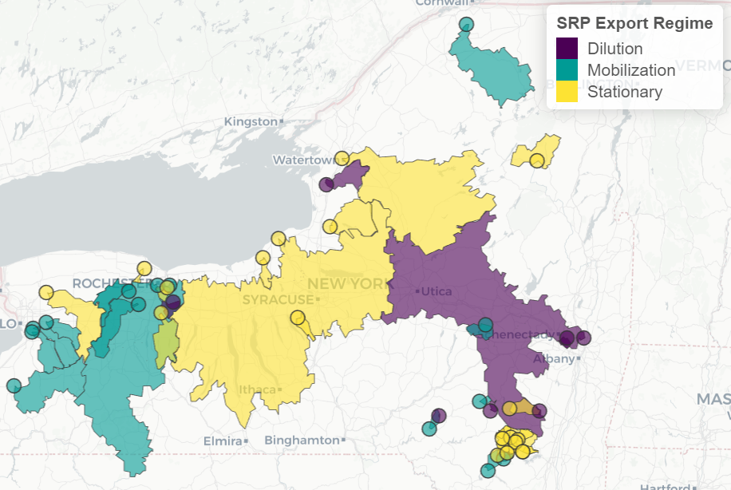
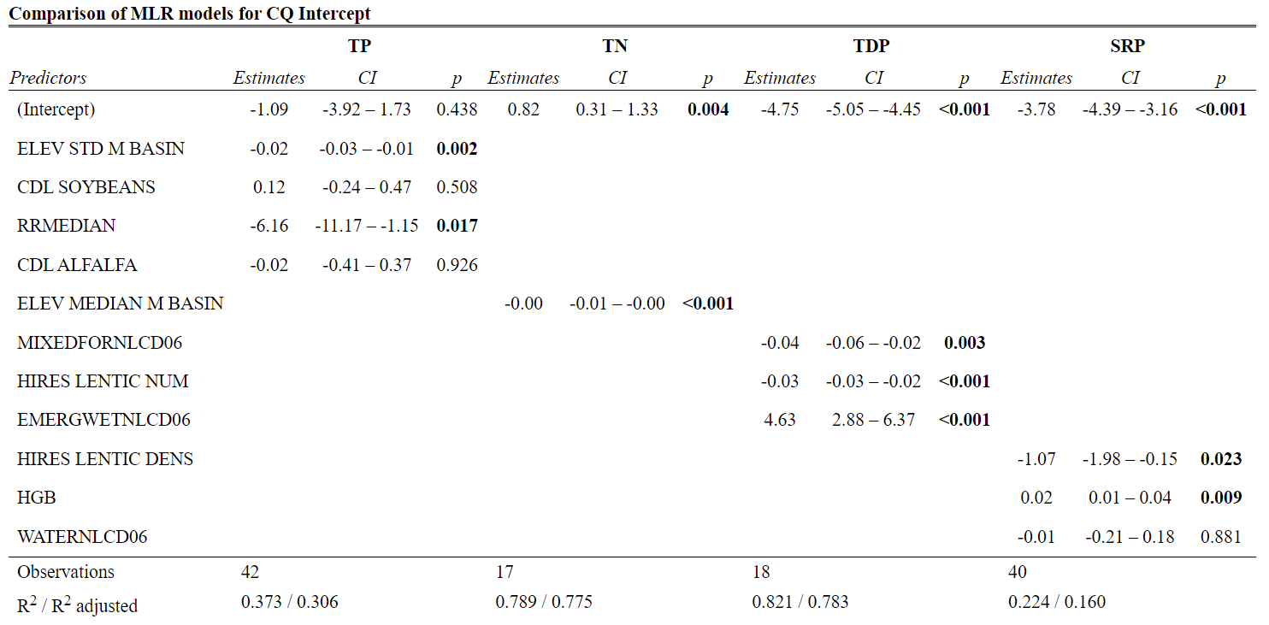
Implications of Watershed Characteristics on Nutrient Concentration-Discharge Relationships in NYS Rivers
Ryan Ruggiero¹, Chuck Kroll¹, Steve Shaw¹, Charley Driscoll²
¹SUNY ESF Department of Environmental Resources Engineering ²Syracuse University Department of Civil and Environmental Engineering
1) Background
Phosphorus (P) and Nitrogen (N) are key nutrients that play a pivotal role in governing primary productivity in freshwater systems. As anthropogenic activities continue to alter global P and N cycles, it becomes imperative to explore the relationship between nutrient concentrations in rivers and discharge
This dependency of nutrient concentrations on discharge – often referred to as a C-Q relationship or CQ curve - provides insight into watersheds-scale controls on nutrient export. The shape of the CQ relationship is often considered to be influenced by watershed characteristics such as land use, soils, and topography. The relationship between C and Q is often conceptualized by empirical models, where the intercept and slope represent essential descriptors of the relationship
3) Methods
4) Results
USGS NWIS Database Query for Sample Locations (Sites) in NYS
Filter List of Sites for Data Requirements
Analysis to Explore Variability in C-Q Relationships as a Function of Watershed Characteristics
Table 1 - Number of sampling locations in NYS with paired observations of USGS gauged flow and nutrient samples as a function of restrictions. The USGS National Water Information System (NWIS) was queried for 5 constituents, three phosphorus species and 2 nitrogen species. These 5 were chosen because they are common analytes in water quality sampling protocols. Nitrate was excluded from the analysis due to the limited number of site in the final site list used in this study (last column). The USGS Geospatial Attributes of Gages for Evaluating Streamflow (GAGES II) database was used as the source of watershed characteristics for the sites used in this study. The numbers in parentheses in the last column give the number of sites that are in GAGES II and meet the restriction criteria in the first and third column, respectively (i.e. no restrictions on the time of the sample).
Table 3 – Comparison of MLR models for Average Annual Yield.
Figure 1 – Conceptual diagrams of C-Q relationships showing the three different nutrient export regimes. A linear regression (blue line) is fit after transforming the data using logarithm base 10. This linear model is used to predict concentration on any day given when flow is known and can be used to estimate average annual nutrient yields. The slope is used to classify the export regime (stationary - slope is not significantly different than zero, dilutionary - slope is significantly different from zero and negative, and mobilization - slope is significantly different from zero and positive), and the intercept predicts the concentration in the river when the flow is equal to zero.
Figure 3 – CQ slope magnitude (normalized to between 0 and 1) as a function of disturbance in the watershed. The sites shown in Figure 3 are labeled. There is a lack of a clear trend in the strength and grouping of C-Q export regimes as a function of disturbance (H2)
2) Hypotheses
While extensive analyses of controls on nutrient export have been conducted in places such as the Chesapeake Bay watershed or intensive agricultural regions in the Ohio, there has been little synthesis of nutrient data collected in NYS. Our goal was to test the following hypotheses:
Anthropogenic disturbance in the watershed will contribute to higher nutrient export
Nutrient export regime (diluting, mobilizing, stationary) is controlled by land use
Table 3 – Estimates of the parameters and coefficient of the multiple linear regression (MLR) models fit to C-Q intercept and average annual nutrient yield (AANY) for each constituent. The predictors come from the GAGES II database and were selected to be included in the MLR models using forward selection and a maximum number of predictors of 5. Only the significant (p<0.05) parameters/predictors are displayed. TN AANY was the only model with positive coefficient estimates for land uses associated with anthropogenic disturbance (H1).
H1.
H2.
3) Methods
3.1) Data
The USGS NWIS database was queried for sites in NYS with >20 paired CQ observations for 5 constituents: total phosphorus (TP), total nitrogen (TN), nitrate (NO3), total dissolved phosphorus (TDP), and soluble reactive phosphorus (SRP). This list of sites was further reduced to those having observations after 2001, sites that are not on Long Island, and sites that are in the USGS Geospatial Attributes of Gages for Evaluating Streamflow database (GAGES II) (Figure 1). Due to a limited number of sites with NO3 data we just focused on TP, TN, TDP, and SRP.
3.2) Analysis
Ordinary least squares (OLS) regression was used to fit the CQ relationship (Figure 2). OLS estimates the coefficients of the linear relationship between the depended (concentration) and independent (discharge) variable. For a specific nutrient at a site, the export regime was determined to be mobilizing or dilutionary if the slope was significantly different from zero and positive or negative, respectively. The export regime was determined to be stationary if the slope was not significantly different from zero.
Average Annual nutrient yield (AAY) was calculated using the OLS regression and an average annual hydrograph (AAH). The AAH was determined by taking the average flow for every day of the year.
Spearman correlation coefficients and multiple linear regression (MLR) using forward selection were used to explore the GAGES II watershed attributes (predictors) that could explain the variations in intercept, slope, and AAY. MLR models were restricted to 5 or less predictors
4) Results
3.1) Water Quality Sites and CQ Trends
There were 42 sites with TP data, 17 with TN, 18 for TDP, and 40 with SRP.
There were 7 dilutionary sites for SRP. Of these 7, only 1 was also dilutionary for TP, while the other 6 were an even split of stationary and mobilizing. None of the TN sites were dilutionary
The distribution of the CQ slope magnitude varied across constituents across sites with varying levels of disturbance (Figure 3). The trend for TP was unclear. The trend for SRP shows that sites with low disturbance have lower slope magnitude, while 4 of the 7 dilutionary sites have considerable % agriculture in the watershed. The trend of TN shows that for both high and low disturbance sites mobilization can be strong
4.2) Correlations and MLR
For CQ intercept and AAY across constituents, with exception of SRP, land use predictors associated with high nutrient loading were generally in the top positive correlates, while land use predictors associated with lower nutrient loading were in the top negative correlates. Top correlates for CQ slope did not follow this trend
MLR models for CQ intercept had good adjusted R2 for TN and TDP, however the model fit for TP and SRP were poor. TN was the only constituent with good model performance for AAY (Tables 1 and 2).
The predictors that were selected for the intercept and AAY models did not overlap between the constituents except for % HSG B for TP and SRP AAY.
5) Conclusions and Future Directions
We aim to included more sites by replicating the GAGES II database predictors using open-source data layers. We can use the GAGES II database as QC for our data layer derived values before extending the workflow to non-GAGES II sites. We also wish to include predictors not in GAGES II, e.g. hydrography limb, wastewater treatment plants, and antecedent moisture conditions. This will allow us to account for the within-site variability and better highlight the between site variability
The goal of this work is to develop an empirical model to predict processed based model output
Figure 2 – C-Q curves for TP. Sites in each row represent similar major land uses – Row 1 is undeveloped (i.e. mostly forested), row 2 is Urban/mixed land use, and row 3 is Agricultural. The smaller of the two watersheds for the similar major land use are in column 1 and the larger of the two watersheds are in column 2. The smaller watersheds have stronger mobilization (indicated by higher slope values) and their point clouds are higher along the y-axis (indicating higher concentrations on average). The smaller sites have similar discharge as the larger sites because we normalized discharge by the drainage area size. When trying to explain the variability in the C-Q relationship parameters, site characteristics other than land use, soils, and slope (e.g. watershed size, hydrologic impoundments, and wastewater treatment plants) may wish to be examined as well.
Figure 2 – Map of watersheds for the sampling sites used in this study. The dots show the outlet (flow gauging station and nutrient sampling location) for each site and the polygons show the sites watershed boundary. The dots and polygons are colored according to the SRP export regime. Refer to Figure 1 for explanation of the different export regimes and Table 1 for the definition and justification of analyzing SRP.
6) Acknowledgments
This project is funded by DEC grant XXX. We would like to thank Anthony Prestigiacomo of the DEC for his input throughout the course of this project
Table 2 – Comparison of MLR models for CQ intercept.

