Slide 1
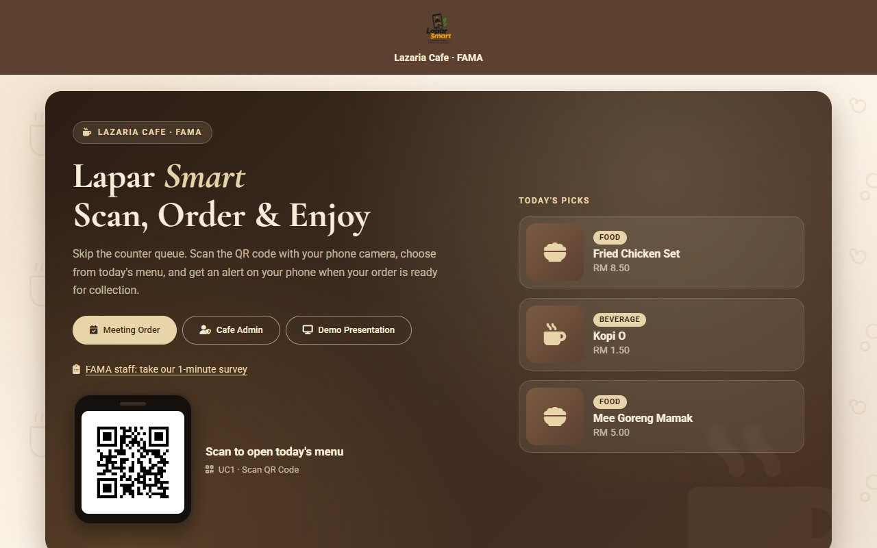
Lapar Smart
FINAL YEAR PROJECT PRESENTATION
QR Menu Ordering System for Lazaria Cafe, FAMA
Abdul Rashid Alias (B24030058)
Supervisor: Dr Ang Ling Weay (Fiona)
BIT4008 Undergraduate Project, Malaysia University of Science and Technology
Notes:
Introduce the project: a QR-accessed mobile web application for ordering at the Lazaria Cafe counter. The talk follows the research: literature, problem, evidence, objectives, method, system, testing and conclusion.

Slide 2
Three ways a cafe can take orders
LITERATURE REVIEW
The literature review compared the current manual practice with two digital approaches.
1
2
3
Manual ordering
Web menu system
QR menu ordering
Orders are given by voice at the counter. It needs no technology, but depends on human accuracy, keeps no record, and shows no progress (Jalaludin et al., 2023).
Orders are placed in a browser with no app to install, as in the UiTM Tapah and UTHM cafeterias. Browser push alerts are limited (AWS, 2026).
A QR code opens the menu at once. Users find it quick and easy (Shahril et al., 2024), but its value comes from the features behind the code.
Notes:
Section 2.2.1 to 2.2.3 of the report.

Slide 3
Existing systems serve restaurants
LITERATURE REVIEW
System | Order tracking | Order-ready alert | Meeting-room pre-order | Built for
Lapar Smart | Yes, status page | In-app and email | Yes, Chief Clerk | In-house staff cafe
Eats365 | Not stated | Not stated | Not stated | Restaurant POS
StoreHub | Not stated | Not stated | Not stated | Restaurant POS
EPOS360 | Not stated | Not stated | Not stated | Restaurant POS
Research gap: no lightweight system was found that combines a daily menu run by the cafe, meeting-room catering pre-orders, and order tracking with an alert, without a POS subscription.
Notes:
Sections 2.2.4 to 2.2.6. Not stated means the vendor pages reviewed do not mention the feature.

Slide 4
Five problems with ordering at Lazaria Cafe
PROBLEM STATEMENT
1
Long queues
The counter is congested at peak hours, so staff lose their short break waiting.
2
Wrong orders
Orders given by voice are misheard, and the wrong food is prepared.
3
No order tracking
Staff wait at the counter because they are not told when the order is ready.
4
A menu that changes daily
The cafe admin has no quick digital way to publish the day's menu.
5
Catering by phone
Meeting-room catering is arranged by phone, so details are delayed or inaccurate.
Notes:
Section 2.1. The next two slides check these problems with the users.

Slide 5
The questionnaire confirms the problems
QUESTIONNAIRE
30 administrative assistants (Pembantu Tadbir) at FAMA headquarters answered a five-question online form shared through WhatsApp.
36.7%
60.0%
93.3%
76.7%
waited 11 minutes or longer in the queue
received a wrong order at least once
find an order-ready notification useful
want to pre-order catering for meetings
Purposive sample of 30 respondents (Table 3.1 and Appendix D of the report).
Notes:
73.3% buy from the cafe three or more times a week, so the queue affects most of them.

Slide 6
The cafe admin describes the same problems
INTERVIEW
A face-to-face interview with the Lazaria Cafe admin, held in Malay on 9 November 2026.
1
Daily menu
The menu is decided every morning from a monthly schedule.
2
Counter at lunch time
The queue is long, and noise makes the admin repeat questions.
3
Meeting requests
They come by phone a day or two ahead, are written on paper, and the headcount often changes.
4
Main challenges
Misheard orders, long queues, knowing who has paid, and keeping track of meeting bookings.
Notes:
Section 3.2.2 and Appendix A.

Slide 7
The findings set four objectives
OBJECTIVES
Aim: a QR-accessed mobile web application for ordering at Lazaria Cafe, FAMA.
Evidence from the questionnaire and interview | Objective of the system
36.7% waited 11 minutes or more; long queues at lunch time | 1. Staff scan a QR code, view the daily menu and order from their phone
60.0% got a wrong order; the menu changes every morning | 2. An admin module to update the daily menu and the status of each order
93.3% want a notification; staff now wait at the counter | 3. An order-ready alert in the app and by email
76.7% want to pre-order; meeting requests are kept on paper | 4. Meeting-room catering pre-orders by a Chief Clerk
Notes:
Objectives from Section 1.2, each traced back to the evidence.

Slide 8
Agile Scrum in six sprints over ten weeks
METHODOLOGY
0
1
2
3
4
5
Planning
Analysis and design
Core development
Enhancement
Testing
Deployment
14 to 21 Sep
21 Sep to 6 Oct
7 to 27 Oct
28 Oct to 3 Nov
4 to 11 Nov
12 to 20 Nov
Proposal, backlog, Gantt chart
Requirements, UI wireframes
Ordering, admin, catering
UI and feature refinements
Functional and regression tests
Vercel release, final report
One developer acts as product owner, Scrum Master and developer, with a self-review at the end of every sprint.
Notes:
Scrum leaves room to re-plan after each sprint review.

Slide 9
From requirements to a tested design
METHODOLOGY
1
2
3
4
Data collection
UML modelling
Requirements
Testing method
A questionnaire for FAMA staff and an interview with the cafe admin set the requirements.
Use case, sequence, class, entity relationship, architecture and data flow diagrams.
15 functional and 4 non-functional requirements, each linked to a use case.
A functional test and a regression test for every one of the 14 use cases.
Notes:
Sections 3.2 to 3.4.

Slide 10
Three kinds of user, fourteen use cases
METHODOLOGY
1
2
3
FAMA Staff
Chief Clerk (CC)
Cafe Admin
Scan the QR code, browse the menu, place a counter order and track it. No login.
Registers and logs in with a Staff ID to order meeting-room catering.
Manages the daily menu, orders, order status and Cafe Admin accounts.
Notes:
The Chief Clerk is a specialisation of FAMA Staff in the use case diagram.

Slide 11
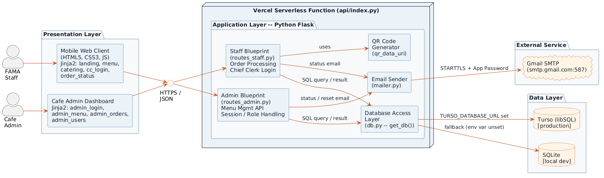
A three-tier architecture on free cloud tiers
IMPLEMENTATION
Presentation
Server-rendered pages for phone browsers
Application
Python Flask on Vercel serverless
Data
Turso (libSQL), SQLite in development
Email
Gmail SMTP for alerts and resets
Notes:
Turso replaced a local SQLite file because the Vercel file system is not persistent.

Slide 12
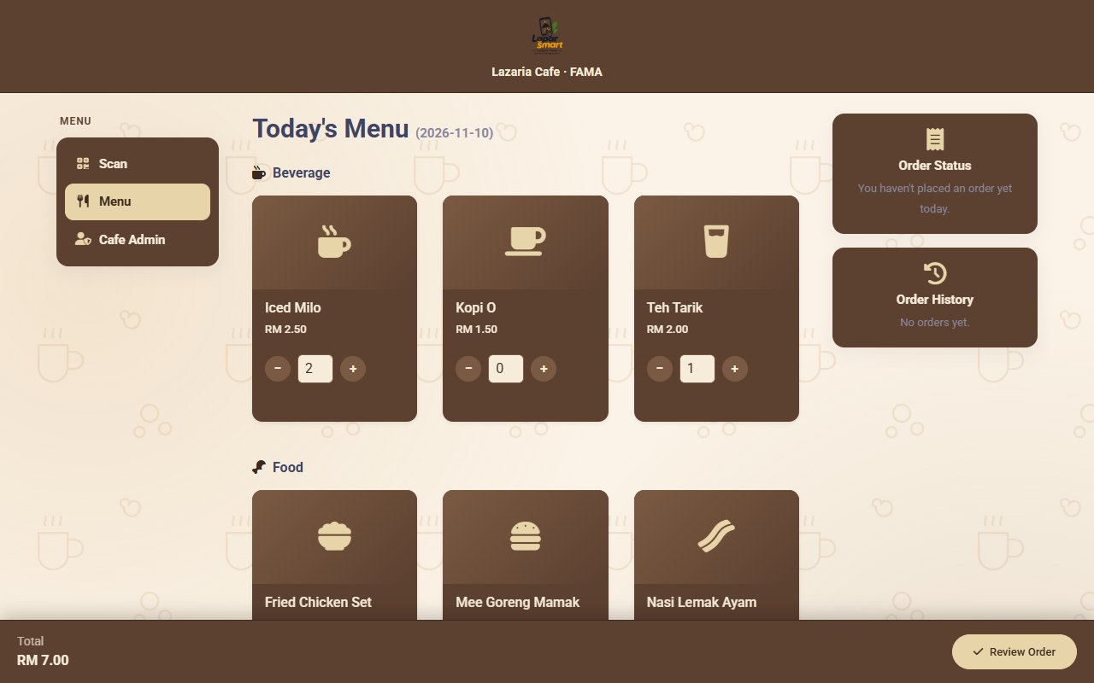
Staff order from their phone in three steps
IMPLEMENTATION
Scan the QR code. The daily menu opens with no login.
Choose items and quantities from today's menu.
Review the order and enter Staff ID, name, department, phone and email.
The server re-reads every price, so the browser is never trusted.
Notes:
Objective 1. Use cases Scan QR Code, View Daily Menu, Place Order and Review Order.

Slide 13
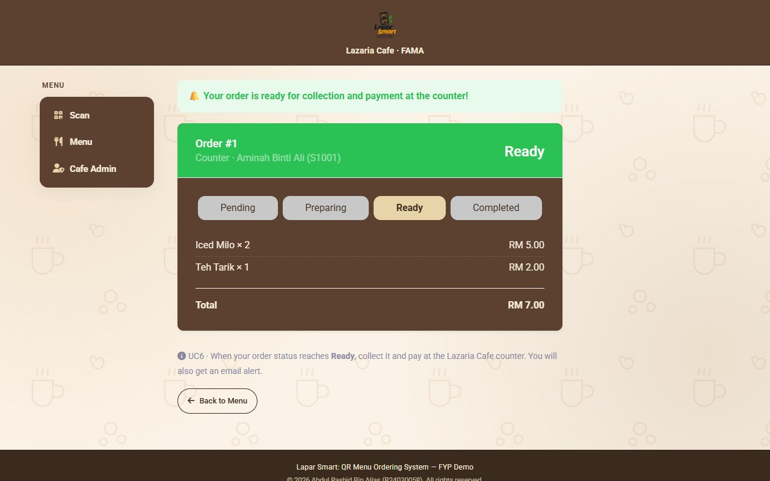
The order is tracked until it is ready
IMPLEMENTATION
Four statuses: Pending, Preparing, Ready and Completed.
The status page refreshes every 3 seconds and shows an alert at Ready.
An email is sent through Gmail, so the alert arrives even when the page is closed.
Payment is made at the counter on collection.
Notes:
Objective 3. Use case Receive Order Notification.

Slide 14
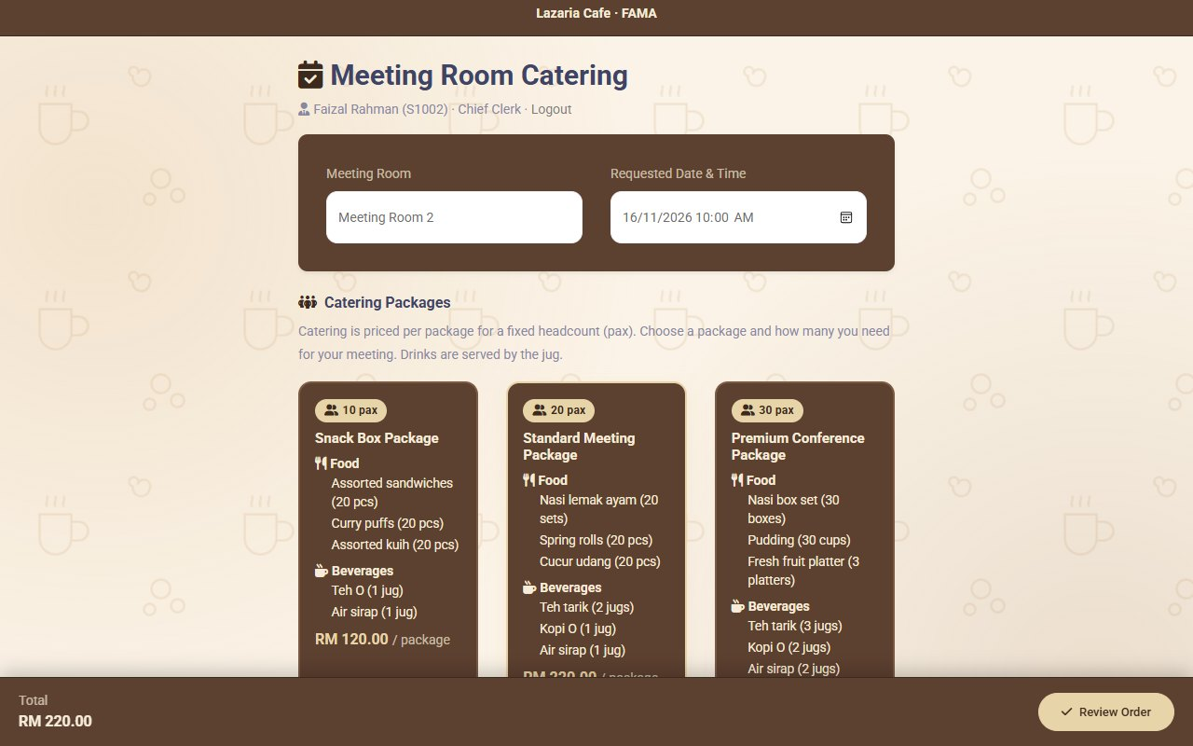
Chief Clerks reserve catering for meeting rooms
IMPLEMENTATION
The Meeting Order button leads to the Chief Clerk login.
Each package lists its food and its beverages by the jug.
The Chief Clerk chooses the room, the date and time, and the quantity.
An email follows at Pending, Preparing, Ready and Completed.
At Ready, cafe staff deliver the order to the meeting room.
Notes:
Objective 4. Use case Reserve Meeting Room Order.

Slide 15
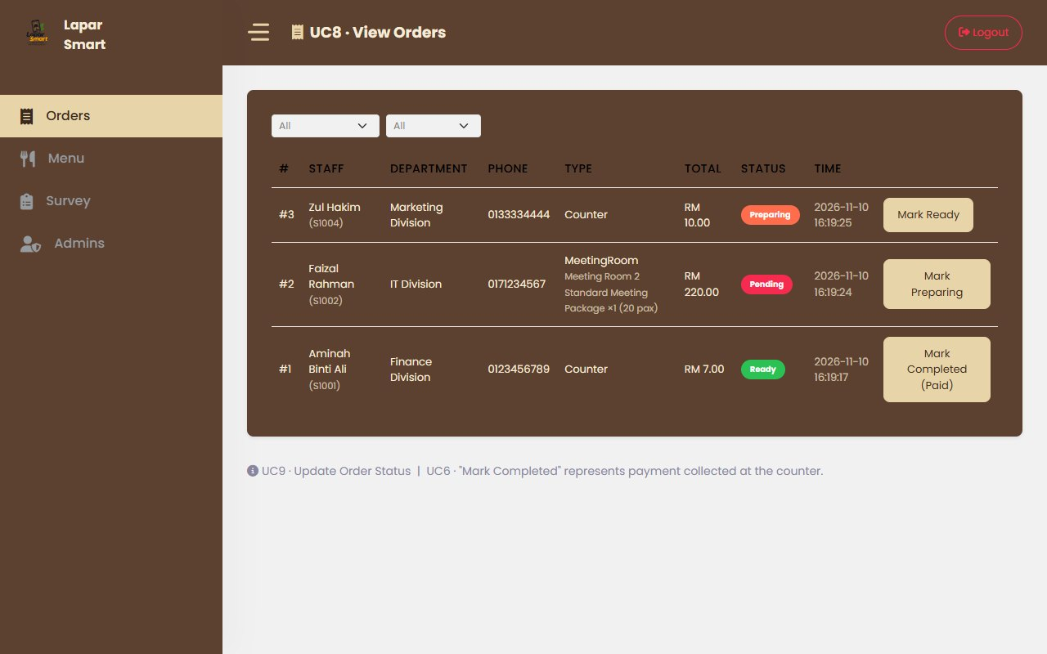
The cafe admin runs the day from one dashboard
IMPLEMENTATION
View and filter counter and meeting-room orders.
Move an order to the next status with one click.
Add, hide or delete items on the daily menu.
Manage Cafe Admin accounts, with registration and password reset by email.
Notes:
Objective 2. Use cases View Orders, Update Order Status, Mark Order Completed, Update Daily Menu and Manage Cafe Admins.

Slide 16
Every use case passed its tests
TESTING
UC1 Scan QR Code
FT-01 RT-01
Pass
UC2 View Daily Menu
FT-02 RT-02
Pass
UC3 Place Order
FT-03 RT-03
Pass
UC4 Reserve Meeting Room Order
FT-04 RT-04
Pass
UC5 Receive Order Notification
FT-05 RT-05
Pass
UC6 Mark Order Completed
FT-06 RT-06
Pass
UC7 Update Daily Menu
FT-07 RT-07
Pass
UC8 View Orders
FT-08 RT-08
Pass
UC9 Update Order Status
FT-09 RT-09
Pass
UC10 Manage Cafe Admins
FT-10 RT-10
Pass
UC11 Register Admin
FT-11 RT-11
Pass
UC12 Forgot Password
FT-12 RT-12
Pass
UC13 Review Order
FT-13 RT-13
Pass
UC14 Login
FT-14 RT-14
Pass
Each test was run through the user interface on the final build and compared with its expected output (Chapter 5 and Appendix C).
Notes:
FT is the functional test and RT the regression test of each use case.

Slide 17
Every objective is achieved
TESTING
The traceability matrix links each objective to its use cases, requirements and test cases.
Objective | Use cases | Requirements | Tests | Status
1. QR ordering | Scan QR Code, View Daily Menu, Place Order, Review Order | FR1 to FR3, FR13 | FT and RT 01, 02, 03, 13 | Achieved
2. Admin module | Update Daily Menu, View Orders, Update Order Status, Mark Completed, Manage Admins, Register, Forgot Password, Login | FR6 to FR12, NFR4 | FT and RT 06 to 12, 14 | Achieved
3. Order-ready alert | Receive Order Notification | FR5, FR15 | FT and RT 05 | Achieved
4. Meeting-room orders | Reserve Meeting Room Order | FR4, FR14 | FT and RT 04 | Achieved
Objective 3 is achieved with an in-app alert, shown while the status page is open, and an email alert (Table 5.5 of the report).
Notes:
Each objective is traced to its use cases, requirements and test cases.

Slide 18
Strengths of the system
CONCLUSION
1
Ordering from a phone
Staff order without queuing at the counter.
2
Accurate orders
Digital orders replace verbal ordering.
3
Alerts that reach staff
An in-app alert and an email when the order is ready.
4
One dashboard
The admin updates the daily menu and every order status in one place.
5
Meeting-room catering
Chief Clerks pre-order packages instead of phoning the cafe.
Notes:
Section 6.1.

Slide 19
Limitations of the system
CONCLUSION
1
Payment at the counter
No online or e-wallet payment is built in.
2
No user acceptance test
Usability has not yet been confirmed by FAMA staff.
3
Self-reported identity
Staff details and Chief Clerk registration are not verified.
4
In-app alert needs the page open
The email alert covers the case when the page is closed.
5
Load tested locally only
High order volumes were not tested on the production database.
Notes:
Section 6.2.

Slide 20
Future work
CONCLUSION
1
2
3
4
Online payment
Verified identity
Push alerts
User acceptance test
Add an e-wallet or payment gateway so staff can pay in the app.
Check staff identity and approve Chief Clerk registrations.
Deliver alerts with Web Push or as a Progressive Web App.
Test with FAMA staff and run a production-scale load test.
Notes:
Section 6.3.

Slide 21
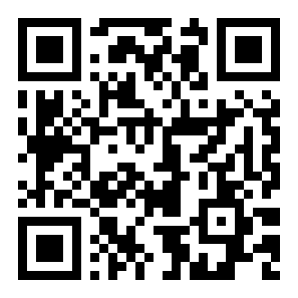
LIVE DEMONSTRATION
Scan, Order & Enjoy
Scan the QR code or open the link to try Lapar Smart.
lapar-smart-tawny.vercel.app
Scan to open the system
Thank you. Questions are welcome.
Notes:
Open the production site for the live demonstration.

