Slide 1
Soil Quality Monitoring System Based on IoT
Mohd. Rasadin
rasadin.ewu@gmail.com

Slide 2
The project is designed to monitoring moisture, ph, temperature of soil. In the field of agriculture, use of proper method of quality monitoring is important. The advantage of using this method is to increase the rate of production in agriculture.

Slide 3
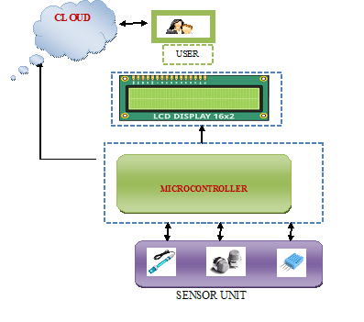
Process

Slide 4
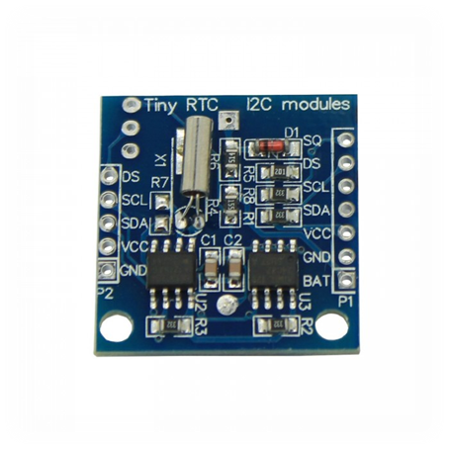
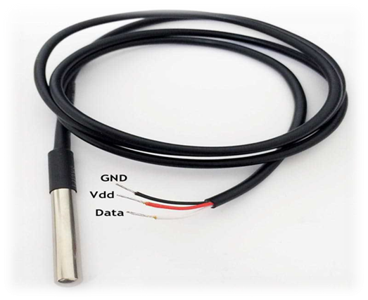
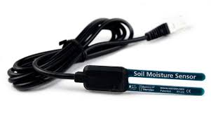
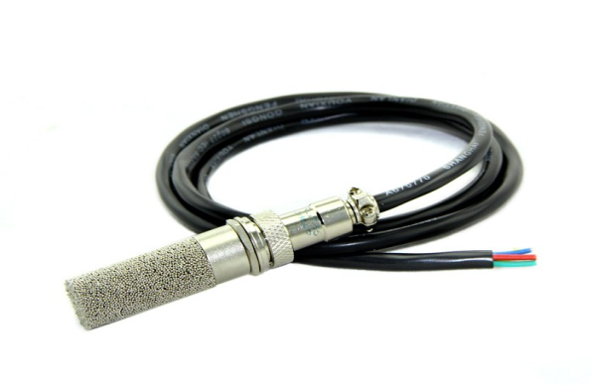
Hardware
RTC
Soil Moisture Sensor
Soil Moisture & Temperature Sensor

Slide 5
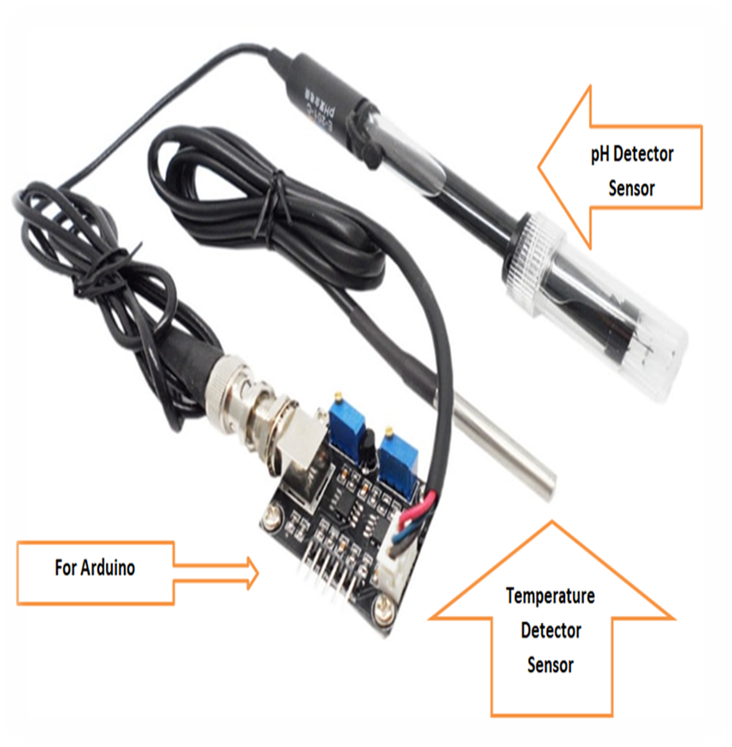
Hardware

Slide 6
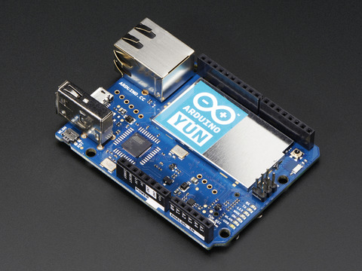
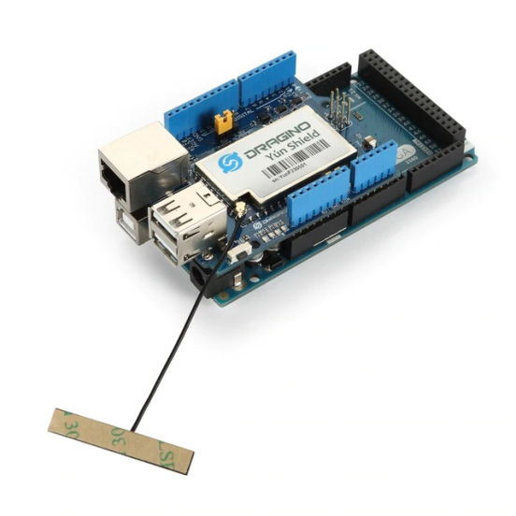
Hardware
Main Module
Yun shield
Arduino Yun

Slide 7
Software
1. Arduino IDE
2. CLOUD
3. Our developed web application using html, css, php, JavaScript and MySQL

Slide 8
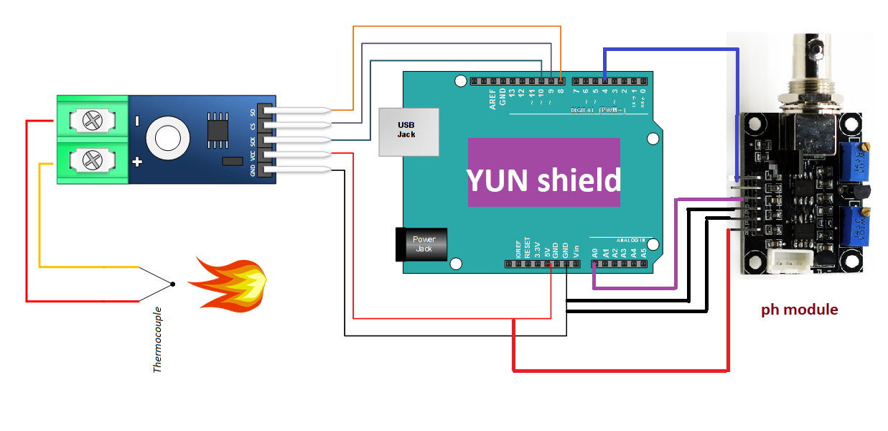
Circuit Diagram

Slide 9
Thank You!

