Slide 1
Computer Vision and Pattern Recognition
CS 4243
Assignment2: Segmentation
TA: Yu Ziwei
yuziwei@u.nus.edu
Notes:
What is the segmetation.

Slide 2
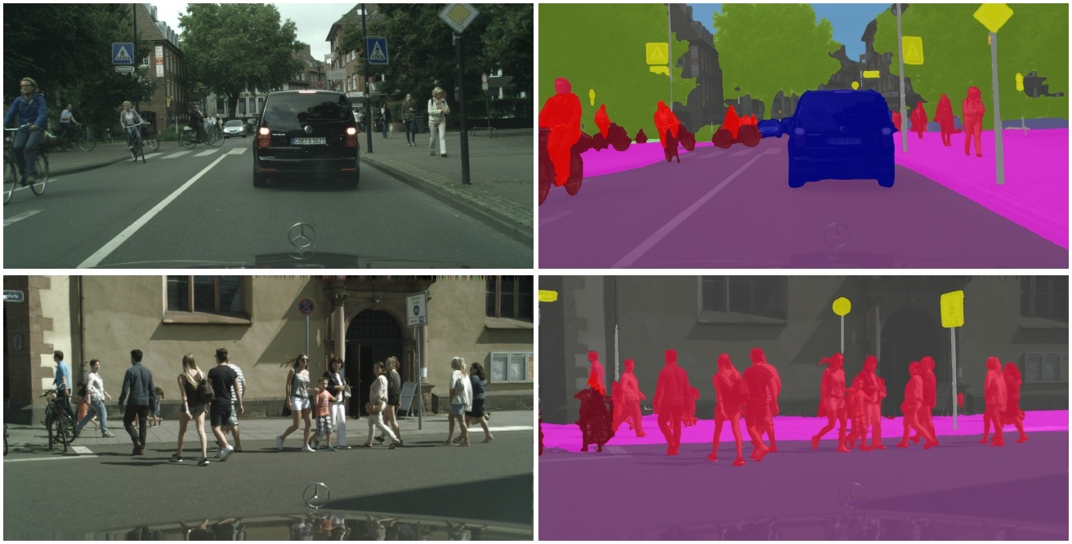
Segmentation
Source: https://images.app.goo.gl/zJPUs65jQecjLBdd7
Notes:
What is the segmetation.

Slide 3
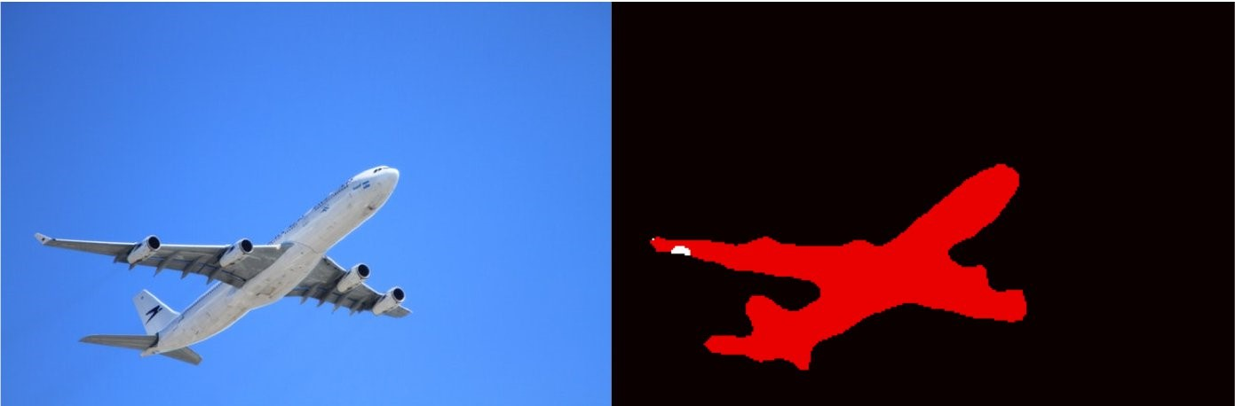
Segmentation
Foreground : We always like to pay attention to the foreground like the “plane” (^0^）.
Background : Usually, we are not interested to the background like the “sky” （T_T）.
Source: https://images.app.goo.gl/Uw5Q7UCTrstWVKVp7

Slide 4
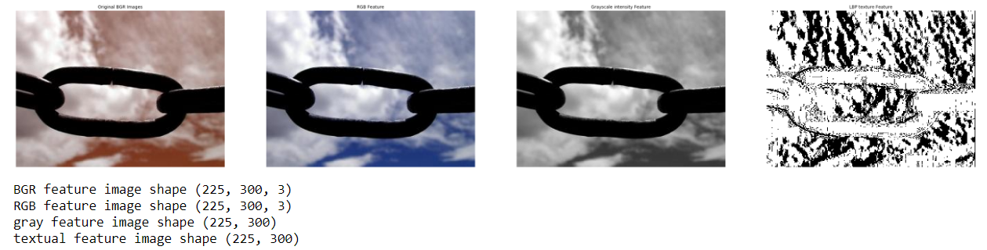
Segmentation
Image feature:
BGR image
RBG image
Gray image
Texture image
You can just use the opencv package to try it.

Slide 5
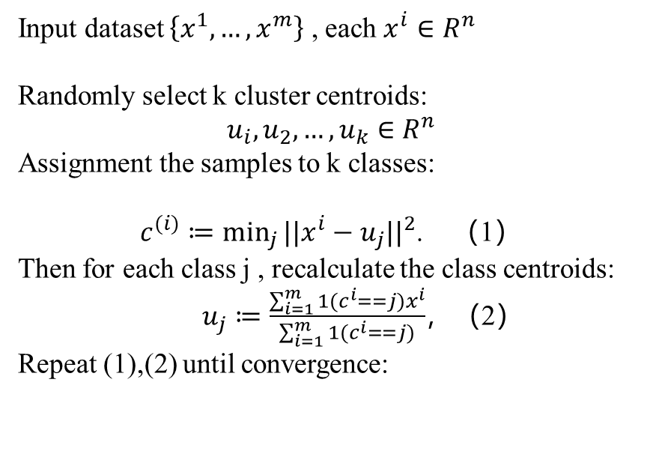
Segmentation
K-means clustering algorithm
Mean shift clustering algorithm
Input dataset $\left\{x^{1},…,x^{m}\right\}$ , each $x^{i}∈R^{n}$
Randomly select k cluster centroids:
$$u_{i},u_{2},…,u_{k}∈R^{n}$$
Assignment the samples to k classes:
$c^{(i)}≔\min_{j}{||x^{i}−u_{j}||^{2}}$. （1）
Then for each class j , recalculate the class centroids:
$u_{j}≔\frac{\sum_{i=1}^{m}{1(c^{i}==j)x^{i}}}{\sum_{i=1}^{m}{1(c^{i}==j)}}$，（2）
Repeat (1),(2) until convergence:
Source: https://images.app.goo.gl/P6RELLksBywZvM6s7

Slide 6
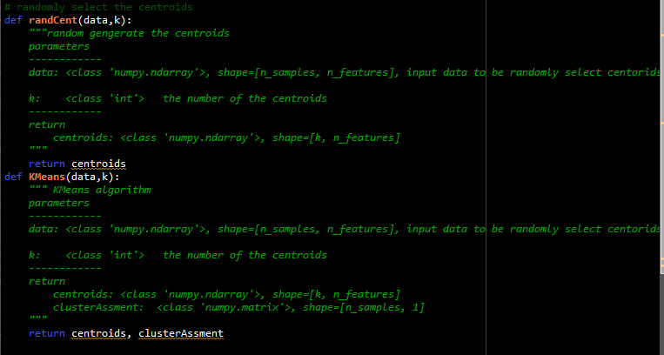
Segmentation
K-means clustering algorithm
Mean shift clustering algorithm
You need to finish:

Slide 7
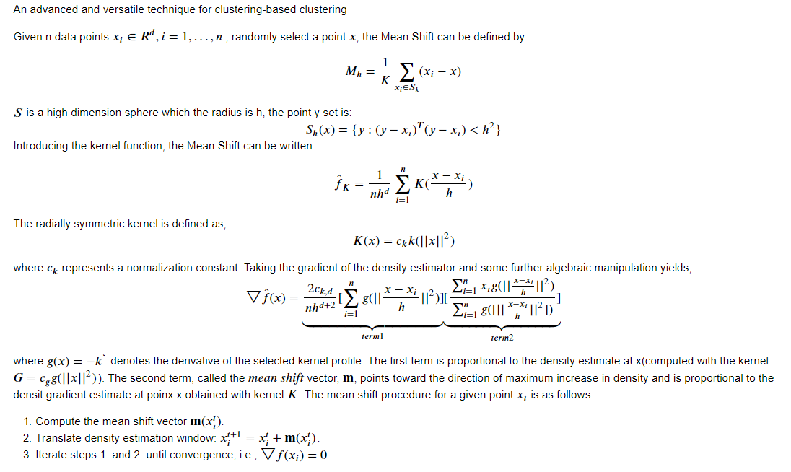

Segmentation
K-means clustering algorithm
Mean shift clustering algorithm
Source:https://images.app.goo.gl/xx58jLhkoQ4RrVqX8

Slide 8
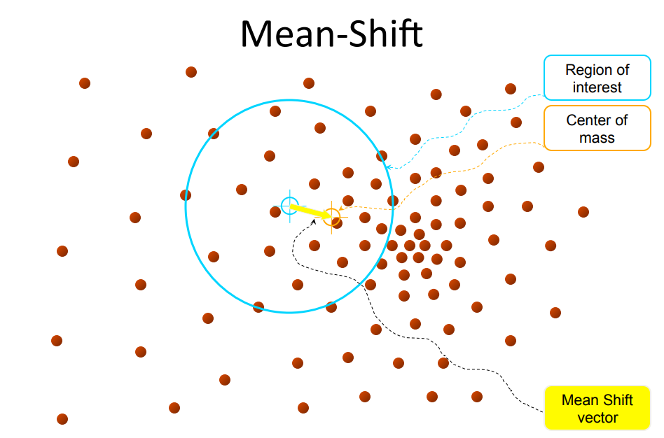
Segmentation
K-means clustering algorithm
Mean shift clustering algorithm
Forget the math equation, follow me!!! You just need three steps
Source: http://vision.stanford.edu/teaching/cs131_fall1314_nope/lectures/lecture13_kmeans_cs131.pdf

Slide 9
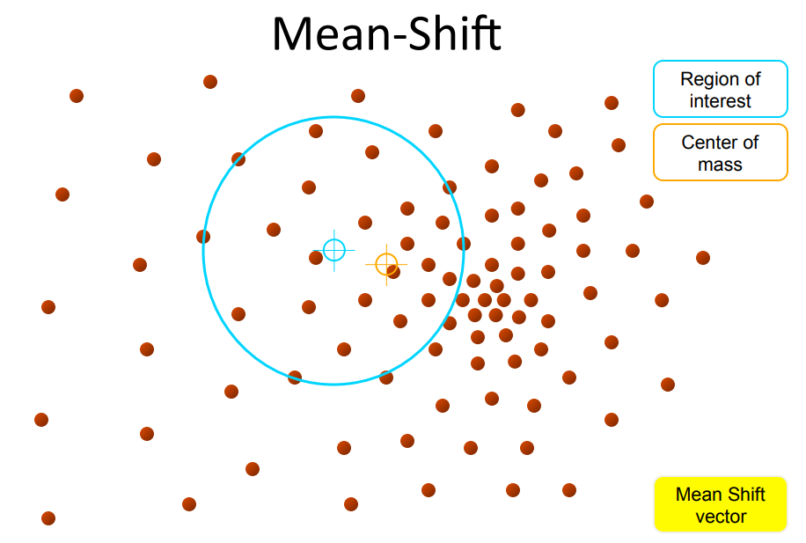
Segmentation
K-means clustering algorithm
Mean shift clustering algorithm
Step 1
Source: http://vision.stanford.edu/teaching/cs131_fall1314_nope/lectures/lecture13_kmeans_cs131.pdf

Slide 10
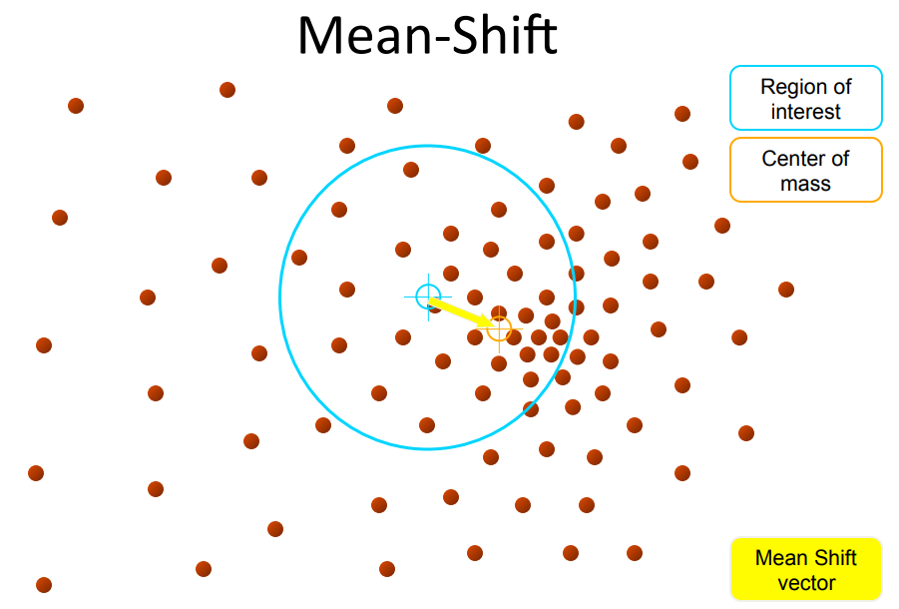
Segmentation
K-means clustering algorithm
Mean shift clustering algorithm
Step 2
Source: http://vision.stanford.edu/teaching/cs131_fall1314_nope/lectures/lecture13_kmeans_cs131.pdf

Slide 11
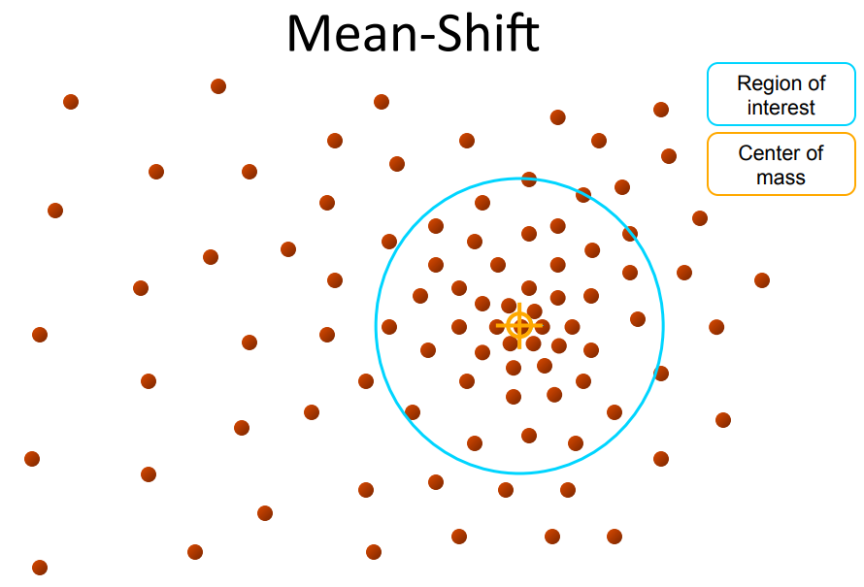
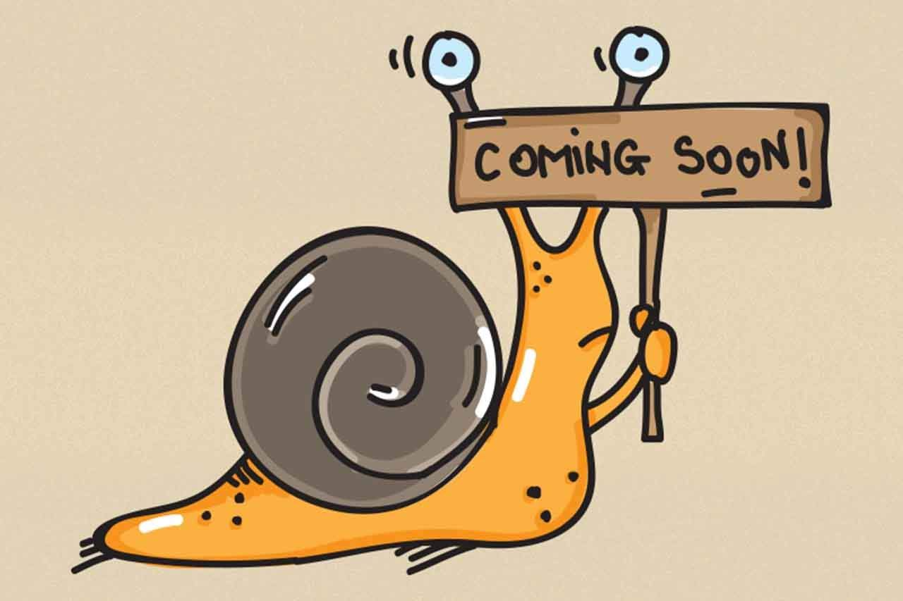
Segmentation
K-means clustering algorithm
Mean shift clustering algorithm
Loop step1 and step 2, until convergence
But, If you have 100k, too slow
Source: https://images.app.goo.gl/8wrmq4JCDcKBHt6j6
Source: http://vision.stanford.edu/teaching/cs131_fall1314_nope/lectures/lecture13_kmeans_cs131.pdf

Slide 12
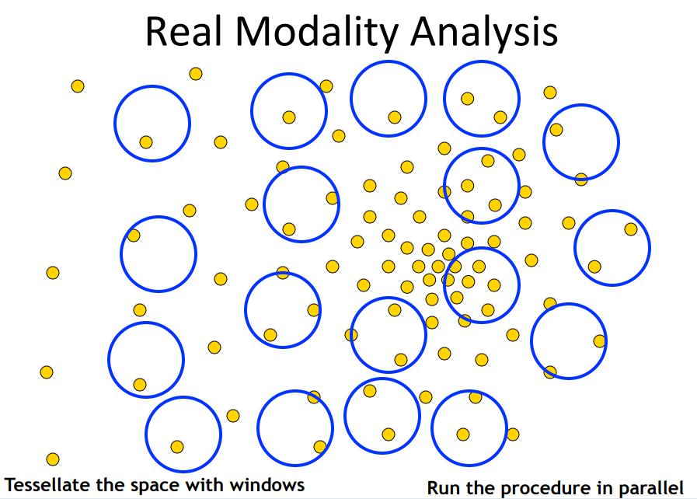
Segmentation
K-means clustering algorithm
Mean shift clustering algorithm
Run the procedure in parallel
Source: http://vision.stanford.edu/teaching/cs131_fall1314_nope/lectures/lecture13_kmeans_cs131.pdf

Slide 13
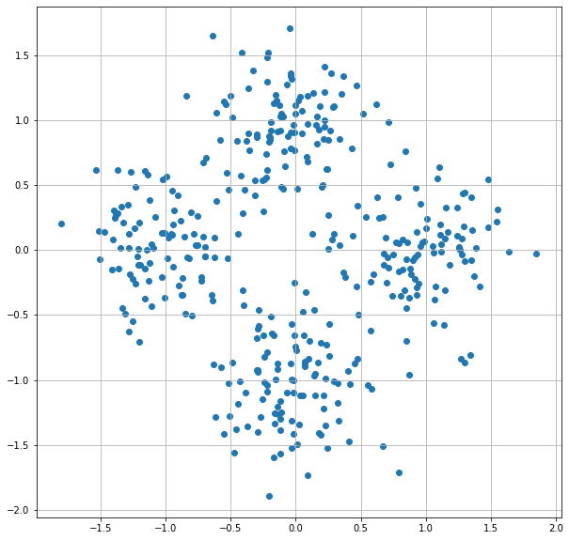
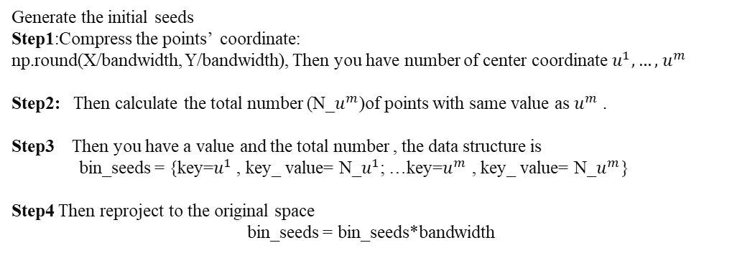
Segmentation
K-means clustering algorithm
Mean shift clustering algorithm
Generate the initial seeds
Step1:Compress the points’ coordinate:
np.round(X/bandwidth, Y/bandwidth), Then you have number of center coordinate $u^{1},…,$ $u^{m}$
Step2: Then calculate the total number (N_$u^{m}$)of points with same value as $u^{m}$ .
Step3 Then you have a value and the total number , the data structure is
bin_seeds = {key=$u^{1}$ , key_ value= N_$u^{1}$; …key=$u^{m}$ , key_ value= N_$u^{m}$}
Step4 Then reproject to the original space
bin_seeds = bin_seeds*bandwidth

Slide 14
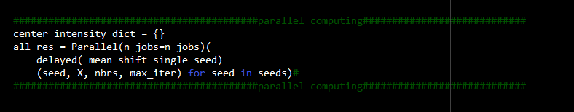
Segmentation
K-means clustering algorithm
Mean shift clustering algorithm
For parallel computing, do not worry, You just need
“From sklearn.utils.__joblib import Parallel”
Thanks to “sklearn package”:

Slide 15
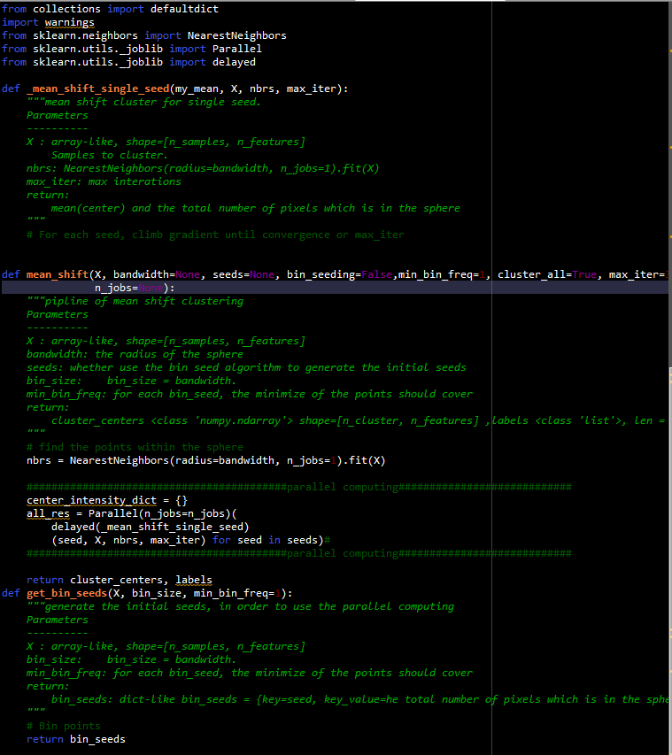
Segmentation
K-means clustering algorithm
Mean shift clustering algorithm
You need to finish:

Slide 16
Segmentation
Reference:
K-means clustering
https://en.wikipedia.org/wiki/K-means_clustering
Mean shift clustering
https://en.wikipedia.org/wiki/Mean_shift
Np.linalg.norm
https://docs.scipy.org/doc/numpy/reference/generated/numpy.linalg.norm.html
K-nearest neighbors algorithm
https://en.wikipedia.org/wiki/K-nearest_neighbors_algorithm
Sklearn.neighbors.NearestNeighbors
https://scikit-learn.org/stable/modules/generated/sklearn.neighbors.NearestNeighbors.html
If you have any problem, please feel free to tell me.
yuziwei@u.nus.edu

