Slide 1
Lamport One time signature (ots)
AKKARAJU RASAGNYA – CB.SC.U4CYS24002
ANKAM CHARAN TEJA – CB.SC.CYS24003
APPAKONDAPPAGARI PRANIDEEP – CB.SC.U4CYS24004
ARANYA ROY – CB.SCU4CYS24005

Slide 2
What is the Project ?
This project is an interactive web-based simulation that visually demonstrates how the Lamport One-Time Signature (OTS) scheme works — a fundamental concept in digital signatures and post-quantum cryptography.
It allows users to:
Understand how hash-based signatures are created and verified.
Explore both secure and attack scenarios interactively.
See the effects of tampering on message verification in real time.
The system guides the user through three simple steps:
Enter a message to sign.
Generate a signature using the Lamport OTS scheme.
Verify or tamper with the message to see how integrity is affected.
It visually reinforces key cryptographic principles like:
One-time key pairs
Message hashing
Signature verification
Integrity and authenticity

Slide 3
TECH STACK
Layer | Technologies Used | Description
Frontend | HTML5,CSS3,Javascript(ES6) | For user interface, styling, and interactivity.
Visualization / UI Logic | DOM Manipulation, Dynamic Event Handling | Shows message flow, tampering, and verification feedback dynamically.
Core Cryptographic Logic | Custom JS Implementation of Lamport OTS using SHA-1 hashing. | Generates private/public keys, hashes messages, and verifies authenticity.
Design Framework | Custom CSS + Flexbox/Grid Layout | Used for responsive, modern interface styling.
Icons & Emojis | Unicode emojis (🛡️ ⚠️ ✅ ❌) | Used for intuitive feedback and mode indication.

Slide 4
1. Strive for consistency
Consistent sequences of actions should be required in similar situations, identical terminology should be used in prompts, menus, and help screens, and consistent color, layout, capitalization, fonts, and so on, should be employed throughout.
Exceptions, such as required confirmation of the delete command or no echoing of passwords, should be comprehensible and limited in number.
Whether it is the layout, the size of the button, the color code or the tone used when writing the page, it is important to be consistent throughout the site. This consistency will allow you to develop your identity and not lose users as they navigate your site.

Slide 5
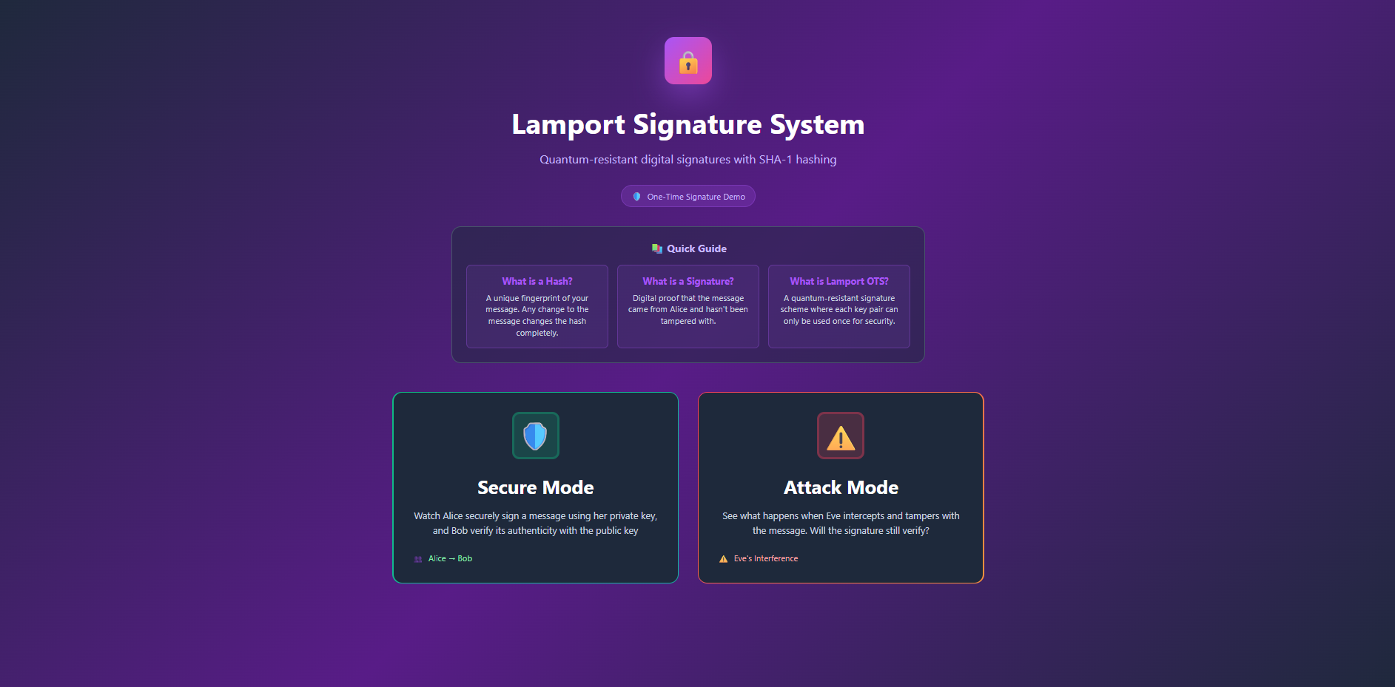
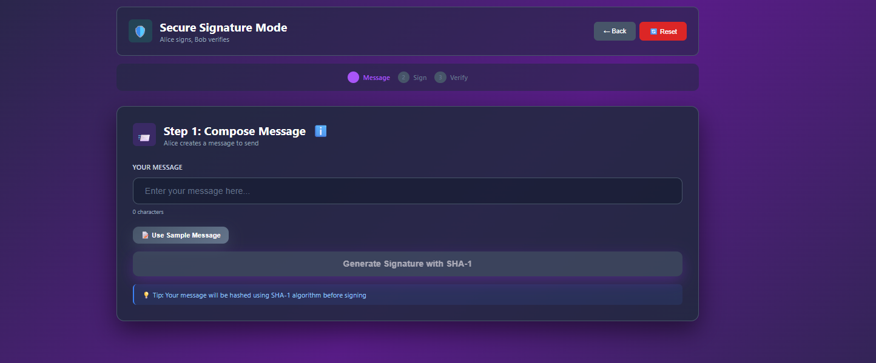
How we covered it:
Button labeling: “Try Another Signature,” “Undo Tamper,” and “Reset” all follow the same style and capitalization.
Button styles & layout: All action buttons use the .btn class → same font, color, hover effects, padding.
Sequence of actions: The three-step flow (Enter Message → Sign → Verify) is consistent every time.
Exceptions: Only the confirmation messages (like “Message cannot be empty”) deviate, but are clear and limited.

Slide 6
2. SEEK UNIVERSAL USABILITY
Recognize the needs of diverse users and design for plasticity, facilitating transformation of content.
Novice to expert differences, age ranges, disabilities, international variations, and technological diversity each enrich the spectrum of requirements that guides design.
Adding features for novices, such as explanations, and features for experts, such as shortcuts and faster pacing, enriches the interface design and improves perceived quality.
Allow your users to access all parts of the website with a minimum of clicks. To do this, you not only need to establish a good hierarchy in the menu, but also make things clear.

Slide 7
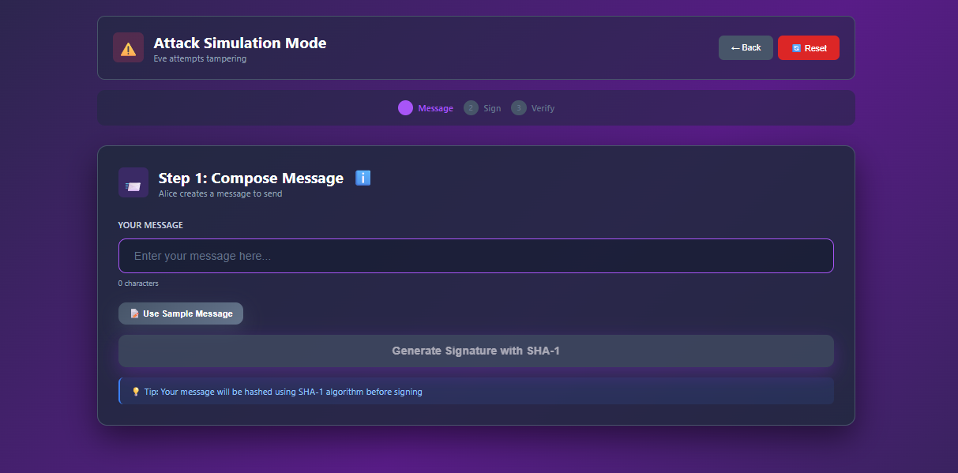
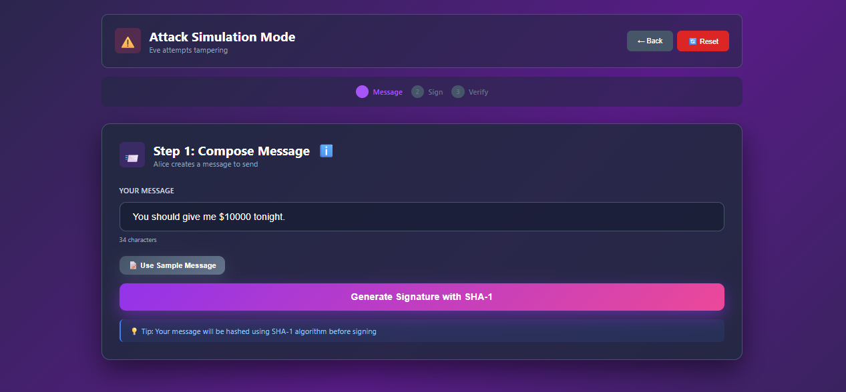


$$→$$
How we covered it:
Novice users: Clear instructions, tooltips on buttons like “Try Another Signature” explain what happens.
Expert users: Shortcut keys are added to speed up the process like “Use Sample Message”
Plasticity: The same interface can be used in Secure mode or Attack mode; content adapts (original message is prefilled in tampering state).

Slide 8
3. Offer Informative feedback
For every user action, there should be an interface feedback. For frequent and minor actions, the response can be modest, whereas for infrequent and major actions, the response should be more substantial.
Visual presentation of the objects of interest provides a convenient environment for showing changes explicitly.

Slide 9
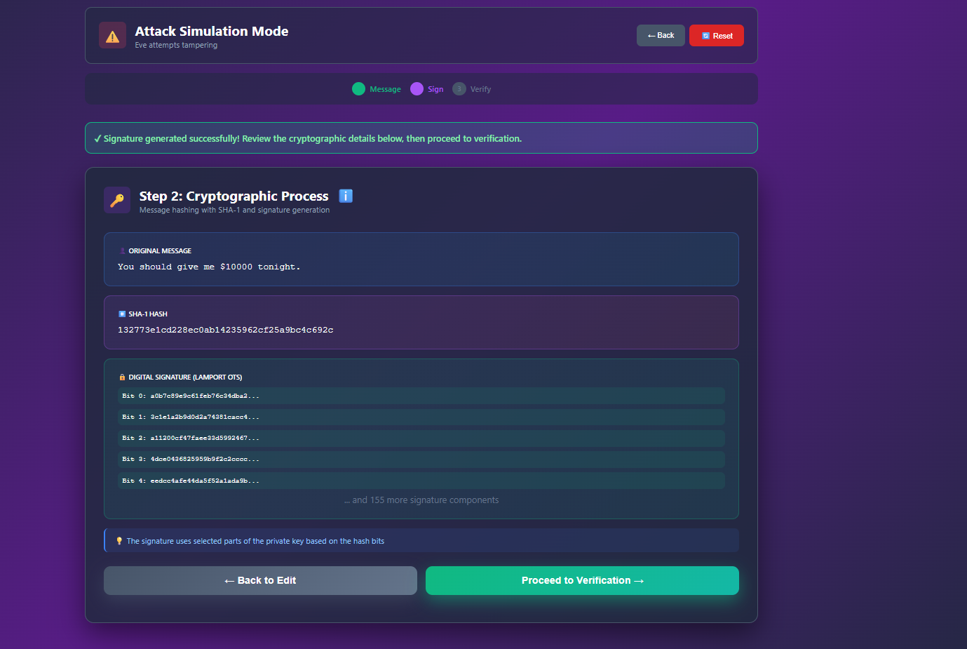
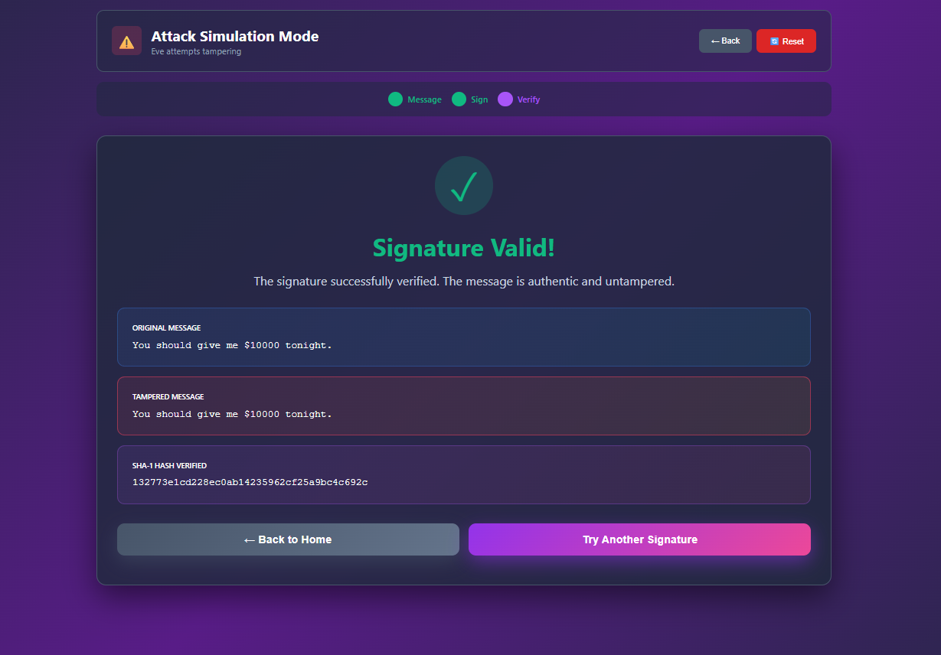
How we covered it:
Generate signature: Shows result in the step2 area.
Verification: Displays success/failure message clearly with step3 content.
Tampering/Undo: When a message is tampered or undone, it immediately updates the text field so users can see the effect.
Reset: Feedback is shown visually — the message input and signature area are cleared and ready for new input.

Slide 10
4. Design dialogs to yield closure
Sequences of actions should be organized into groups with a beginning, middle, and end.
Informative feedback at the completion of a group of actions gives users the satisfaction of accomplishment, a sense of relief, a signal to drop contingency plans from their minds, and an indicator to prepare for the next group of actions.
Your user must see the path in his action by offering him the end of an interaction through feedback you reduce his mental load and improve his experience on your interface.

Slide 11
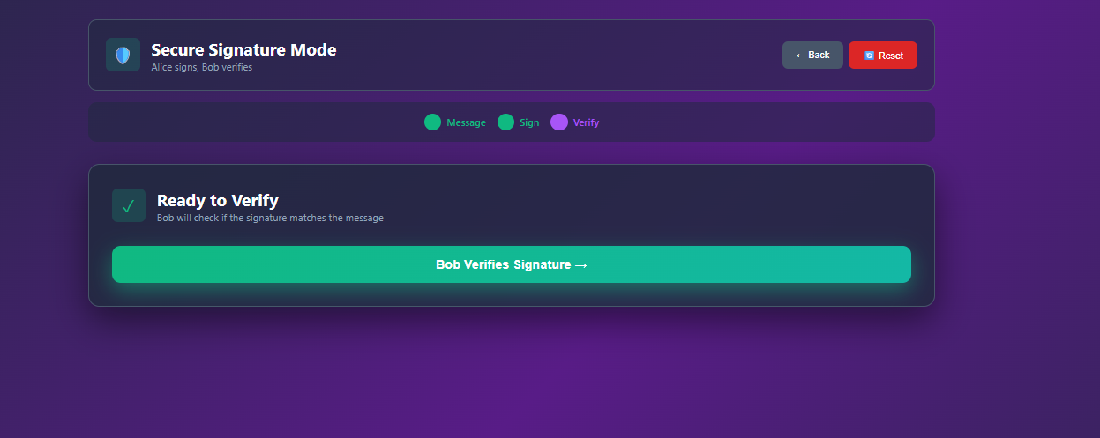

How we covered it:
Three-step flow:
  Step 1 — Enter message (beginning)
  Step 2 — Sign message (middle)
  Step 3 — Verify signature or tamper (end)
Completion feedback: After verification, users see a clear confirmation of signature validity or tampering success.
Buttons guide next steps: “Try Another Signature” or “Undo Tamper” gives clear closure and prompts the next action.

Slide 12
5. Prevent ERRORS
As much as possible, design the interface so that users cannot make serious errors; for example, gray out menu items that are not appropriate and do not allow alphabetic characters in numeric entry fields. If users make an error, the interface should offer simple, constructive, and specific instructions for recovery.
A good interface should be designed to avoid errors as much as possible.
However, if something goes wrong, your system should make it easy for users to understand and resolve the problem.
Simple ways to deal with errors include displaying clear error notifications and descriptive hints to resolve the problem.

Slide 13
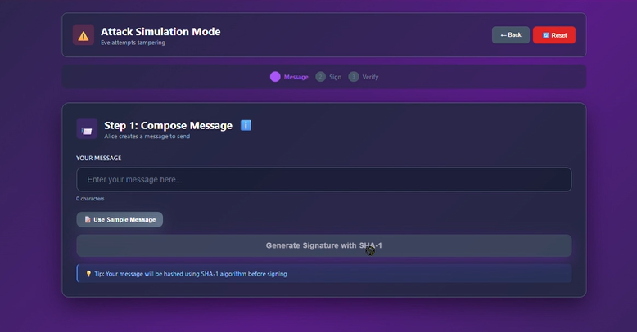
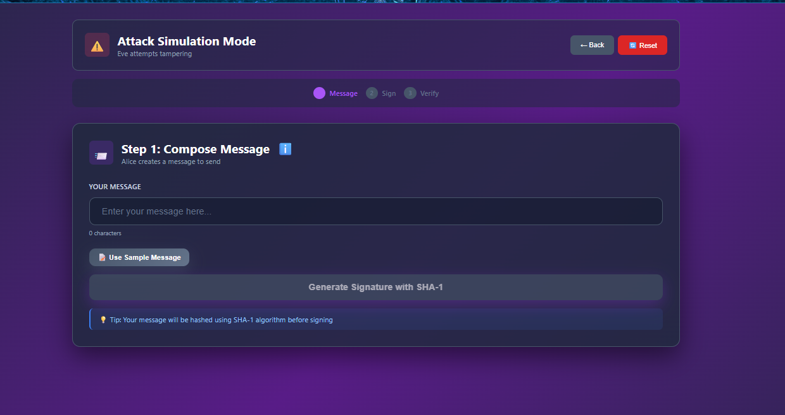


How we covered it:
Disabled buttons: “Generate Signature” is disabled if message input is empty → prevents empty signature errors.
Input validation: Users cannot proceed without typing a message.
Recovery: If user tries tampering or verification incorrectly, they are prompted or can easily reset.
Reset button: Allows restoring interface to initial state without data loss.

Slide 14
6. Permit easy reversal of actions
As much as possible, actions should be reversible.
This feature relieves anxiety, since users know that errors can be undone, and encourages exploration of unfamiliar options.
The units of reversibility may be a single action, a data-entry task, or a complete group of actions, such as entry of a name-address block.
Immediately discovering that it is easy to choose "Cancel" after making an error is a very good thing for the user.
If your users know that there is an easy way to solve a problem, they will feel less anxious and more willing to explore the options.

Slide 15
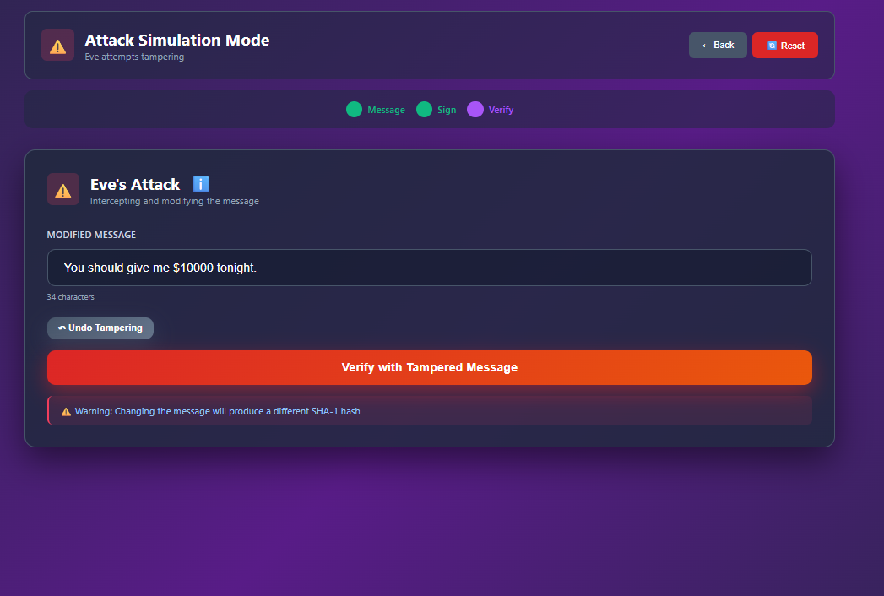
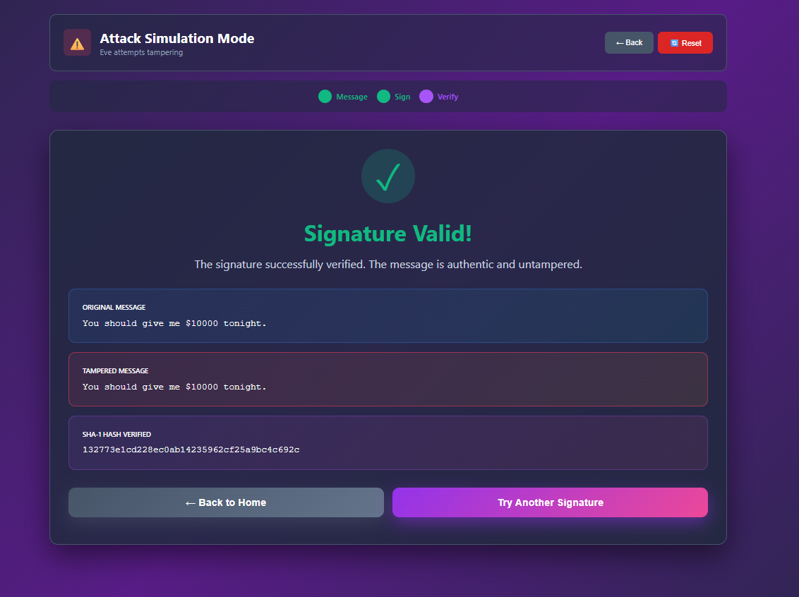


How we covered it:
Undo Tamper: User can revert the tampered message to the original message.
Reset / Try Another Signature: Users can return to a previous state or start fresh without losing control.
Tampering: Users can experiment freely, knowing they can undo changes.

Slide 16
7. Keep users in control
Experienced users strongly desire the sense that they are in charge of the interface and that the interface responds to their actions.
They don’t want surprises or changes in familiar behavior, and they are annoyed by tedious data-entry sequences, difficulty in obtaining necessary information, and inability to produce their desired result.
We need to give control and freedom to the users, so that they can feel that they are in control of the system themselves, giving them some form of free will helps to reassure the user.

Slide 17
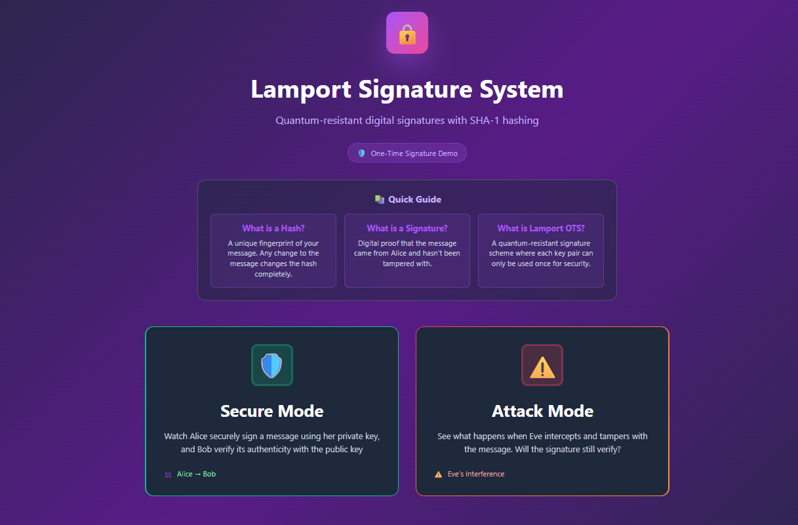
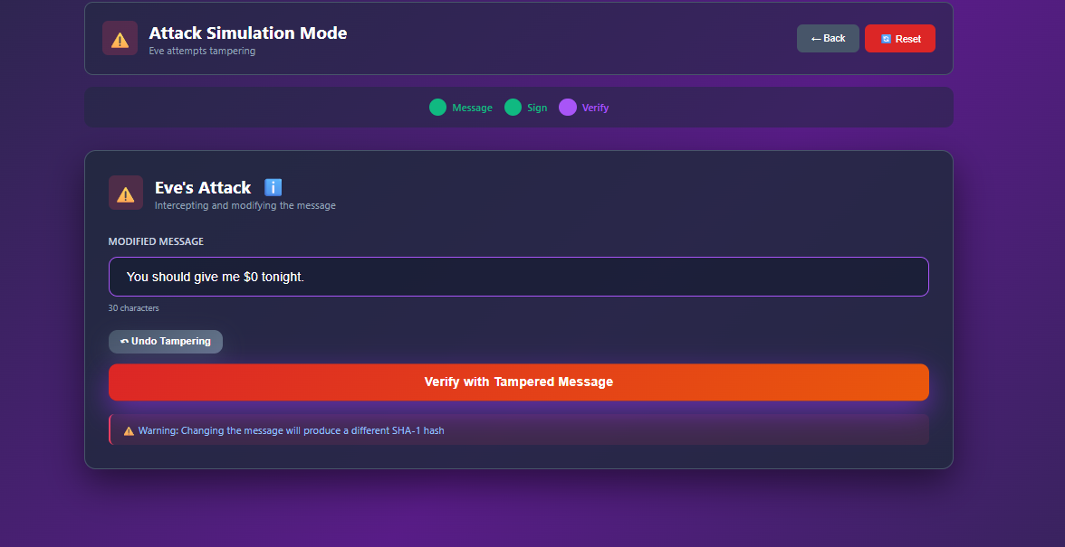


How we covered it:
Mode selection: User chooses Secure or Attack mode explicitly.
Message prefill in Attack mode: User sees the original message and can edit it — system does not auto-change it.
Buttons behave predictably: “Try Another Signature” generates a new signature in Attack mode instead of reusing the same one.

Slide 18
8. Reduce short-term memory load
Humans’ limited capacity for information processing in short-term memory (the rule of thumb is that people can remember “seven plus or minus two chunks” of information) requires that designers avoid interfaces in which users must remember information from one display and then use that information on another display.
It means that cellphones should not require reentry of phone numbers, website locations should remain visible, and lengthy forms should be compacted to fit a single display.
The limitation of human information processing in short-term memory requires that displays be kept simple, multiple page displays be consolidated, window-motion frequency be reduced, and sufficient training time be allotted for codes, mnemonics, and sequences of actions.
Avoid overloading your site or application with information of the same level. You have to deduce which ones should be placed first or you will lose the user's attention. No matter where you place your site, whether it's the home page or the menus, make sure that your user can't be distracted by unnecessary information.

Slide 19
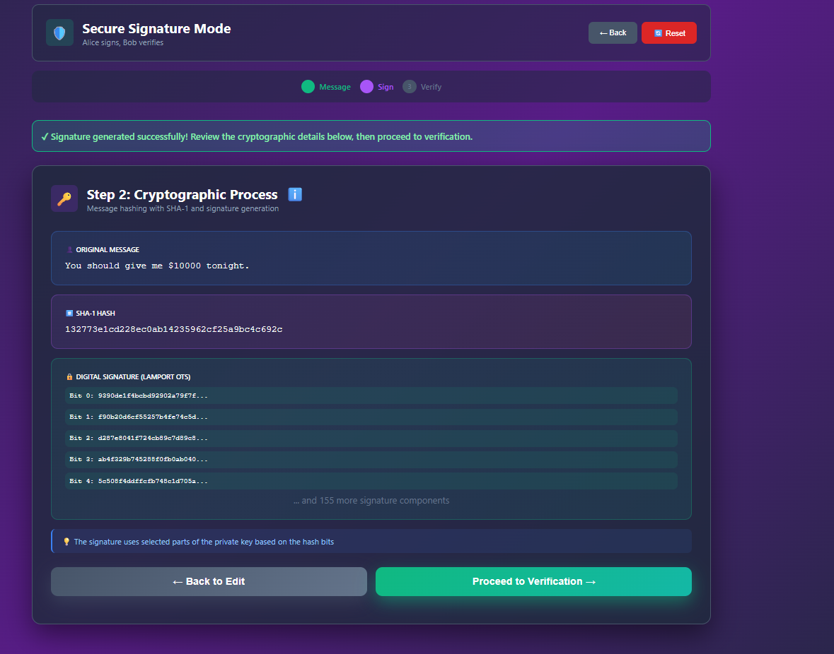


How we covered it:
Original message display: Always visible even in tampering/verification steps.
Step indicators: Progress bar clearly shows which step the user is on.
Signature & hash: Both are displayed immediately after generation → users don’t need to remember them.
Undo / Reset: Users don’t need to memorize previous states; interface visually restores or clears them.

