Slide 1
Development of a Deep-Learning System for Automated Tree Recognition & Green-Space Mapping in Urban Environments
Rasul Aidarkhanov · Berik Sharipov · Anuar Totin
Supervisor: Syndar Satbayev
Astana IT University · 6B06101 Computer Science · 2026

Slide 2
Contents
01 Relevance of the topic
02 The gap & research aim
03 What this project is — a system
04 Objectives & methods
05 Problem statement · Input / Output
06 Literature review & the gap
07 The automated pipeline
08 Data, database & hardware
09 How we measure success
10 Four detection engines
11 Why several models · ensembles
12 Results on one common set
13 Canopy — the system in use
14 Discussion & conclusion
Presenter — Rasul Aidarkhanov · system + YOLO + web app
2

Slide 3
Relevance
Urban trees regulate microclimate, sequester carbon and mitigate the heat-island effect — so a growing city like Astana needs an up-to-date, spatially accurate inventory of its green infrastructure for planning and climate-adaptation decisions.
Traditional inventories rely on manual field surveys — slow, expensive, and outdated before completion. A fundamental scalability problem for any large urban area.
Deep-learning detection on free satellite imagery is a feasible alternative — but the real gap is that no automated process for this exists in Astana at all. So the task we set ourselves was an engineering one: build that process.
Criterion 1 · Topic disclosure
3

Slide 4
Why we couldn't just use an existing tool
0.012
Box mAP@50
A popular ready-made detector (NEON DeepForest), run as-is on Astana. Essentially blind. There was no off-the-shelf system that worked here, so building one was the only option.
Research aim
Design, build and evaluate an automated end-to-end system that recognises trees and maps green space from Astana satellite imagery — delivered as a working tool, with detection accuracy reported honestly.
Criterion 1 · Aim
4

Slide 5
The thesis, in one idea
The deliverable is a system — not a model
Our title says “automated … system.” So the unit of work isn't “which neural net scores highest” — it's the whole machine that turns a raw satellite capture into a usable, georeferenced tree inventory. Everything else is a component of building that:
Dataset
What the engine learns from — a means, not the goal.
The models
Four interchangeable engines that plug into the pipeline.
The experiments
How we tuned the engine — evidence of depth, not the product.
UI & features
What makes it usable by a non-technical operator.
We could have shipped the bare minimum — one model, a mask, no metrics. Instead we built a tool someone at a city service could actually operate. The slides that follow lead with the system; the models come later, as parts of it.
Criterion 1 · Framing — engineering deliverable
5

Slide 6
Objectives & methods
1. Build an annotated Astana dataset (tiled satellite imagery, instance polygons).
2. Train and compare four detection engines — YOLOv8-seg, Mask R-CNN, DeepForest, SAM 2.
3. Combine them through ensembles and test whether that helps.
4. Evaluate everything on one common test set for a fair comparison.
5. Wrap it all in an automated web application — the deliverable that ties tasks 1–4 together.
Methods
Supervised deep learning · transfer learning from pretrained weights · sliding-window tiling · pixel → WGS-84 geo-referencing · mAP@50 as the single comparison metric · software engineering (FastAPI · React · SQLite).
Criterion 1 · Tasks & methods
6

Slide 7
Problem statement — Input / Output
Input
A satellite capture of an area of Astana at zoom 19 (~0.3 m/px) — uploaded, or drawn on a map and auto-fetched from ESRI or Google tiles — cut into overlapping 640 px RGB tiles.
Plus the operator's choices: model, confidence, geo-mode.
Output
For every detected tree: a bounding box, an instance mask, a confidence score, crown area and lat/lng.
Tiles are stitched, duplicates merged, results shown on a map with per-area counts and GeoJSON / CSV / HTML export.
capture → tile → model f(·) → { box, mask, conf, area, lat/lng } → merge & map & export
Criterion 1 · Problem formulation
7

Slide 8
Literature review — what others report, and the gap each leaves
Method | Authors · year | Data | Best metric | Gap for our problem
Mask R-CNN (MCAN) | Lv et al. · 2023 | UAV RGB, China | Det AP 92.4% | Forest UAV, not urban satellite; research result only
RetinaNet / Faster R-CNN | dos Santos et al. · 2019 | UAV RGB, Brazil | AP 82–93% | Detection only — no segmentation, no system
YOLOv12m | Abbas & Damaševičius · 2025 | RGB satellite | mAP@50 90.8% | Benchmark on a clean public set; no deployable tool
DeepLabV3+ / U-Net | Martins 2021 / Wang 2021 | Aerial 10–32 cm | F1 91% · IoU 96% | Semantic mask, not per-tree; not Central Asia
DeepForest (off→fine) | Ventura et al. · 2024 | NAIP 60 cm, USA | F 0.42 → 0.73 | US imagery; collapses without local fine-tuning
YOLOv5x | Velasquez-Camacho · 2023 | Ground-level, Spain | F1 84.9% | Europe, ground-level; no GIS/coordinate pipeline
DeepForest (urban) | Dakov & Petrova-Antonova · 2024 | Aerial, Sofia | F1 0.67–0.69 | Closest analogue — but Europe, still research-only
Every study reports high accuracy — on its own region and sensor, as a research result. Overall limitation: none was tested on Central Asia, and none delivers a deployable, operator-run system. That gap — not a higher mAP — is what this project fills. (31 references reviewed.)
Criterion 1 · Critical literature analysis · ≥ 20 sources
8

Slide 9
The core of the project
The automated pipeline
Front end — React 18 + Leaflet
One automated chain
Capture → tile → detect → merge → georeference → store → map → export. No manual step between the operator drawing an area and the finished, downloadable inventory.
API — FastAPI
Sliding-window tiling (640 + 128)
Engine — swappable (YOLO · M-RCNN · DF · Ensemble)
Swappable engine — the key design idea
The detection model is just one plug-in step. Swap YOLO for Mask R-CNN, DeepForest or an ensemble without touching the rest — a better model tomorrow drops straight in.
Global NMS — cross-tile merge
Geo — pixel → WGS-84
Performance
~1 km² at zoom 19 in ~18 s on a single laptop GPU, with live streaming progress.
SQLite store → Map & export
Criterion 1–2 · System architecture + software
9

Slide 10
Engineering effort
A minimal version would do far less — we built a tool
THE BARE MINIMUM
WHAT CANOPY ACTUALLY DOES
– One model, hard-coded
– Just a segmentation mask
– No coordinates, no export
– No metrics, no comparison
– Run once, nothing saved
+ Two tile providers — ESRI & Google, fetched in-browser
+ Model choice — 7 YOLO sizes · Mask R-CNN · DeepForest ± SAM 2
+ Ensembles — Weighted Box Fusion + cross-YOLO vote
+ Manage scans — name · hide · delete (cascade)
+ Live metrics — tree count · canopy coverage % · crown area
+ Geo + export — WGS-84 · GeoJSON / CSV / HTML · persistent map
None of these is required to “detect a tree” — each is a deliberate choice to make the system usable, comparable and repeatable. That is where most of the engineering effort went.
Criterion 2 · Depth & completeness of the software
10

Slide 11
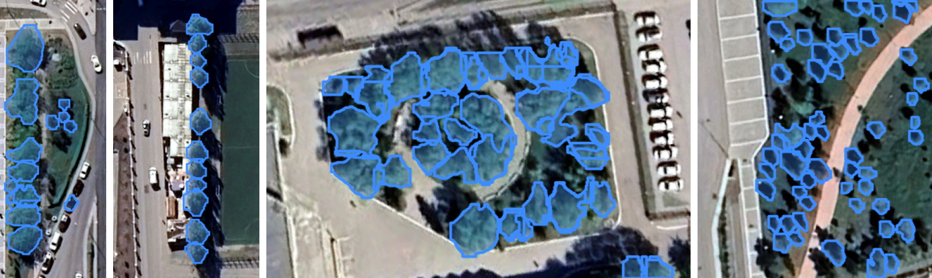
A component of the system — inputs & infrastructure
Data, database & hardware
Dataset
High-zoom Astana captures (~0.3 m/px). We hand-labelled ~5,500 tree crowns across ~100 images as instance polygons (~8,700 tiles after 640+128 tiling). Held-out common set: 14 images · 702 trees.
Hardware
RTX 4060 8 GB — YOLO + all common-set inference · RTX 4070 — Mask R-CNN · RTX 4050 — DeepForest. The 8 GB ceiling forces batch 2 + mixed precision — deliberately modest, to prove it runs without a cluster.
Database — SQLite
scan_sessions → snapshots → runs → detections
One-to-many, ON DELETE CASCADE — delete a scan, its detections go too.
Criterion 1–2 · DB schema + hardware
11

Slide 12
The maths, in plain terms
Three simple ideas — one comparison number
1 · IoU — did the box land on the tree?
IoU = (overlap area) ÷ (combined area). 1.0 = perfect, 0 = miss. A tree counts as found when IoU ≥ 0.5.
3 · mAP@50 — the single score
Sweep the confidence threshold, track precision against recall, take the area under that curve (IoU ≥ 0.5). One honest number to compare every engine — the 0.315 on the results slide.
2 · Precision & recall
Precision — of the trees we flagged, how many were real. Recall — of all real trees, how many we found: ours ≈ 30% at the default setting.
How the two detectors work
YOLOv8 — one pass: grid → boxes + masks in a single look (fast). Mask R-CNN — two passes: propose regions, then refine (slower, careful).
Criterion 1–2 · Mathematical support (≤ 10 pts)
12

Slide 13
Four interchangeable engines · one pipeline
The system doesn't depend on one model — any of four can drive it.
YOLOv8-seg (Rasul) · Mask R-CNN (Berik) · DeepForest + SAM 2 (Anuar) · plus two ensembles. Each plugs into the same automated pipeline and is scored on the same 14 images.
Team diploma — each member presents & is scored on their branch
13

Slide 14
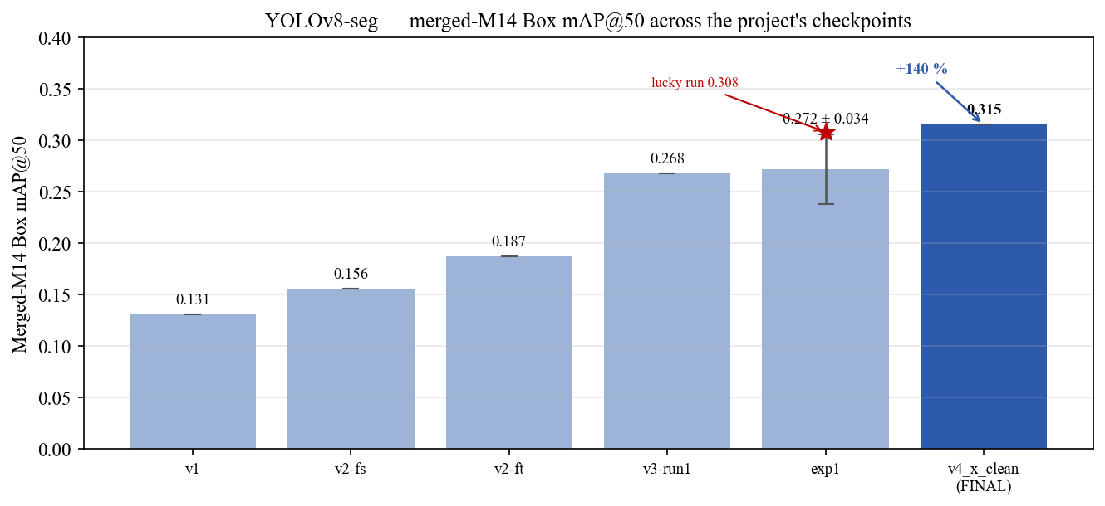
Engine #1 · Rasul Aidarkhanov · 23 experiments
YOLOv8x-seg — from 0.131 to 0.315
+140%
Box mAP@50 over my own first model (0.131 → 0.315).
What actually mattered
① Start from pretrained (COCO) weights · ② tile at the resolution you deploy at · ③ keep augmentation moderate.
What I also found
Default augmentation beat hand-tuned; model size is U-shaped; run-to-run noise ≈ ±0.03 — so small gaps aren't real.
Box mAP@50 across every experiment on the common set.
Criterion 1 · Results + ablation · YOLOv8x-seg v4 · M14
14

Slide 15
Engine #2 · Berik Sharipov
Mask R-CNN — the careful, mask-first engine
A classic two-stage, region-based detector. Where YOLO looks once, Mask R-CNN looks twice — propose, then refine — slower, but with naturally crisp instance masks. One of the swappable engines behind the same pipeline.
How it works
An RPN suggests candidate boxes → RoIAlign crops each region → three heads output a box, a class and a per-pixel mask. Segmentation is built in, so outlines hug the crown.
How it does on Astana
Box mAP@50 0.166, Mask 0.158. At conf 0.5: precision 0.44 · recall 0.22. Strongest on medium, well-separated crowns.
How Berik trained it
Transfer-learned from a COCO-pretrained ResNet-50-FPN, fine-tuned on the same Astana tiles (v2 + v3), single “tree” class, same split. 50 epochs, SGD.
Why it stays in the app
Below YOLO overall — but it recovers some larger trees the others miss, and its masks are the cleanest. So the pipeline keeps it as a selectable engine.
Team member · Berik Sharipov · box 0.166 · mask 0.158
15

Slide 16
Engine #3 · Anuar Totin
DeepForest + SAM 2 — the forest specialist, re-taught
A two-part engine: DeepForest (a RetinaNet-style crown detector) finds the trees, then SAM 2 turns each box into a high-quality mask. It produced the 0.012 that started the whole project.
How it works
DeepForest outputs a box per crown; each box becomes a prompt for SAM 2, which segments the exact pixels — zero-shot, no extra training.
How Anuar fixed it
Fine-tuned DeepForest on the Astana data (LR 1e-4, 30 ep) + SAM 2 masks. Result: 0.012 → 0.146 Box mAP@50 (Mask 0.134) — a ×12 jump.
The domain problem
DeepForest is pretrained on North-American forest imagery. Pointed at a dry steppe city it was nearly blind — 0.012. A mismatch, not a bug.
Why it stays in the app
SAM 2 gives the best general-purpose masks of any engine, and the off-the-shelf → fine-tuned story is the project's core lesson.
Team member · Anuar Totin · 0.012 → 0.146 · ×12
16

Slide 17
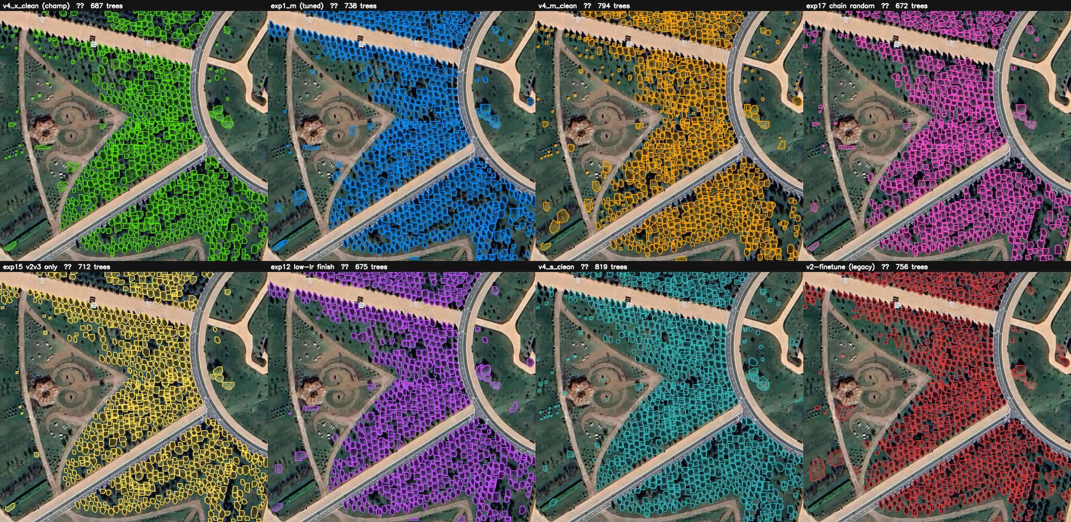
A system choice, not a model choice
Same garden, eight engines, eight answers
The same Botanical Garden, scanned by eight engines — each outlines a different set of trees and reports a different count (672–819). None is simply “right”.
So the system lets the operator switch engines and combine them — Weighted Box Fusion + a cross-YOLO 4-vote that drops single-model false positives. Choice is a feature.
Criterion 1 · Own contribution — design rationale · WBF · cross-YOLO vote
17

Slide 18
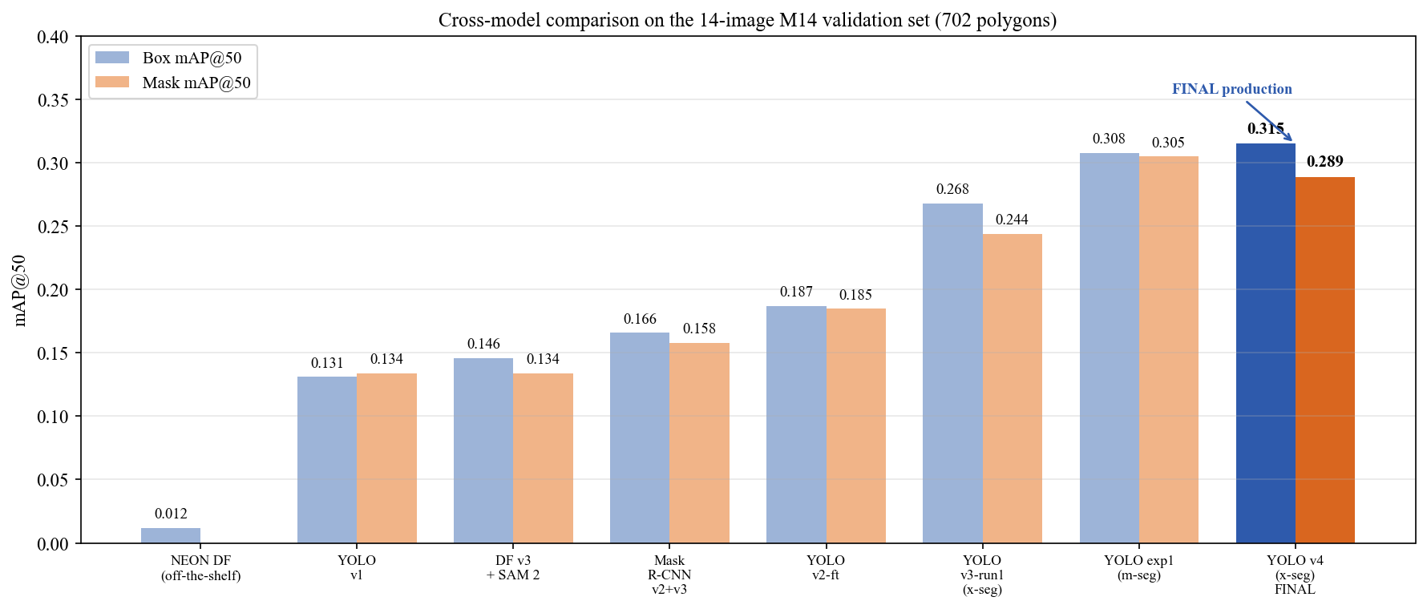
Head-to-head · same 14 images · 702 trees
One common test set, every model
Model | Box mAP@50 | Mask mAP@50
YOLOv8x-seg v4 (ours) | 0.315 | 0.289
YOLOv8x-seg v3 | 0.268 | 0.244
Mask R-CNN | 0.166 | 0.158
DeepForest + SAM 2 | 0.146 | 0.134
YOLO v1 baseline | 0.131 | 0.134
NEON DeepForest (off-the-shelf) | 0.012 | —
These engines are in the same ballpark on Astana — what matters is that any of them can drive the system.
Champion operating point (conf 0.25): precision 0.52 · recall 0.29. Margins between top models are small — partly within run-to-run noise.
Criterion 1–2 · Results + comparison · M14 · 702 polygons
18

Slide 19
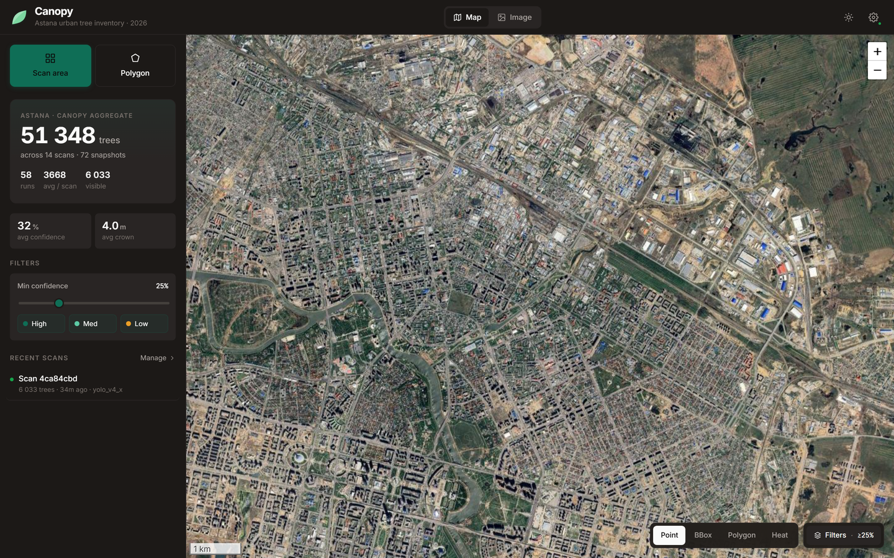
The deliverable
Canopy — the system in use
One flow
Select an area of Astana → the app tiles it, runs the chosen model, and draws every detected tree on the map — confidence filter, Point / Box / Polygon / Heat layers.
Grows as you use it
Every scan is stored; the city map is the running aggregate of everything ever processed. Coverage and counts update live.
Counts in screenshots come from repeated demo scans — not a full city census.
Criterion 1–2 · Information system built & working
19

Slide 20
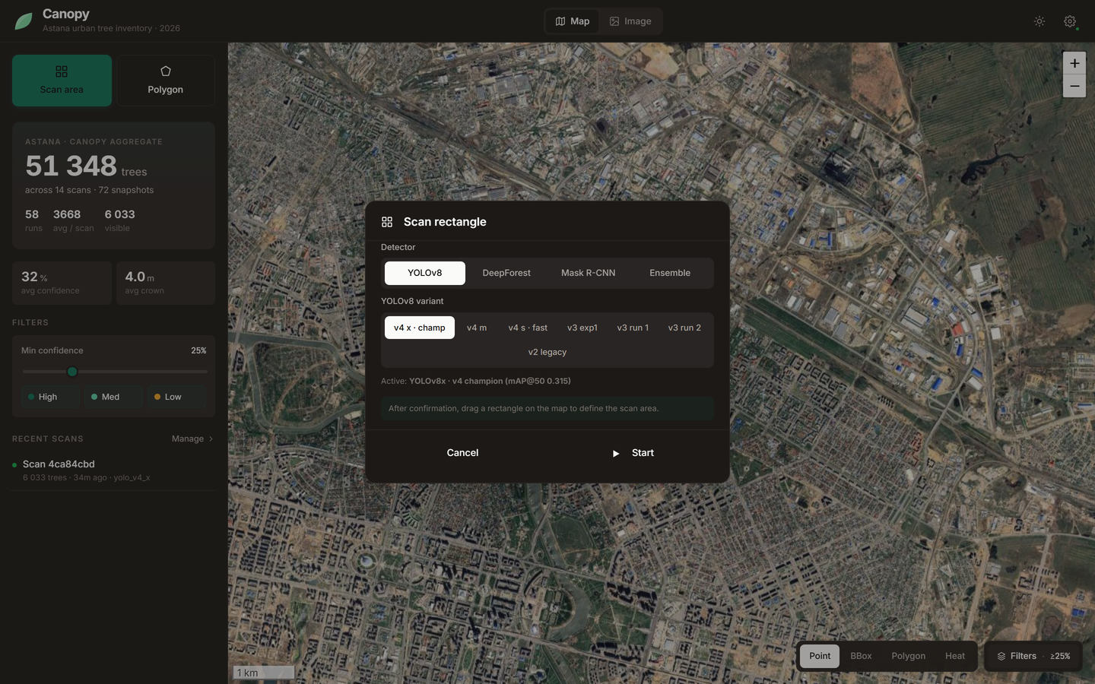
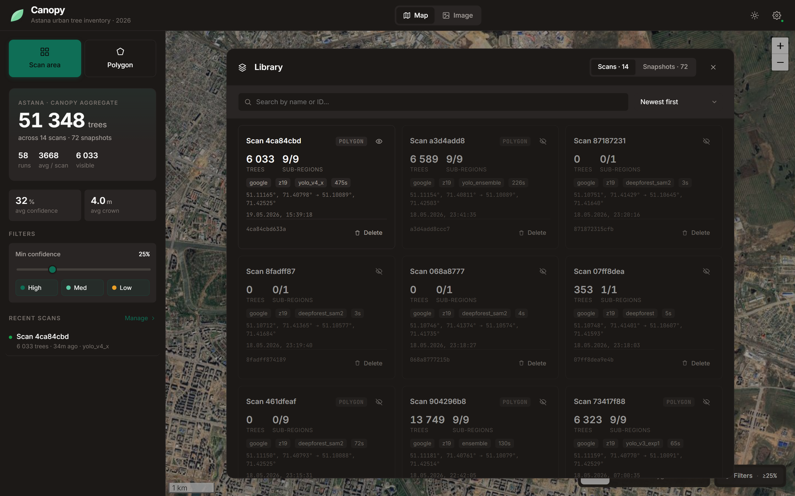
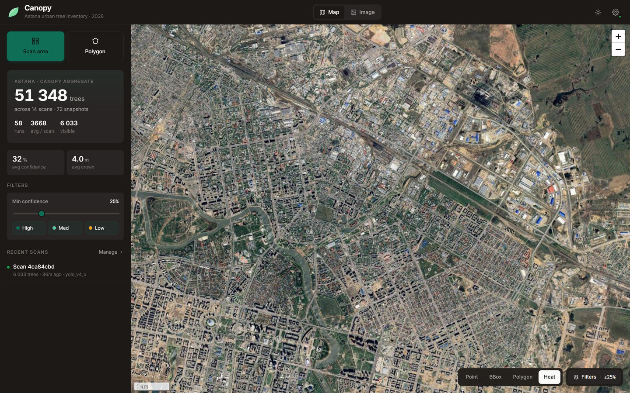
The choices that make it a tool, not a demo
Choose · combine · manage · measure
Choose & combine
7 YOLO sizes · Mask R-CNN · DeepForest ± SAM 2 · WBF & cross-YOLO vote — chosen per scan, with provider (ESRI / Google) and confidence.
Manage
Every scan & snapshot is renamable, hideable and deletable (cascade) from a library modal — the workspace stays usable over time.
Measure
Density heat-map, per-area count, green-space coverage % and crown area inside a drawn polygon — metrics, not just dots.
Criterion 2 · Feature depth of the system
20

Slide 21
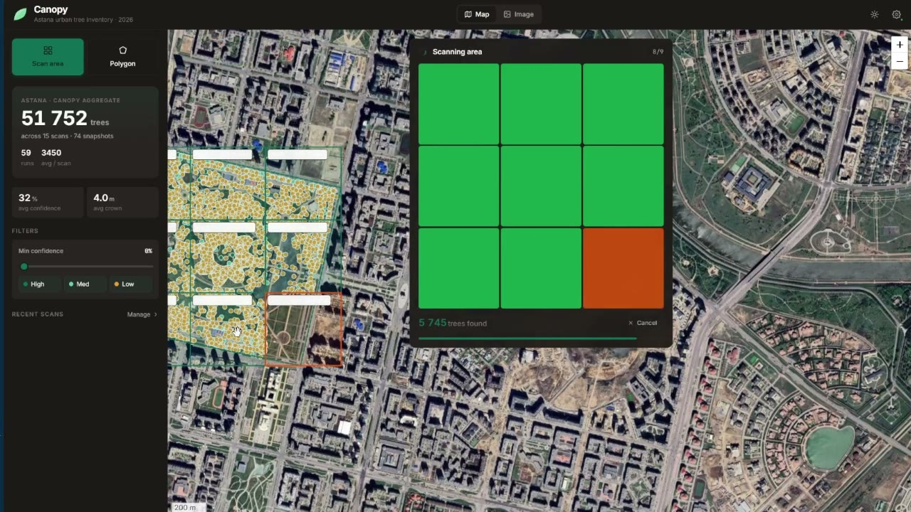
The pipeline running end-to-end
Live demo — automated scan of the Botanical Garden
What you're seeing
The v4 engine scanning the Botanical Garden end-to-end in Canopy: tile → detect → map, every tree drawn live.
Why this scene
A dense, well-defined planting — the clearest case. Honest reminder: on sparser scenes recall drops.
Full recording
drive.google.com/file/d/1OceaLC4yMEgLtIThVR8t7_B4VRRPNaNf/view
Replace this poster with the embedded video in Canva (assets/canopy_demo.mp4).
Criterion 2 · Demonstration of the working system
21

Slide 22
Conclusion
O1 · Dataset
Custom Astana dataset built from scratch — ~100 images, ~5,500 crown polygons (~8,700 tiles); held-out M14 = 14 images / 702 trees.
O2 · Detection engines
Four engines trained & compared; YOLOv8x-seg leads at Box mAP@50 = 0.315 (+140% over our v1 baseline).
O3 · Ensembles
WBF + cross-YOLO vote implemented in the system — choice and combination exposed to the operator.
O4 · Fair evaluation
Every engine scored on one common set — the first such measurement for Astana (off-the-shelf ≈ 0.012).
O5 · The system — Canopy
FastAPI + React + SQLite + Leaflet, deployed: provider & model choice, ensembles, manage, live metrics, geo + export.
The headline
Not a score — a manual task is now an automated system. Accuracy is modest and honestly so; the system is the contribution.
Criterion 1 · Conclusions map 1:1 to tasks · manual → automated system
22

Slide 23
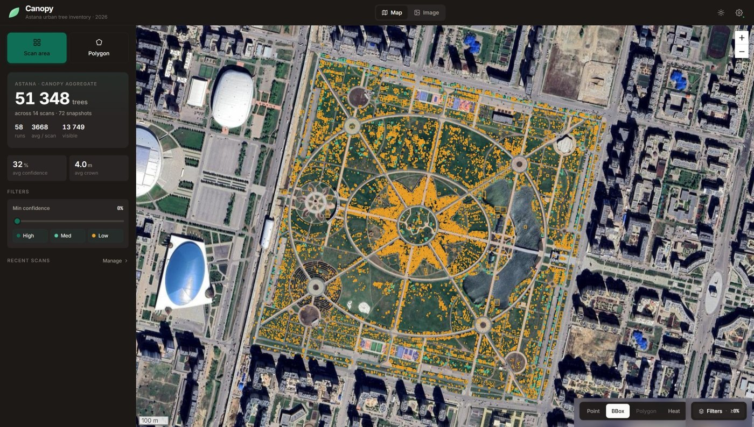
Thank you — we'll gladly answer your questions.
From a manual, one-by-one task to an automated tree-mapping system for Astana — a working tool anyone can run.
Rasul Aidarkhanov · Berik Sharipov · Anuar Totin | Supervisor: S. Satbayev

