Slide 1
Application of Neural Networks in Mobile robot Motion
Meet – 4
Date:- 01/03/2016
Submitted by:- Kunal Gupta
Guide :- Dr.Surekha Bhanot

Slide 2
Points discussed in this presentation
Introduction to Robot Operating System (ROS).
MATLAB support for ROS.
Gazebo simulator and TurtleBot.
Work done in MATLAB.

Slide 3
Robot Operating System
ROS is a collection of software frameworks for robot software development.
It provides operating system-like functionality on a heterogeneous computer clusters (robot-computer, robot-robot, computer-computer).

Slide 4
Robot Operating System
ROS provides standard operating system services such as
Hardware abstraction
Low-level device control
Implementation of commonly used functionalities
Message-passing between processes
Package management

Slide 5
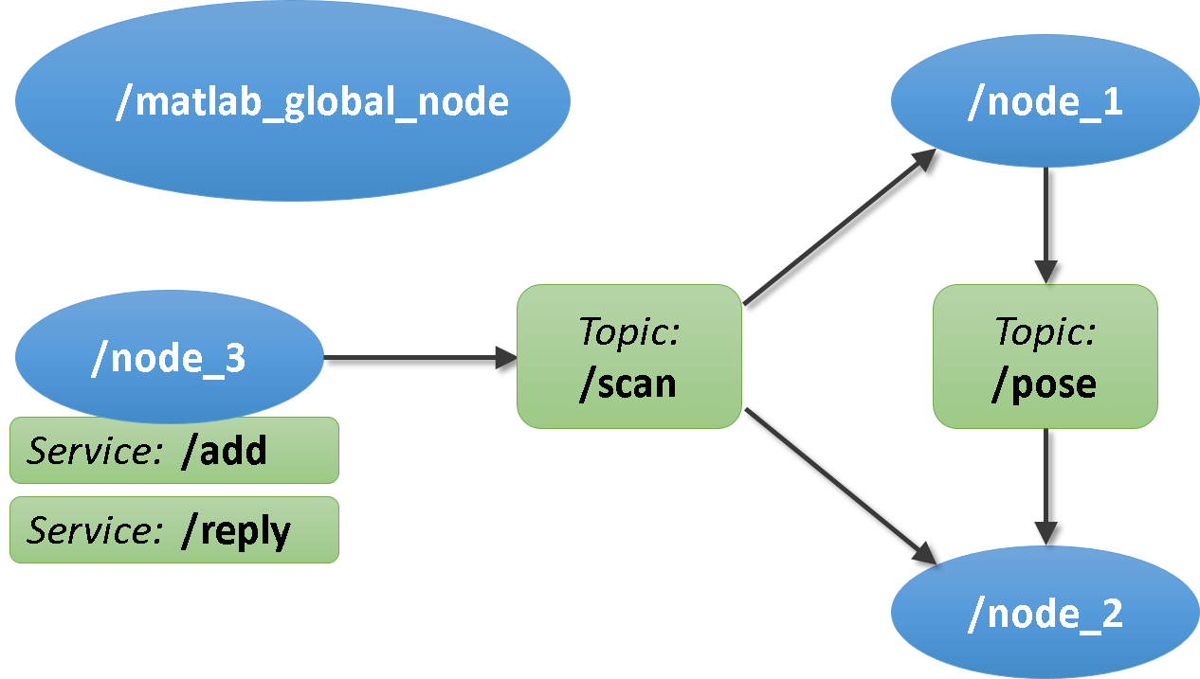
Robot Operating System
ROS-based processes are represented in a graph architecture where processing takes place in nodes.
Nodes may receive, post sensor data.
They can also Control actuators and run other programs.

Slide 6
Robot Operating System
Invented by Willow Garage (Stanford Artificial Intelligence Laboratory)
Initial release in 2007 but stable release in 2015.
Written in C++, Python.
Operating system : Linux.
http://www.ros.org/

Slide 7
MATLAB support for ROS
Robotics System Toolbox™ allows access of ROS functionality in MATLAB.
Helps to communicate with a ROS network, interactively explore robot capabilities, and visualize sensor data.

Slide 8
MATLAB support for ROS
Develop robotics applications by exchanging data with ROS-enabled robots and robot simulators such as Gazebo.
However, it only give support for Mobile robot platform TurtleBot and no support for any other robot platform.

Slide 9
Gazebo Simulator for ROS
Robot simulation is an essential tool. A well-designed simulator makes it possible to rapidly test algorithms, design robots, and perform regression testing using realistic scenarios.

Slide 10
Gazebo Simulator for ROS
Gazebo offers the ability to accurately and efficiently simulate populations of robots in complex indoor and outdoor environments.
It has a robust physics engine, high-quality graphics, and convenient programmatic and graphical interfaces.
Gazebo is free with a vibrant developer community.

Slide 11
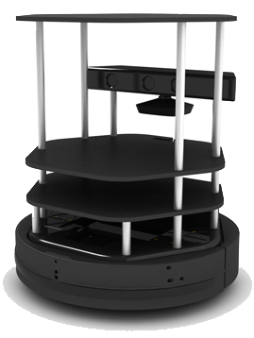
TurtleBot
A differential drive robot.
Kinect sensor providing image and laser scanning facilities.
Simulation support for Gazebo.
Widely used in industry and academia.

Slide 12
WORK DONE..?

Slide 13
Interfacing
MATLAB provides package for ROS+Gazebo on a Linux Virtual Machine, to be run on Windows platform.
All the three softwares were successfully interfaced with each other.

Slide 14
World Building
The world needs to be built in Gazebo for simulation purpose.
It should consist of walls, obstacles and doors representing indoor environment.
A sample world is made in Gazebo.

Slide 15
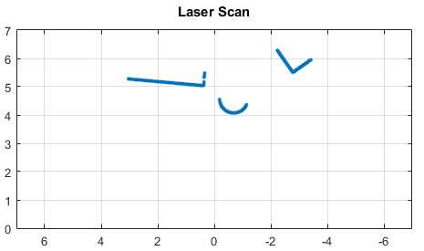
Motion of TurtleBot in environment
The robot was able to successfully move in the environment made using keyboard commands.
It was able to sense the environment around it using its laser range finder with 180 degree view.

Slide 16
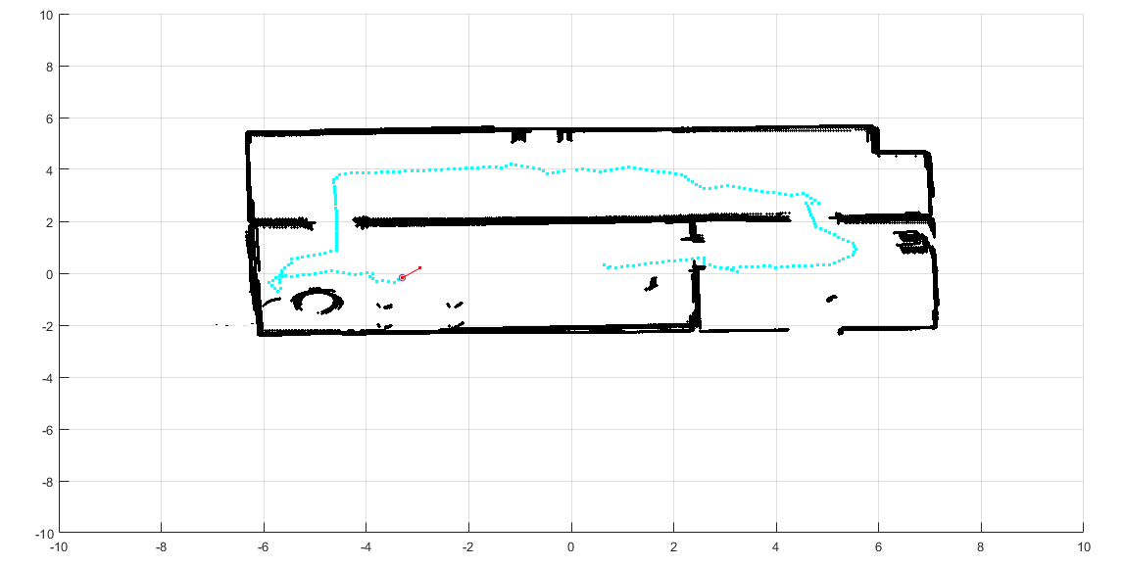
Map building by TurtleBot in MATLAB
After moving around in the world the robot was successful in making a map of the world.

Slide 17
THINGS TO BE
DONE NEXT..?

Slide 18
Global path planning using ACO
The map built by the robot will be used to extract obstacles and then fed to the global path planning algorithm along with starting and goal destination.
Ant Colony Optimization will be used to lay the global path for robot’s motion.

Slide 19
THANK YOU
FOR YOUR
TIME AND PATIENCE

