Slide 1

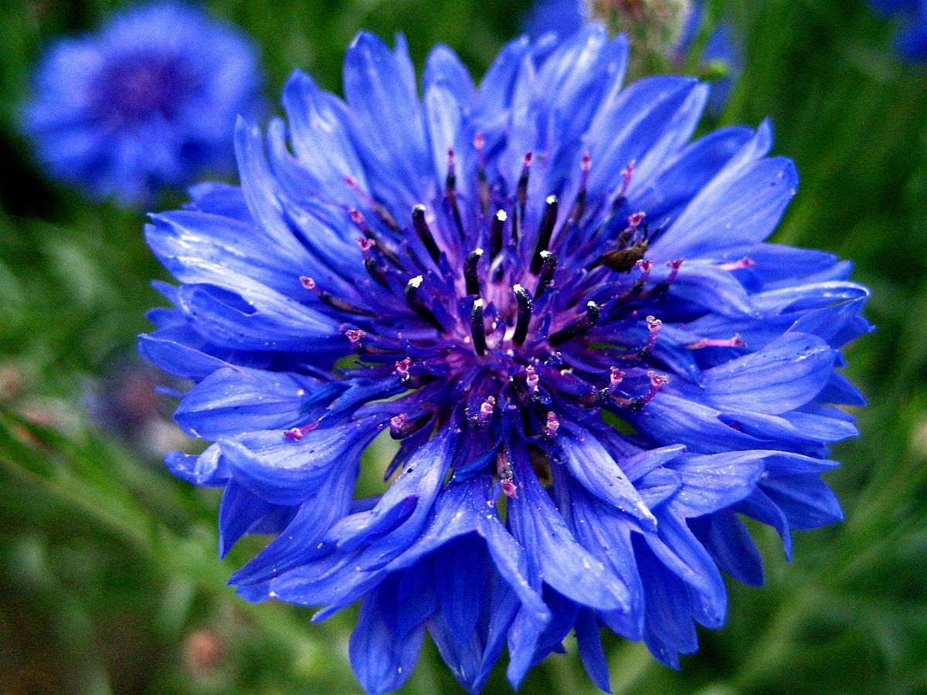

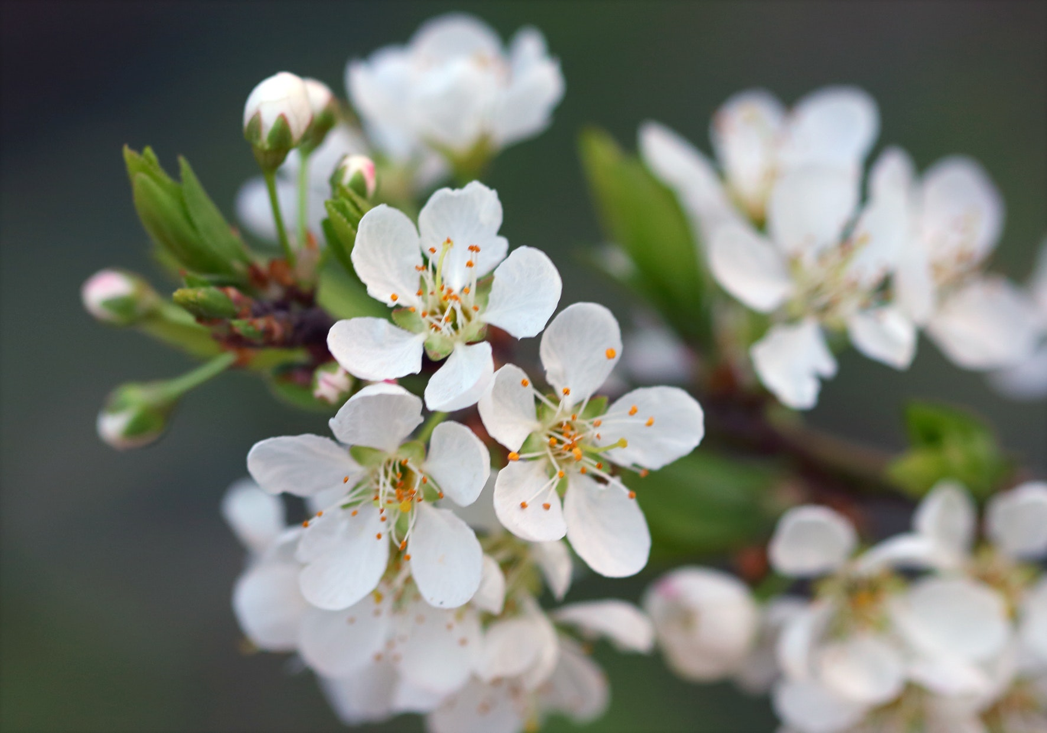
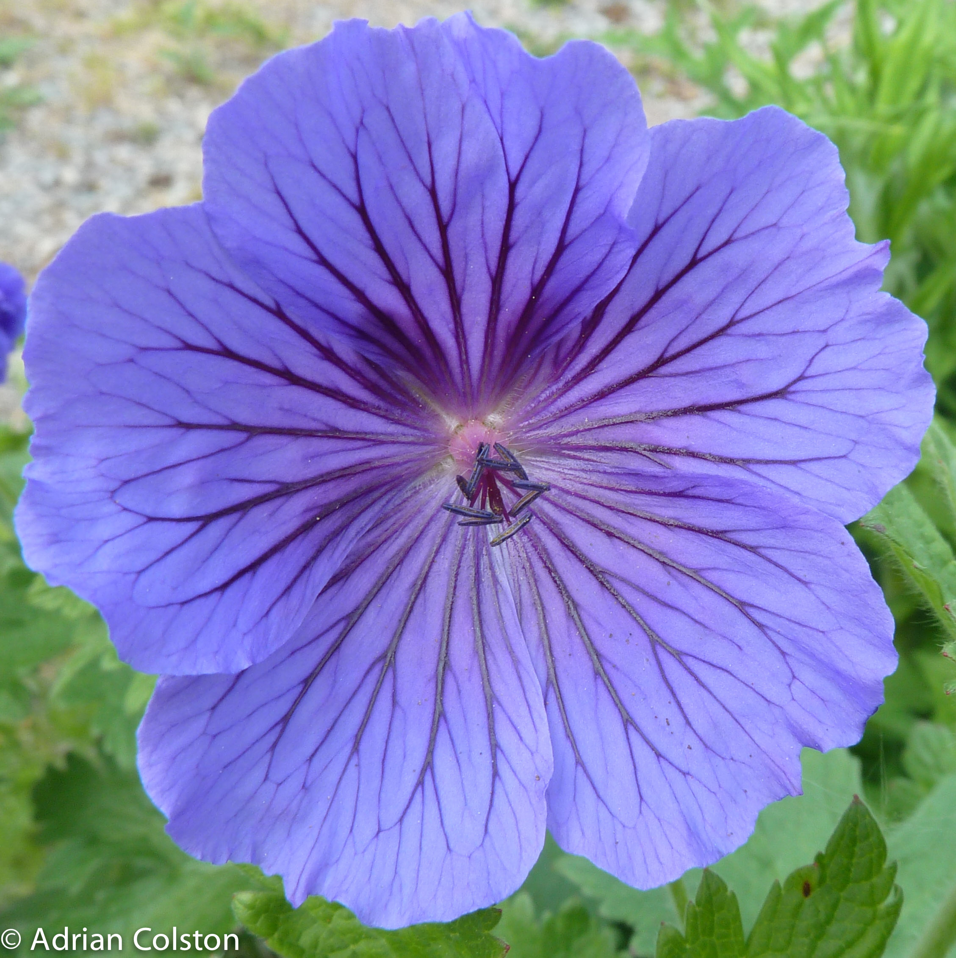
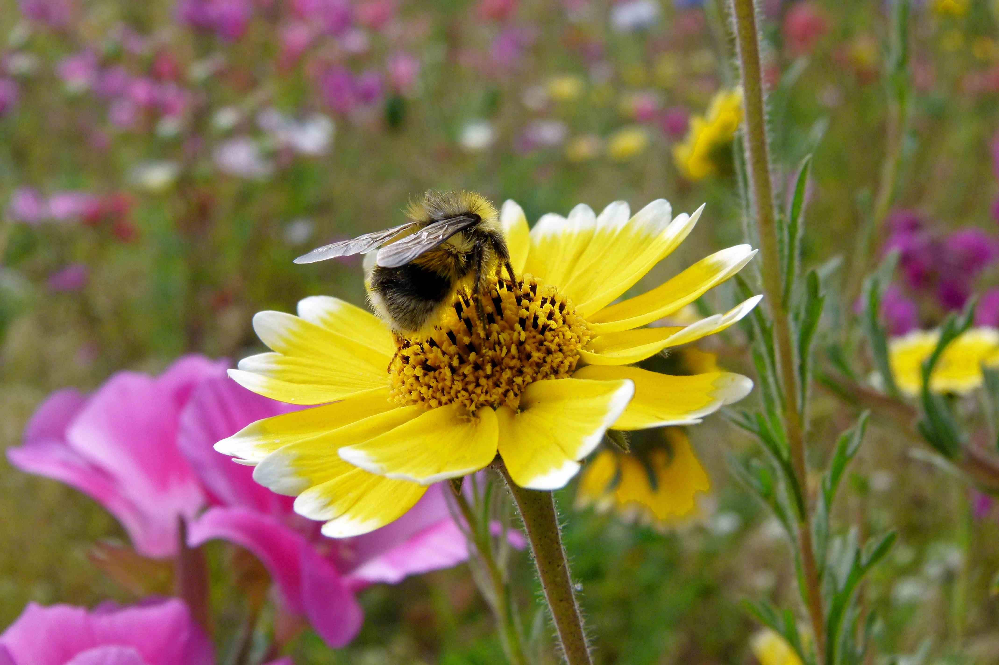

Slide 2
P-value Interpretation
0.001 Wow : I must be an amazing scientist!
0.02
0.03 Hooray : statistically significant!
0.04
0.0499
0.05 Oh no : let’s try repeating the analysis
0.051 Teetering on the edge of significance
0.09 Quote as significant at P<0.1 and hope no-one notices!

