Slide 1
Finding a Suitable System for Multiscale Control Implementation
Selection criteria:
Available comprehensive data
Exhibits both fast and slow dynamics
Potential for hierarchical control structure
Existing successful control strategy to compare
01
02
Oil refinery MPC cascade
Battery for FR market
Production Planning Layer (hours to days)
Unit-Level MPC Controllers (minutes to hours)
Battery degradation (weeks to years)
Frequency Regulation Participation (every 2s)
Data set (Teams group)
Single layer MPC implementation
Codes (JULIA language) Available
MPC cascade implementation
Lu 2015
Cao et al., 2020
12 June 2025

Slide 2
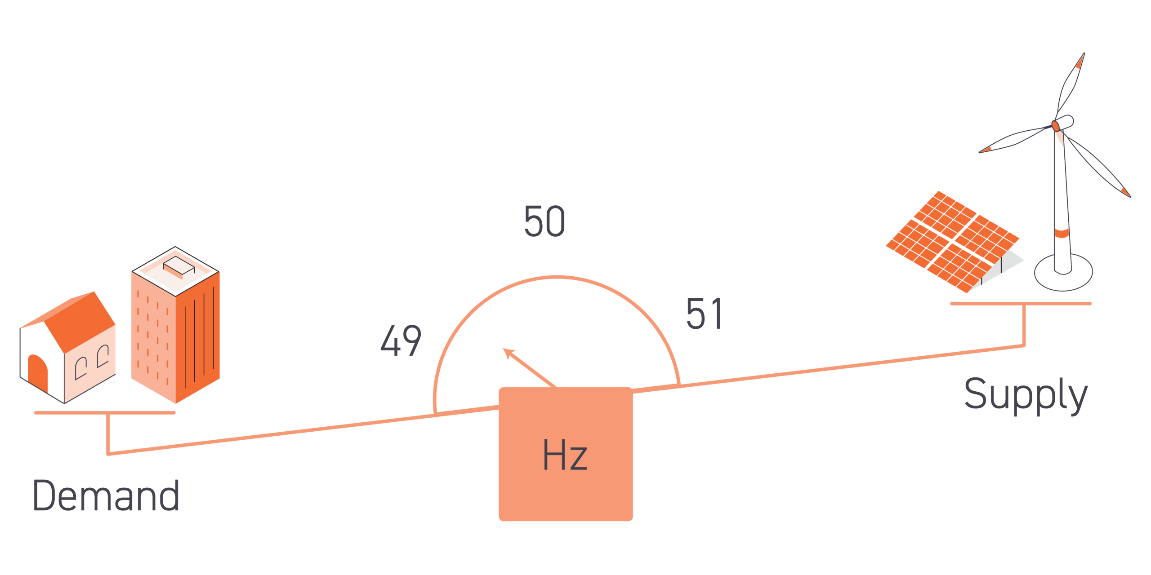
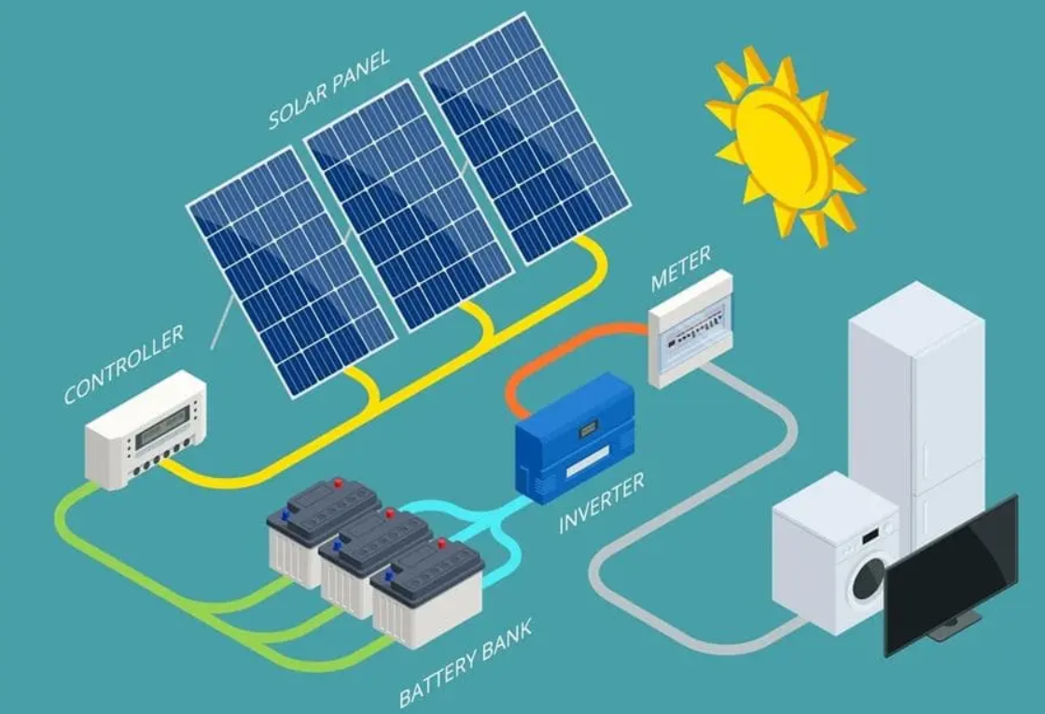
Frequency Regulation
Electricity grid stability
Balance between electricity supply and demand in real-time (every 2s)
Small deviations blackouts!
Renewable energy sources can fluctuate in generation.
Battery Energy Storage Systems (BESS)
Charge from the grid when electricity is cheap or abundant Discharge to the grid when demand is high
Degradation-sensitive
Performance declines with frequent cycling, especially under high power.

Slide 3

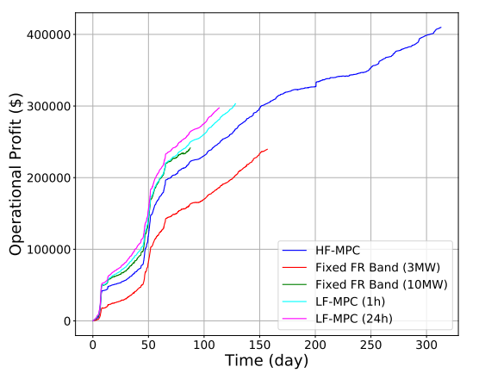

Trade-off
Short-term economic incentives provided by energy and frequency regulation (FR) markets Long-term degradation effects
One centralized MPC
Data from PJM (US Grid Operator):
2s for FR signal; 1-hour updates for prices
Used 2 different battery model:
High-Fidelity: more accurate, computationally expensive
Low-Fidelity: simpler, faster
Revenue from FR market
Purchasing power from the day-ahead market
Capacity fade penalty

Slide 4
Practical limitation:
They assumed deterministic process (known FR and price signals)
Computationally expensive for HF-MPC
Hierarchical strategy
Slave controller (RL)
Receives:
Hourly power limits from master
SoC boundaries
Tracks:
Real-time FR signal
Battery internal state
Learns to:
Maximize FR tracking performance
Avoid safety violations
Stay within master-specified operating envelope
Master controller (MPC):
Uses coarse-scale forecasts of:
FR signals, energy prices
Battery health state
Plans:
FR band commitments for upcoming hour
Charging/discharging schedules
State of Charge operating margins and degradation constraints

