Slide 1

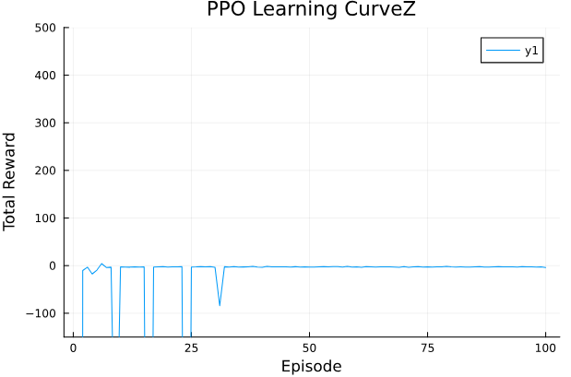
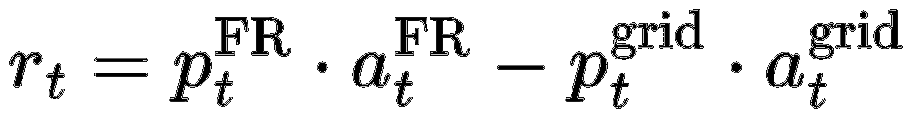
Goal: Optimize battery operation for revenue while minimizing degradation
Scope: Frequency Regulation market participation
Slave controller (RL)
Fast dynamics (2s)
Inputs: state vectors: [SoC, pot, cf, FR_price, grid_price, FR_signal]
Outputs: [FR_band, buy_from_grid]
Environment: Complex DAE-based battery model simplified ODE-based model
Proximal Policy Optimization (PPO)
Reward function:
18 June 2025

Slide 2
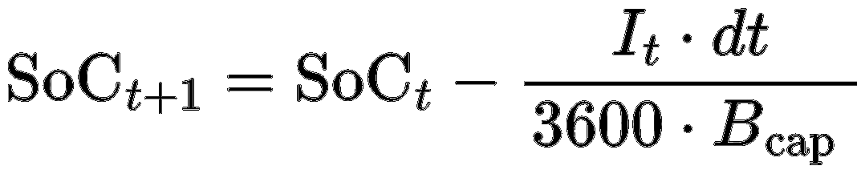
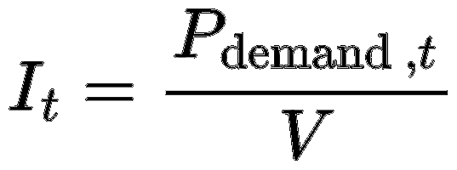

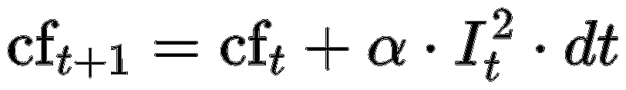
States
SoC (State of Charge): Fraction of battery capacity currently available.
Cf (Capacity fade): Proxy for battery degradation.
pot (voltage): fixed parameter @ 3.3 V
FR_price: Payment received per (Data)
grid_price: Cost of buying electricity from the grid (Data)
FR_signal: Instruction from the grid operator to charge or discharge (range: −1 to +1) (Data)

Slide 3
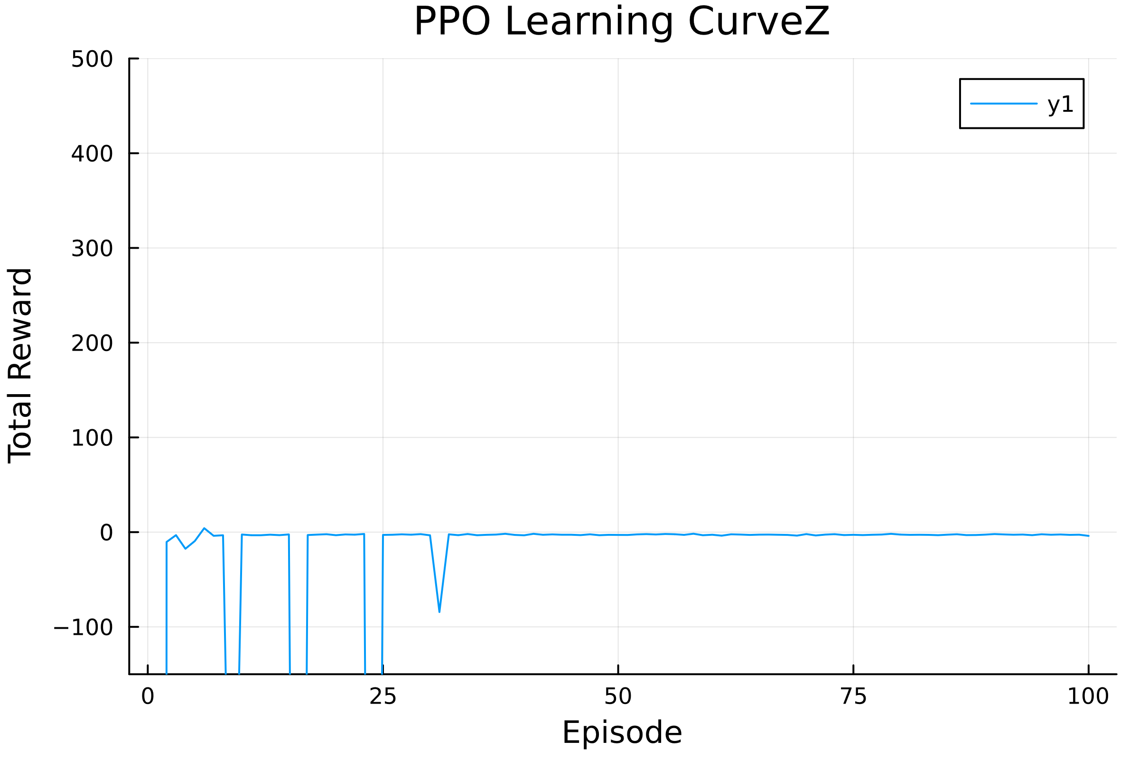
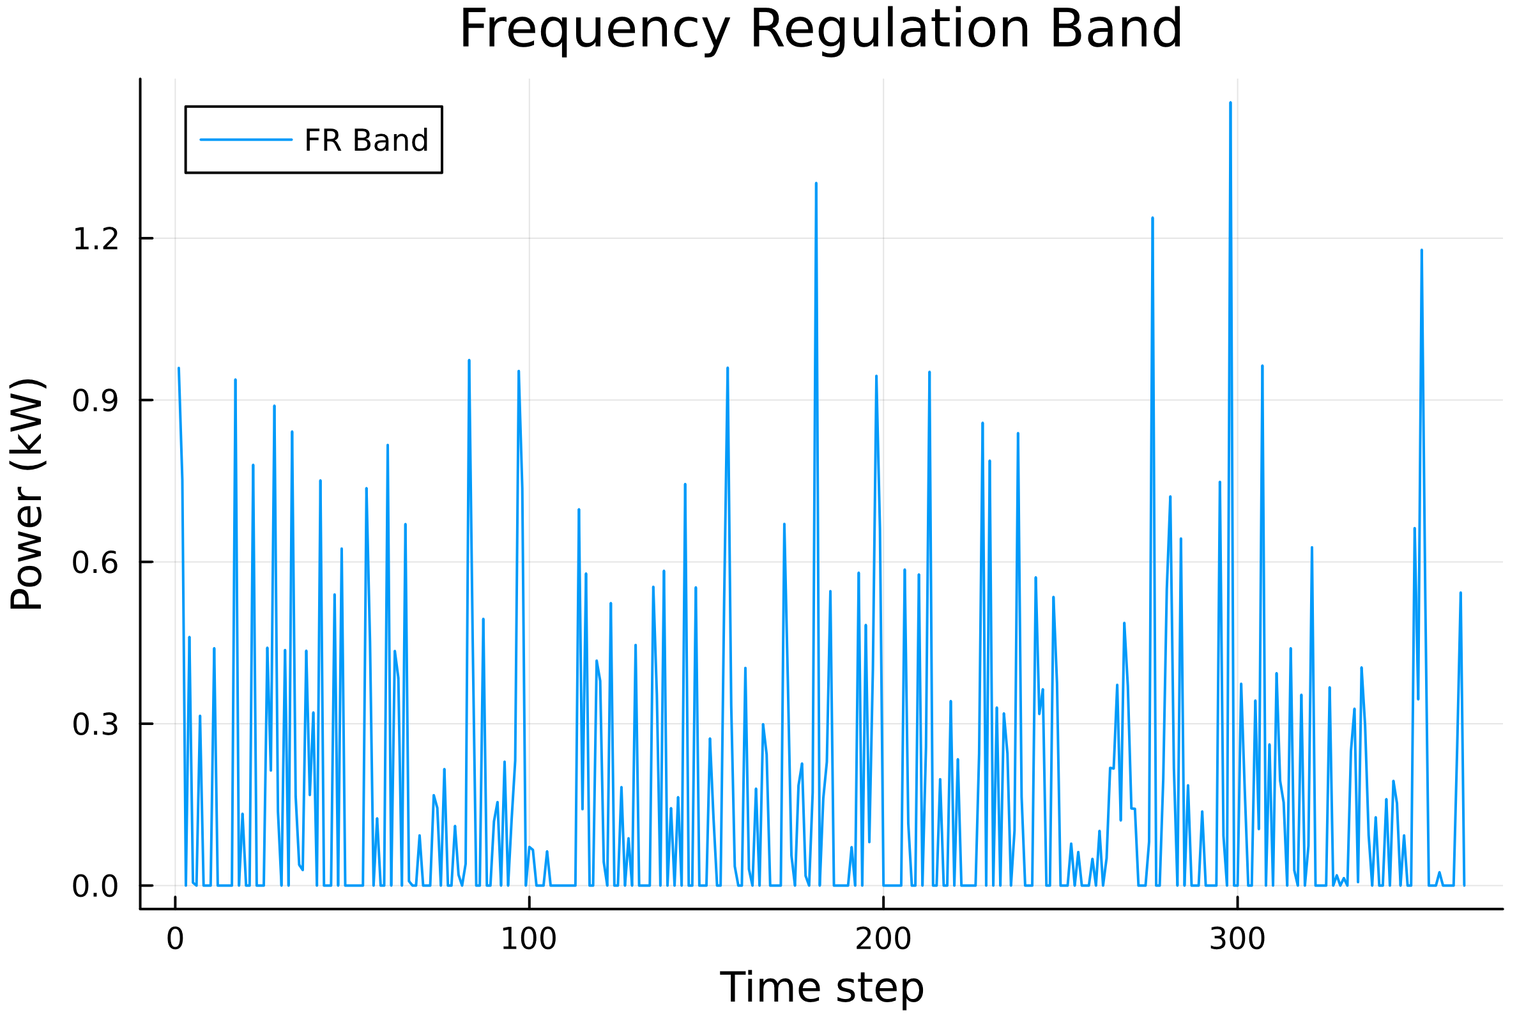
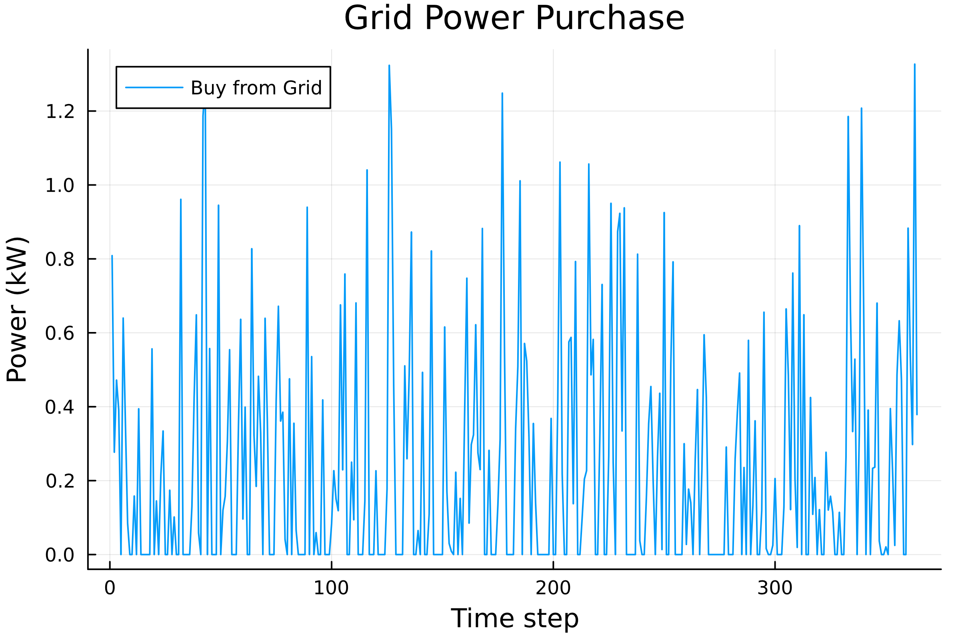
Control Variables
FR_band: battery capacity to offer to the market
buy_from_grid: energy purchased

Slide 4
