Slide 1

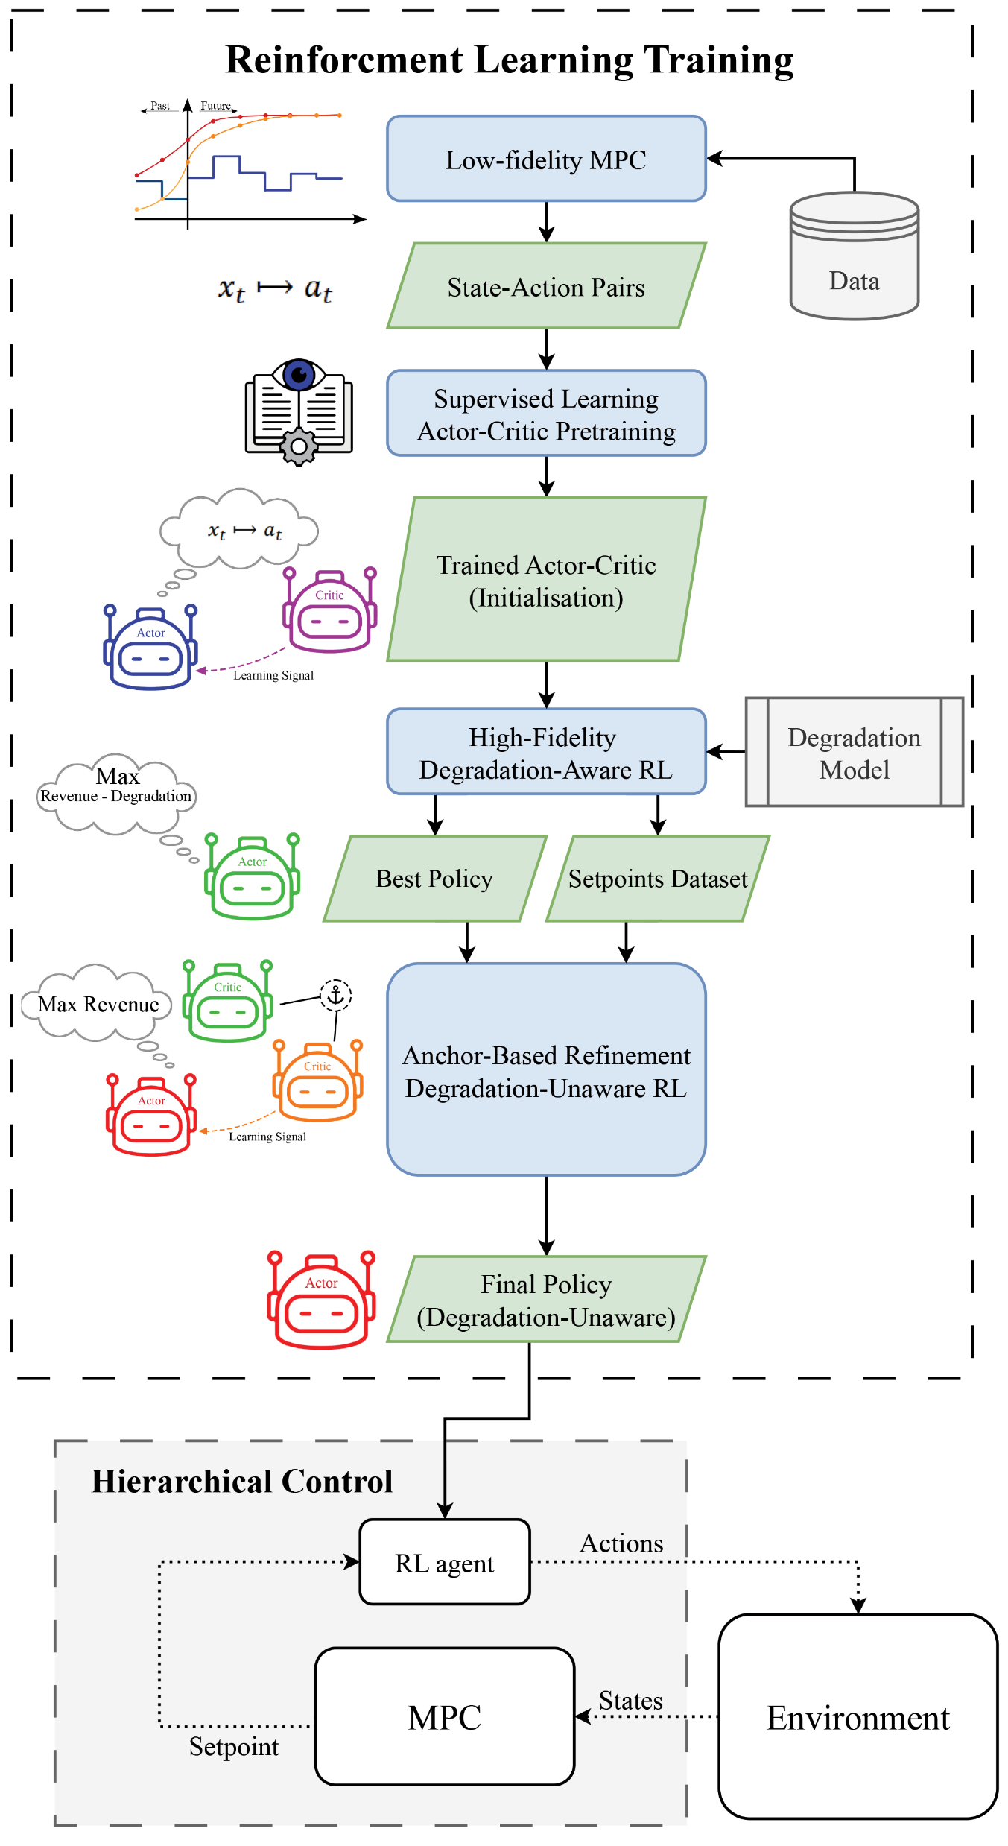
The next draft will be in LaTeX.
Possible adjustments:
Add tracking error to Actor network to improve setpoint tracking.
Tune time-horizon of the MPC.
Online training.
...?
3. Decide on journal or conferences for publishing. Possible options:
Journal of Process Control
Energies
Industrial & Engineering Chemistry Research
IEEE Transactions on Smart Grid
Energy & AI
Engineering applications of artificial intelligence
September 25, 2025

