Slide 1
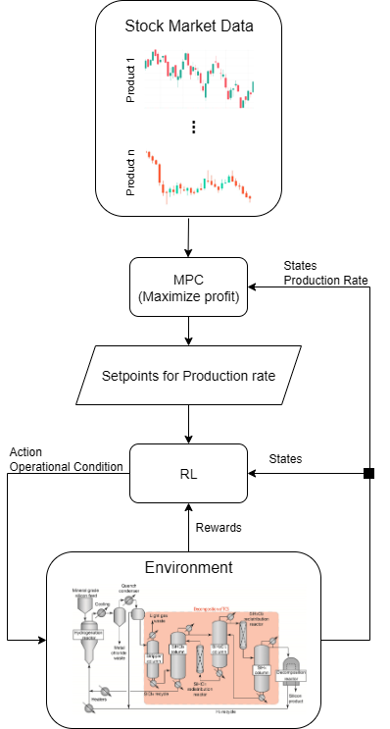

Possible Case Studies
Related to chemical engineering industry
High level
Observe: price and volume demand of a product
Output: generate setpoints for production rate of the product
Low level
Receive: order from High level and current states
Output: adjust operation condition to meet the order
Challenges:
Finding a multiproduct system

Slide 2
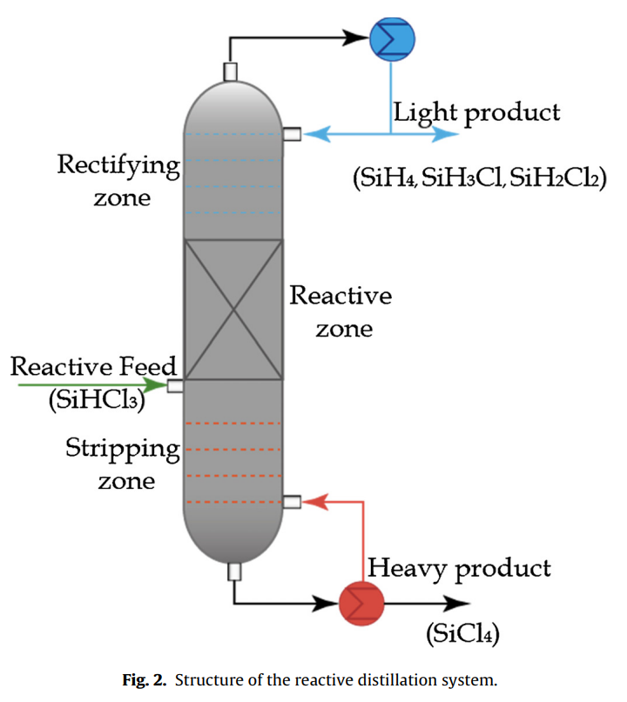
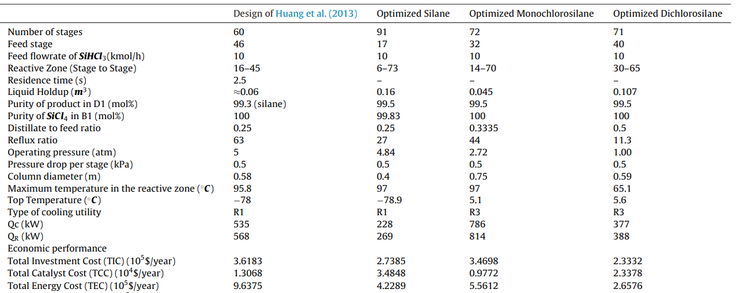
Multi-product Reactive Distillation system for silanes production
Three product: Silane, Monochlorosilane, Dichlorosilane
Can be simulated in Aspen
Optimized operational condition for each product is known
Challenges:
Market data
(adopted from [Medina-Herrera et al., 2017])

Slide 3
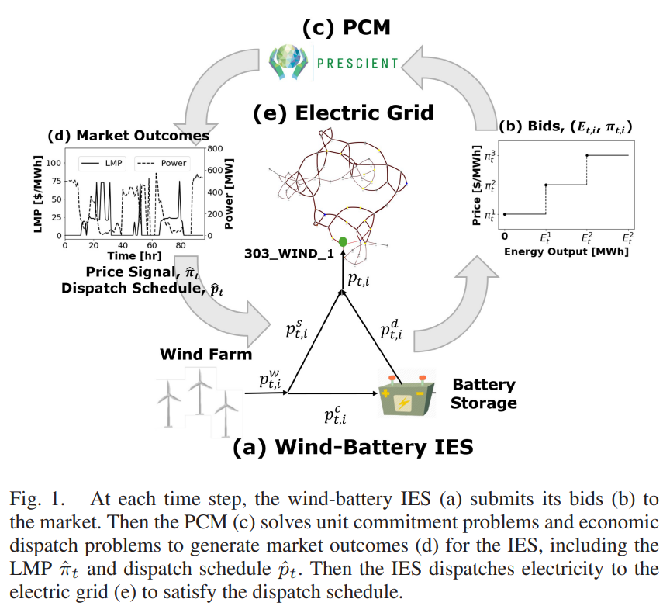
Multiscale Optimization of Wind and Battery Integrated Energy Systems
Core idea: large-scale storage are price-makers NOT price-takers
Actions affects the market balance.
Dataset is available: Open-source developed by the National
Renewable Energy Laboratory
Challenges:
Repository is not available.
Takes time to familiarize with the system.
(adopted from [Chena et al., 2025])

Slide 4
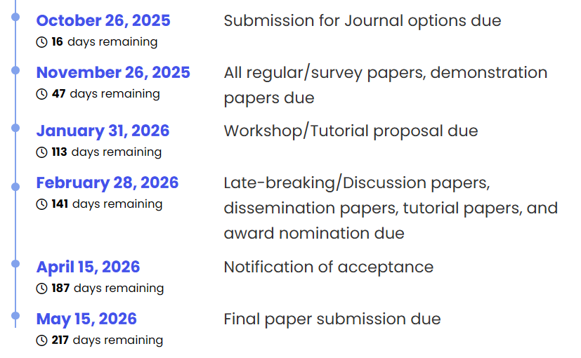
Progress
Online-training
Tracking error as input
Parallelization
Distributed and ClusterManagers for PBS integration
Deadlines
IFAC
ESCAPE36
19 Oct Abstract submission
02 Feb Paper submission

