Slide 1
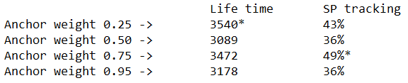
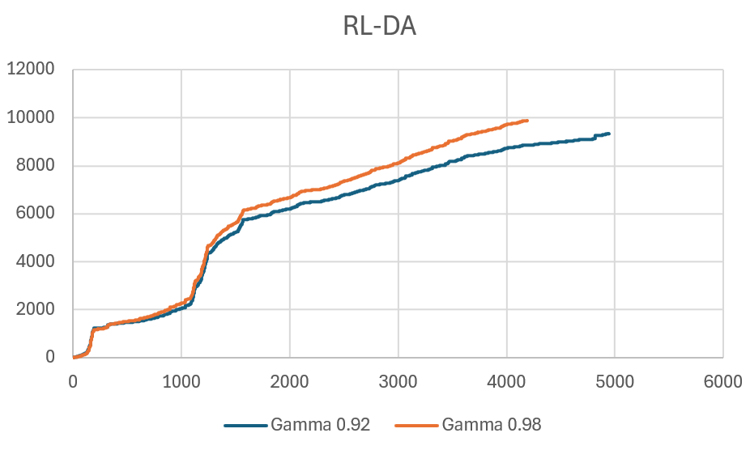
RL-DU (10D input)
Progress
Changing Anchor weight
Online-training
Tracking error as input
Fine tunning the RL pretraining phase
MPC horizon
RL-DA
Changing tracking penalty weight
Changing gamma
22-Oct-2025

Slide 2
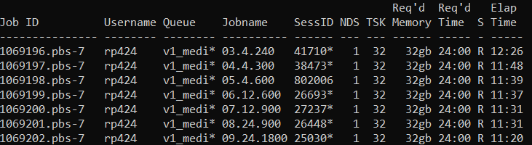
MPC-RL
Changing time horizon

Slide 3



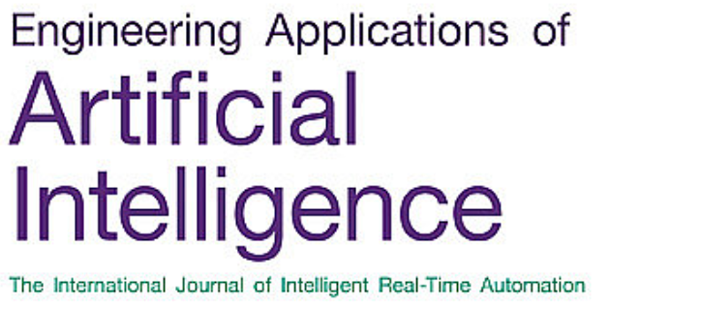
Possible differentiation
1,2, 3, online learning
1) Testing generalization over LFP, NMC, NCA, degraded
2) Degradation rate control
3) Measurement noise of SoC
4) Partial observability: SoC, Kalman filter?
5) Offline/Online learning
6) SafeRL
4, online learning
1,2,4, online learning

