Slide 1
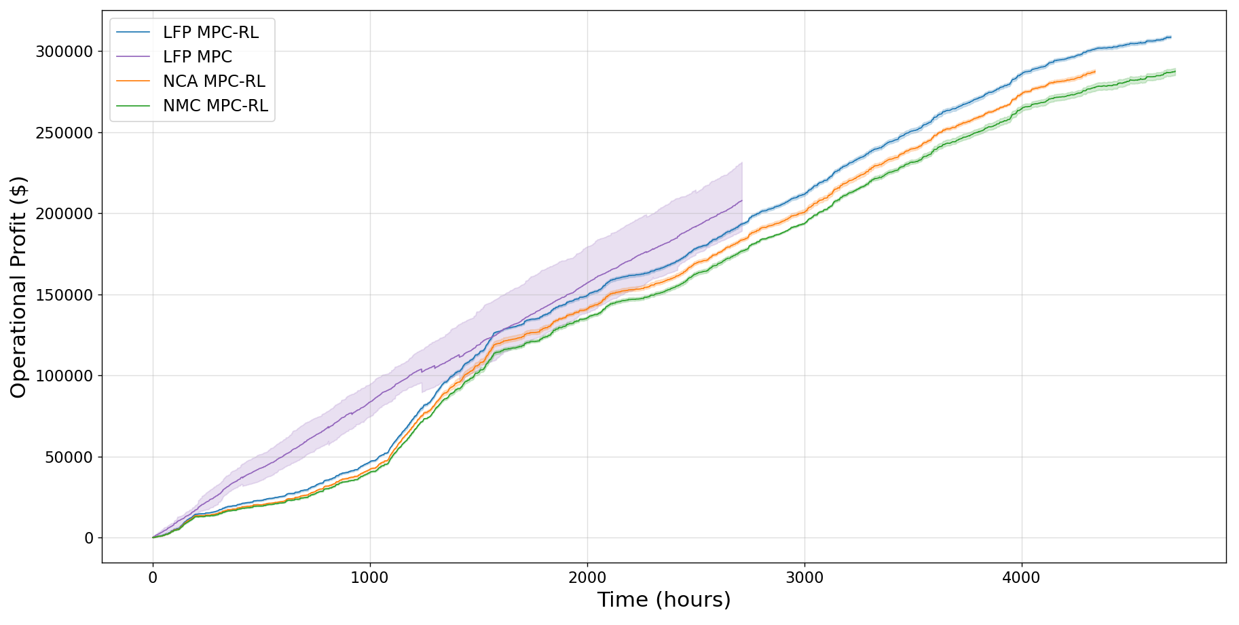

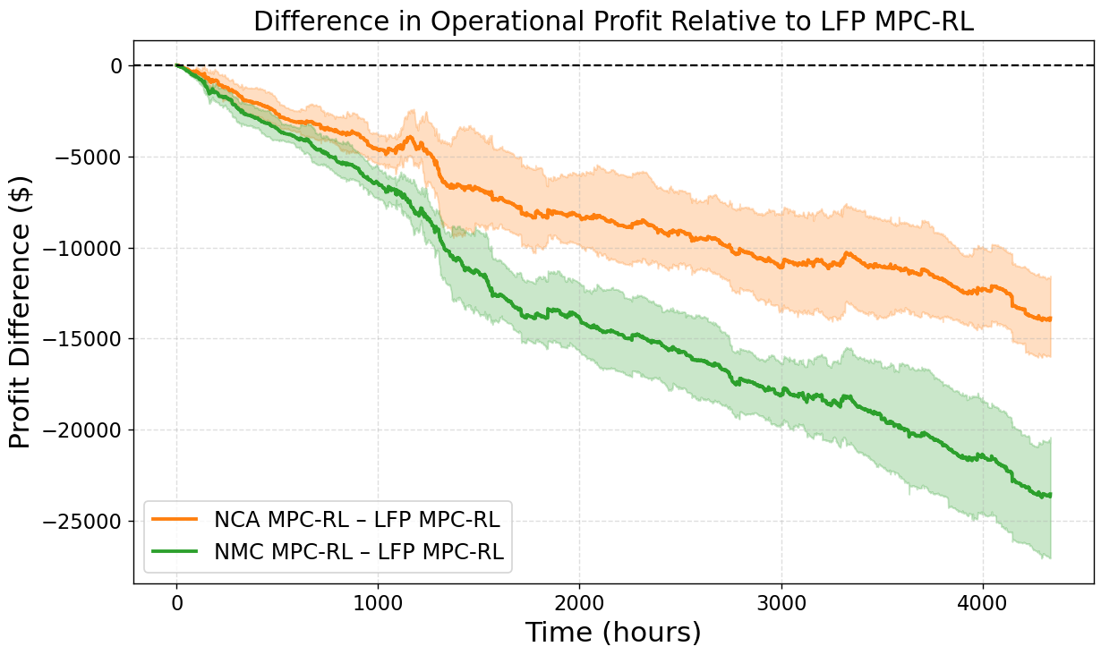
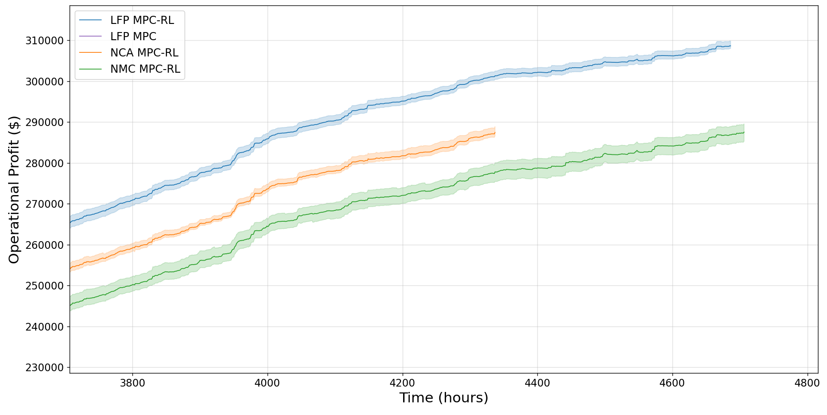
Confidence intervals for operational profit figure
22 Nov 2025

Slide 2
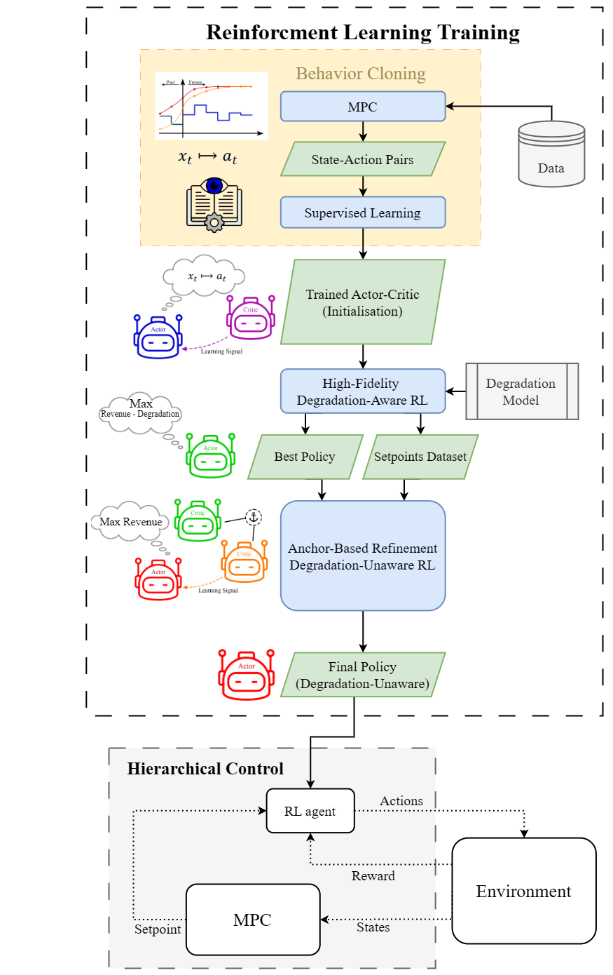
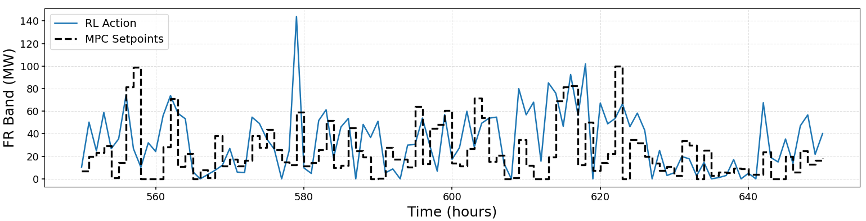
Low-fidelity environment for MPC (stage 1)
Redesign setpoint tracking figure
Partial observability for SoC

