Slide 1

20 August 2025
Writing
60%
Introduction: Renewable energy problem, BESS and its problem, Recent solution, our proposed framework
Preliminaries: High/Low-fidelity environment
Methodology: Data structure, Control variables, low-fidelity MPC, SL, RL, …
~ 6 Page
Recap
SL over state-action pairs of low-fidelity MPC for actor-ctiric initialization
RL problem: weak setpoint tracker

Slide 2
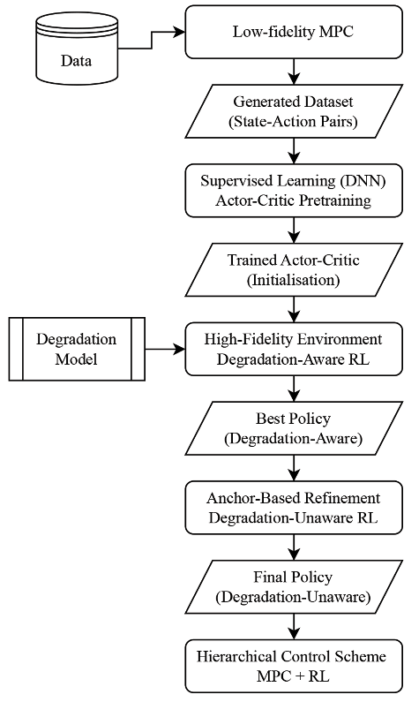
Adjustments
Add setpoints in states for better tracking
Increase states from 6 to 8
Transfer learning
80% of RL actions fall within the 20% deviation range of RL degradation-aware actions.

Slide 5
