Slide 1

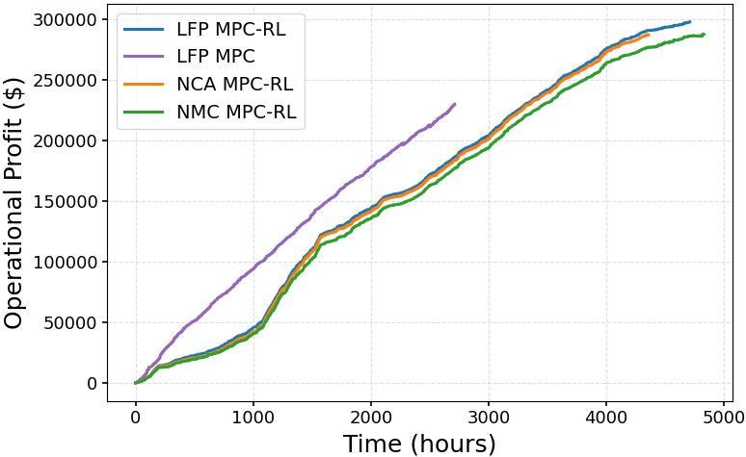
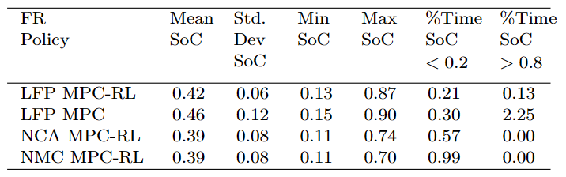
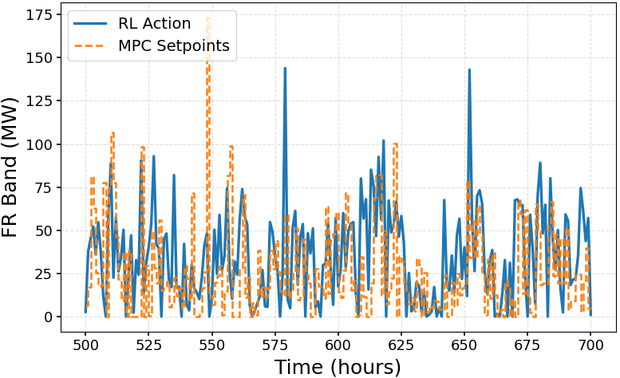

1) Testing generalization over LFP, NMC, NCA battery system
2) Added measurement noise to SoC
3) Optimized MPC horizon (4 hour) and simulation timestep (20minutes)
SEI growth, chosen action, capacity remain
12-Nov-2025

Slide 2
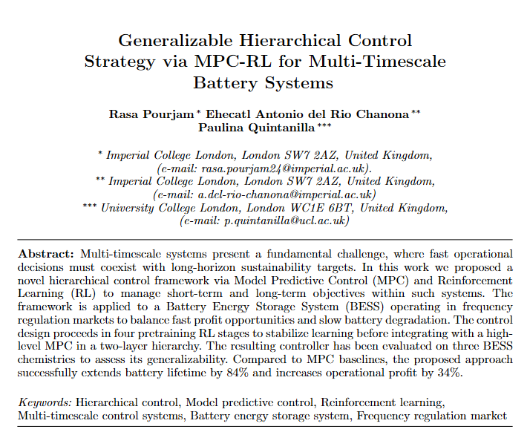

Slide 3
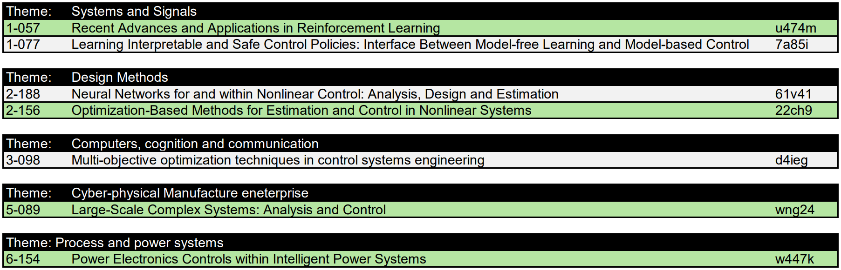
Theme selection
Plagiarism check
PIN

