Slide 1
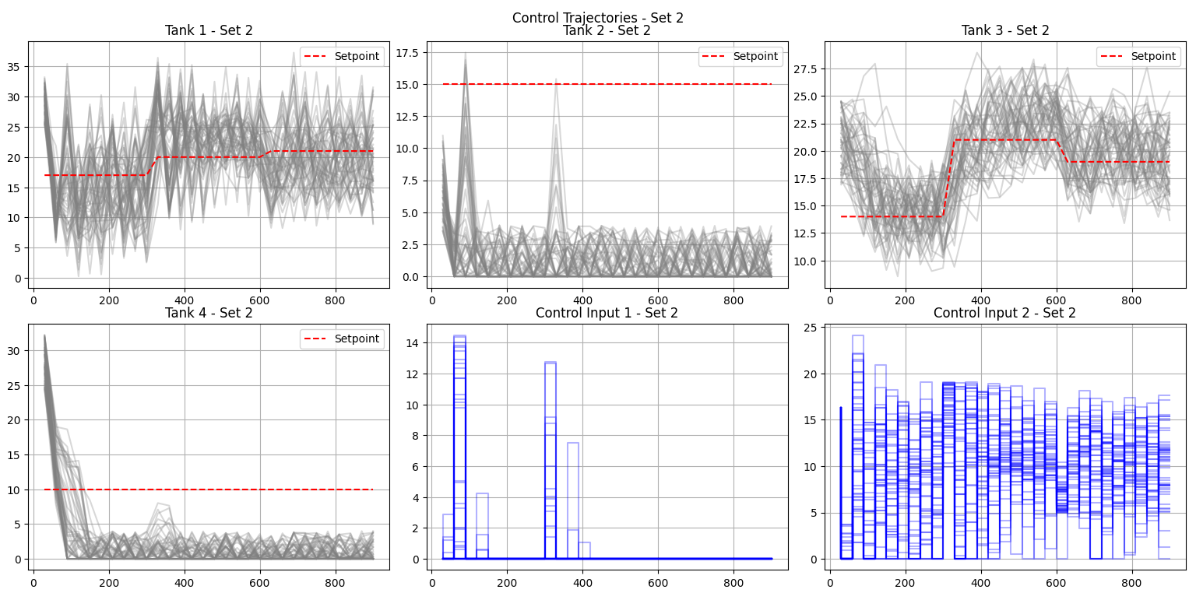
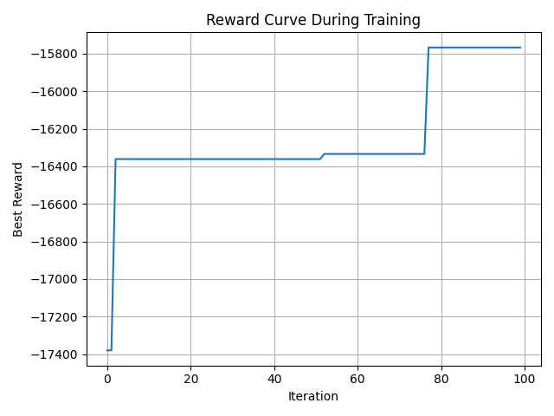
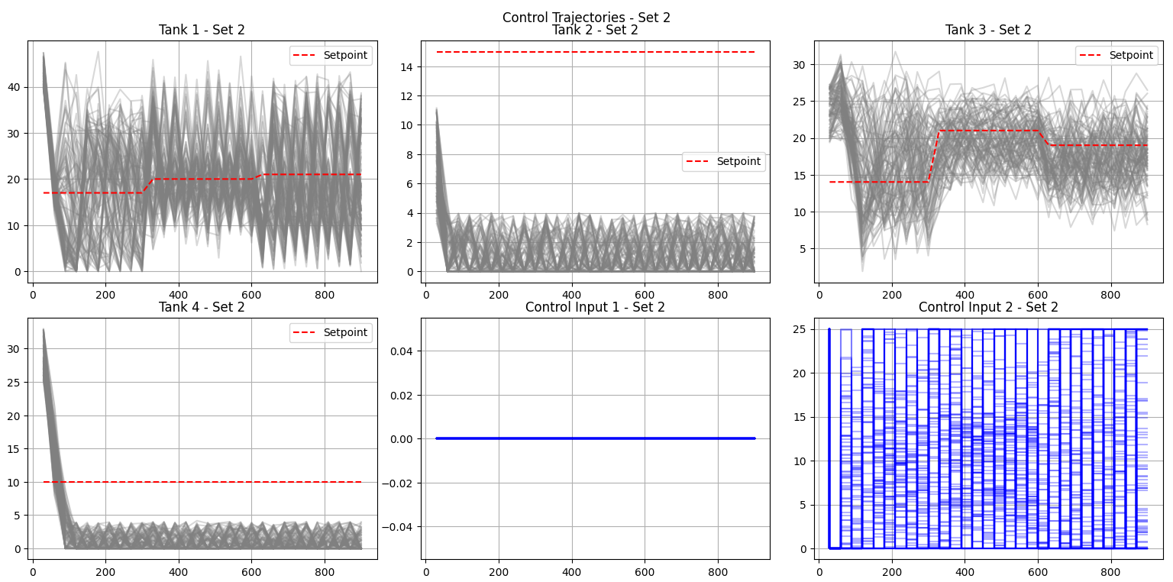
Date: 04.06.2025
Recap
GPS + Shrinkable radius local search
Add clamping to prevent negative tank level
Add small weights to reward control smoothness
Promising but noisy

Slide 2
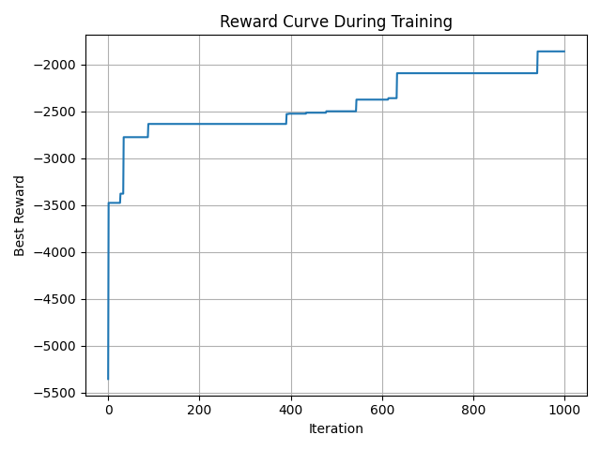
New Changes
1000 iteration – shrink every 25 iter with 0.9 ratio
Layer normalization
Feed the NN with previous control
Initialize the NN with Xavier (Glorot)
Reward function:
r_tot -= (
+(x_next[0] - Xs_r[0, t])**2
+ (x_next[2] - Xs_r[2, t])**2
+0.01 * np.sum((u)**2)
+ 0.03 * np.sum((u - prev_u)**2)
+0.001 * u[1] ** 2
-0.01 * u[0] ** 2
)

Slide 3
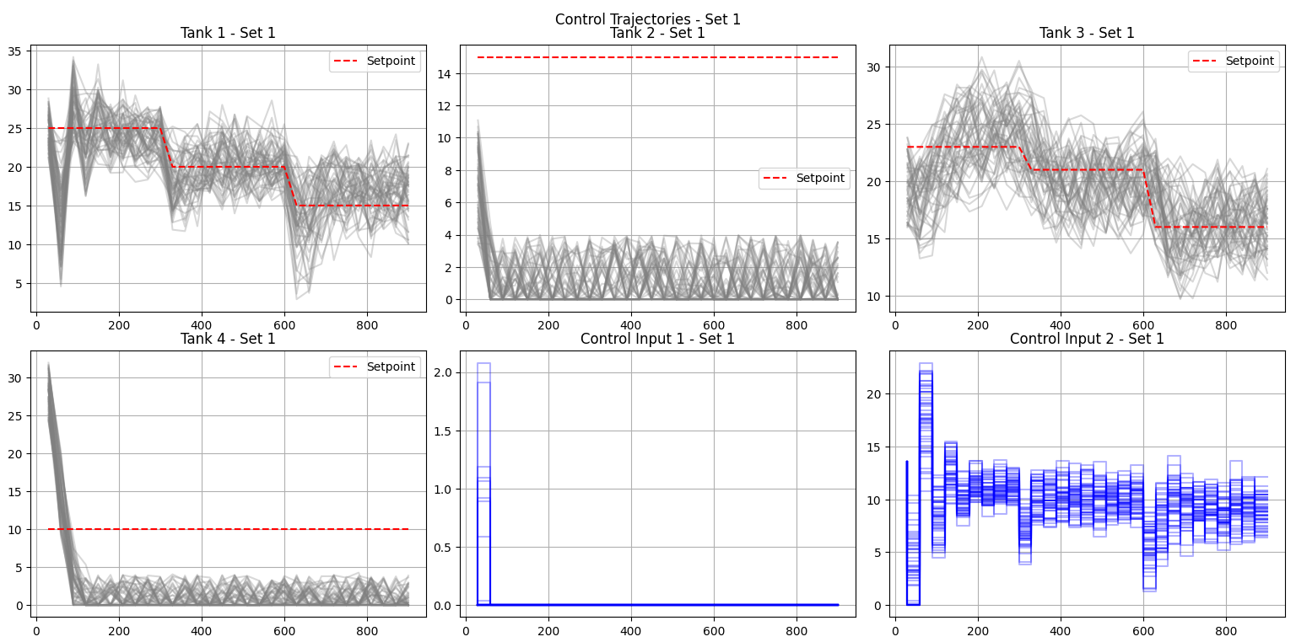

Slide 4
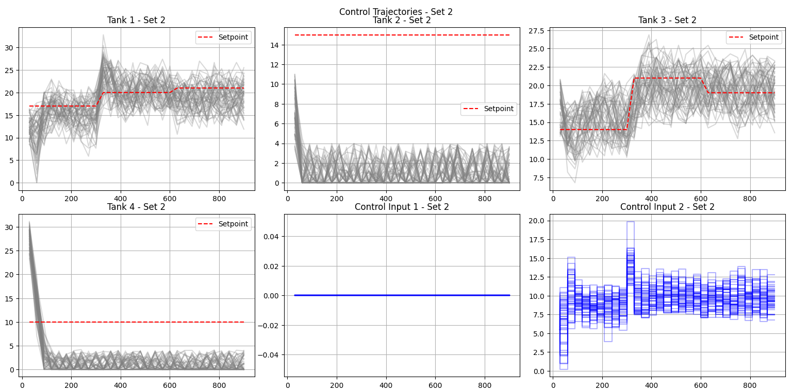

Slide 5
