Slide 1

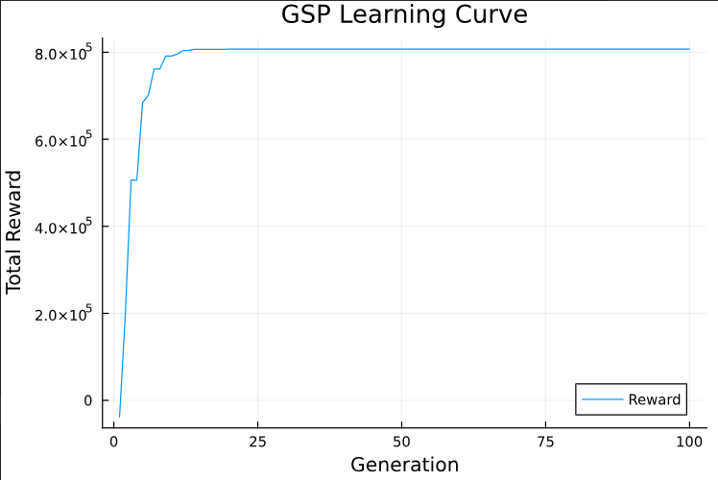
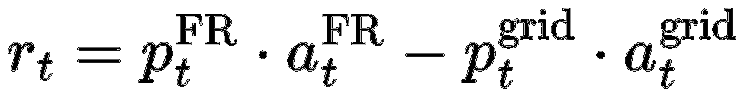
Goal: Optimize battery operation for revenue while minimizing degradation
Scope: Frequency Regulation market participation
Slave controller (RL)
Generalized Policy Search (GPS)
Environment: Complex DAE-based battery model Simplified ODE-based model
Modularized Environment
NN – Based
Reward function (Same as before):
27 June 2025

Slide 2
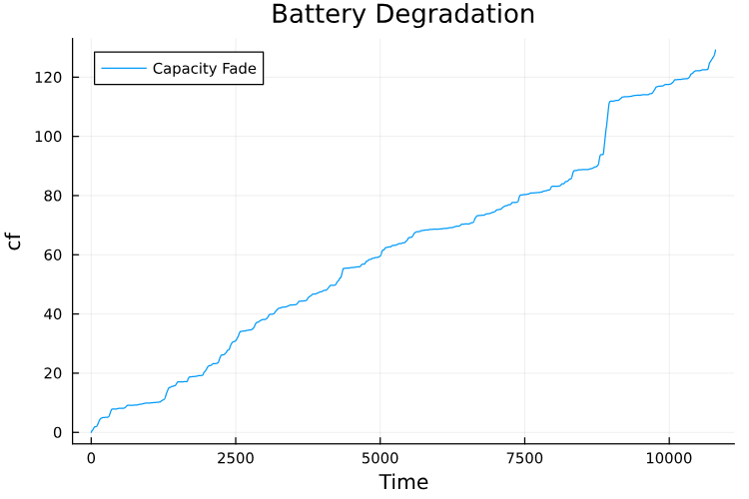
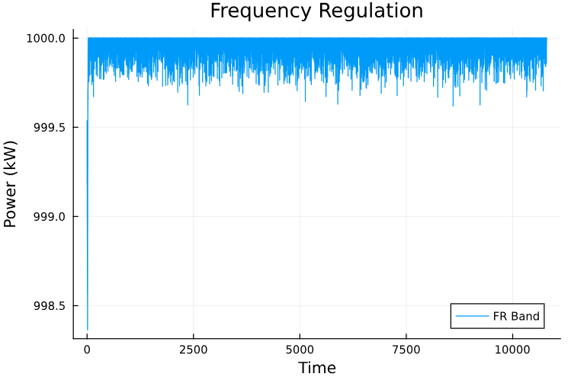
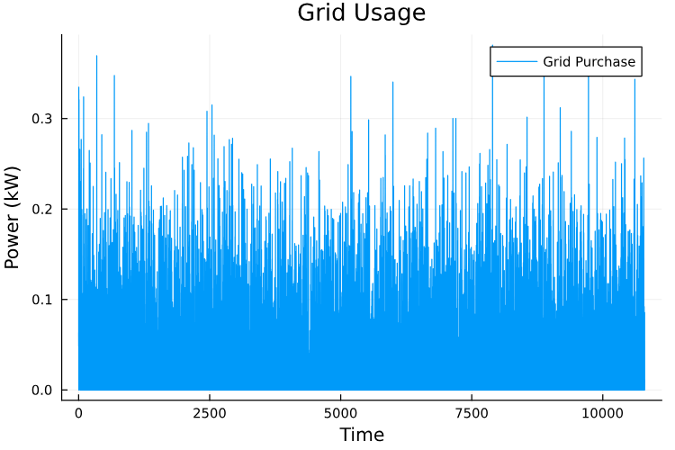
Results
Implemented without cf penalty
As expected:
High FR band
High Grid usage
Fast degradation
EOL limit: cf=1.48 Ah

Slide 3
Master controller (MPC)
MPC
Goal: Minimize battery degradation
Receives new states every time horizon
Set new constraint for every time horizon
min cf
Main issues:
Infeasibility Fallback constraints strategy
Problem: chain of non-convergence
High Computational Cost
15 policy population, 7 epochs, time horizon 3h = 9 hour!
For every generation
For every Policy
Solve MPC with nonlinear cons
end
end
cons
RL
State
max revenue
State
Reward
Act
Env
Break if cf > cf_max

Slide 4
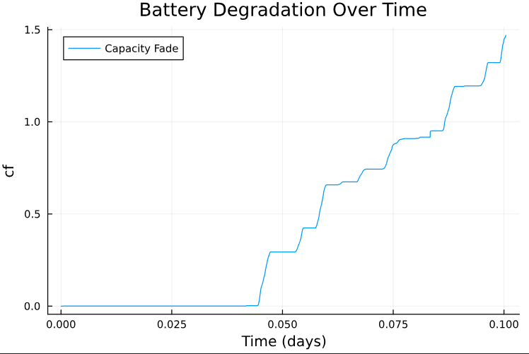
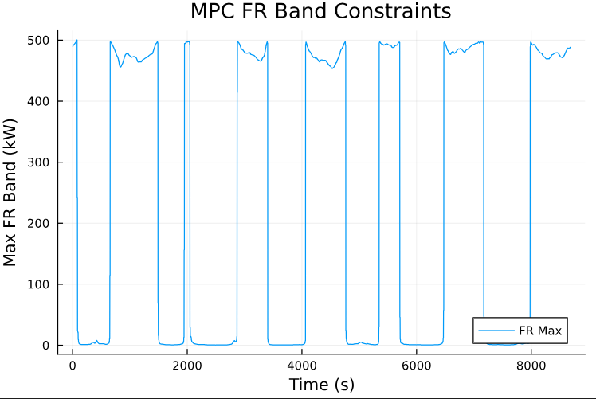
Solution?:
Upsampling (Already implemented):
Increased MPC timestep to 6 seconds
Fewer time interval
Already using low fidelity and linear objective
Warm start for RL and MPC (Already implemented)
Implement PSO algorithm from Bloor’s work
Test 1:
8 policies, 5 generation
Increased degradation rate from 1e-9 (original) to 1e-6

Slide 5
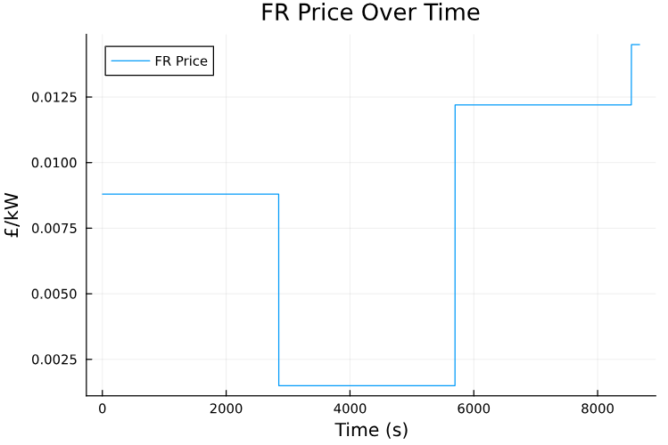
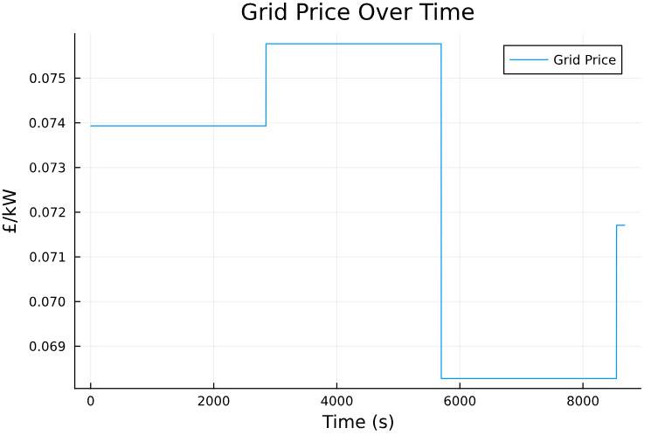
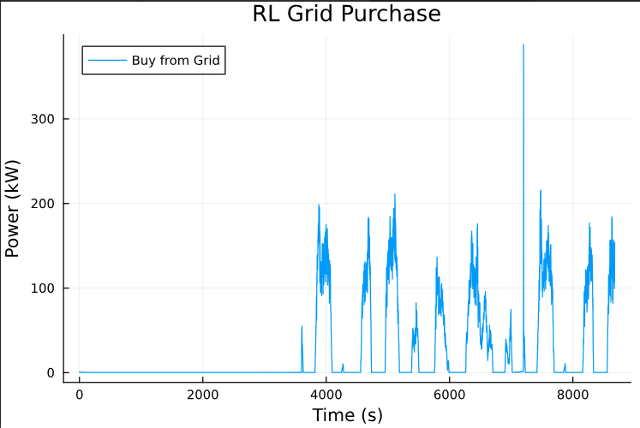
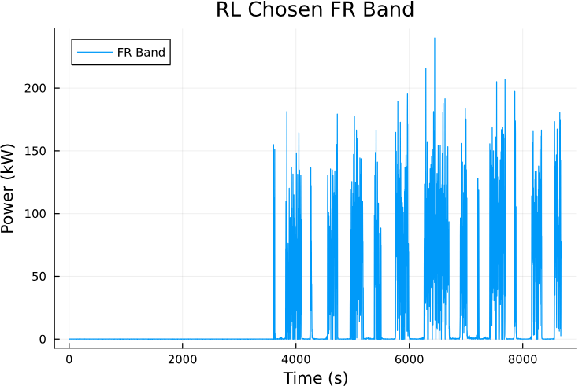

Slide 6
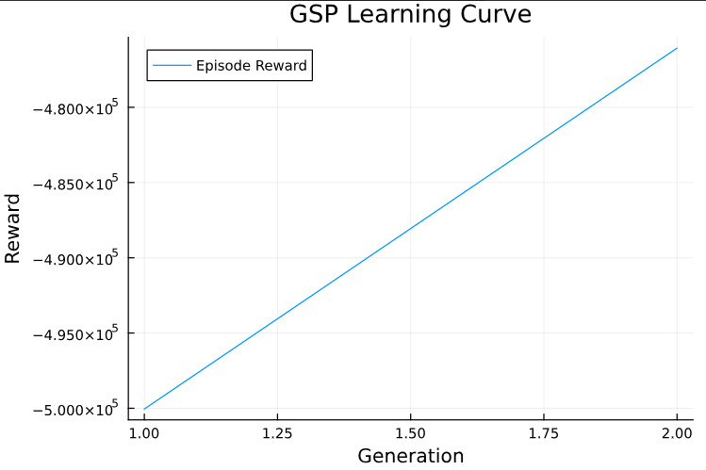
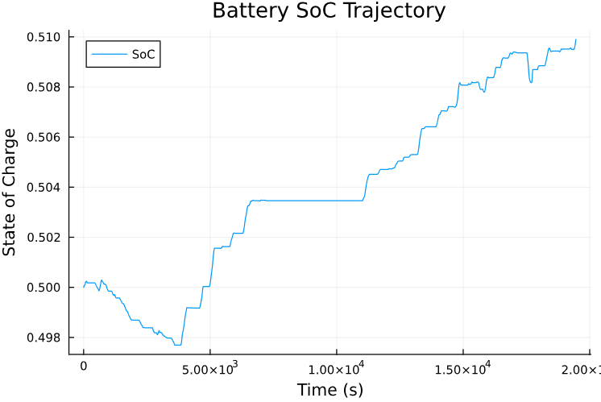
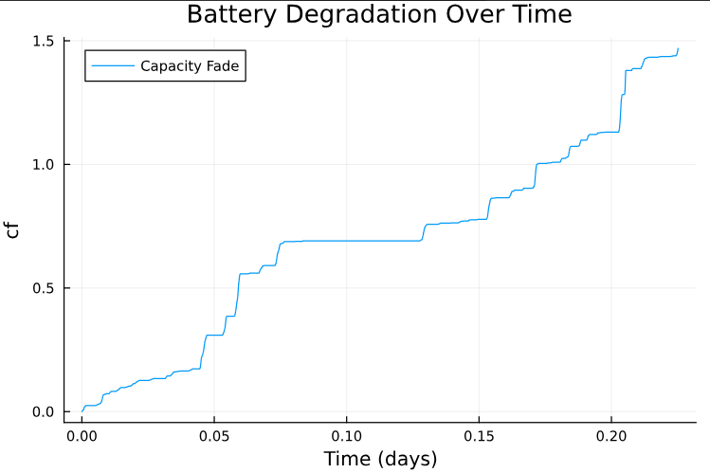
Test 2:
1 policies, 2 generation
degradation rate = 1e-6
Increased MPC timestep to 60s
Generate cons. for next hour
Every MPC is being solved in 0.5s
Much faster
04 July 2025

Slide 7
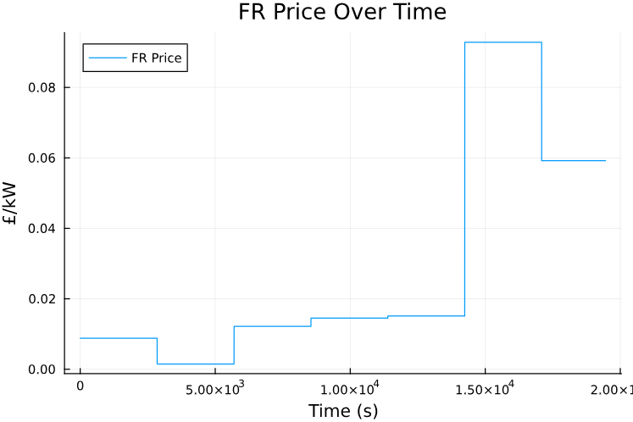
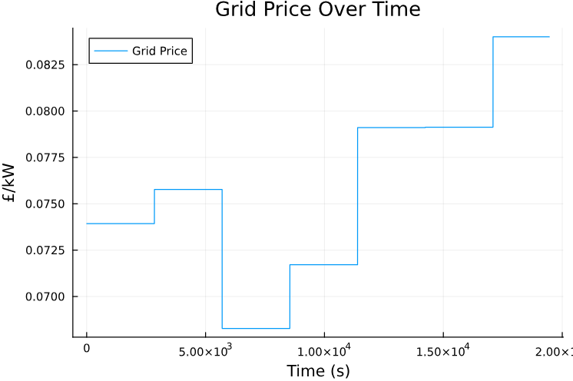
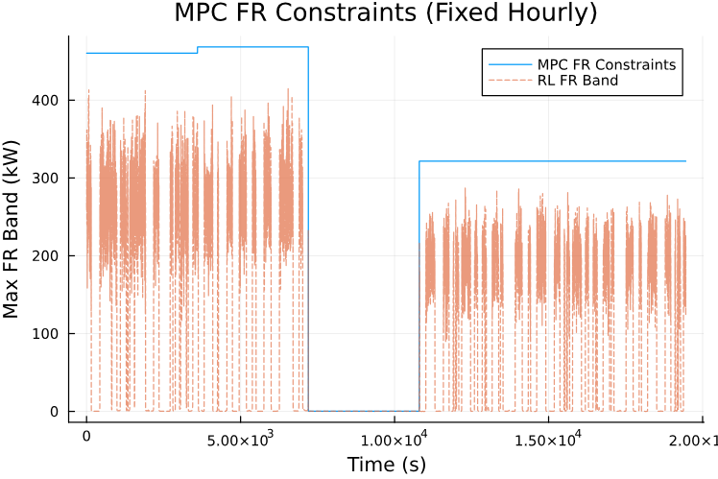
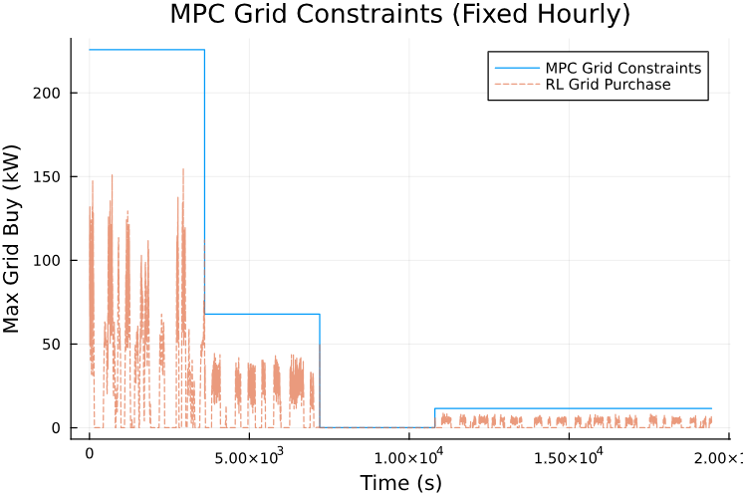

Slide 8
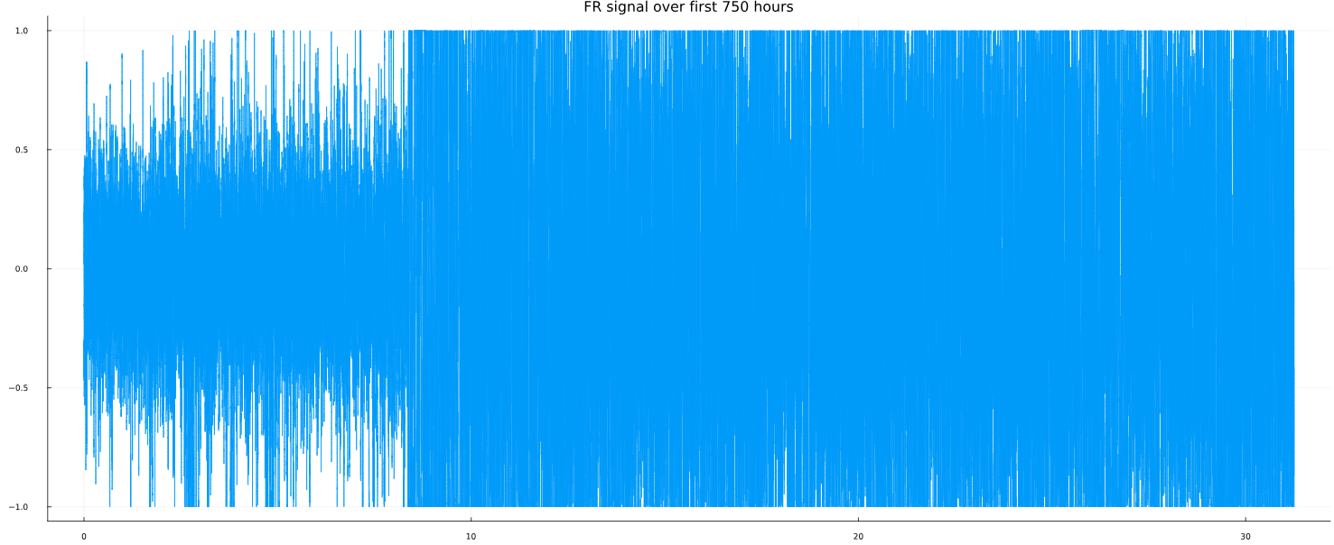
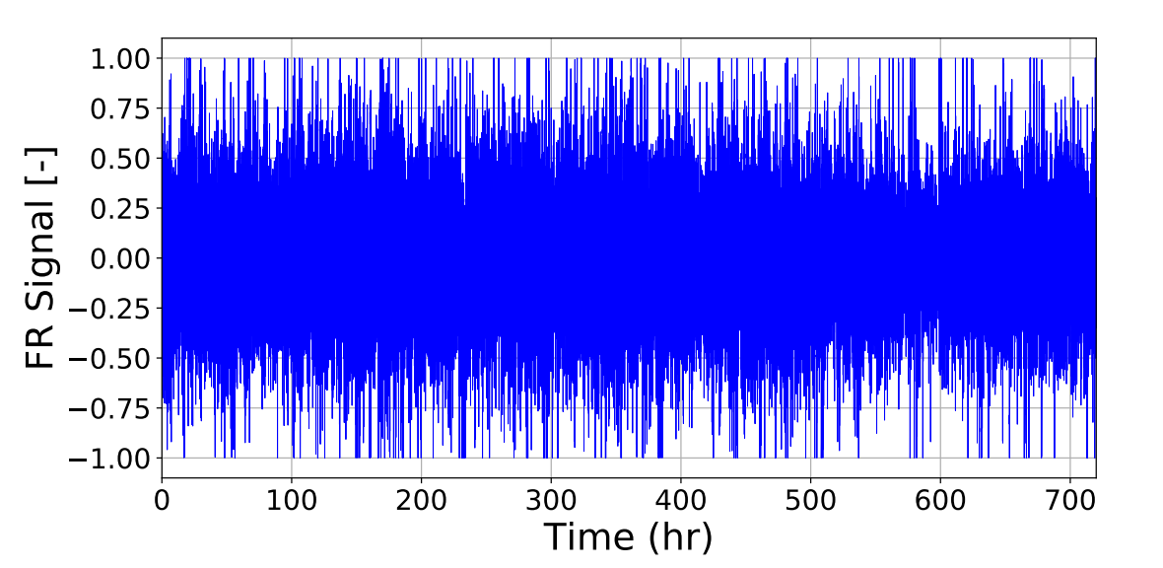
Next steps:
Implement DAE simulator for SEI thickness growth (needed for benchmark)
Try to implement Bloor’s PSO algorithm for RL for less epochs
Make the RL cf aware
Problems:
MPC convergence
FR signal dataset doesn’t match the paper’s plot

