Slide 1

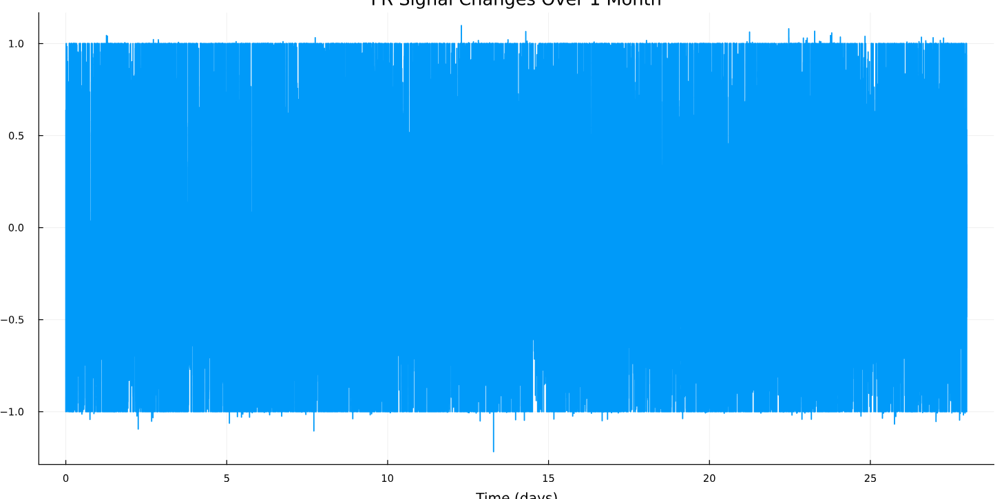
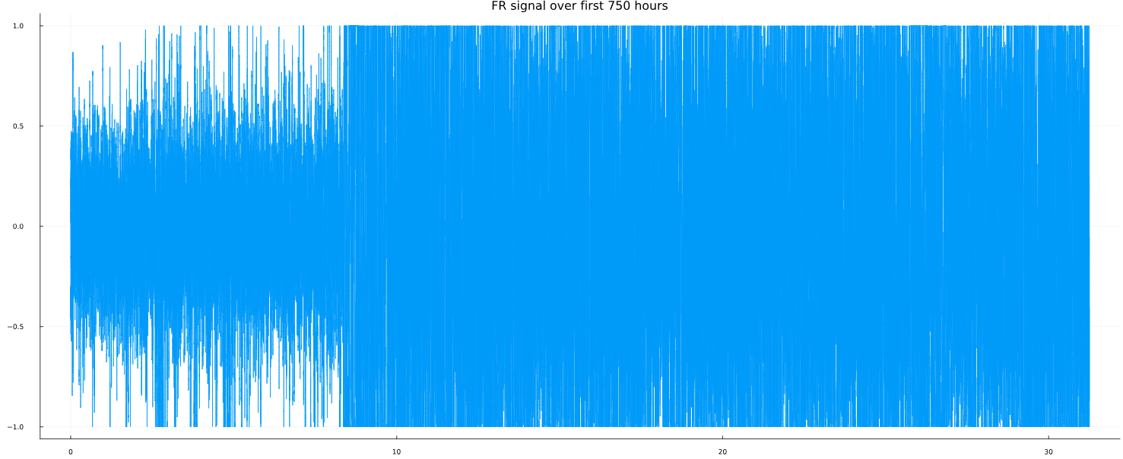
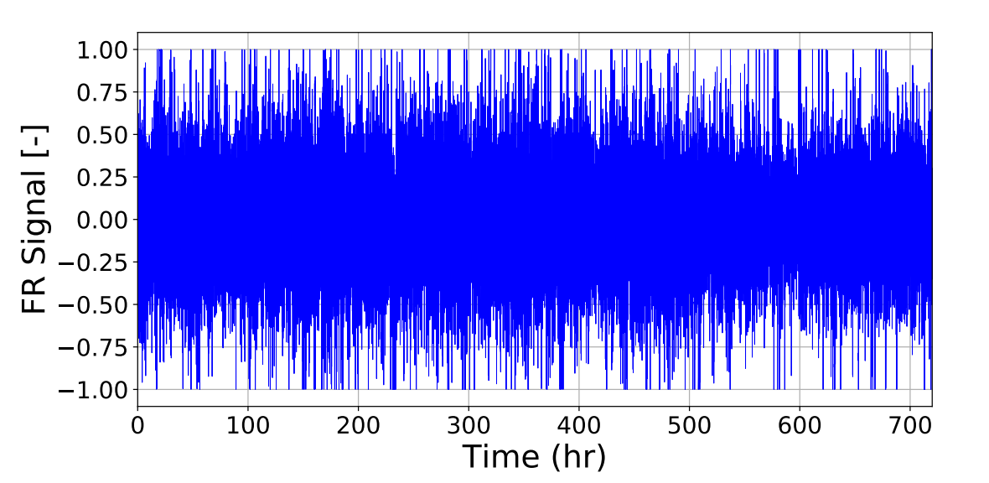
Goal: Cleaning the datasets + pretrain RL
Identify potential invalid data for FR signal
11 July 2025
First 10 days:
The rest of the days:
(from the paper)
identify_invalid_data.jl + data_generation.jl
cyclically repeating the initial eight-day
slight random noise to each repetition
clamp to -1 and 1

Slide 2
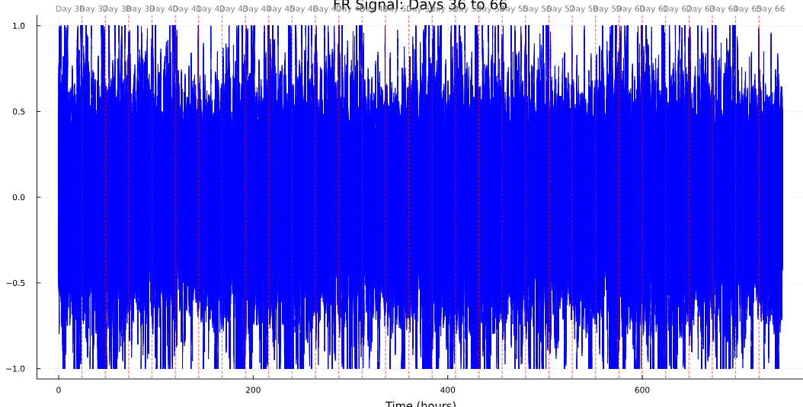
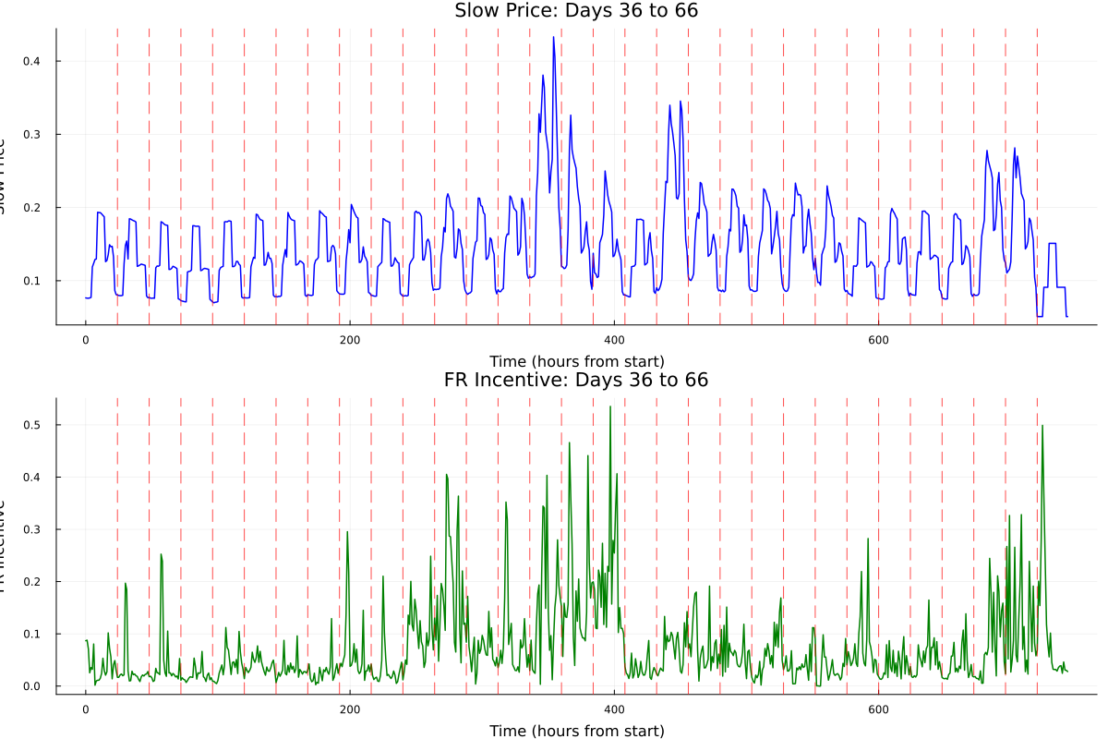
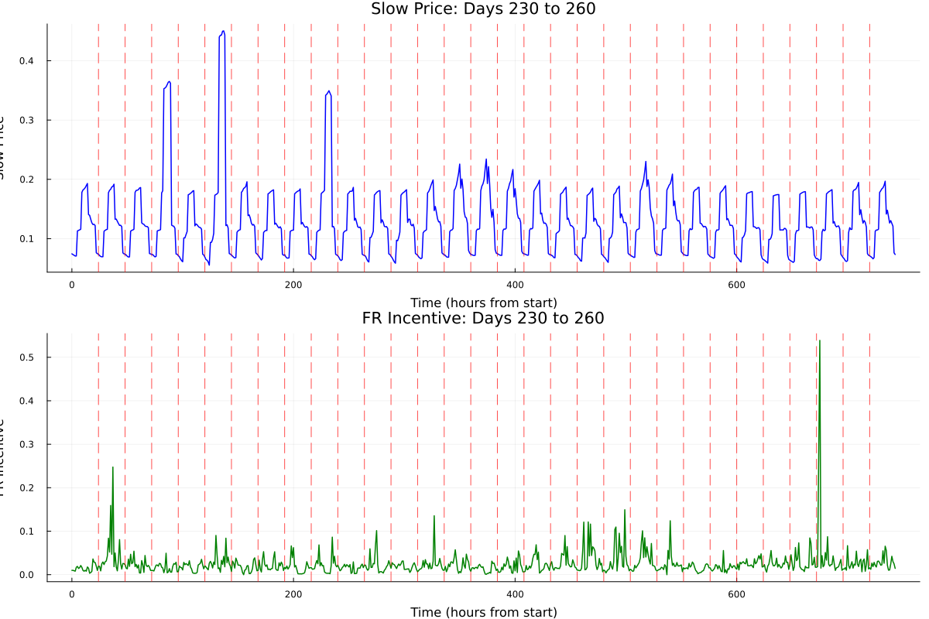
0.05 random variation factor
New dataset for FR signal: extended_365_days.csv
Identify potential invalid data for grid and FR price

Slide 3
RL pretraining
Generate logical constraint to train
FR incentive | FR signal | FR band (MW)
 |  | set 1 | set 2 | set 3
high | high | 7.0 | 8.0 | 9.0
high | low | 4.0 | 5.0 | 6.0
medium | medium | 2.0 | 3.0 | 4.0
low | high | 1.0 | 1.5 | 2.0
low | low | 0.1 | 0.5 | 1.0
grid price | FR incentive | Grid buy (MW)
 |  | set 1 | set 2 | set 3
low | high | 5.0 | 6.0 | 7.0
high | high | 3.0 | 4.0 | 5.0
medium | medium | 2.0 | 2.5 | 3.0
low | low | 0.5 | 1.0 | 1.5
high | low | 0.1 | 0.3 | 0.5
The FR signal, FR incentive, and grid price are each classified as high, medium, or low depending on whether the one-hour average (time horizon) is above, equal to, or below the 24-hour moving average.
Generate two other constraint sets from set 2:
medium noise = ±25%
high noise = absolute noise = ± 3.0
Output: 10 csv file (5 for FR band and 5 for Grid buy)
Corresponding file: grid_buy_cons.jl + FR_signal_cons.jl + generate_noisy_constraints.jl
Are 5 constraints sets sufficient for RL generalization?

Slide 4
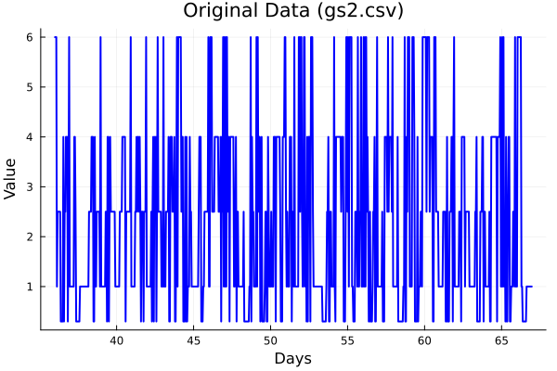
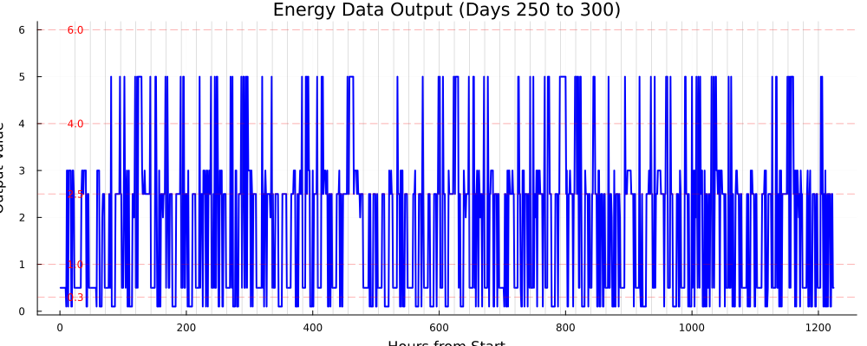
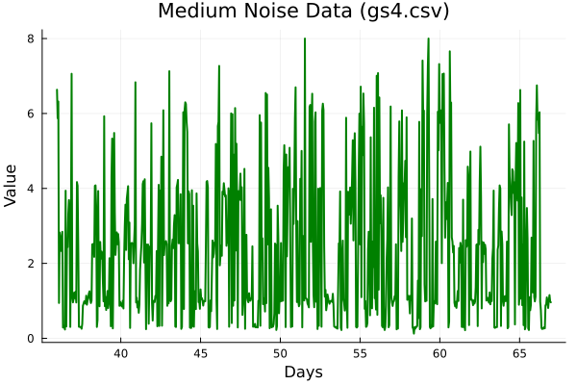
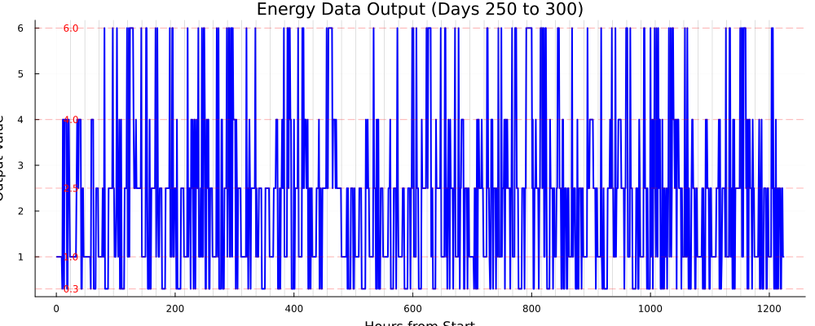
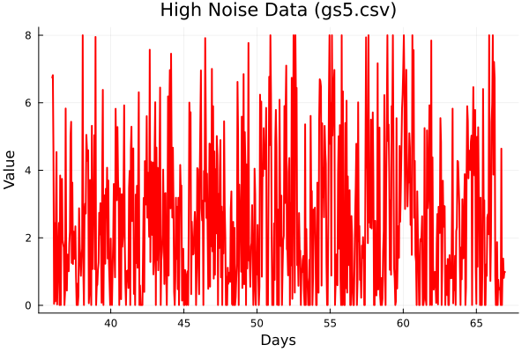
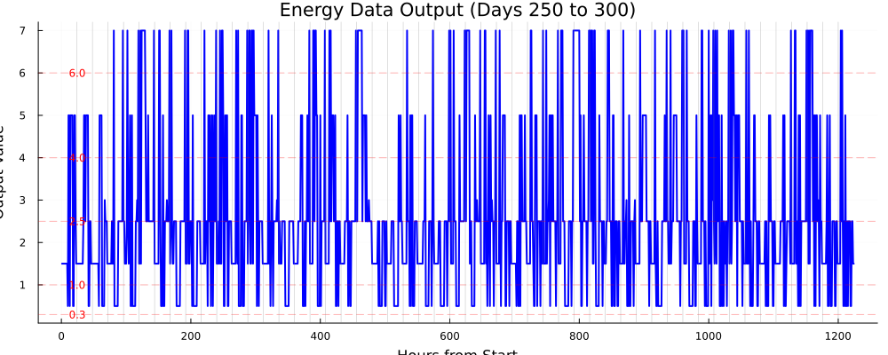
Grid buy constraints
Medium noise
High noise

Slide 5
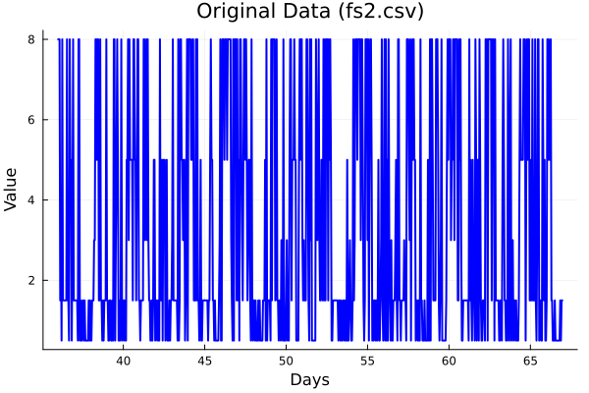
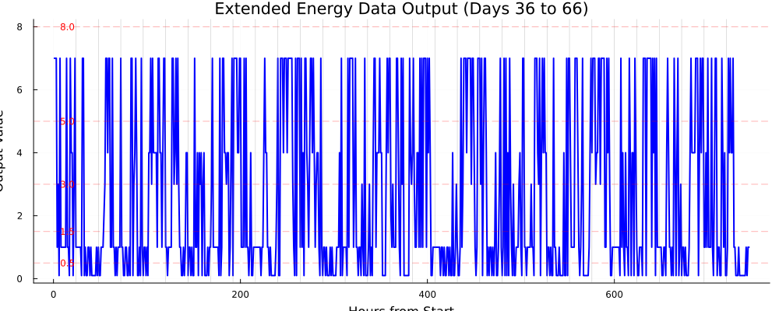
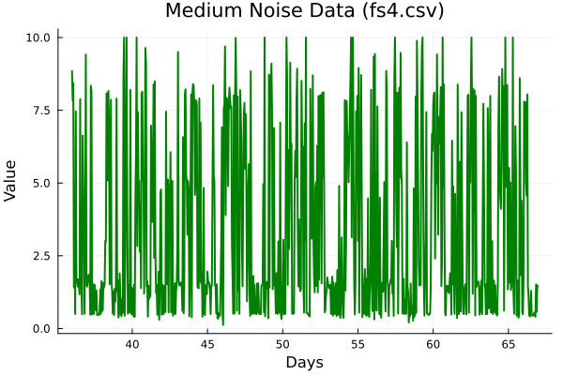
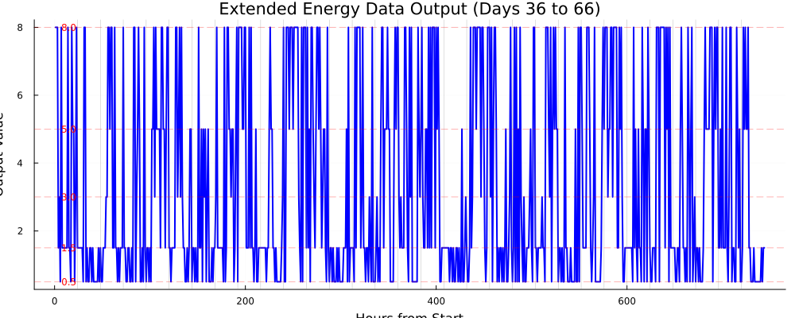
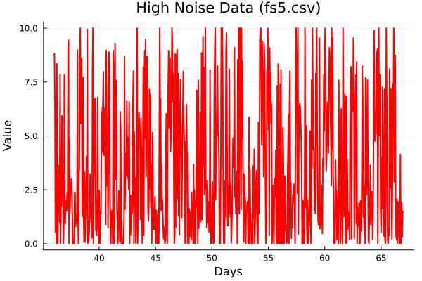
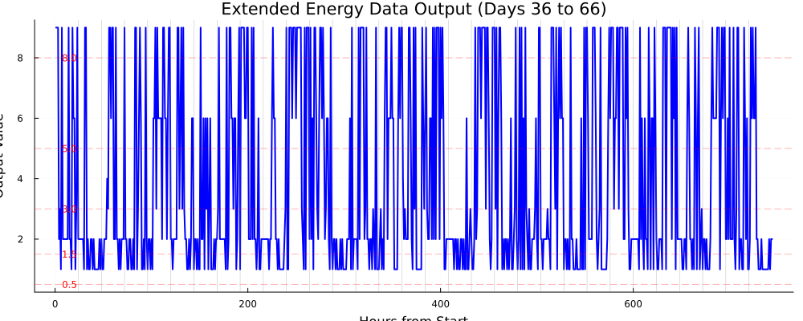
FR band constraints
Medium noise
High noise

Slide 6
DAE simulator
Needed for calculating SEI growth for benchmarking
Attempted to use original setup.jl file
Outdated packages/syntax, resolved.
Next steps
Pretrain the RL with generated constraints
Integrate our strategy into setup.jl

